Slide 1
The RESEARCH DATA ALLIANCE
GEO BON Workgroup 8
WG: Brokering Governance
Wim Hugo – ICSU-WDS/ SAEON
/ GEO BON

Slide 2
GEO BON
http://www.earthobservations.org/
http://www.earthobservations.org/geobon.shtml
The Group on Earth Observations Biodiversity Observation Network – GEO BON – coordinates activities relating to the Societal Benefit Area (SBA) on Biodiversity of the Global Earth Observation System of Systems (GEOSS). Some 100 governmental, inter-governmental and non-governmental organizations are collaborating through GEO BON to organize and improve terrestrial, freshwater and marine biodiversity observations globally and make their biodiversity data, information and forecasts more readily accessible to policymakers, managers, experts and other users. Moreover, GEO BON has been recognized by the Parties to the Convention on Biological Diversity.

Slide 3
GEO BON has a Manifesto …
It is possible, desirable, and in the public interest to:
  Ensure that scientific data is described properly, preserved properly, and discoverable;
  Once discovered, its utility, quality, and scope can be understood, even if the data sets are large;
  Once understood; it can be accessed freely and openly;
  Once accessed, it can be included into distributed processes, preferably automatically, and on large scales;
  Once processed, the knowledge gathered can be re-used.
… across multiple domains and dissemination channels.

Slide 4
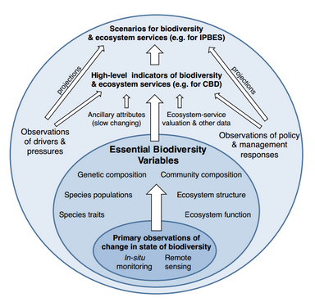
Typical EBV Details
Notes:
Presumably the narrative for this slide would be something like “Initially, groups should focus their Use Case efforts on identifying those observations, data-sources, and models that can yield insights into the EBV’s such as these…”
WE HAVE TO REVERSE ENGINEER THESE

Slide 5
Typical EBV Details
EBV Class | EBV
Genetic Composition | Allelic Diversity for Selected Species
 | Breed and Variety Diversity
Species Populations and Ranges | Abundances for a selected set of species
 | Distributions for a representative set of species
Species traits | Phenology of selected functional groups
 | Body Mass for Selected Species
Community Composition and Interaction | Overall taxonomic diversity for selected locations
 | Species interactions
Ecosystem Extent and Structure | Ecosystem extent and fragmentation for a range of ecosystems
 | Ecosystem structure
Ecosystem function and processes | Net primary productivity
 | Nutrient retention
doi=10.1.1.365.9257
Notes:
Presumably the narrative for this slide would be something like “Initially, groups should focus their Use Case efforts on identifying those observations, data-sources, and models that can yield insights into the EBV’s such as these…”
WE HAVE TO REVERSE ENGINEER THESE

Slide 6
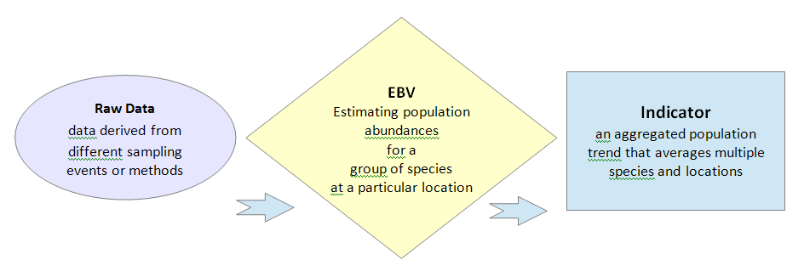
Example: Simplified Objective

Slide 7
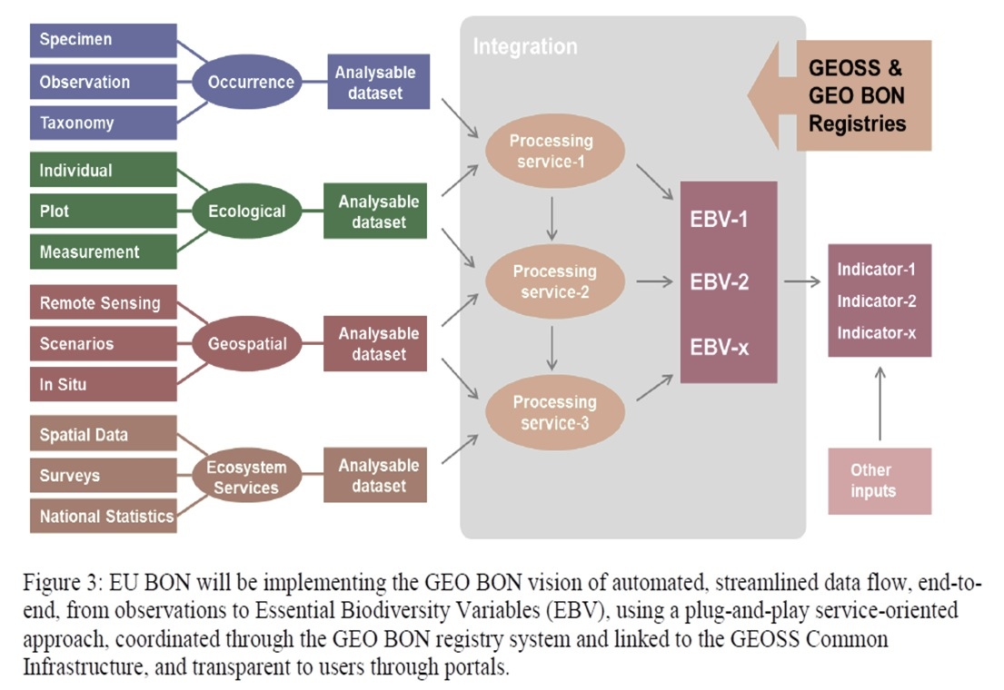
Generic Use Case

Slide 8
Main Components
Data
“Bind”
Visualise
Data
Analysis
Mediator/ Broker
“Publish”
www
www
Process
Discovery
Assess
Meta-Data
“Find”

Slide 9
Generic Dimensions of Data
Spatial Coverage
  XYZ
Temporal Coverage: T
Topic or Semantic/ Ontological Coverage
  P: Phenomenon
    mostly physical, chemical, or other contextual data
  B: Biological
    Tx: Species and Taxonomy (with some extensions)
    Al: Allele/ Genome/ Phylogenetic
Each unique combination of these, supported by a vocabularies/ ontology is a generic data family
Continuous or Near-Continuous: Uppercase
Discrete or dispersed: Lowercase

Slide 10
Some Generic Data Standards and Interoperability Requirements
XYZ, t, P
NetCDF
NetCDF
Multi-dimensional
Traditional Spatial
XY, t, P
S-DB
WxS
Signals
XYZ, t, P/ B
O&M
SOS
Ecosystem
XYZ, t, P/ B
MetaCat
CSV
XYZ, T, Tx
GBIF Index
DwC
Occurrence
XYZ, T, Al
GenBank
FTP/ ASN.1
Genome

Slide 11
Status: Working Demonstrator
Extending functionality as and when we have opportunity within existing projects. No dedicated funding.
SAEON is building a loosely coupled open prototype
EU BON is building a closely coupled operational system
Supported by ongoing efforts in GBIF, DataOne, and other stakeholders

Slide 12
Areas of Collaboration: GEO-BON Workgroup 8
Updates to GEO BON Handbook WIKI pages on standards, software, and best practices
Identify/ Develop Content Standards and Vocabularies for EBVs and Data Families
  Including name services for
    Taxonomy
    Traits
    Location
    Time
    Habitats
    Species Interaction
    …

Slide 13
For Each Data Family…

Slide 14
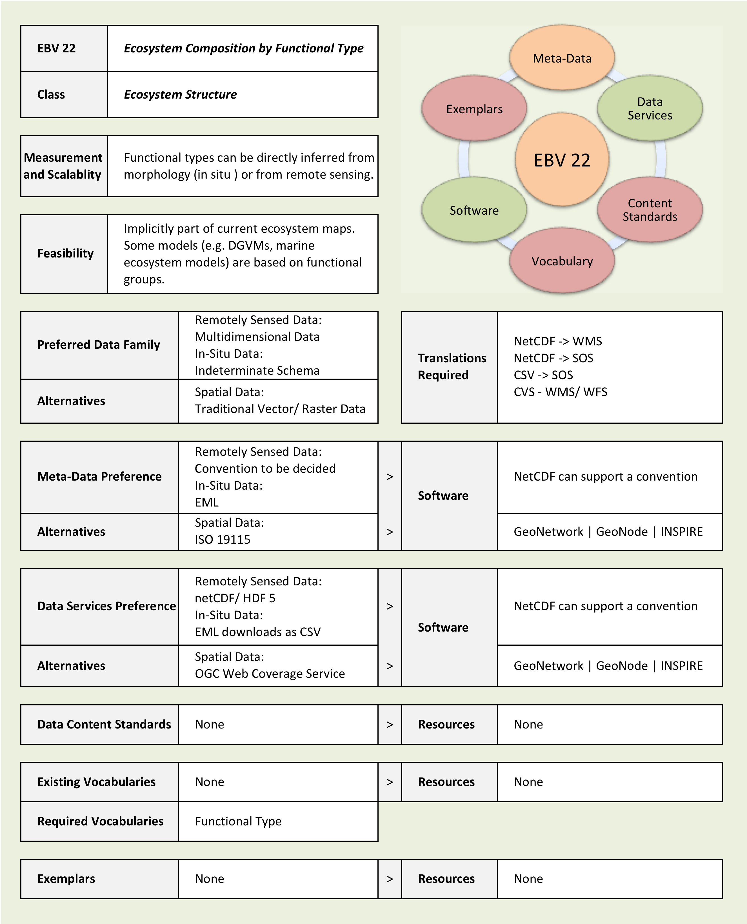
Typical Guidance
For Each EBV …

Slide 15
☺
?

Slide 16
… described properly, preserved properly, and discoverable
  Meta-data standards implied.
  Harvesters, brokers, and meta-data interoperability implied.
  Persistent identifiers implied.
  Protocols and standards for data exchange/ uploads implied.
  Preservation standards and formats implied.
  Tools and approaches to make searches more efficient (vocabularies, ontologies, dealing with massive meta-data collections, …).
  Sustainable, accredited data centers and long-term archives are implied – depositor SLA and contract.
How long is the ‘Long Term’?
Who funds this?
Distributed or Centralised Infrastructure?

Slide 17
… its utility, quality, and scope can be understood …
Implies:
Visualisations, Collations, Data Exploration Tools,
Utility metrics (‘Like’ ..),
feedback on quality, quality metrics and standards,
viewing search results in relation to reference spatial, temporal, and ontological/ taxonomic coverages,
ability to dynamically extract 'thumbnail' views of large datasets, …
‘Big’ Data: Different protocol – not HTTP but maybe RPC?

Slide 18
… accessed freely and openly …
  Implies:
  Standardised services, licenses and policies,
  Standardised, generic conditions and exceptions to free and open access,
  Simplified, effective distribution channels, even if costs are involved, …
  Equal opportunity to discover and apply.

Slide 19
… included into distributed processes …
  Implies:
  Persistence of mash-ups, derived works, and mediations,
  Web context documents,
  Web processing services,
  Standards and guidelines for grid computing,
  Ability to construct decision support models, indicators, and standardized, interoperable final products, …
What moves? Data, Processes, or Both?
Concept of a ‘Distributed Indicator Standard’

Slide 20
… due recognition is afforded to the creators …
  Implies:
  Data publication and citation,
  Data and service citation indices,
  Linking to scholarly articles, …

Slide 21
… the knowledge gathered can be re-used …
  Implies:
  Defining and storing templates and examples of finished work, processes, mash-ups, …
  Liberalising Meta-Data and building formal knowledge networks, …
ICSU-WDS Working Group on Knowledge Networks
(seeking a home in an RDA Collaboration)
Collaboration with RDA on Trusted Digital Repositories

Slide 22
… against a backdrop of …
The push to extend formal meta-data with linked open data;
The increased availability of crowd-sourced and citizen contributions;
A proliferation of devices and sensors;
And the construction of knowledge networks.

Slide 23
Building Infrastructure
Is NOT a Research Task – it is an Engineering Task
We can realise large parts of the GEO BON infrastructure already
Issues are not so much technological as institutional
Our first principle should be to engage and amend existing infrastructure components
Infrastructure cannot be funded through projects or through voluntary contributions.

Slide 24
Web Context Document
Indicator Component
Chart Component
Map Component
3
Search Component
2
CS/W Endpoint
GEOSS
Broker
1
Shared Platform – Meta-Data Repository
GEOSS Meta-Data Resources
Other Sources
MetaData: SOS
MetaData: WxS
MetaData: MetaCAT
MetaData: NetCDF
Variety of Standards and Protocols
Data Source: SOS
Data Source: WxS
Data Source: MetaCAT
Data Source: NetCDF

Slide 25
Some Generic Data Standards and Interoperability Requirements
XYZ, t, P
NetCDF
NetCDF
Multi-dimensional
Traditional Spatial
XY, t, P
S-DB
WxS
Signals
XYZ, t, P/ B
O&M
SOS
Ecosystem
XYZ, t, P/ B
MetaCat
CSV
XYZ, T, Tx
GBIF Index
DwC
Occurrence
XYZ, T, Al
GenBank
FTP/ ASN.1
Genome

Slide 26
Use Case to be achieved
User discovers a standardised data source
Do for more than one discovery action
User saves
Choice(s)
Mediation Saved?
Broker confirms user choice
Render/ Preview/ Download/ Model
Yes
No
Online Resource(s) forwarded to Broker
Broker sends request for mediation to Registry
Registry sends a list of compliant ‘Mediations’
Persist as a Web Context Document

