Slide 1
Mini-workshop on Crediting Data Providers
SANSA/ SAEON/ Meraka Institute
18 February 2015
Wim Hugo
CDIO - SAEON
wim@saeon.ac.za

Slide 2


Slide 3
Some Important Trends
General
The Semantic Web
Linked Open Data
Credibility of Science
Policy and Pressure from Funders
Emergence of Data Citation Indices
Industry Consensus on Data Publication Workflows, Roles, and Responsibilities
Specific

Slide 4
Extremes
The Complete (Semantic) Web: every piece of information at a physical network node is potentially in multiple relationships with every other. This enormous network is many times larger than the physical internet ⁽¹⁾ and is not practically useful for science.
Formal Meta-Data: very few relationships are formally specified, eliminating almost all of the potential links between pieces of information to favour only a very rigid collection.
(1) Fensel, D. and van Harmelen, F. (2007). Unifying Reasoning and Search to Web Scale, IEEE Computer Society, 1089-7801/07. http://www.cs.vu.nl/~frankh/postscript/IEEE-IC07.pd f

Slide 5
Permanent Identifiers in the Web
Why do we need permanent identifiers in the web?
Two main considerations
  The URI (URL, or other manner of reference) may change, in which case references to the object are no longer valid.
    Frustrating, and also nukes Linked Open Data
  Clustering: The object identifier serves as an agnostic pointer to a collection of ‘properties’ or data items, reducing complexity
    Example to follow

Slide 6
Complexity
In a completely connected network, complexity quickly grows: c=½n(n-1) ~ =½n²
n=3
c=3
n=4
c=6
n=5
c=10
n=6
c=15

Slide 7
Efficiency and Optimality
Reduction in Complexity
n=6
c=15
n=3
c=3
n=3
c=3
c=1
c=1+3+3=7
Note diminishing benefit from increased levels of clustering
Cluster Levels

Slide 8
SAEON Meta-Data base: ± 7 000 records
WDC-BHH Meta-Data base: ± 22 000 records
WDC
SAEON

Slide 9
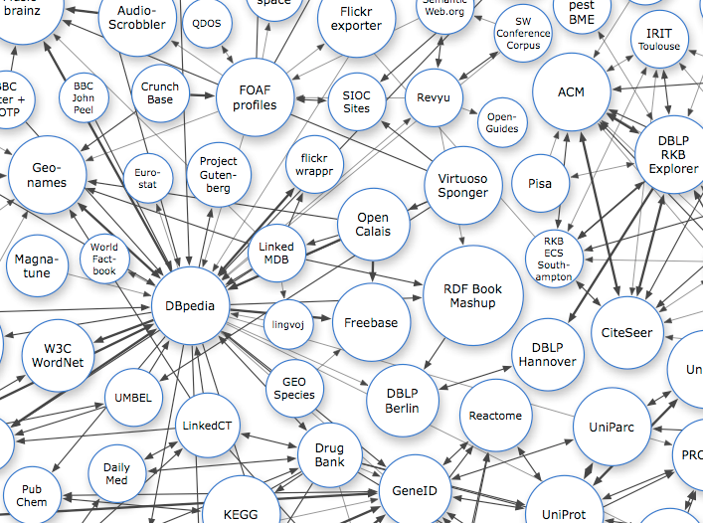
Linked Open Data
Network of referenced objects in the web
Dependent on permanent identifiers for the objects
References vocabularies, ontologies, registries, …

Slide 10
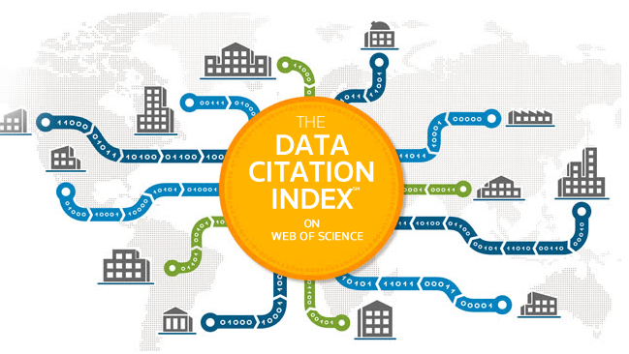
Data Citation Indices
Thomson-Reuters – Web of Science
  Problem! Not always open access …

Slide 11
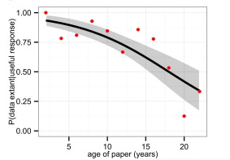
Credibility of Science
Access to original and complete data sets for reproducibility
Re-usability declines with time
Availability declines with age
http://journals.plos.org/plosone/article?id=10.1371/journal.pone.0000308#pone-0000308-g002
http://www.sciencedirect.com/science/article/pii/S0960982213014000

Slide 12
Policy and Pressure from Funders
Many ‘Open Access’ type statements
  For example the Berlin Declaration
Requirements for complete open access deposit
Data Management Plans
NRF is a recent signatory and has published an Open Access Statement
Can be seen as an intent to follow up with policy
http://openaccess.mpg.de/319790/Signatories

Slide 13
Typical Research Workflow Network Elements
Trusted Digital Repositories
Publisher
People
RDI Outputs/ Online Resources
Coverage
(Temporal, Spatial, Topic)
Citation
Institutions
Projects
Initiatives
Use, Caveats, Lineage, Methods, and Licenses
Networks
Funders
Relationships are contributed by (1) publication (2) meta-data mining (3) information from websites conforming to schema (4) social-media-type sites and VREs (5) existing network contributions (6) scraping existing websites (7) ontologies and vocabularies (…)

Slide 14
Many Initiatives of Varying Maturity to Consider
Initiative | Focus | Involvement/ Implication
RDA: Data Publication and Citation | Workflows, citing constantly updated data sets and subsets of large data sets | WG Member Specification
RDA: Certification of Digital Repositories | Alignment of certification schemes, development of maturity models for repository assessment and improvement | WG Member Specification
RDA: Registry of Trusted Digital Repositories | Development of WDS-aligned, DataCite-linked registry of trusted repositories, building on re3data and DataBib | WG Member Specification
GEO/ GEOSS, and RDA: Brokering | Meta-data and data brokering | WG Member
Common Repository APIs | Piloting common API model for data repositories | Specification
DataCite/ Identifiers, Metadata, and Machine Accessibility Group | Minimum Meta-Data Scope | Specification
CoDATA/ Creative Commons | License and Policy Guidance | Specification
WDS a major driver for RDA initiatives

Slide 15
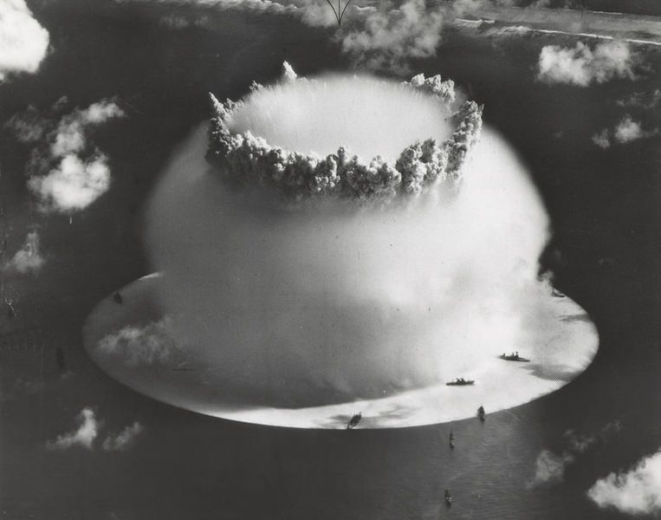

Slide 16
Technical Requirements
Data Citation and DOIs
Trusted Digital Repositories
Researcher Registration
Registry of Institutions
Registry of Funders (Belmont Forum?)

Slide 17
Digital object identifiers
Technical – Section 1

Slide 18
Global RDI Ecosystem – Knowledge Network
TDRs
(WDS, DSA, DataCite*)
Publishers
(CrossRef?)
People
(ORCID)
RDI Outputs/ Online Resources
Coverage
(Temporal, Spatial, Topic)
Citations
(DataCite)
Institutions
(?)
Projects
Initiatives
Use, Caveats, Lineage, Methods
Networks
Licenses
(CoDATA, Creative Commons)
Funders
(?)
* Including re3data, DataBib
Exists
Maybe
Not Now
WDS

Slide 19
Why Cite Data?
It is as important an output as a scholarly publication
Credit and attribution need to be formalised
Reproducability and evidence for claims
Broad-based requirements for citation
  Machine-readable and actionable unique identifiers
  Access to data sets and evidence
  Persistence and version management
  Links to meta-data for verification and re-use
  Allow diversity and interoperability

Slide 20
Permanent Identifiers in the Web
Several working alternatives
  Handle System (CNRI)
  DOI (DataCite and Crossref)
  URI (native HTTP, or Identifiers.org)
  PURL (OCLC)
  ARK (Consortium)
  NBN
Why DataCite and DOIs?
  Strongly linked into data publication workflows and agreements with key industry stakeholders
  Added value services (indices, citation formatting, resolvers)
  Brokers diversity of publication workflows and practices on our behalf
  No need for Data Publication – but not discouraged

Slide 21
SAEON, NRF, and DataCite
DataCite members act as allocating agents on a regional or country basis
SAEON currently holds a license for South Africa and operates this on behalf of NRF
SAEOSS/ Shared Platform implementation is available
Meta-data aggregator links automatically to DataCite and provides depositor services
NRF Open Access Implementation Workshop: 18 March 2015

Slide 22
Use Cases: Main Actors
Type of Stakeholder | Meta-Data Actions | Data Actions | Example
Individual Depositors | Individually uploaded and maintained | Optional upload of data | SAEON-hosted postgraduate student
Custodians (SASDI/ NSIF) | Automated harvester/ automated push service | Data hosted with custodian | Government Departments, SANSA, Research Councils
Institutional Repositories | Automated harvester/ automated push service | Data hosted in institutional repository or NRF listed repository | HEIs, NRF National Facilities
Hosted Data Sets | Any method | Data hosted in shared platform | Projects and pre-arranged stakeholders
* Dryad, Figshare, …

Slide 23
Process (1)
Depositor registers
Depositor provides Meta-Data end-point
Depositor Corrective Actions
Allocator Verifies Repository
Harvested by
Allocator
Verified by
Allocator
Register in re3data if required
Create/ Assign
DataCite Suffix

Slide 24
Valid Meta-Data Endpoints
 | CS/W | OAI-PMH | HTTP | FTP | IPT
Dublin Core |  | Yes | Yes | Yes
ISO 19115 … | Yes |  | Yes | Yes
FGDC | Yes |  | Yes | Yes
SANS 1878 | Yes |  | Yes | Yes
EML |  | Yes | Yes | Yes
DataCite |  | In Process | In Process | In Process
ArcCatalog | Scheduled
DDI |  | In Process | In Process | In Process
Darwin Core |  |  |  |  | Scheduled
Database Adapter for DC-CS/W

Slide 25
Minimum Criteria for Meta-Data
Requisites
  DataCite Schema or Dublin Core
  Unique Identifier in Depositor Collection
  RIMS Grant Identifier
Optional but Good
  ORCID
  Coverages as Linked Open Data

Slide 26
Process (2)
Depositor Preferences
Meta-Data Push Service
Depositor links DOI and UID
Automated Meta-Data Push
Update Meta-Data Record
Push Service or REST interface
Lodge DataCite Record
Asynchronous!

Slide 27
Process (3)
Meta-Data Push Service
Depositor links DOI and UID
Automated Meta-Data Push
Update Meta-Data Record
Push Service or REST interface
Lodge DataCite Record
Synchronous: Request-Response

Slide 28
Process (4)
On-Site
Self-Deposit
Depositor links DOI and UID
Automated Meta-Data Push
Update Meta-Data Record
Push Service or REST interface
Lodge DataCite Record
Synchronous: Request-Response

Slide 29
Version Management
Once a DOI has been issued, a data set must remain available, together with its meta-data record.
Some meta-data software environments allow succession of data versions and meta-data based on small improvements and corrections – deprecating the earlier version and rendering it inaccessible through the web.
This cannot be done: the data set in one of its previous versions may already have been cited.
Best practice: store a version chain (parent/ child) element with meta-data.

Slide 30
Process (5)
Depositor
Depositor Actions
Push or Repeated
Harvest
Compare to Archive
Handle Cases
Communicate/ Push
DataCite Actions
Asynchronous

Slide 31
Meta-Data Synchronisation Actions
 | Match Result | Action
Same Meta-Data and Data | UID Match Content Match DOI Match | No Action
Modified Meta-Data | UID Match Content Mismatch DOI Match | Update DataCite
New Version (unmanaged) | UID Mismatch Content Match DOI Match | Notify Depositor
Missing Meta-Data | Depositor: No Record Allocator: Record | Notify Depositor – Confirm Object Removal Update Allocator Meta-data
New Meta-Data and Data | Depositor: Record Allocator: No Record | Issue DOI Push Meta-Data to DataCite
We have identified these in tests with DataFirst at UCT
There will be more as implementation progresses

Slide 32
Process (6)
RIMS Request
DOI Response
Match RIMS Grant ID
Synchronous

Slide 33
Trusted digital repositories
Technical – Section 2

Slide 34
Evolution: Accreditation and Certification
ICSU
WDS
RDA
WDS-DSA
Working Group:
Aligned Process
Maturity Model
OAIS
TRAC
WDS
DSA
DSA
DIN
NESTOR
CCSDS
RAC
ISO
16363:2012
ISO
16919:2014
All certifications are process-centric
Except ICSU-WDS: adds data quality and sustainability

Slide 35
Problem Statement
How do we make an objective assessment of a complex, multi-faceted evaluation?
Will someone else reach the same conclusion?
How do we know where we are in terms of performance, and how do we account for multiple sets of objectives and criteria for compliance?
What do we need to do to improve?
https://www.icsu-wds.org/news/wds-related/a-maturity-model-for-digital-data-centers

Slide 36
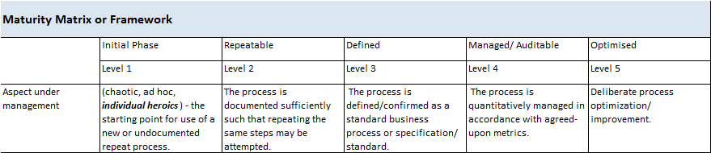
Alternative Classifications/ Scales of Maturity
Ignorance | Awareness | Adoption | Implementation | Management | Continuous Improvement

Slide 37
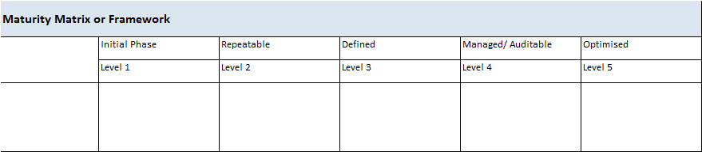
Scope of Management
Populated from an ‘Objective Hierarchy’, KPA’s, etc.

Slide 38
Objective Hierarchy …
WDS
Governance
Networking & Sharing
Policies and Procedures
Infrastructure

Slide 39
Objective Hierarchy …
WDS
Governance
Vision &
Planning
Oversight
Science Committee
Mandate
Tech Steering
Committee
…
Network of Experts
…
Networking & Sharing
Expertise
Network of Experts
…
…

Slide 40
… or Objective Graph
WDS
Governance
Vision &
Planning
Oversight
Science Committee
Mandate
Tech Steering
Committee
…
Network of Experts
…
Networking & Sharing
Expertise
Network of Experts
…
…

Slide 41
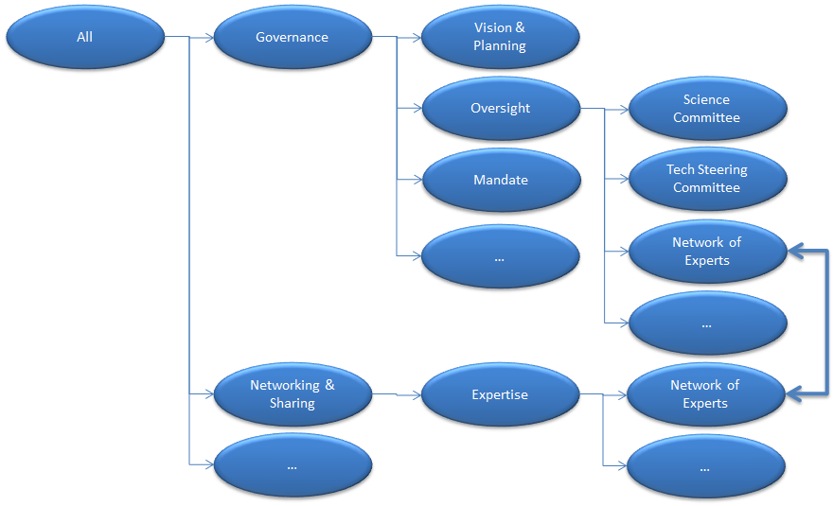
Large and Complex Matrix …

Slide 42
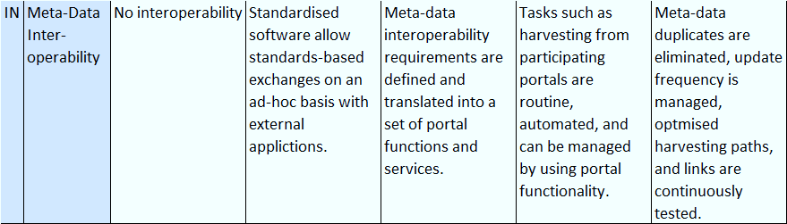
… each with Metrics
Supported by relevant user requirements, specifications, standards, and reference implementations.
“Good” or “Best” practice

Slide 43
Current Performance

Slide 44
Self-Assessment
‘WDS’
‘DSA’
‘NESTOR’
‘OAIS/ TRAC’
‘ISO’
…
Limited Impacts
‘GEOSS’ (Technology)
‘APA’ (Preservation)
…

Slide 45
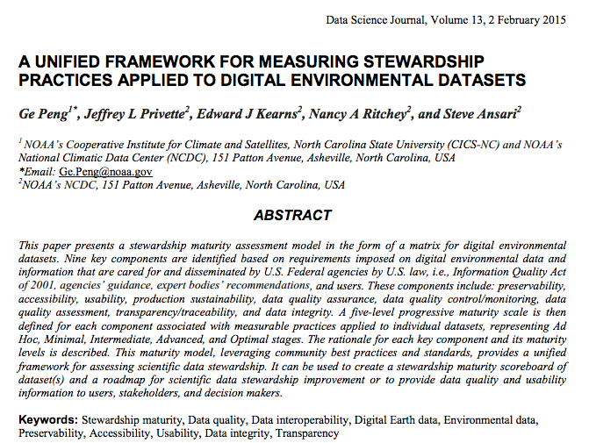
Limited Impact or Scope
https://www.jstage.jst.go.jp/article/dsj/13/0/13_14-049/_article

Slide 46
Milestones and Goals
Use Matrix to Develop Milestones for Continuous Performance Improvement

Slide 47
Quality Assurance
Extent to which I am meeting my Own Goals
‘Internal Audit’

Slide 48
Audit
External Measurement Against Published Criteria
‘Audit’ & ‘Accreditation’

Slide 49
Proposal
Within ICSU-WDS/ RDA/ DSA Working Group
  Develop common framework (almost done)
  Develop Maturity Model for DDRs
South Africa
  DSA/ WDS Framework
  NESTOR: Open Choice
  TRAC: Comprehensive Self-Assessment
  ISO 16363: A bridge too far

Slide 50
Registries
Technical – Section 3

Slide 51



Important Registry Initiatives
ORCID
  http://orcid.org/
Re3data/ DataBib/ DataCite
  http://www.re3data.org/
CrossRef
  http://www.crossref.org/

Slide 52
Implementation
Technical – Section 4

Slide 53
Roles and Responsibilities
DOI License Allocator
  Verify that data is managed properly
    Very few institutions locally are accredited
  Verify meta-data completeness and schema compliance
    Periodic automated review and reporting to depositor
  Version Verification
  Persist Meta-Data/ Object Removal
  Application of License/ Terms and Conditions
NRF/ License Allocator
  Maintain a registry of repositories in re3data/ DataCite
  Develop and publish guidelines
  Publish a policy in respect of grant-funded research

Slide 54
Roles and Responsibilities
DOI License Allocator
  Services
    Asynchronous
      Meta-Data and Status Inventory (OIA-PMH, CS/W, JSON REST)
      Request DOI
      Find DOI
      Discrepancy Report – Harvesting
      Link to GEO/ GEOSS Broker, WDS, DSA
      Search, Download Statistics
      User assessments and comments
    Synchronous
      Push Meta-Data Request
      DOI and Status Return
      RIMS Service

Slide 55
Roles and Responsibilities
Depositor
  Provide information about guideline criteria and register
  Follow broad-based aspects of repository management:
    Governance and Accountability
    Sustainability and Cost Recovery
    Curation Practice and Digital Object Management
    Dissemination and Access Policies
    Risk Mitigation
    Technical Environment and Standards
  Provide meta-data harvest endpoint in a supported format
    SAEON implements brokering for additional community standards as needs dictate and if funds are available.
  Maintain meta-data services and data repository
  React to and attend to issue notifications

Slide 56
Work to Date
Technical capability will be ready end of March 2015 – in test at present
Development of guidelines for repositories, meta-data, and data
  Data Seal of Approval/ World Data System common denominators
  Move to higher levels of maturity
  Compilation of a maturity model for general use by the community
SAEON will implement initially for
  Its own data sets
  Shared Platform stakeholders (SAEOSS) as test cases
  Specific funded projects (Bioenergy Atlas, Risk Atlas)
  NRF stakeholders and HEIs as test cases
Operational support for wider implementation
  to be agreed with NRF and DST

Slide 57
Call for Task Groups
Best Practice Guidelines
  Accreditation as a Trusted Digital Repository
  Meta-Data Standards and Management Practice
  Data Service Standards
  Digital Object Management and Curation
  Governance and Oversight
Advisory on Implementation
  Report on Sustainability and Funding

Slide 58
☺
???

Slide 59
Mini-workshop on Crediting Data Providers
SANSA/ SAEON/ Meraka Institute
18 February 2015
Wim Hugo
CDIO - SAEON
wim@saeon.ac.za

Slide 60
Data Policy Considerations
Data sharing and availability of publicly funded RDI outputs at no cost, or at the cost of dissemination, is a widely adopted trend in the developed world, and is the basis of engagement for a number of influential organisations, including GEO and ICSU. This trend is expected to continue and penetrate into developing countries.
OECD:
  http://www.oecd.org/dataoecd/9/61/38500813.pdf
List of organisations subscribing to a free and open data policy:
  http://www.codata.org/data_access/policies.html
GEO:
  http://www.codata.org/GEOSS/GEOdataPolicyBriefingMar07dist.pdf
ICSU:
  http://www.icsu.org/events/ICSU%20Events/international-symposium-the-case-for-international-sharing-of-scientific-date-a-focus-on-developing-countries

Slide 61
Main Driver for Open Publishing
Increasing support inthe scientific community peer-reviewed data publication.
Adequate professional recognition.
Reproduction and verification of results.
Consequences:
  Improved accessibility to and description of data sets, driven by scientists’ desire to publish;
  The majority of these published data sets will be freely available in the public domain, supported by transparency demanded in scientific journals and the emerging infrastructure allowing linkages between data sets and scholarly articles.
A need for the infrastructure to publish, curate, and disseminate published research outputs is implied – and not all institutions or relatively short-lived funded projects will be in a position to provide such infrastructure.
Brussels Declaration: http://www.dlib.org/dlib/january11/smit/01smit.html

Slide 62
“Free and Open”
Free access:
  it is recognised that data should be free of charge if possible, but this does not mean that reasonable cost of availability and dissemination cannot be recovered. This is often funded as a public good.
Open access:
  the emphasis is on equal opportunity to discover, obtain, and use the data without prejudice.

Slide 63
Funders: Motivations
Governments invest large sums of money into science as a driver for data acquisition, knowledge creation, capacity building, and innovation. This is a virtuous circle that is fed by availability of data, information, knowledge, and capacity. At a basic level, reduced access to the outputs of such funding diminishes the return on investment. What is often overlooked, though, is that reducing the efficiency of this feedback loop hurts the return on investment even more by limiting indirect returns and collaboration. It is the equivalent of removing compound interest from a financial investment.
Secondly, the public has funded the outputs from state department data collection and state funded research, and owns it already. Allowing selective access infringes basic rights of citizens in general, and the scientific community in particular. This right has to be balanced by reasonable measures to allow researchers to exploit the academic value of their work without undue competition, typically in the period leading up to publication of a paper or thesis. Typical reductions in access: financial constraints, embargoes and classification, poor dissemination, lack of standardisation, poorly described data.

Slide 64
Counter-Arguments
Developing Countries often indicate that they regard some of their research data as sensitive, based on the (possible) future commercial value of such data, or on its conservation implications.
The data has current commercial value, and the state entity depends on the income derived from it to fund its operations.
It is obvious that some data held by the state is private to companies or individuals.
The users will apply the data incorrectly, will apply it to challenge government, or gain financially from it.
Scientists need time to publish and ‘own’ the data.

Slide 65
Legal Environment
Intellectual Property Rights from Publicly Financed Research and Development Act (Act No 51 of 2008): potentially restricts the access to research data and outputs which would conflict with the principles of data democracy.
Spatial Data Infrastructure Act (Act No 54 of 2003): Improves discoverability but does not guarantee access. Could limit data availability because of the legal obligations of ‘custodianship’, which may make institutions unwilling to publish all available data sets.
South African Weather Service Amendment Bill: A benchmark example of a step in the wrong direction, it impedes climate change research and discriminates against local enterprise while foreign entities are free to continue with services and data in competition with the SA Weather Service.
Promotion of Access to Information Act, 2000 (Act No. 2 of 2000):
Protection of Information Bill: policy or regulation required to declassify and exempt the data.
National Archives and Records Service of South Africa Act, 1996 (Act No. 43 of 1996)

Slide 66
Policy Recommendations (1) ☺
All data, information, and research outputs generated by state-funded means should ideally be included in a national policy. This includes grant-funded university research, and data generated by state departments. It specifically excludes contract research performed for private entities.
The data so described should be exempted or declassified in terms of the Protection of Information Bill, as provided for in the authority of each state department.
The legal meaning of ‘custodian’ of a publicly funded database should include the provision of free and open access.
Conditions and qualifications are valid, based on
  Reasonable embargoes to allow publication of research and papers;
  Privacy afforded to legal entities and individuals;
  Conservation considerations, mainly to protect endangered species and habitats;
  Infringement of rights afforded by the Intellectual Property Rights Act;
  Infringement of current or future legal rights to exploit natural resources.

Slide 67
Policy Recommendations (2) ☹
Existing arrangements where state departments or agencies derive a significant proportion of their income from the sale of publicly funded data should be discontinued and mitigation measures should be put in place to replace the loss of income.
If the state implements a policy of free and open access to data, the state should fund and support the electronic infrastructure whereby research outputs are preserved, discovered, and accessed. This infrastructure is a necessary expenditure to protect the investment in Research, Development and Innovation, and should complement and underpin the arrangements put in place by individual state departments, and academic or research institutions.

Slide 68
Process Model

Slide 69
Process Model
RDI outputs can have access is restricted, due to three situations:
  Grant-funded research that has not yet been published is available to a collaboration community but not generally;
  Grant-funded research that has a commercial exploitation potential that far outweighs its general public good, and is offered protection under the Intellectual Property Rights Act;
  Grant-funded research that is embargoed because of conservation considerations, privacy issues, or legal rights of third parties.
  In all of these cases, it remains good practice to publish the meta-data openly: this means that the research outputs are discoverable but not openly or freely accessible.
State-generated data that is classified: not openly and freely accessible, and no meta-data is openly published.
State-generated data that currently supports a significant proportion of the income of a sate entity, and for which the aim is to phase out such dependency where possible. Meta-data is openly published, and the data is openly available but not free.
The balance of grant-funded or state-generated outputs is freely and openly available and meta-data is published openly.

Slide 70
Separate Licenses and Policy
Policy and the license in support of the policy must be separated. Quality public domain licenses (such as Creative Commons) exist, and these should be used by preference.
Creative Commons licenses cannot be made more restrictive, and hence cannot be applied for the conditions of use identified earlier.

Slide 71
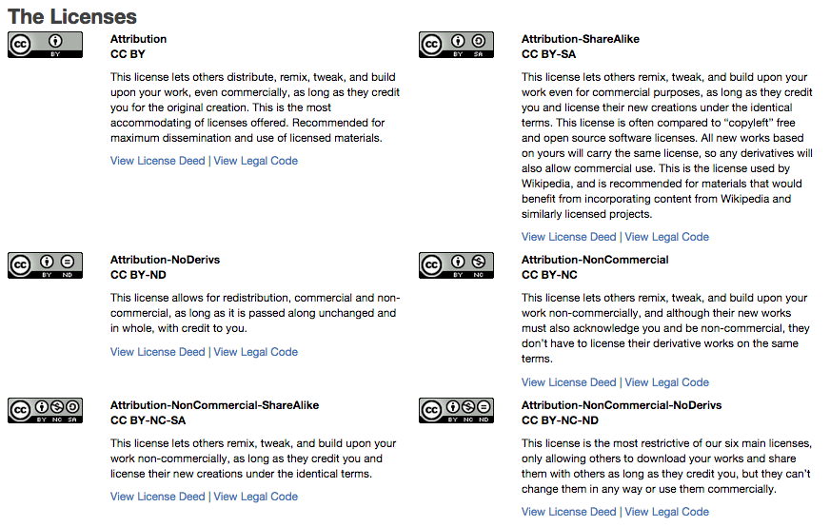
Creative Commons

Slide 72
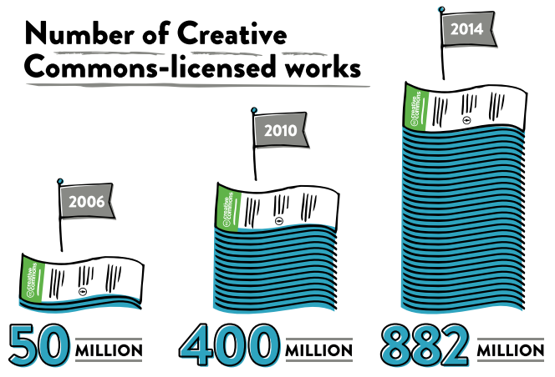
Growth of Creative Commons

Slide 73
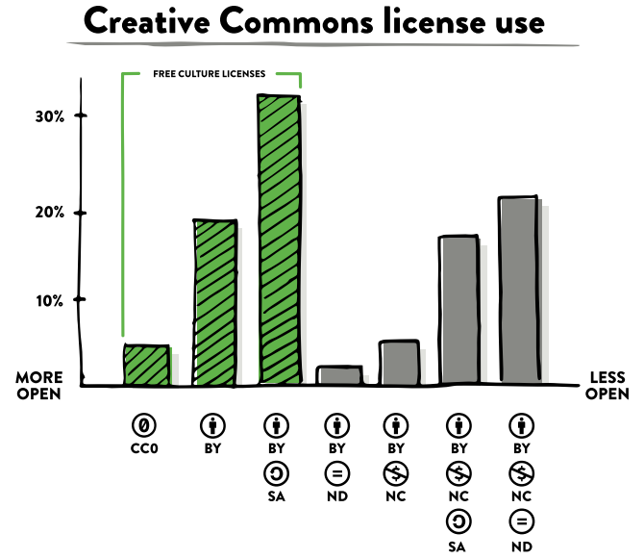
Creative Commons License Use

Slide 74
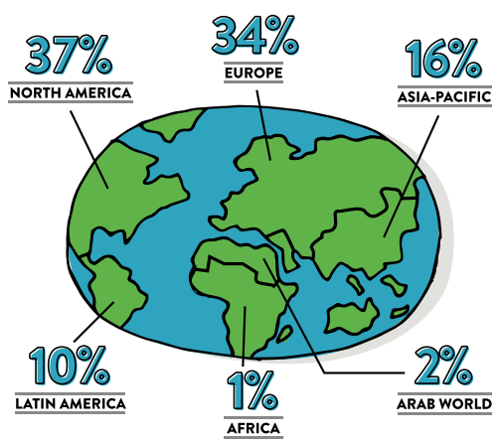
Where CC Works are Published

Slide 75
Next Steps
Policy Guideline: each institution will have its own variation, but should include some foundational clauses
Licenses: Consent on Creative Commons
  Machine Readable Version
  Human-readable Version
  Legal Version
Adapt Creative Commons Licenses for
  Restrictions to physical access
  IP constraints
  Identification Constraints

Slide 76
☺
???

