Slide 1

Search Stratification
SRS 336.3.9.2
Wim Hugo, 08 February 2012

Slide 2
Concept
GEO Search Facilities allow XML (GeoRSS) returns of search requests.
CS/W Search allows ISO or DC-type XML returns
Results are returned
  In Summary Form
  In
Results can be aggregated and stratified in the following ways:
  By way of a set of filters obtained from the result XML.
  By refining the search based on filters obtained from the result XML.
  By aggregating the search result based on metrics obtained from the result XML.

Slide 3
Test Sources - GEO
http://196.213.187.51/PAGE/SAEOS/saeos_GEO_II.html

Slide 4
Process
Server
Client
Aggregate View
CS/W Search Service
DC/ ISO XML
Result
GEO Search Service
GeoRSS XML
Result
XML Element
Analysis
(Filtered)
Result View
Search Request
Search Page
(exists)

Slide 5
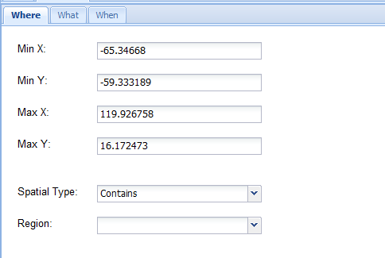
Search Page
Search (+Result)
Result-Filter
Analysis
Map
Search

Slide 6
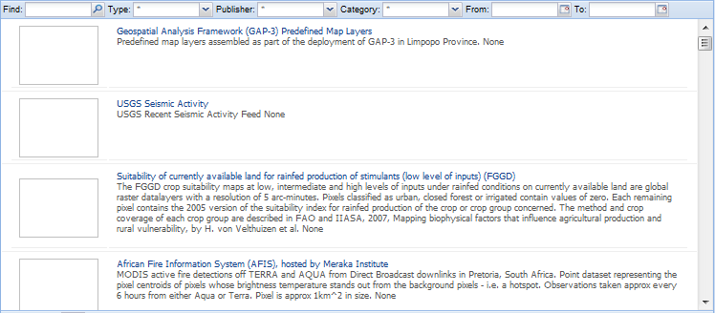
Result Page
Search (+Result)
Result-Filter
Analysis
Map
Two possible actions:
Go to meta-data link
If WxS/ SOS/ NetCDF view in map
Workaround: Fetch thumbnail from portal as a manufactured URL
Search Again

Slide 7
Result/ Filter Page
Search
Result-Filter
Analysis
Map
Author
Date
Resource Type
List Box
Between
And
Web Map Service
Web Feature Service
KML (Google)
GeoRSS
Other
Keywords
Publisher
Custodian
List box
List Box
List Box
Cannot be implemented now
Refine

Slide 8
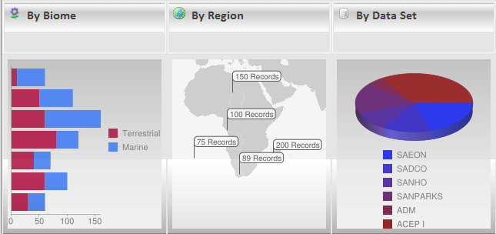
Analysis Page
Search
Result-Filter
Analysis
Map
Count
Author
Resource Type
Date (Month)

