Slide 1
Mapping Interface
Review – URS IV
G336.3.7.5 SRS Map Viewer Integration
August 2012

Slide 2
Change Requests
Risk and Vulnerability Atlas Workshop
SAEON User Training

Slide 3
Aspects to Change
Main Map View
  Presentation of Layer Information
    Control: Meta-data summaries and Download
    Citations and Licensing
  Presentation of Legend Information
  Save/ Open/ Backdrop Tab
  Minimised View (borderless view)
Integration with Portal
  Create a New Map Window
  Navigate to Existing Map Window
  Layer Upload Process
Search Result Presentation
  Nested Search Capabilities
  Hide Detail Panel
  New Buttons for Online Resources/ Meta-Data
Online Resource Presentation
  Improved Layout
  Present in Panel – not floating window

Slide 4
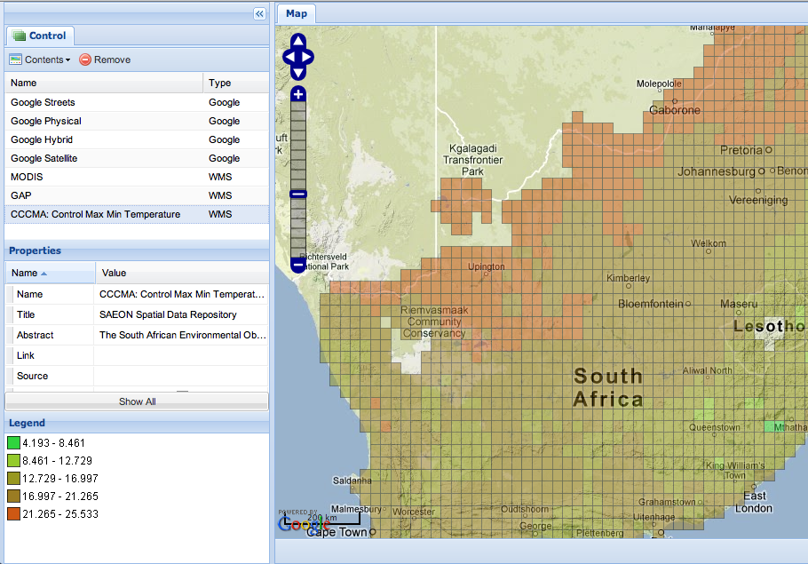


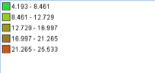
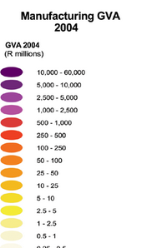
Main Map Window Layout: 1 - Legend
Citation
Layer Name

Slide 5
Main Map Window Layout: 2 - Citation
Legend
Citation
Citation:
[1] Layer Name
Author, Title, Publisher, Date
[2] Layer Name
Author, Title, Publisher, Date
[3] Layer Name
Author, Title, Publisher, Date
[…
Copy
Conditions and License:
[1] Layer Name
License
[2] Layer Name
License
[3] Layer Name
License
[…
Copy

Slide 6
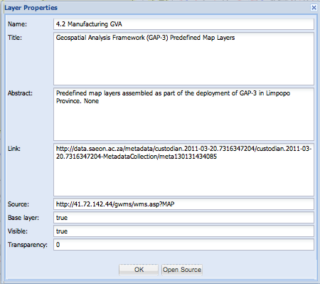
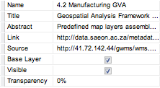
Main Map Window Layout: 3 - Control
Legend
Citation
Not Editable
Not Editable
Remove
Remove
Tick Box
Tick Box
Dropdown
Registered User
Download Layer
Full Meta-Data
Edit
Download Layer
Full Meta-Data
Registered User
Some data downloads require registration.
Click here to register

Slide 7
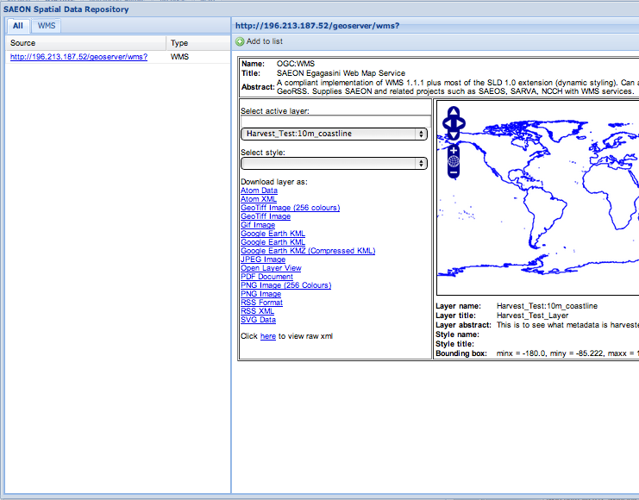
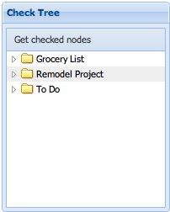
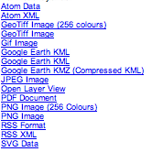
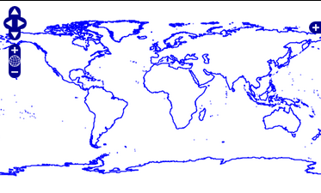

Main Map Window Layout: 3 - Control
Legend
Citation
Add to Map
Download Data
Available Resources
Registered User
Web Page
OGC Services
Downloadable Files
ALSO:
SOS
NetCDF
KML
Etc.
ADDITION:
Nested Search
Registered User
Edit
Download Layer
Full Meta-Data
Registered User
Some data downloads require registration.
Click here to register

Slide 8
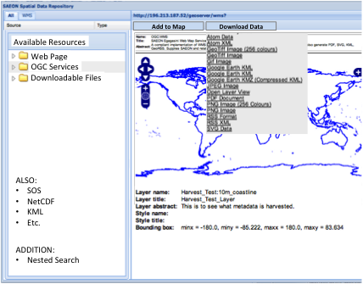
Main Map Window Layout: 3 - Control
Resources
Legend
Citation
Registered User
Edit
Download Layer
Full Meta-Data
Registered User
Registered User
This is better – the floating panel does not work on screens with smaller resolution
Some data downloads require registration.
Click here to register
Embed this map

Slide 9
Tree View Details
Load on Demand
Web Sites
  URL
OGC Map Services
  Web Map Service
    Layer 1
    Layer 2
      Style 1
      Style 2
  Web Feature Service
  …
Downloadable Files
  CSV 1
  CSV 2
  …
SOS
NetCDF
  Service 1
  Service 2
Nested Search: See overleaf
…

Slide 10
Nested Search
Current Implementation:
  http://app01.saeon.ac.za/saeon/search_portal.htm?MODE=CSW
  Points to CSW source
Online Resource Points to Search Page with a Named Data Source:
  http://app01.saeon.ac.za/saeon/search_portal.htm?MODE=CSW&URL=<new_end_point_for_service>
  Implies multiple CSW end points for one or more services (each having a separate ‘meta-data’ table in our case).

Slide 11
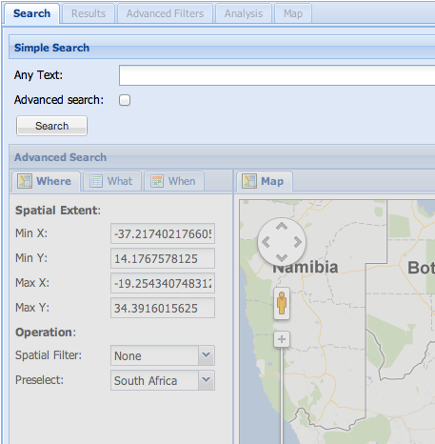
Main Map Window Layout: 3 – Control (Search)
Resources
Legend
Citation
Available Resources
Registered User
Web Page
OGC Services
Search the Facility
Registered User
Edit
Download Layer
Full Meta-Data
Registered User
Registered User
Some data downloads require registration.
Click here to register

Slide 12
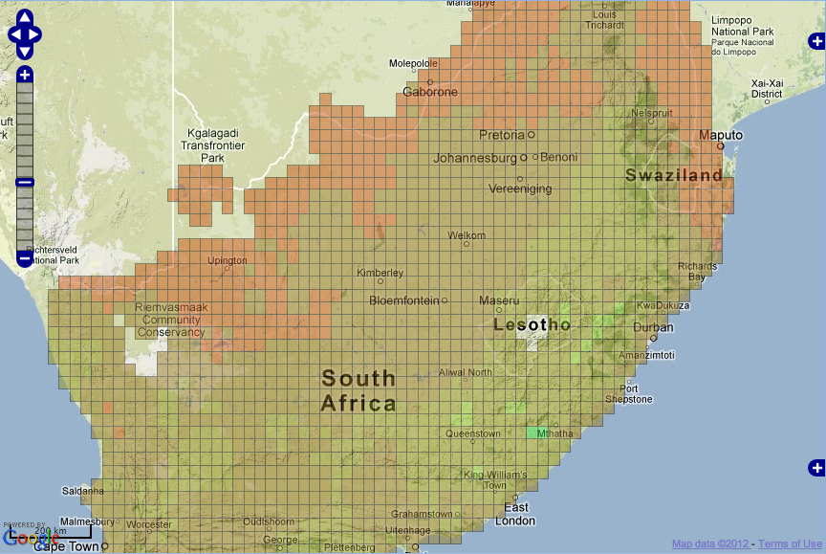
Borderless View
http://app01.saeon.ac.za/saeon/index.htm
?MODE=OPEN_WMC
&URL=csag_cccma_control_temp_maxmin.xml
&SHOW_CONTROL=borderless
Need a menu to:
Open in full screen (new tab) with controls
2. Show controls

Slide 13
Main Map Window Layout: 3 – Control (Embed)
Legend
Citation
Copy the HTML below to embed the map into your application.
Frameless Map:
Full-Frame Map with Controls:
Full-Frame Map without Controls:
Legend:
Add citation
Add link to Full-Screen Map
<div><iframe>MAP URL</iframe></div>
<div>link to full map in new window</div>
<div>citation</div>
<div><iframe>MAP URL</iframe></div>
…
<div><iframe>MAP URL</iframe></div>
…
Registered User
Edit
Full Meta-Data
<div><iframe>COMPOSITE LEGEND URL</iframe></div>
…
Download Layer
Registered User
Some data downloads require registration.
Click here to register
Embed this map

Slide 14
Registration Interface
To determine if user is registered:
  Query string parameter TOKEN will have a value
Assist user with registration:
  chpc.dirisa.org/join_form in new window
Check for data set (do not allow downloads):
  chpc.dirisa.org/<custodian>/checkTerms
  <custodian> is found in meta-data record/ search result
  Empty custodian record: functionality disabled

Slide 15
Modifications to Search Panels

Slide 16
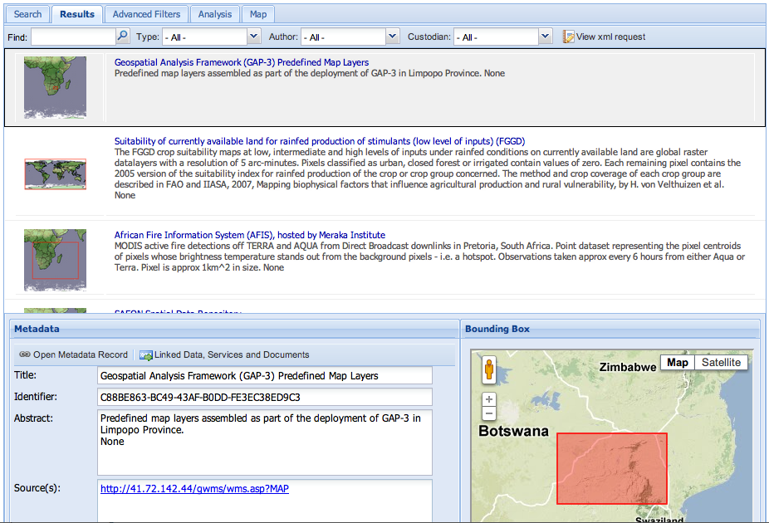
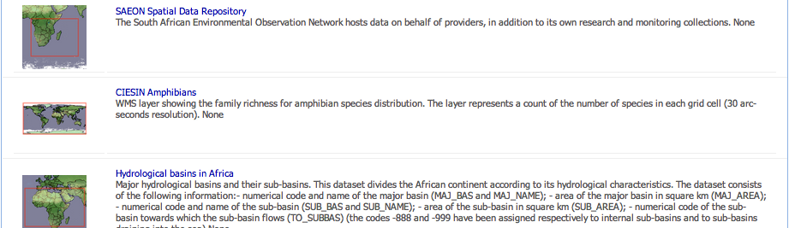
Search Panel: No Detail Up Front
View Details
View Meta-Data
Online Resources
View Details
View Meta-Data
Online Resources
Question: What do we do if we receive many hits?

Slide 17
Tooltips
View Details:
  View more detail for this entry
View Meta-Data
  View full meta-data for this entry in a new window
Online Resources
  Access websites, data services, and downloads linked to this entry.

Slide 18
Search Panel: No Detail Up Front
View Details
View Meta-Data
Online Resources
View Details
View Meta-Data
View Meta-Data

Slide 19
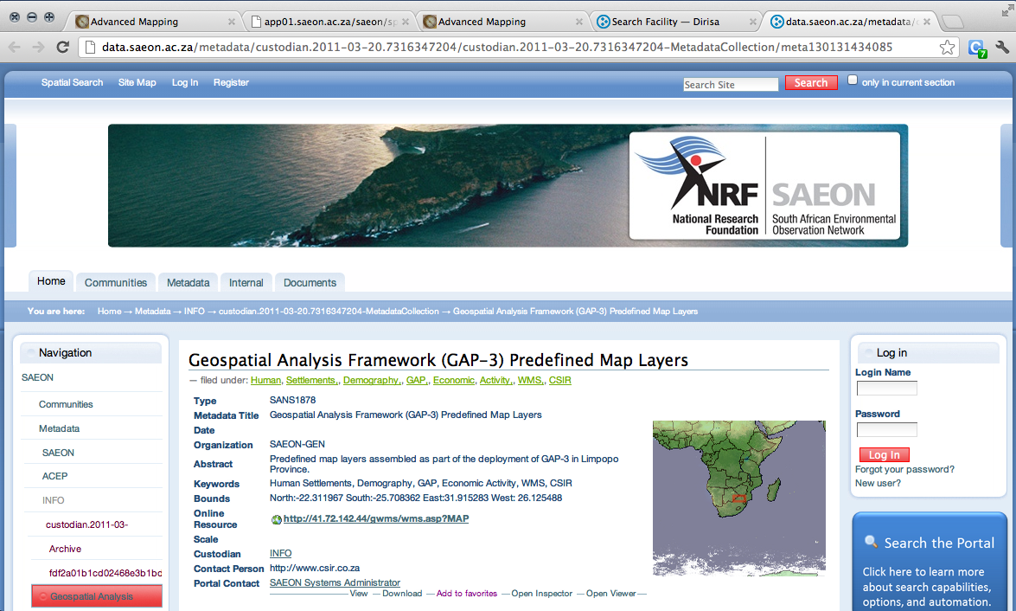
Search Panel: Meta-Data
View Details
View Meta-Data
Online Resources
View Details
View Meta-Data
View Meta-Data

Slide 20
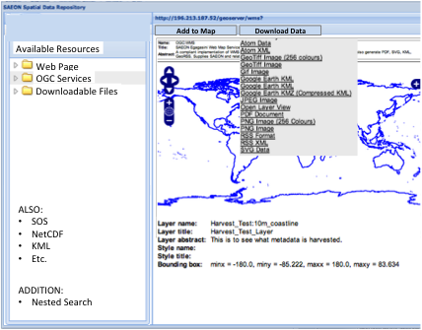
Search Panel: Online Resources
View Details
View Meta-Data
Online Resources
View Details
View Meta-Data
View Meta-Data

Slide 21
Integration with Portal

Slide 22
Confirmation of Interfaces and Query String Parameters
Map Window
  Webtide to verify in portal
Search Page
  Extensions to accommodate nested search
Web-Based Uploader
  Robustness remains a problem
  Webtide to add token to calls
Request User Status
  Webtide to implement interface sending token
Request User/ Custodian Status
  Webtide to implement interfaces:
    Custodian has terms and conditions
    User is registered
    User has ticked terms and conditions
    External (background)log-in request
    External ‘Accept terms and conditions’
    External ‘Show terms and conditions’
  No download without confirmation
  Checklist:
    No terms and conditions for custodian: download
    Terms and conditions for custodian:
      user is registered (if not, guide to registration page)
      User has ticked
      User is logged in

