Slide 1

Amendments to GetRecords
SRS 336.3.7.4
Wim Hugo, 9 March 2012

Slide 2
GetRecords Extension for EML Records
For EML records, GetRecords at present returns one or more ‘online resource’ references. This needs to be extended to add an item as the first in the array:
  Look up the ‘packageId’ attribute in the EML element
    Example: <?xml version="1.0"?><eml:eml packageId=“victoriag.21.7" system="knb"
  Create an online resource as follows:
    http://saeonocean.co.za/knb/metacat?action=read&qformat=saeon&sessionid=0&docid=[packageId]
    Example: http://saeonocean.co.za/knb/metacat?action=read&qformat=saeon&sessionid=0&docid=victoriag.21.7

Slide 3
Pushing Meta-data to Meta-Database
SRS 336.3.7.4
Wim Hugo, 9 March 2012

Slide 4
Events
On completion of harvest
On change of meta-data publication status
On edit/ delete/ update of meta-data record
On ‘Add from Template’
On ‘Upload from File’
Each event: fires a search that is committed to database
  http://data.saeon.ac.za/GetRecords?resulttype=georss&anytext=
  This is executed when you call http://196.213.187.51/PLATFORM_2/MAP/harvest_service.asp

Slide 5
Map Viewer Integration
SRS 336.3.7.4
Wim Hugo, 9 March 2012

Slide 6
Data Viewer Integration Product
(Spatial Extention Product (sic))

Slide 7
What does this do?
Product is used to define URL to handle viewing of ‘Online Resources’ when the tab is clicked.
Use second URL definition to point to map creation process where user uploads a layer themselves
Add third URL for map viewing URL when users creates a map (Viewer URL)

Slide 8
Original Map Viewer Product Interface Elements
(to be updated)
Specifies the following:
  (Map) Service Inspector
    URL (can include preset query string parameters)
    Set of predetermined KVPs
  (Map) Service Previewer
    URL (can include preset query string parameters)
    Set of predetermined KVPs
  Default Web Context Document
    Obtain from an HTTP folder
    URL to folder is defined here.

Slide 9
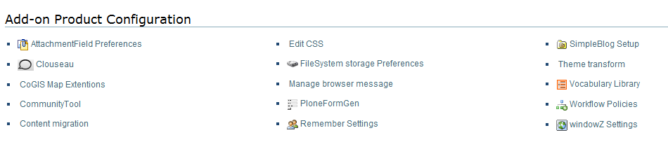
Original Map Viewer Product Interface – Access
http://data.saeon.ac.za/plone_control_panel
Task 1: Change the Name: Map Extension URLs

Slide 10
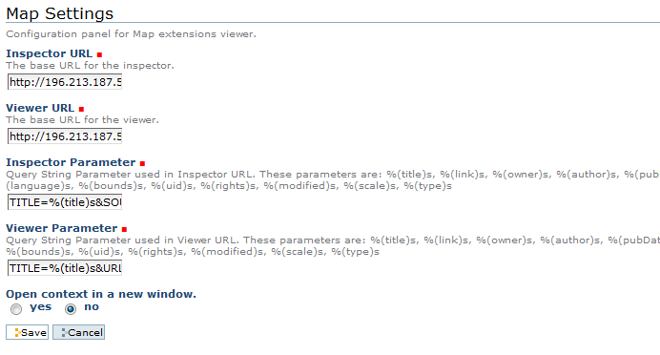
Map Viewer Product Interface – Configuration
http://geoportal.csir.co.za/@@map-settings
Task 2: Change to Online Resource Viewer
Task 3: Change to Map Viewer URL
Task 4: Add TOKEN as a query string parameter
Task 5: New Query String Parameter Set
Task 6: Add New URL Configuration for Map Creation
Same Query String Parameters as Task 5

Slide 11
Integration Points

Slide 12
1. Creation of a New Map
At any folder where users can create content:
  Add ‘Map’ to list of content types
  ‘Map’ is a content type based on WindowZ
It needs to take the following actions:
  Ask for a Title for the map
  Get the Plone object name for the new item.
  Create a URL for the new windowZ item as follows:
    http://196.213.187.51/PLATFORM_2/MAP/index.htm?MODE=SAVE_WMC&URL=[PLONE_NAME].xml&SHOW_CONTROL=hide&TOKEN=[USER_TOKEN]
  Then open this item in Plone as normal.

Slide 13
2. Upload data and see as a map
Specification to follow

