Slide 1

Map Viewer Integration
SRS 336.3.7.1
Wim Hugo, 9 June 2010

Slide 2
Map Viewer Product

Slide 3
Map Viewer Product Interface Elements
Specifies the following:
  Map Service Inspector
    URL (can include preset query string parameters)
    Query string parameter name
    Choice of value to be passed
      Current WMS
      Current WFS
  Map Service Previewer
    URL (can include preset query string parameters)
    Query string parameter name
    Choice of value to be passed
      Current WMS
  Default Web Context Document
    Obtain from an HTTP folder
    URL to folder is defined here.

Slide 4
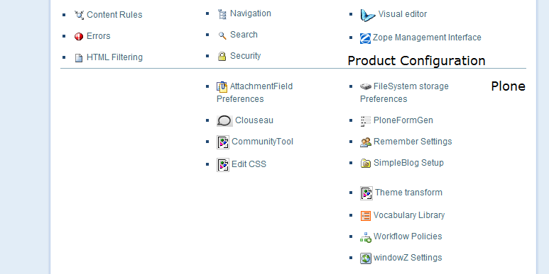
Map Viewer Product Interface – Access
http://data.saeon.ac.za/plone_control_panel
mapComponent Settings

Slide 5
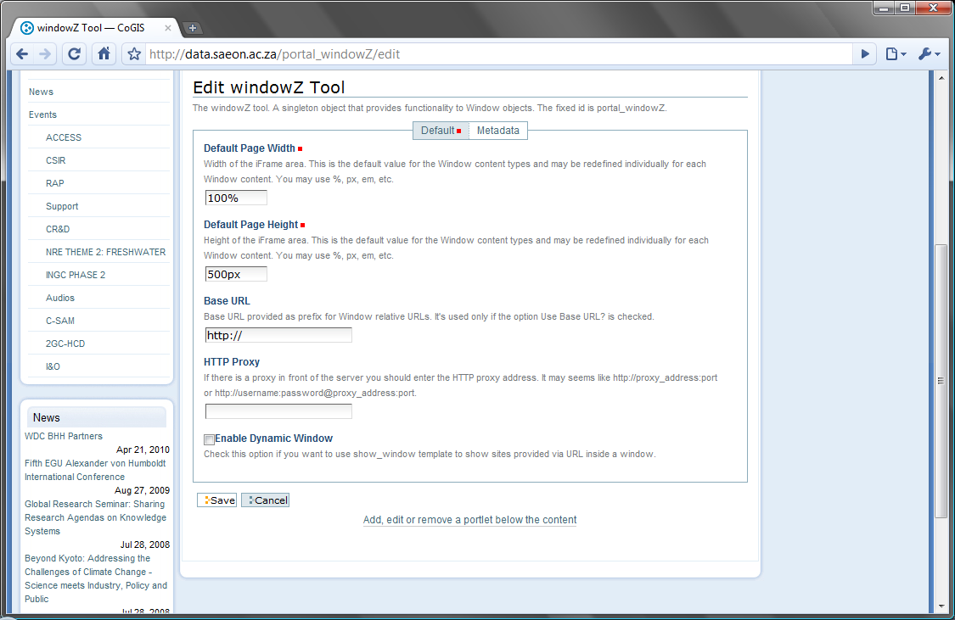

Map Viewer Product Interface – Configuration
http://data.saeon.ac.za/plone_control_panel
Edit mapComponents Tool
Provides functionality to a dynamically created WindowZ object or a map component in a new window
Location of component URLs
Provide a URL for the map service inspection tool, and for the map service preview tool. The URLs can contain query string parameters as required.
Inspector URL
Viewer URL
Configurable Query String Parameter
Provide a query string parameter that can be added to each of the component URLs
Inspector Parameter
Viewer Parameter
Source of Query String Parameter
Provide a query string parameter source that can be added to each of the component URLs
Inspector Source
Web Map Service
Viewer Source
Web Map Service
Default Web Context Document
Provide a source for Web Context Documents and select a default.
Web Context Source URL
Default
My WCD
Check this to open the component by default in a new window

Slide 6
Test Values
Inspector URL | http://www.swdev.co.za/saeon/qwms.htm
Viewer URL | http://www.swdev.co.za/saeon/index.htm
Inspector Parameter | WMS=
Viewer Parameter | URL
http://www.swdev.co.za/saeon/index.htm?
MODE=OPEN_WMS
&TITLE=SAEON%20WMS
&URL=http://146.64.101.6/ArcGIS/services/pop2007_meso/MapServer/WMSServer
&LAYER=bgis%3Abmr_conservancies_basic_jun06
&SET_BOUNDS=22.681274%2C-34.663711%2C25.339966%2C-32.589635
&SHOW_CONTROL=show

Slide 7
Integration Points

Slide 8
1. Creation of a New Map Viewer Instance
Add to ‘Add New Menu’: Map View
Following steps:
  Inspect configuration – obtain
    Viewer URL
    Default Web Map Context (URL and File Name)
  This is used as a parameter for the WindowZ product, constructing a URL as in the following example:
    <ViewerURL>?MODE=OPEN_WMC&URL=<URLandFileName>&SHOW_CONTROL=show

Slide 9
2. Preview a Map Server Facade Entry

Slide 10
3. Preview a Map Server Meta-Data Entry

