Slide 1

Map Viewer Integration
Wim Hugo

Slide 2
Architecture: Thin Client
Any Service, including Server-Side Analysis
“Map Viewer “ (TCL)
Analysis
Routines
Application
Interface
Web Processing
Services
Vector Data
Vector Data
Attribute Data
Attribute Data
Any Data, including CoGIS Repositories
Vector Data
Web Feature
Services
Documentation
Attribute Data
Web Map
Services
Predefined
Maps (WCD)
Public Map
Services (Google, …)

Slide 3
Architecture: Integrated Components
CoGIS Favourites (MYF)
“Map Viewer “ (TCL)
Predefined
Maps (WCD)
UploadXML
OpenLayers
Component
GetFavourites
CoGIS Web Map Services (IMS)
“Visualisation Page“ (SVS)
Vector Data
Web Map
Services
Internal List of Base Maps
“Component” Base Maps
Attribute Data
GetCapabilities
Internal List of Layers and Styles
External Web Map Services (WMS)
Vector Data
Internal List of Options
Web Map
Services
Attribute Data
GetCapabilities
Viewer URL
(TCL is default)

Slide 4
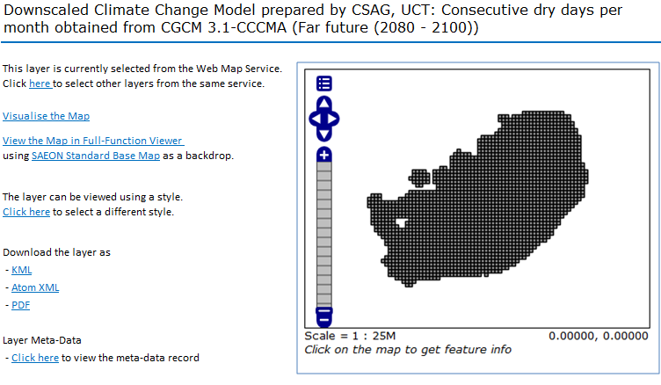
Page Layout

Slide 5
Commented Page Layout
Obtained as a title in Query String
GetCapabilities ‘OpenLayers’ format
GetCapabilities ‘OpenLayers’ format
Send Layer, Style, BB to TCL Component in new window
Using first entry in list of Base Maps (WCD’s)
Only if GetCapabilities has more than one style for the layer
Other formats allowed by GetCapabilities
Passed as Referrer in Query String

