Slide 1
Map Search Interface

Slide 2
Existing CoGIS Implementation

Slide 3
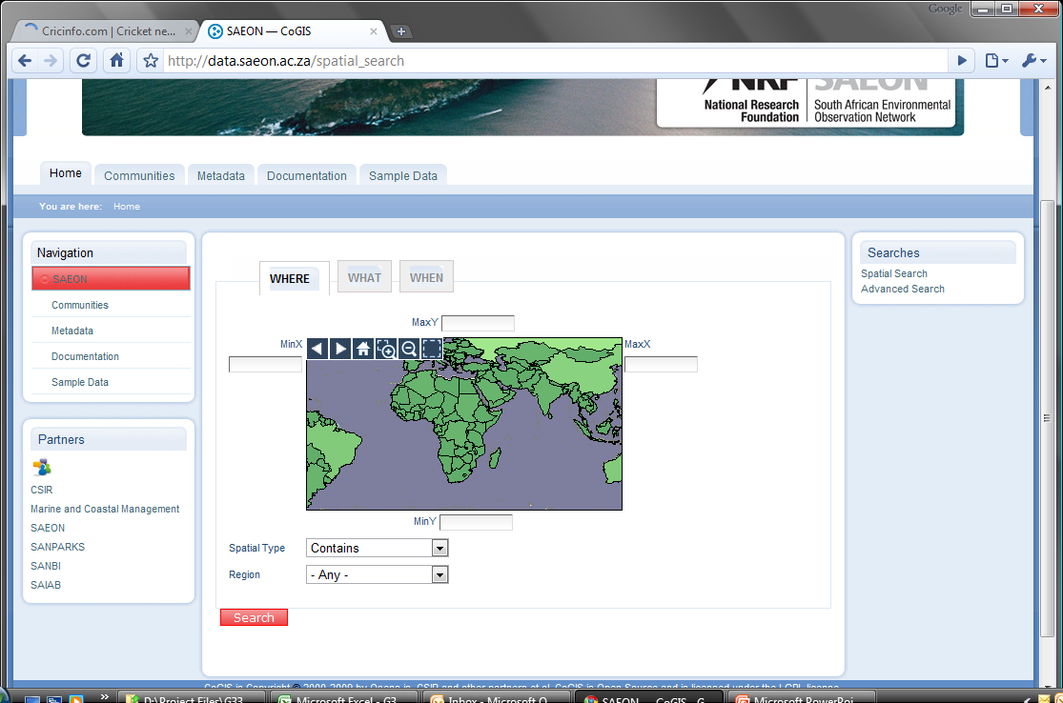
‘Where’
196.30.78.27

Slide 4
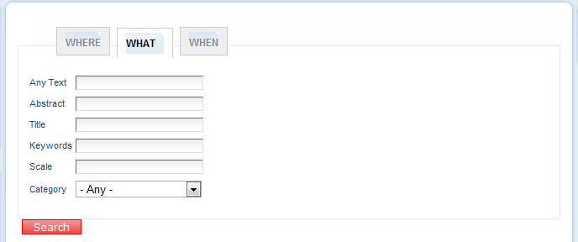
“What”

Slide 5
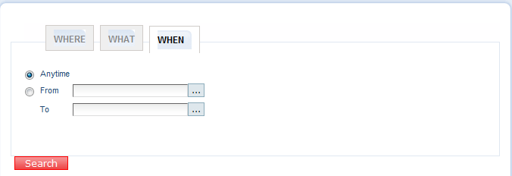
“When”

Slide 6
Map Interface Scpecification

Slide 7
Key Value Pairs
Number | Description | Interface Definition
1 | URL | http://<baseURL>/metadata_tool/GetRecords?
2 | ReturnType | &returntype=<1,2,3>
3 | AnyText | &anytext=<some text>
4 | Date Range* | &fromdate=yyyy-mm-dd
 |  | &todate=yyyy-mm-dd (default is always today’s date)
5 | Modified – PublicationDate | &modified= yyyy-mm-dd
6 | Title | &title=<some text>
7 | Abstract | &abstract=<some text>
8 | Subject | &subject=<some text>
9 | Extent (Spatial Bounds) | &extent=<MinX - West>%2C<MinY - South>%2C<MaxX - East>%2C<MaxY - North>
 | WestBoundLongitude | &WestBoundLongitude=LO
 | SouthBoundLatitude | &SouthBoundLatitude=LA
 | EastBoundLongitude | &EastBoundLongitude=LO
 | NorthBoundLatitude | &NorthBoundLatitude=LA
10 | Spatial Search Type* | &spatialtype=<Contains, Equals, Intersects, Touches, Within, Outside> (by default, if absent, equates to “Contains”.
11 | Taxonomic Coverage* | &eml_TaxonomicCoverageRankName=<Kingdom, Phylum, Genus, Species>
 |  | &eml_TaxonomicCoverageRankValue=<some text> a
 | a: Add to anytext

Slide 8
“Where”
Where
What
When
Simple map window with extent currently in main map window. Coordinates are populated can user can edit them.
(Key Value Pair 9)
Enumerated list
(Key Value Pair 10)
Enumerated list
(Key Value Pair 10)

Aggregate Non-Spatial Sources into a Single GeoRSS Layer

Slide 9
“What”
Where
What
When
(Key Value Pair 3)
Any Text
(Key Value Pair 6)
Title
(Key Value Pair 7)
Abstract
(Key Value Pair 8)
Subject (Keywords)
Taxon Rank
Kingdom
Enumerated List
(Key Value Pair 8)
Taxon Name
Note: Taxon Searches apply only to EML Records

Aggregate Non-Spatial Sources into a Single GeoRSS Layer

Slide 10
“What”
Where
What
When
Note: Searches a Date of Publication Range
Calendar Controls
(Key Value Pair 4)
(Key Value Pair 4)
After
Before

Aggregate Non-Spatial Sources into a Single GeoRSS Layer

