Slide 1
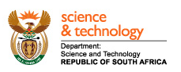

Systems Engineering
G336.3.5.2 Specification
SAEOS Site Layouts and User Interfaces

Slide 2
Site Map
Content
SAEOS Landing Page
Home
Partners & Stakeholders
Custodian Pages
Meta-Data Collections
Legal
Meta-Data Collections
Terms and Conditions, Licenses
Catalogues
Data Policy
Map-Based Visualisation
Tools
Disclaimer
Benefit Area
Search
Search
Static
Advanced Search
Login/ Registration
Spatial Search
Contact Particulars
Services
GEO-Compliant Services
CoGIS
Services

Slide 3
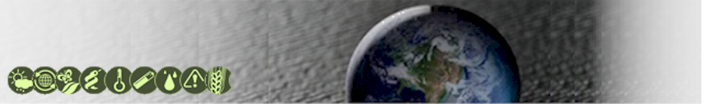
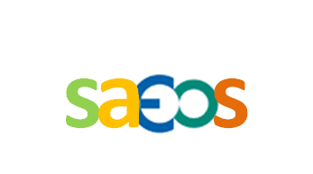


Banner
SOUTH AFRICAN EARTH
OBSERVATION STRATEGY
SOUTH AFRICAN EARTH
OBSERVATION STRATEGY

Slide 4
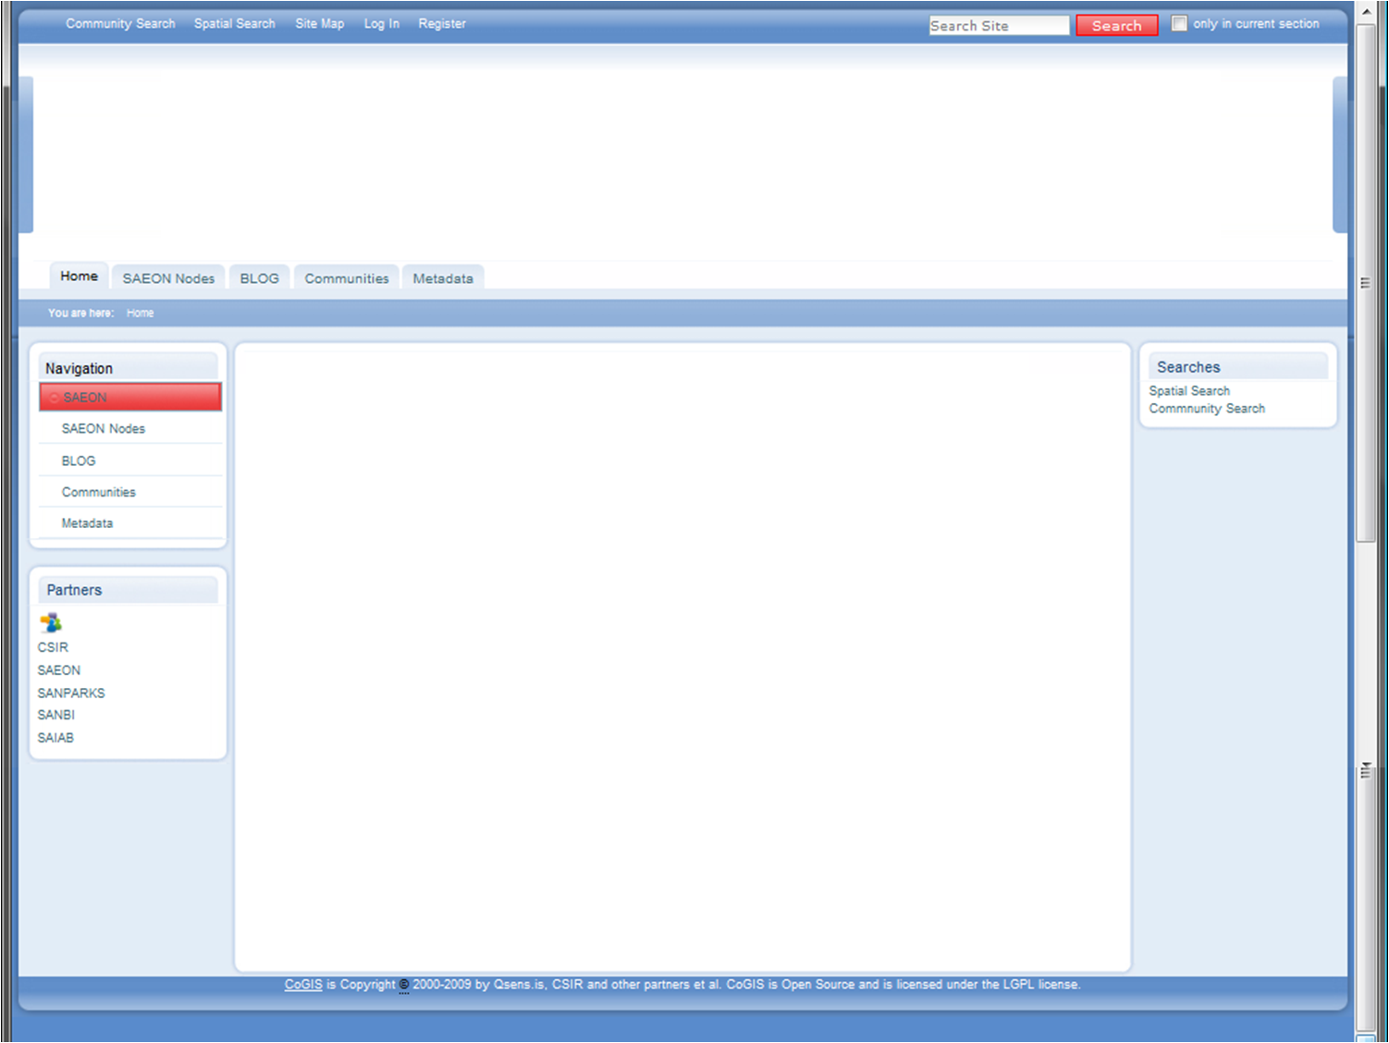
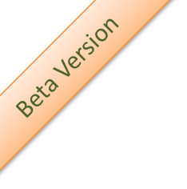
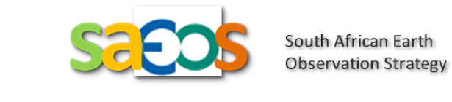

Home Page
SAEOS (The South African Earth Observation Strategy) directly supports the access to and visualization of data dealing with the societal benefit areas identified by GEO.
Through strong partnerships, and in collaboration with the South African Environmental Observation Network (SAEON), SAEOS provides both a sustainable technical platform and long-term data and preservation of such data.
The SAEOS Platform implements GEO recommendations for interoperability with other GEOSS components – opening up access to South African Earth and Environmental Data to researchers and decision-makers everywhere.
12451 Records from21 Partners

Slide 5
Home Page
SOUTH AFRICAN EARTH
OBSERVATION STRATEGY
SAEOS (The South African Earth Observation Strategy) directly supports the access to and visualization of data dealing with the societal benefit areas identified by GEO.
Through strong partnerships, and in collaboration with the South African Environmental Observation Network (SAEON), SAEOS provides both a sustainable technical platform and long-term data and preservation of such data.
The SAEOS Platform implements GEO recommendations for interoperability with other GEOSS components – opening up access to South African Earth and Environmental Data to researchers and decision-makers everywhere.
12451 Records from21 Partners

Slide 6
Home Page
SOUTH AFRICAN EARTH
OBSERVATION STRATEGY
SAEOS (The South African Earth Observation Strategy) directly supports the access to and visualization of data dealing with the societal benefit areas identified by GEO.
Through strong partnerships, and in collaboration with the South African Environmental Observation Network (SAEON), SAEOS provides both a sustainable technical platform and long-term data and preservation
The SAEOS Platform implements GEO recommendations for interoperability with other GEOSS components – opening up access to South African Earth and Environmental Data to researchers and decision-makers everywhere.
12451 Records from21 Partners

Slide 7
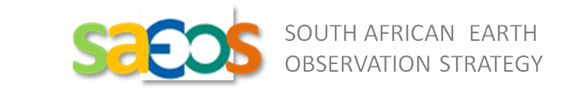


Detail: Home Page Tabs and Banner
Home
Partners
Search
Services
Documents

Slide 8


Portlet: Societal Benefit Area Searches
Societal Benefit Areas
Predefined Searches for Data On …
Disasters
Health
Energy
etc …

