Slide 1
Charting and Tabling Tools
G336.3.24.1 Consolidated Charts and Tables

Slide 2
Objectives
Multiple standardised data sources
Mash-ups of distributed data sources
Multiple presentation options
Persistence and embedding

Slide 3
Data Sources
SensorWeb
HDF 4/5 (Meraka/ WAMIS Time Series)
WFS
Special WFS
EcoGRID/ CSV

Slide 4
Mash-Ups
Need to link on
  Dimension
Non-Linked
  Shared independent variable
Assumptions
  Aggregation is already correctly done

Slide 5
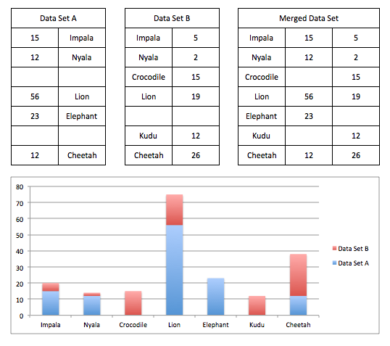
Linked – Shared Dimension

Slide 6
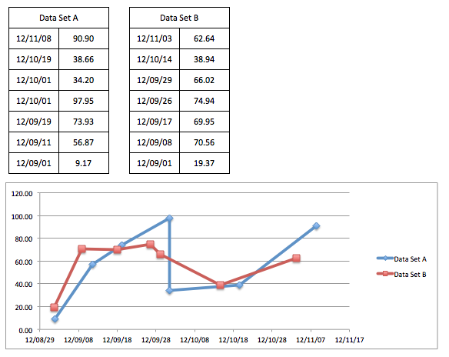
Independent Variables

Slide 7
Data Architecture
HDF-5
WAMIS
HDF-5-TS
Adapter
Any Other JSON?
Linker/ Selection
Other
HDF-5 ?
SensorWeb
JSON ?
PostGIS
Meta-Data
Standard WFS
Chart
Table
SAEON BigTable
‘Packaged’
WFS
Google
Analytics
EcoGRID/
CSV

Slide 8
Components
Google Charts
  https://developers.google.com/chart/interactive/docs/gallery
  https://developers.google.com/chart/interactive/docs/more_charts
EXT-JS Charts
  http://www.sencha.com/products/extjs/examples/#sample-3

Slide 9
Persistence
Store chart or table composition
Analogous to WMC documents

Slide 10
User Interfaces
Chart Component
  Similar to Map Component
  Allow search for data sources, same as for map component
While Searching
  Allow previews of recognised signatures

