Slide 1
Specification
G336.2.23.1 Revised Styling and Special Page Interfaces

Slide 2
Theme Pages

Slide 3
Folder Structure
Theme Page (page object)
  Always called “theme-page-xxx”
  Streamed as HTML from a service request
Theme Banner
  Always called “theme-banner-xxx”
Atlas Subfolders
Links Subfolders
Other Subfolders

Slide 4
Test URL
http://bea.dirisa.org/themes-1/potentials-and-yields

Slide 5
Simple Listing Pages

Slide 6
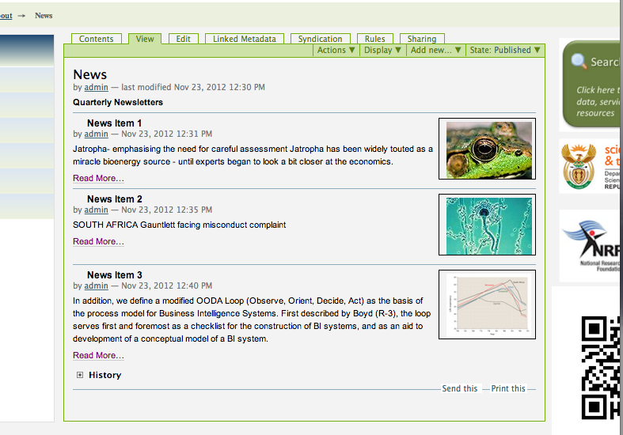
News Items
Test URL: http://bea.dirisa.org/about-bea/news

Slide 7
Typical Views
Simple Listing
Side-by-side listing
Slideshow listing
Filters:
  Author (not currently listed in JSON))
  Keywords (not currently listed in JSON)
    Allow multiple (i.e. KW1+KW2)
  Date (not currently listed in JSON)
    Allow after and between

Slide 8
Other Feeds
Element | Any | News | Link | Image
Author* |  | Yes | Yes | Yes
Title | Yes | Yes | Yes | Yes
Description | Yes | Yes | Yes | Yes
Link/ URL (Context Path) | Yes | Yes | Yes
Image URL |  | Yes |  | Yes
Keyword(s)* | (Yes) | (Yes) | (Yes) | (Yes)
* Not currently part of JSON interface

Slide 9
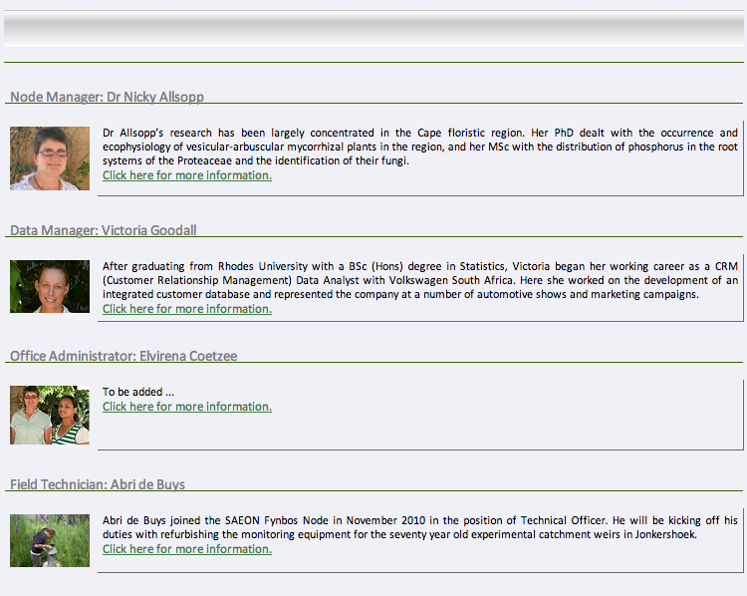
Simple Listing
Heading: Query String Parameter
Title
Description
Image
Link

Slide 10
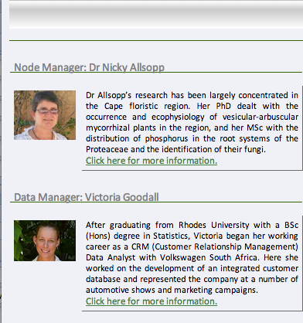

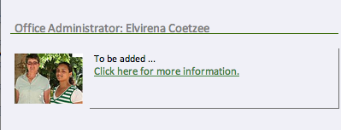
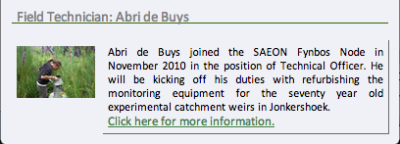
Side-by Side Listing

Slide 11


Slide Show View
Left and right only shows on mouse-over
Bottom is a placeholder for the array of slides
Transition:
  simple wipe with wipe duration and interval,
  Simple opacity switch with duration and interval
  Allow other transitions even if not implemented

Slide 12
CSS
Banner (Heading) backdrop (optional)
Background colour
Heading Font
Title Font
Text Font

