Slide 1
Specification
G336.2.23.1 Revised Styling and Special Page Interfaces

Slide 2
Simple Listing Pages
Part II

Slide 3
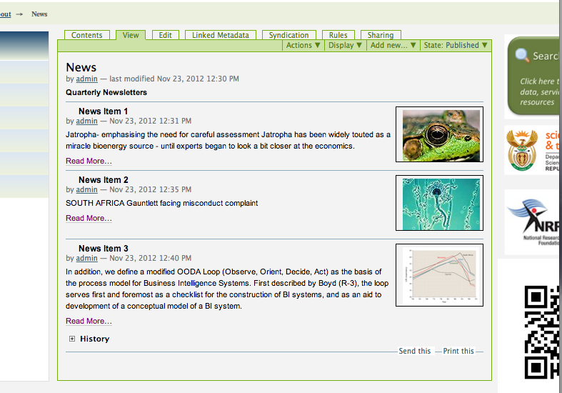
News Items
Test URL: http://bea.dirisa.org/about-bea/news

Slide 4
Typical Views
Simple Listing
Side-by-side listing
Slideshow listing
Filters:
  Author (not currently listed in JSON))
  Keywords (not currently listed in JSON)
    Allow multiple (i.e. KW1+KW2)
  Date (not currently listed in JSON)
    Allow after and between
  Toggle visibility at top of page

Slide 5
Other Feeds
Element | Any | News | Link | Image
Author* |  | Yes | Yes | Yes
Title | Yes | Yes | Yes | Yes
Description | Yes | Yes | Yes | Yes
Link/ URL (Context Path) | Yes | Yes | Yes
Image URL |  | Yes |  | Yes
Keyword(s)* | (Yes) | (Yes) | (Yes) | (Yes)
Date* | Yes | Yes | Yes | Yes
* Not currently part of JSON interface

Slide 6
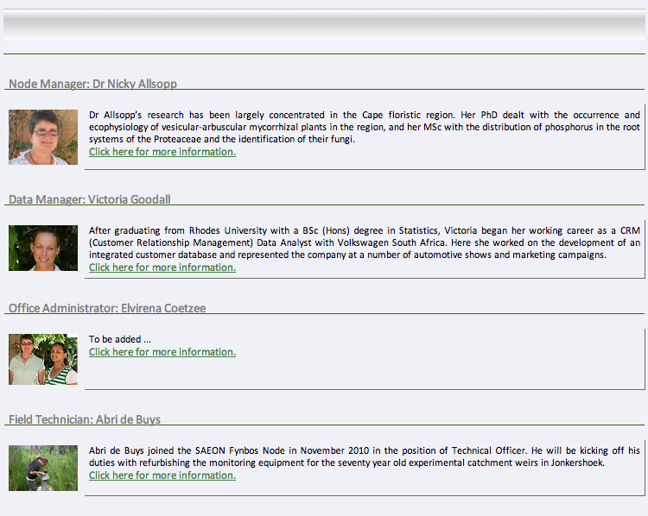
Simple Listing
Heading: Query String Parameter
Title
Description
Image
Link

Slide 7
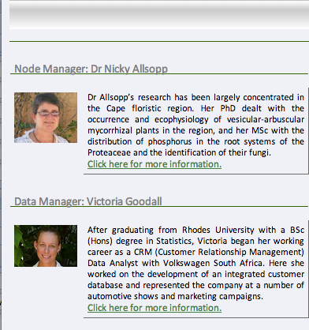

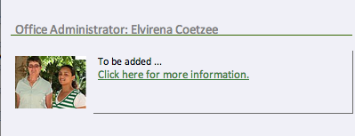
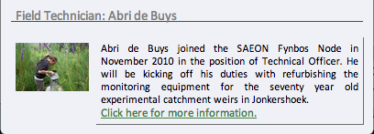
Side-by Side Listing

Slide 8


Slide Show View
Left and right only shows on mouse-over
Bottom is a placeholder for the array of slides
Transition:
  simple wipe with wipe duration and interval,
  Simple opacity switch with duration and interval
  Allow other transitions even if not implemented

Slide 9
CSS
Banner (Heading) backdrop (optional)
Background colour
Heading Font
Title Font
Text Font

