Slide 1
Portal Integration Interfaces
Review – URS IV
G336.3.22.2 Summary of Portal Integration Interfaces
September 2012

Slide 2
Portal Integration
Registration, Terms and Conditions
Map Creation
Data Upload and Map Creation
Atlas Creation
GeoRSS View
RSS View
Embedding a Map or WindowZ (Later)
Generalise other services
  Google Analytics Stream
  User Status/ Accounts

Slide 3
Registration Use Cases

Slide 4
Registration, Terms and Conditions, Downloads
Users are not required to register.
Some data sets (‘custodians’) have ‘Terms and Conditions’ associated with them.
On registration, users can elect to tick ‘Terms and Conditions’ for one or more custodians.
Data sets that require registration can only be downloaded if a user is registered and logged in.

Slide 5
Portal Services
Ask if Custodian has Terms and Conditions
  Request:
    <<portal_URL>>/getTerms?CUSTODIAN=<<some_text>>
    [&TOKEN=<some_text>]
  Return
    <getTerms>
    <custodian><<return_value>></custodian> (0: not found, 1: found)
    <terms><<return_value>></terms> (0: no terms, 1: terms; 2 ticked)
    <termText><<some_text>></termText>
    <session><<return_value>></session> (0: not logged in, 1: logged in)
    </getTerms>

Slide 6
Portal Services
Ticking Service
  Request
    <<portal_URL>>/tickTerms?CUSTODIAN=<<some_text>>
    [&TOKEN=<some_text>]
  Return
    <tickTerms><<some_value>></tickTerms> (0: error, 1: success)
Log-In in Background
  Request:
    <<portal_URL>>/logIn_form_noframe
  Return
    None

Slide 7
Decision Tree
0: Custodian does not have terms
  Download Buttons Available
1: Custodian has terms
  0: Not Logged In
    Call Login Service in background
      0: Not Registered or Registration Call:
        Registration Page in Portal
      1: Login success
        Reload Page
    Go to next check
  1: Logged in not ticked
    Show Terms and Conditions for viewing
    Call ‘Ticking’ Service in background
    Download Buttons Available
  2: Logged in and ticked
    Download Buttons available

Slide 8
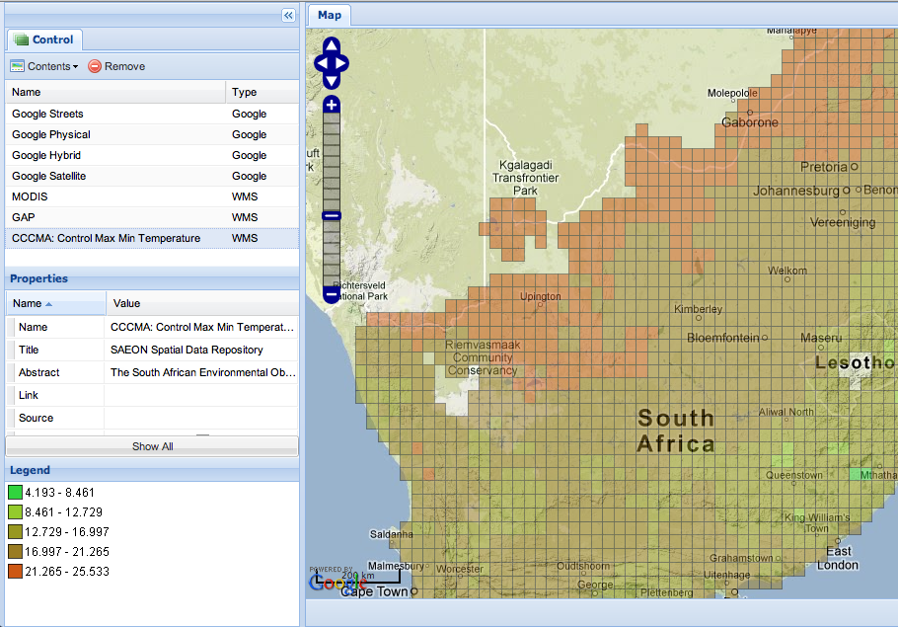

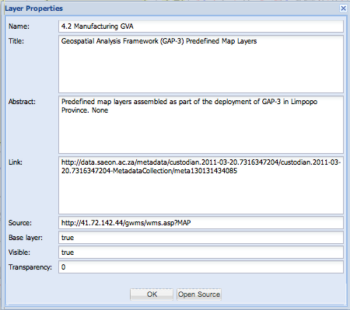
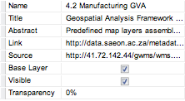
Main Map Window Layout: Registration and Download Interface
Legend
Citation
Not Editable
Not Editable
Remove
Remove
Tick Box
Tick Box
Dropdown
Registered User
Download Layer
Full Meta-Data
Edit
Download Layer
Full Meta-Data
Registered User
Logged In
This data download requires registration.
Click here to register

Slide 9
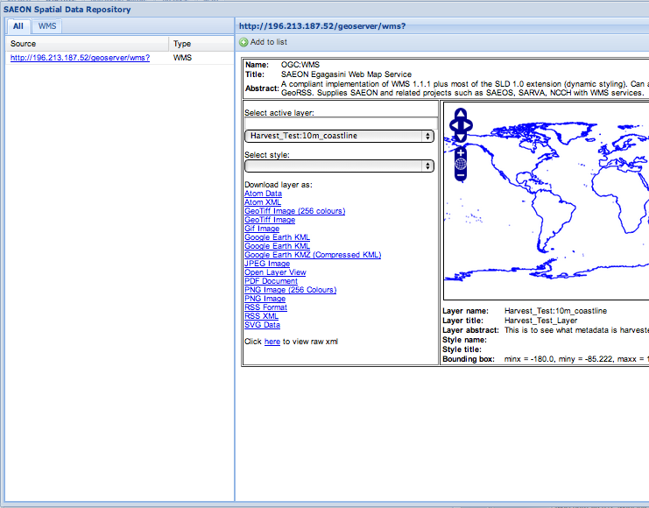
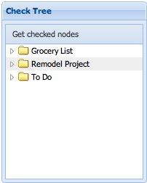
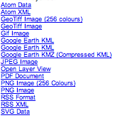
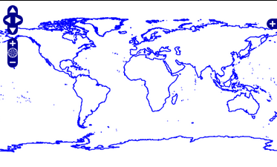

Main Map Window Layout: 3 - Control
Legend
Citation
Add to Map
Download Data
Available Resources
Registered User
Web Page
OGC Services
Downloadable Files
ALSO:
SOS
NetCDF
KML
Etc.
ADDITION:
Nested Search
Registered User
Edit
Download Layer
Full Meta-Data
Registered User
Logged In
This data download requires registration.
Click here to register

Slide 10
Map Creation

Slide 11
Event Sequence
Map creation is defined in site setup (WebTide - done)
Added to ‘Add Item’ menu (WebTide - done)
Open a URL based on setup and title supplied by user (WebTide – done)
URL saves empty WMC (Softwave – done)
User (optionally) updates WMC
WindowZ object has slight change from initial URL (WebTide/ Softwave – correction needed)
Optional Refinement: List of WMCs to be used as a basemap
Webtide: change product setup from ‘CoGIS Map Extentions’
To
‘Map Extensions’

Slide 12
Interfaces
To create a new WMC based on a title of a WindowZ object created in the portal:
Map Creation URL – navigate to this page
  http://app01.saen.ac.za/saeon/index.htm
  Construct parameters
    User Supplies a Title: <<title>>
    User has a Token: <<token>>
  <<MapCreationURL>>
  ?MODE=SAVE_WMC (Create if not exists, open if exists – Softwave)
  &URL=<<title>>
  &TOKEN=<<token>>
  &SHOW_CONTROL=hide
Map Open URL – STORE this page with WindowZ (Webtide to Fix)
  http://app01.saen.ac.za/saeon/index.htm
  Construct parameters
    User Supplies a Title: <<title>>
    User has a Token: <<token>>
  <<MapCreationURL>>
  ?MODE=OPEN_WMC
  &URL=<<title>>
  &TOKEN=<<token>>
  &SHOW_CONTROL=show
  Refinements (Softwave)
    currently opens on search - yes
    populate search with mappable items (WMS, WFS, KML, SOS, etc.)

Slide 13
Data Upload and Map Creation
Deferred

Slide 14
Atlas Creation

Slide 15
Atlas Creation
New Item Type: WindowZ Object Called ‘Atlas’ (WebTide)
Add to ‘Map Extensions’ as Atlas URL (WebTide)
Only available if folder contains 1 or more Maps (WebTide)
Atlas Creation URL – navigate to this page
  http://app01.saen.ac.za/saeon/atlas.htm
  Construct parameters
    User Supplies a Title: <<title>>
    Current Folder has new MapRSS Method and URL (WebTide – see overleaf)
  <<AtlasCreationURL>>
  ?MODE=OPEN_RSS
  &URL=<<current_portal_folder_URL>>/@@MapRSS (WebTide – see overleaf)
  &TITLE=<<title>>
  &MENU=true
  Refinements:
    After creating WindowZ Object, make it the default view for the folder

Slide 16
MapRSS Method
Use Syndication Method in Plone
  Will be re-used for other purposes too. In this case, process WindowZ items.
  MapRSS Elements:
    <title>: WindowZ Title
    <link>: WindowZ attribute URL
    <description>: WindowZ Description
    <k eywords>: WindowZ keywords (Plone categorisation)

Slide 17
RSS Method
Use Syndication Method in Plone
  In this case, process WindowZ items, Links, Images, News Items.
  MapRSS Elements:
    <title>: WindowZ Title
    <link>: WindowZ URL
    <description>: WindowZ Description
    <k eywords>: WindowZ keywords (Plone categorisation)

Slide 18
Atlas Component
Accepts RSS or GeoRSS as input.
Keywords: First Tier of Menu System (unless too many) – see below
Titles: Second Tier of Menu System
Titles can be repeated in more than one parent keyword
Link: Open in <iframe> linked to menu entries
Too many keywords, entries, or MENU=false
  Force Simple RSS Listing
  Show thumbnail if image link exists.
  Keyword filtering in place.
  Open target in a tab

Slide 19
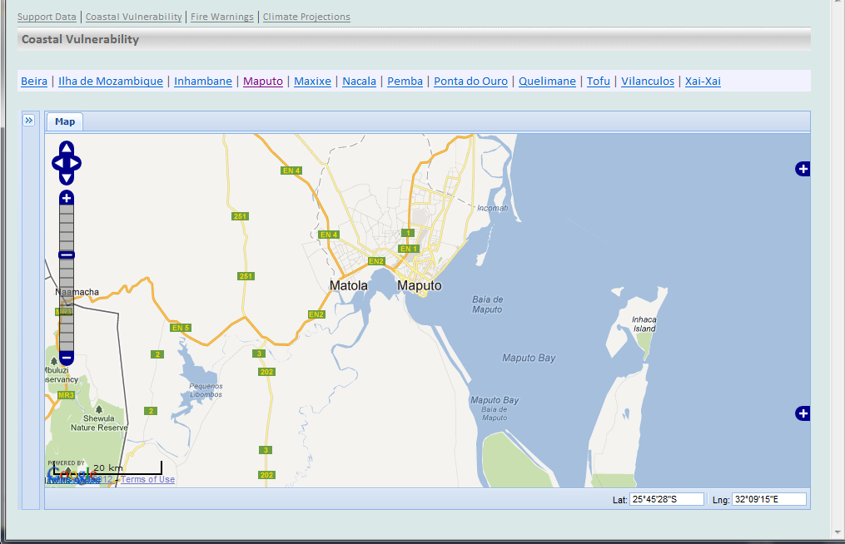
Atlas View (MENU=TRUE)
Keywords
Use Drop-Down Menu
Titles
Link URL

Slide 20
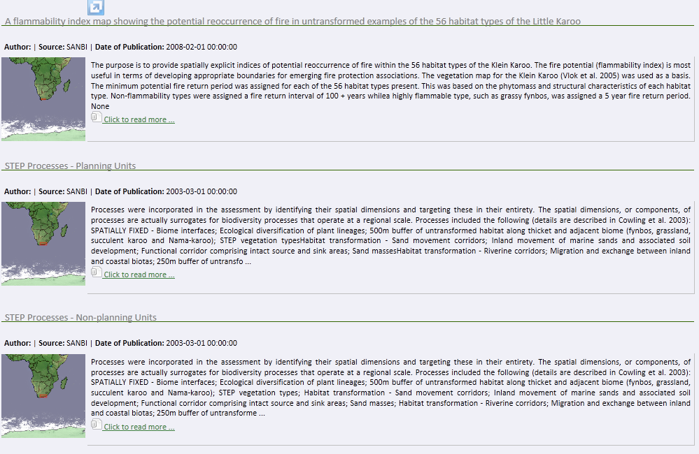
Atlas View (MENU=FALSE)
Keyword
Keywords

Slide 21
GeoRSS Viewer

Slide 22
GeoRSS Viewer
New Item Type: WindowZ Object Called ‘GeoRSS Viewer’ (WebTide)
Uses ‘Map Extensions’ Map Creation URL (WebTide)
Available if folder contains 1 or more GeoTagged Images (WebTide)
Viewer Creation URL – navigate to this page
  http://app01.saen.ac.za/saeon/index.htm
  Construct parameters
    User Supplies a Title: <<title>>
    Current Folder has GeoRSS Method and URL (WebTide – exists)
  <<MapCreationURL>>
  ?MODE=OPEN_RSS
  &URL=<<current_portal_folder_URL>>/@@GeoRSS (WebTide – exists)
  &TITLE=<<title>>
  Refinements:
    After creating WindowZ Object, make it the default view for the folder
    Figure out or ask for a bounding box
Example:
http://ingc.dirisa.org/ingc/repository/image-test/folder-view-as-map

Slide 23
Embedding a Map or a WindowZ

Slide 24
Main Map Window Layout: 3 – Control (Embed)
Legend
Citation
Copy the HTML below to embed the map into your application.
Frameless Map:
Full-Frame Map with Controls:
Full-Frame Map without Controls:
Legend:
Add citation
Add link to Full-Screen Map
<div><iframe>MAP URL</iframe></div>
<div>link to full map in new window</div>
<div>citation</div>
<div><iframe>MAP URL</iframe></div>
…
<div><iframe>MAP URL</iframe></div>
…
Registered User
Edit
Full Meta-Data
<div><iframe>COMPOSITE LEGEND URL</iframe></div>
…
Download Layer
Registered User
Some data downloads require registration.
Click here to register
Embed this map

Slide 25
User Lists and Usage Statistics

Slide 26
Google Analytics
Call
  Google Reporting API – incremental harvest
    Start date: last date in database
    End date: today’s date
Response
  JSON, containing above elements
DB:
  Add Harvest URL and date of harvest
  Output to existing Google charting/ tabling toolset from views
  APP01 server: add to Google Analytics -

Slide 27
User Analysis
User Name (Portal-supplied)
Full Name (Portal-supplied)
Date of First Activity
Date of Last Activity
E-mail address (Portal-supplied)
Group (Portal-supplied)
Location
Domain (Portal-supplied)
Organisation (Portal-supplied)
Page Hits
Searches
Downloads

Slide 28
Citation
Elements (as received in Search Result):
  Author
  Date of Publication
  Title
  Publisher (Custodian)
  URL
Citation Format (note punctuation):
<<Author>> (<<Year of Publication>>). <<Title>>. <<Custodian>>, <<Publication Date Month and Year>>. <<URL>>. Retrieved on <<Date of adding to WCD>>
Stephen Yoder (2008). The APSA Guide to Writing and Publishing and Style Manual for Political Science. APSA, August 2006. http://www.someurl.com . Retrieved on 2009-02-05
Concatenate for each element in the map.

