Slide 1

Web Processing Services
Wim Hugo
G2336.3.19.2
14 Dec 2011

Slide 2
Use Case - Overview
A web processing service will be established that is capable of calculating interactions through a network. This service can be used to perform supply and/or demand-constrained allocation problems, for example calculating the supply and demand-constrained interactions between rural settlements and firewood sources.
The web processing service requires the following inputs:
  An estimate of the spatial distribution (and possibly income levels) of rural populations in a study area.
  An estimate of the availability of woody biomass in a study area.
  A network for linking supply and demand.
A second processing service may be required to supply a ‘virtual’ network in cases where one does not exist. For iteration 1, it is assumed that a suitable network can be found.

Slide 3
Use Case - Discovery
The web processing service requires suitable inputs to be found through discovery. In this iteration, we will aim to:
  Find a suitable population distribution layer by searching the SAEOS repository;
  Likewise, find a suitable network in the SAEOS repository;
  Extend the search through the EuroGEOSS broker to find a woody biomass distribution.
These searches are constrained by time and location: inputs have to overlap temporally and spatially to be suitable.

Slide 4
Use Case – Algorithm (Service)
The web processing service contains an algorithm that accomplishes two things:
  It calculates proxies for supply and demand from population and biomass data. These can be simple in Iteration 1 (percentages of the raw data), but in future iterations can it be complex, and invoke additional services to determine a proxy value.
It calculates a catchment area for each settlement, based on supply and demand constraints, as well as a travel time constraint (a time budget per household for gathering of firewood). This is a classic network allocation problem.

Slide 5
Use Case - Mediation
Parameters for the processing need to be set, and this can be seen as a mediation of sorts. In this step, values determined from each input source through GetCapabilities requests need to be mapped to the parameters required by the process.

Slide 6
Use Case - Result
The result is a new data set, available as a standards-based service, with an appropriate, automatically generated meta-data record lodged in the SAEOS meta-data repository.
By extension, the result and the service itself are also discoverable through the EuroGEOSS broker.

Slide 7
Process Flow
Search for Service
Service GUI
User Information
For n parameters
Parameter n:
Demand
Search for Data
Parameter n:
Mediate
(WFS)
GetCapabilities
Calculate
Publish Meta-Data
Publish WFS

Slide 8
Components
Web Processing Service and its Meta-Data
Web Processing Service GUI
  Parameter Provision
  Link to Discovery Service
  Link to ‘Instance’ Meta-Data
Discovery Service
  KVP – Dublin Core, Atom/JSON or GeoRSS
  EuroGEOSS Broker – CS/W KVP – Dublin Core?
Mediation Service
  Match WFS GetCapabilities information to Parameters

Slide 9
Test Data
Demand:
  CSIR StepSA Rural Settlements
    Population
    GVA per person
  EuroGEOSS NDVI or similar
  Network
    Simple ‘walkabout’ network
    Walkabout with constraints (topography, etc.)

Slide 10
Parameters: Simple Case
Demand:
  Location of demand
  Population Count (Primary Demand Variable)
  Income Level (Filter)
  Demand Factor (Function, but % for now))
Supply
  Location of Supply
  Woody Biomass Value
  Supply Factor (Function, but % for now)
Constraints
  Travel time
  Supply cannot be exceeded
Network

Slide 11
Questions
CS/W Accepted by EuroGEOSS Broker:
  Key Value Pairs for Filtering
  GetCapabilities Service
  GetRecords Service
  GetRecordById Service
  Dublin Core Return

Slide 12
Proposed Milestones
By 21 November 2011
  Basic Processing Service can be Tested
  EuroGEOSS Data Set Identified
  SAEOS Data Sets Identified
End November 2011:
  Iteration 1
    Test Data
    Demonstrable
Mid-January 2012
  Iteration 2
    EuroGEOSS Broker Integration Test
End February 2012
  Iteration 3
    Any Data
    Live Release
    Links SAEOS to EuroGEOSS Broker Operationally
    SAEOS CS/W Registered as GEO Component
    Service Registered as GEO Component

Slide 13
Resources
http://webhelp.esri.com/geoportal_extension/9.3.1/index.htm#geoportal_csw_cmpnts.htm
http://www.ogcnetwork.net/node/630

Slide 14
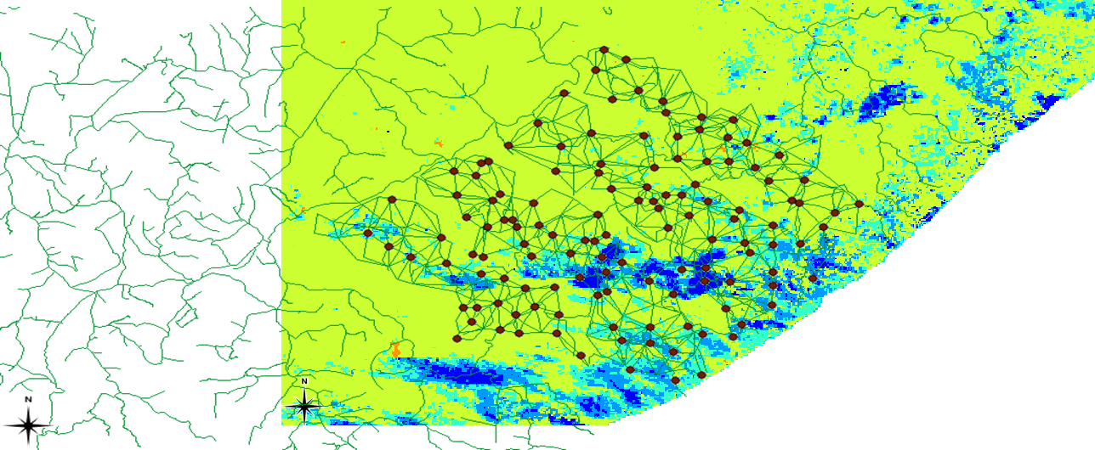

Slide 15
Outline of Steps
Each Web Processing Service has an interface URL
The interface URL is composed of services:
  GetCapabilities
  DescribeProcess
  Execute
.NET Source Code for a generic web processing service is available

