Slide 1

SAEOS CS/W Layer and Adapter
SRS 336.3.15.1
Wim Hugo, November 2011

Slide 2
PostGIS implementation:
  196.213.187.51
    See PostGres (password = postgres)
    GeoNetwork database
    Public Schema
    MetaData table
Shared Platform Services:
  http://data.saeon.ac.za/GetRecords?help=yes

Slide 3
Current Arrangement
Shared Platform implements a search service against its meta-data repository, which is based on a Zope-DB file object database.
Future implementations will be database driven, probably using the GeoNetwork PostGIS implementation as a pattern.
To build an interim solution, we will be simulating the PostGIS schema as a fully resolved view.

Slide 4
Mandatory CS/W Methods
Use SAEON GeoNetwork as example
http://www.saeonocean.co.za/geonetwork/srv/en/test.csw
  Username: admin
  Password: s0sten1ble
Mandatory (Preferred/ Secondary):
  GetCapabilities (GET, POST)
  DescribeRecord (GET, POST)
  GetRecords (POST, GET)
  GetRecordByID (GET, POST)

Slide 5
Mappings

Slide 6
Interface Amendments

Slide 7
Test Interface
http://196.213.187.51/PLATFORM_2/MAP/csw_query.asp
Amendments: As per spreadsheet

Slide 8
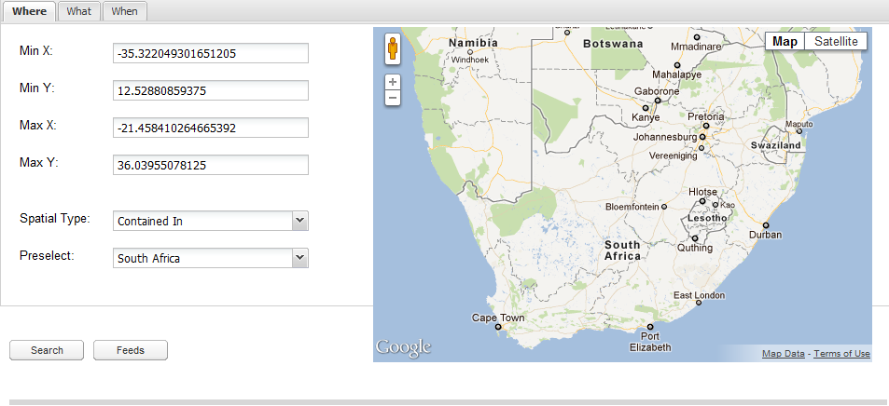
‘Live’ Interface
Amendments: Operates in two modes:
‘Normal’ (points to data.saeon.ac.za/GetRecords)
‘CS/W’ (points to any csw url)
http://196.213.187.51/PLATFORM/MAP/search_a_portal.htm

Slide 9
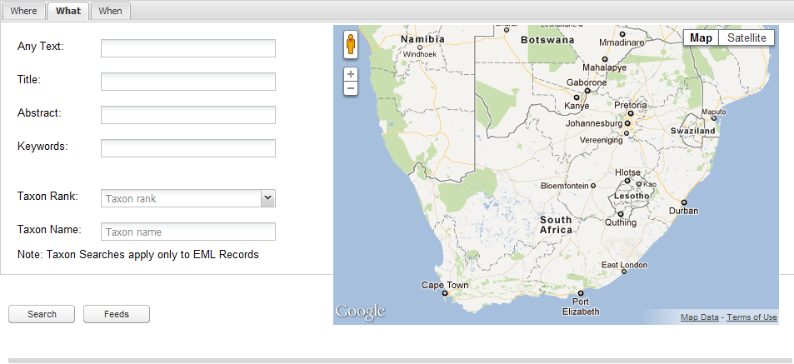
‘Live’ Interface
Amendments:
Add fields for CS/W mode: Language, Contributor, Publisher, etc.
Remove fields for CS/W mode: Taxon Rank and Taxon Name

Slide 10
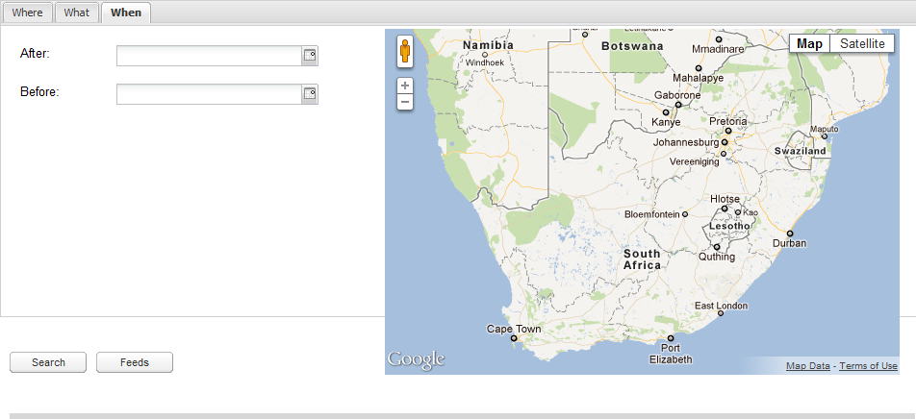
‘Live’ Interface
Amendments:
Add radio buttons for ‘Date of Publication’ or ‘Date of Last Modification’

