Slide 1

SAEON Data Portal Revision
Single Meta-Data View
SRS 336.3.14.6
Wim Hugo, November 2011

Slide 2
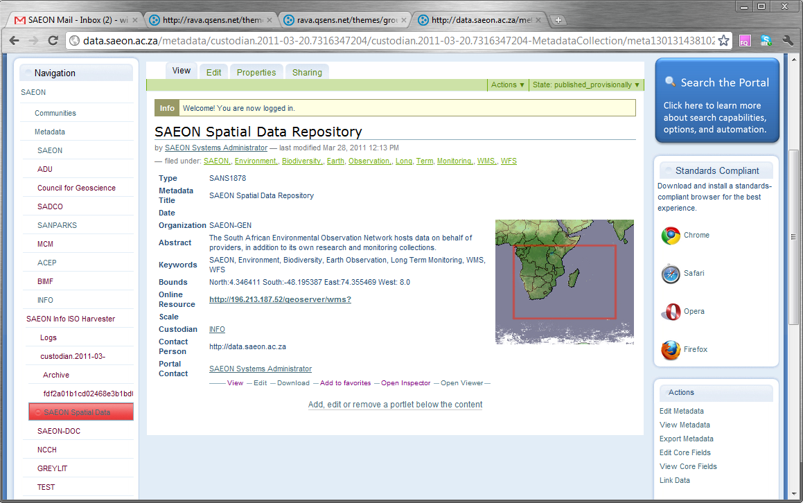
Current Layout

Slide 3
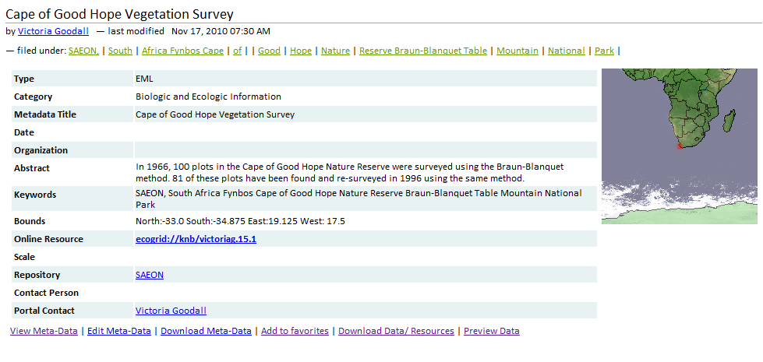
Revised Layout
Proposing alternating background row colour s to make the information more readable

Slide 4
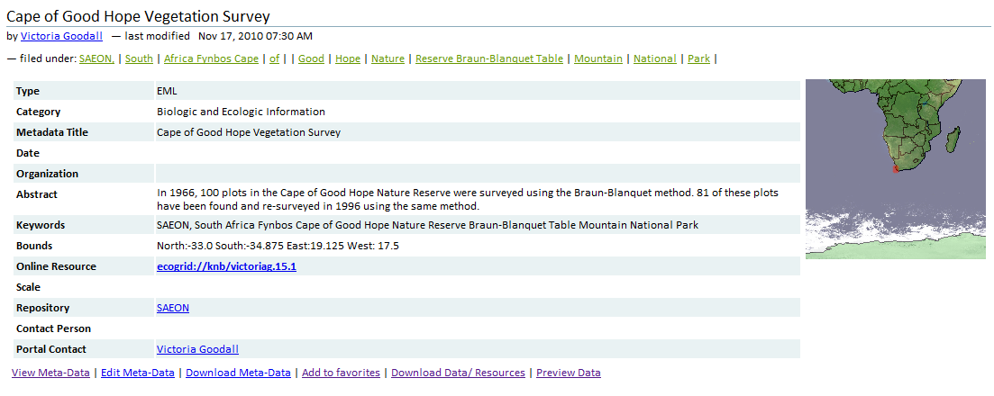
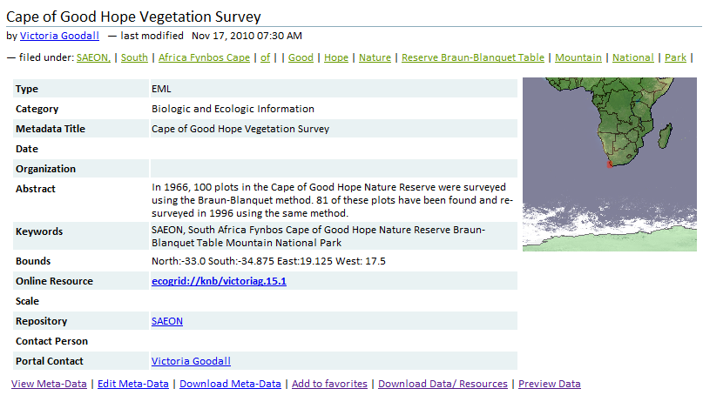
Resizable to 100% of Frame Width
Make sure that the table and accompanying thumbnail resize properly in all mainstream browsers .

Slide 5
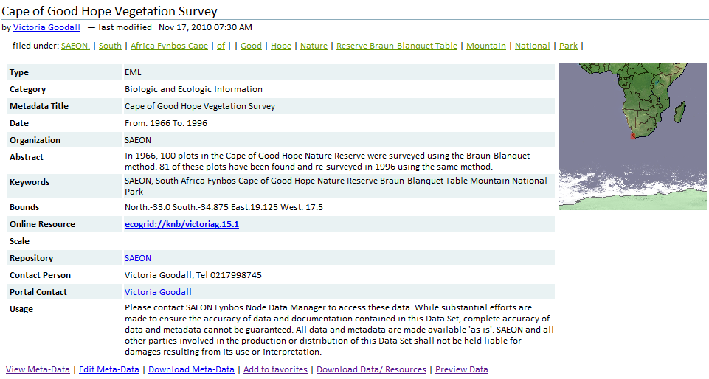
Changes
4
6
7
8
2
5
1
9
3
There are changes to the layout in 9 places

Slide 6
Changes
Changes to styling – see accompanying HTML and style sheet, sample page.
‘Custodian’ changes to ‘Repository’ (Done already)
All functions are redeployed as tab and menu entries – see detailed specification.
Changes to keyword styles and process
Changes to ‘Contact Person’ element.
Changes to ‘Organisation’ element.
Changes to ‘Date’ element.
Make it a label
Add the element ‘intellectualRights’ in the ‘Usage’ row.
Sample Page:
http://196.213.187.51/PLATFORM/PORTAL/sample_single_metadata_view.htm

Slide 7
Improved Keyword Processing
Keywords in XML File
keyword: SAEON, South Africa
keyword: Fynbos
keyword: Cape of Good Hope Nature Reserve
keyword: Braun-Blanquet
keyword: Table Mountain National Park
http://saeon.qsens.net/metadata/custodian.2009-05-26.0776892451/custodian.2009-05-26.0776892451-MetadataCollection/metadata.2010-07-08.4010835173/view_metadata
How Keywords are Currently Parsed – clearly not workable or correct
SAEON,, South, Africa Fynbos Cape, of, Good, Hope, Nature, Reserve Braun-Blanquet Table, Mountain, National, Park
Proposal
Read keyword elements into an array (EML), replacing each comma (,) and each semi-colon (;) with an unambiguous delimiter (such as # or | ) in each entry.
Check for duplicate array entries
Concatenate array entries, using the same delimiter (# or | )
Recreate array by splitting on new delimiter (# or | )
This array is used to create HTML output.

Slide 8
Keywords: Stepwise
1. Replace commas and semicolons with #
keyword: SAEON#South Africa
keyword: Fynbos
keyword: Cape of Good Hope Nature Reserve
keyword: Braun-Blanquet
keyword: Table Mountain National Park
2. Concatenate and delimit with #
SAEON#South Africa#Fynbos#Cape of Good Hope Nature Reserve #Braun-Blanquet#Table Mountain National Park
3. Split into New Array
SAEON
South Africa
Fynbos
Cape of Good Hope Nature Reserve
Braun-Blanquet
Table Mountain National Park

Slide 9
Changes to ‘Contact Person’:
In EML, read the contents of ‘Associated Party’ where role = ‘custodian/ steward’ and concatenate the following elements:
  individualName
    givenName + “ “ +surName
    Phone
    electronicMailAddress
Expand on other possibilities

Slide 10
Changes to ‘Organisation’:
In EML, read the contents of ‘Creator’ and use the organizationName if it is specified.
else, read the contents of ‘Associated Party’ where role = ‘custodian/ steward’ and use the organizationName element.

Slide 11
Changes to ‘Date’:
In EML, read the contents of ‘temporalCoverage’ and do the following:
  If one date element (singleDateTime) is present, show the value only (YYYY/MM/DD).
  If two date elements are present, parse it as ‘From: YYYY/MM/DD To: YYYY/MM/DD’

Slide 12
Changes to Actions and Methods
Function/ (New Function) | Description | Method Name | Current Location | New Location | Visibility
‘View’ (Summary) | Means ‘View the Default Rendering of a Meta-Data Record’. Slides 2-4 show this view. | /view | Tabs (1) | Tabs (1) | All
‘View’ (Detail) | Means ‘View Full Meta-Data Record’. This displays the full meta-data record and not only the common elements in the main page. Cannot have the same name as ‘View’ in the tabs . | /view_metadata | Links below meta-data page (1) | Tabs (2) | All
“View MetaData” REMOVE | Duplicates the above | /view_metadata | Actions Portlet (2) | REMOVE | All
‘Edit’ (Edit Item) | Means ‘Edit the Object Entry (Content Type Entry) in Plone’. Same screen (almost?) as ‘New Meta-Data’ in meta-data collection. | /edit | Tabs (2) | Tabs (3) | Owner Administrator
‘Edit’ REMOVE | Means ‘Edit the Full Meta-Data Record’. Cannot have the same name as ‘Edit’ in the tabs. | /edit_metadata | Links below meta-data page (2) | REMOVE (Keep Method) | Owner Administrator
“Edit MetaData” REMOVE | Duplicates the above | /edit_metadata | Actions Portlet (1) | REMOVE | Owner Administrator
‘Properties’ REMOVE | Applies to all Plone content items. Not used. | /properties | Tabs (3) | REMOVE | Owner Administrator
‘Sharing’ (Sharing) | Applies to all Plone content items. | /@@sharing | Tabs (4) | Tabs (4) | Owner Administrator
‘Download’ (Download This) | Downloads the full XML Meta-data file. | /downloadXML | Links below meta-data page (3) | Links (1) | All
“Export MetaData” (Mail This) | Allows sending XML document by e-mail | /export_metadata | Actions Portlet (3) | Links (2) | Logged In User
“Edit Core Fields” (Edit Meta-Data) | Means “Edit the elements that are shared between the various metadata standards.” | /generic_corefields_editor | Actions Portlet (4) | Tabs (5) | Owner Administrator
“View Core Fields” REMOVE | Means “View the elements that are shared between the various metadata standards.” | /generic_corefields_view | Actions Portlet (5) | REMOVE | All
Link Data (Linked Content) | Means ‘Link this Meta-Data Record to a Portal Content Item” OR “Show it if it has already been linked”. | /linkData | Actions Portlet (6) | Tabs (6) | Owner Administrator
“Open Inspector” (Online Resources) | Means “Analyse the Online Resource(s) element and suggest actions to the user”. External page with KVP interface. | /@@embedded-map-window? | Links below meta-data page (4) | Tabs (7) | All
“Open Viewer” REMOVE | Means “Open the Online Resource(s) element in an appropriate embedded viewer”. External page with KVP interface. | /@@embedded-map-window? | Links below meta-data page (5) | REMOVE Keep Method | All

Slide 13
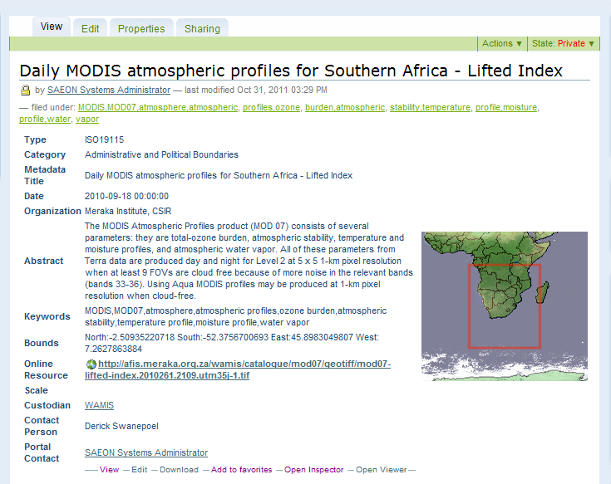
Proposed Changes – Actions and Methods Layout
Item
Edit MetaData
Linked Data
Resources
--------------------------------------- Download This| e-Mail This ------------------------------------

Slide 14
Additional Refinement
If linked content (i.e. ‘Online Resource) is
  1 element only
  A portal content item and not an external URL
  Then ‘Resources’ tab is inactive.
  ‘Linked Data’ tab shows

Slide 15
Intellectual/ Usage Rights: ISO 19115
<gmd:resourceConstraints>
<gmd:MD_LegalConstraints>
<gmd:accessConstraints>
<gmd:MD_RestrictionCode codeListValue="copyright" codeList="http://www.isotc211.org/2005/resources/codeList.xml#MD_RestrictionCode" />
</gmd:accessConstraints>
<gmd:useConstraints>
<gmd:MD_RestrictionCode codeListValue="copyright" codeList="http://www.isotc211.org/2005/resources/codeList.xml#MD_RestrictionCode" />
</gmd:useConstraints>
<gmd:otherConstraints>
<gco:CharacterString>xx</gco:CharacterString>
</gmd:otherConstraints>
</gmd:MD_LegalConstraints>
</gmd:resourceConstraints>
Display String: Concatenate values of Access Constraints, Use Constraints, and Legal Constraints.
Note that there may be more than one entry for each of the elements.

Slide 16
Intellectual/ Usage Rights: SANS 1878
<gmd:resourceConstraints>
<gmd:MD_LegalConstraints>
<gmd:accessConstraints>
<gmd:MD_RestrictionCode codeListValue='copyright' codeList='http://www.isotc211.org/2005/resources/codeList.xml#MD_RestrictionCode' />
</gmd:accessConstraints>
<gmd:useConstraints>
<gmd:MD_RestrictionCode codeListValue='copyright' codeList='http://www.isotc211.org/2005/resources/codeList.xml#MD_RestrictionCode' />
</gmd:useConstraints>
<gmd:otherConstraints>
<gco:CharacterString>Publicly available, copyright vests with SADCO. SADCO must be acknowledged as the data source.</gco:CharacterString>
</gmd:otherConstraints>
</gmd:MD_LegalConstraints>
</gmd:resourceConstraints>
Same schema as ISO family. Different example. Concatenate all elements.

Slide 17
Intellectual/ Usage Rights: EML
<intellectualRights>
<para>Free to use with proper Attribution, Acknowledgement and Citation</para>
</intellectualRights>
Reproduce as is – content of <para>

Slide 18
Intellectual/ Usage Rights: Dublin Core
<dc:rights>License or Usage Restrictions</dc:rights>
Reproduce as is.

Slide 19
Intellectual/ Usage Rights: FGDC
<accconst>xx</accconst>
<useconst>xx</useconst>
Combine the two elements.

