Slide 1

SAEON Data Portal Revision
Custodian Content View
SRS 336.3.14.5
Wim Hugo, October 2011

Slide 2
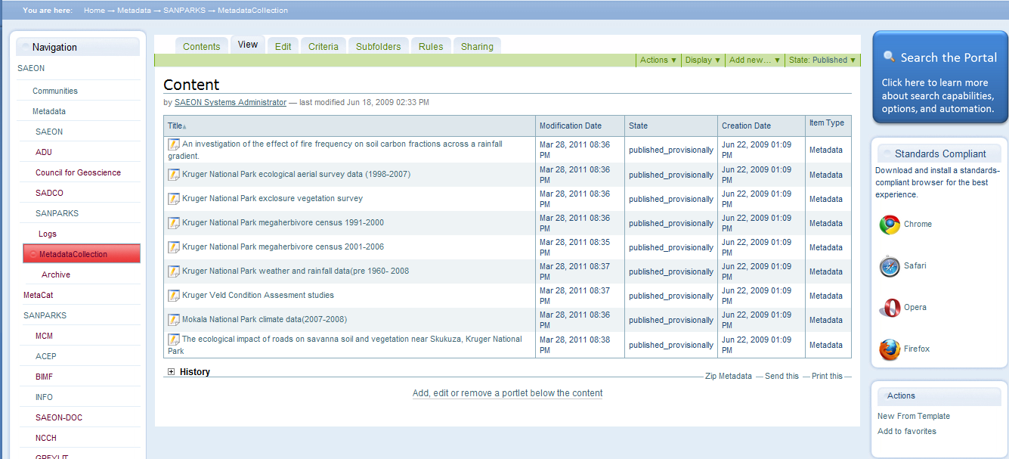
Current View

Slide 3
Adjusted View
‘New from Template’ to be moved to ‘Add New’.
See overleaf.
‘Remove ‘Add to Favourites’
Limit the entries to the level of ‘Custodians’ i.e. on level up from the collection.
‘New from Template’ to be moved to ‘Add New’

Slide 4
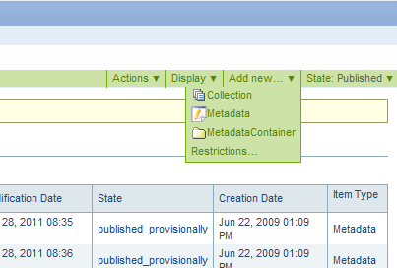
Menu Entries
Will now be two entries:
‘Upload MetaData From File’
‘New MetaData from Template’

Slide 5
Other Improvements: Templates
In time, we need to store a template for each standard for each custodian (at the maximum).
If no standard is stored for the custodian, we use the defaults (as we do at present).
This implies that when a new custodian is created, we copy the templates to a collection folder that is similar to the real meta-data collection and has the same methods and functions.
Users can then delete the ones they do not need, and edit the ones they want to change.

Slide 6
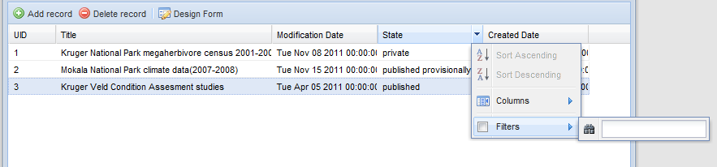
Other Improvements: Grid Filters
The best view for a large meta-data collection is a grid that can be filtered.
See example below:

