Slide 1

Creating and Linking Meta-Data to Data
W Hugo
13 September 2010

Slide 2
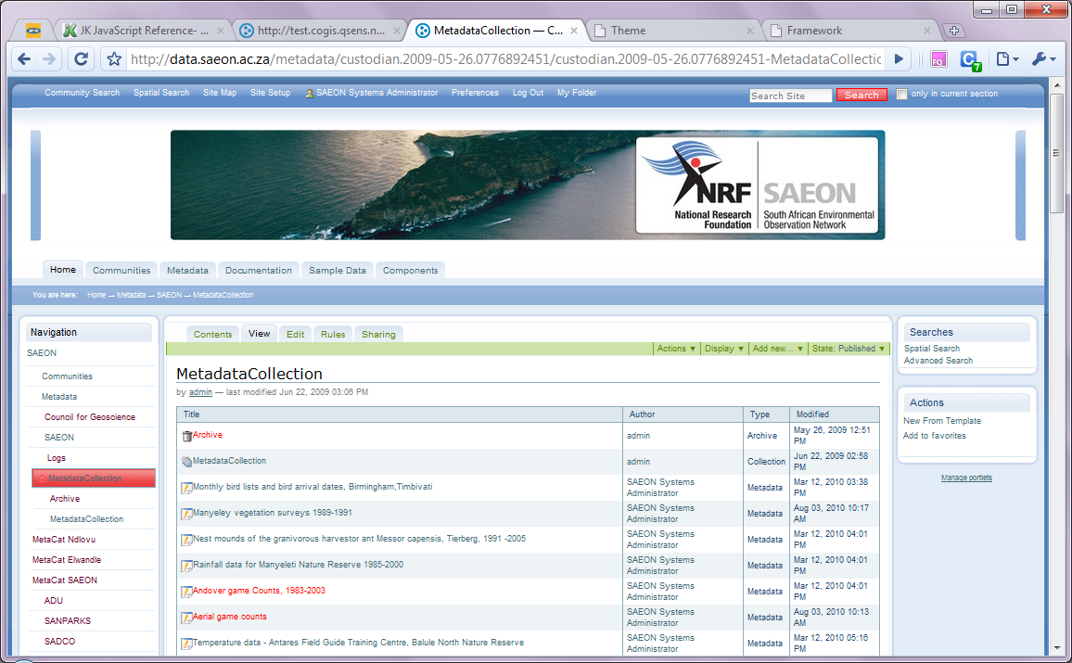
Select a suitable Meta-Data Collection
Add New from Template

Slide 3
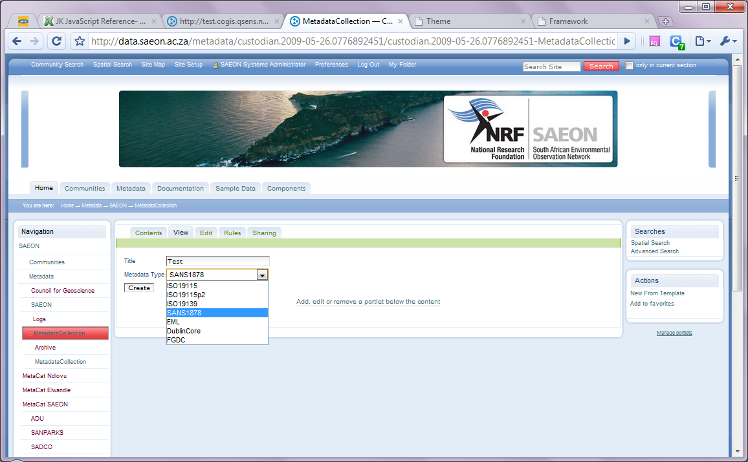
Select a suitable Meta-Data Standard (SANS 1878)
Name for Meta-Data Record (not important)
Select a Standard and click ‘Create’

Slide 4
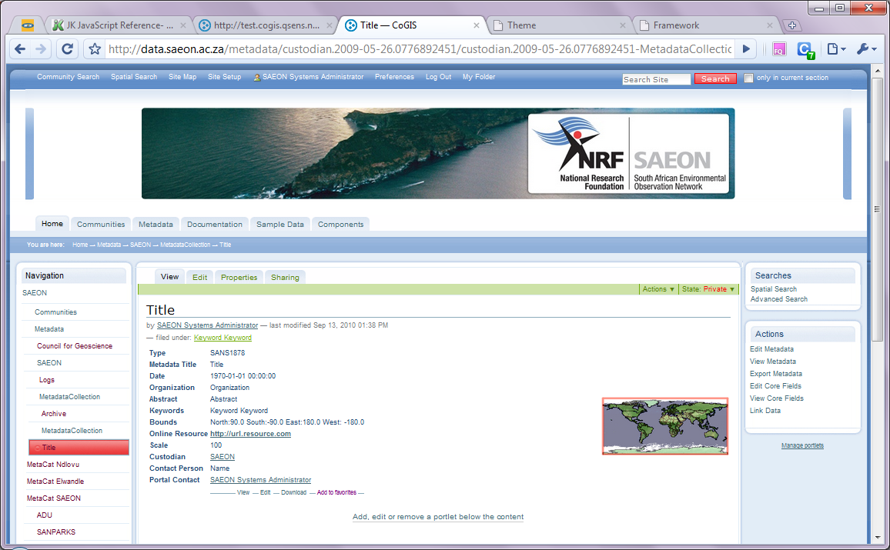
Template is Created – Must Be Edited
Click ‘Edit Core Fields’

Slide 5
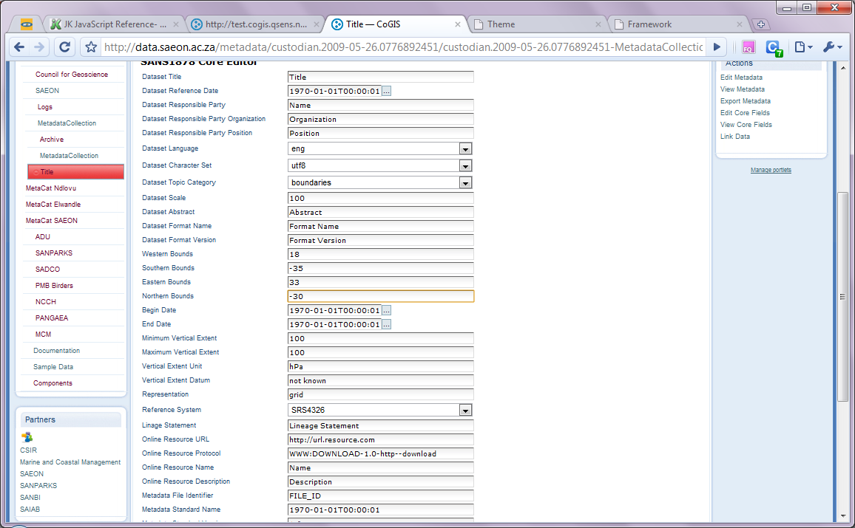
Edit Meta-Data
Edit fields (in this case bounding box) and click ‘Save’ at bottom of the screen

Slide 6
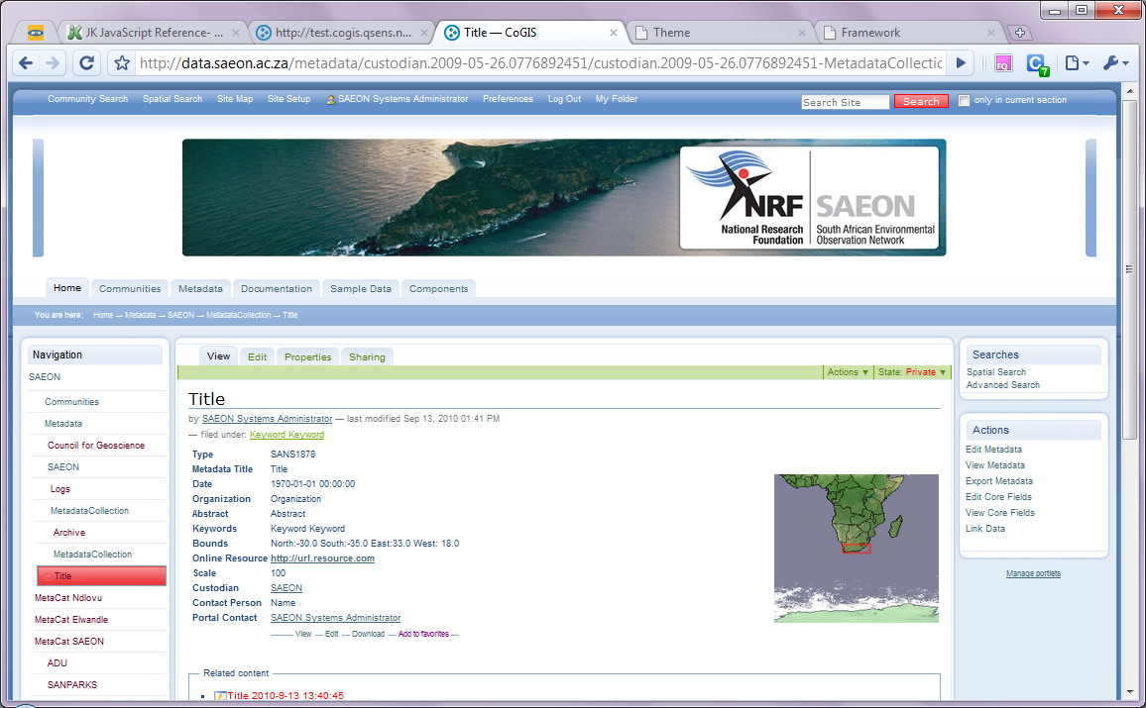
View to confirm changes
Bounding box has been updated
Click ‘Link Data’

Slide 7
Search for and Link Data
Bounding box has been updated

Slide 8
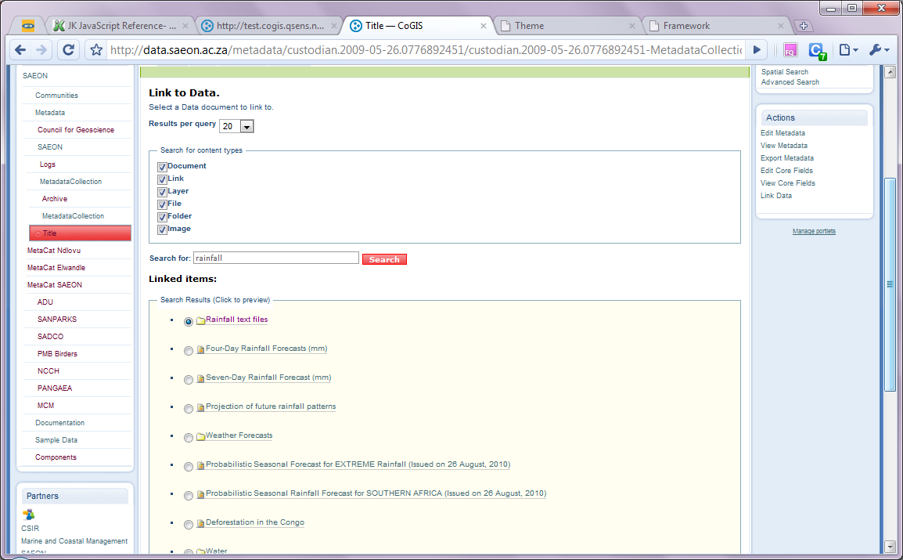
Search for and Link Data
Search for a text phrase
Select a data set
Click ‘Save’

Slide 9
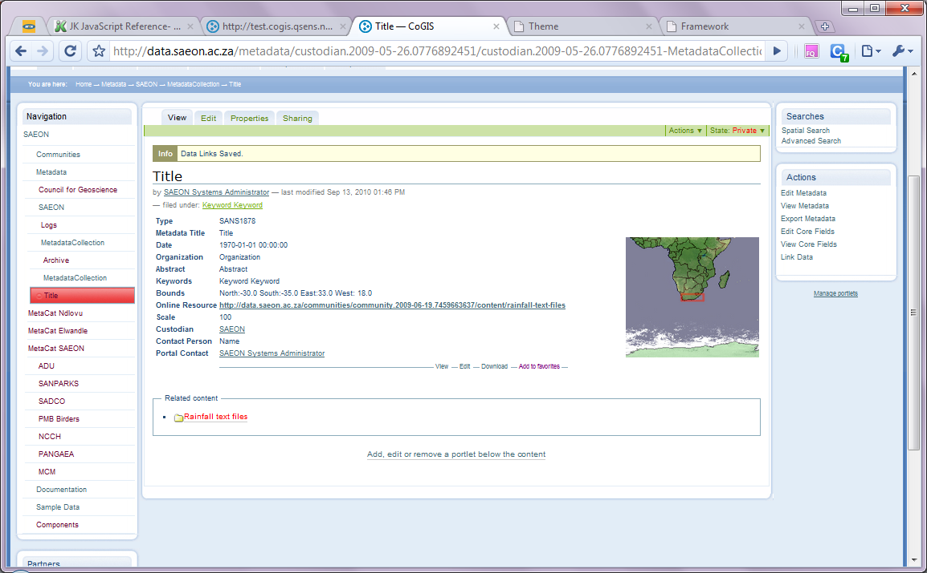
Meta-Data can Point to Multiple Data Files
‘Online Resource’ has been updated
Link is provided to data. Click to view.

Slide 10
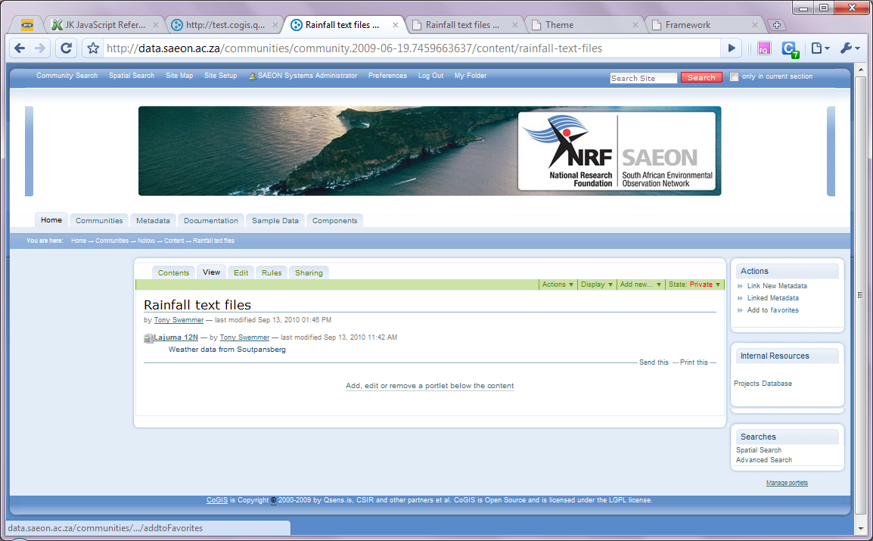
Data File provides a link to Meta-Data
Link is provided to meta-data. Click to view.

Slide 11
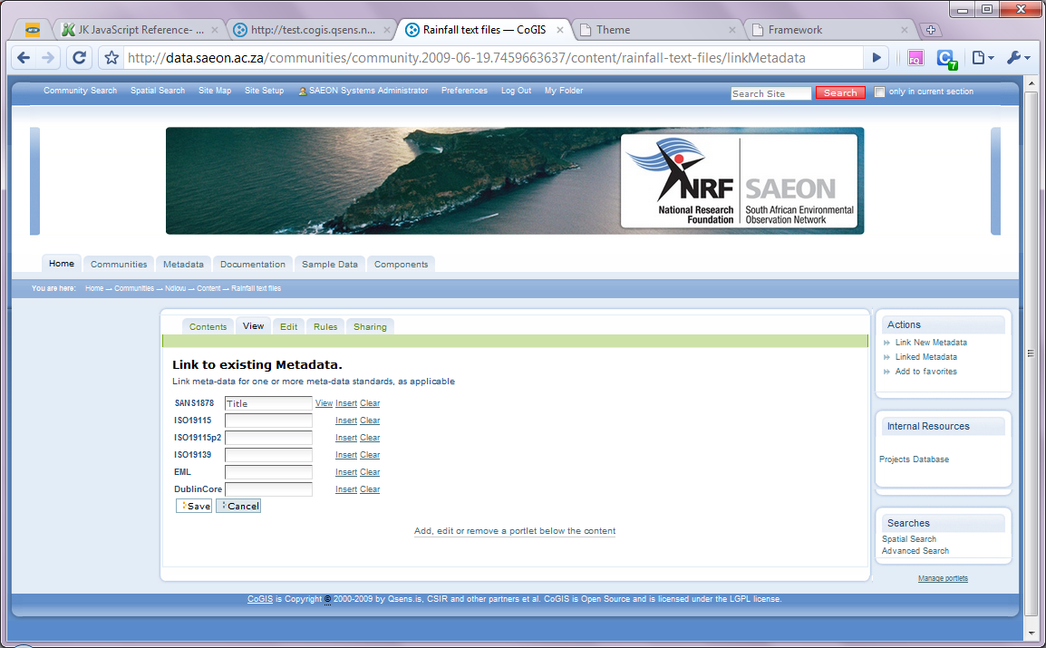
Portal Allows Multiple Formats for Each Data Item …
Click to view.

Slide 12

… back to the Meta-Data

