Slide 1

Administrative Extensions to the SAEON Data Portal
SRS 336.3.11.1
Wim Hugo, August 2010

Slide 2
Conceptual Overview

Slide 3
Main Use Cases
Users can typically self-register in the portal. After doing so, these users have very limited privileges: restricted to editing content and adding items to their own personal work areas.
Extensions are required to allow:
  Portal to gather more information from users.
  Allow users to select and agree to one or more ‘Conditions of Use’ documents.
  Allow user accounts to be queried through a service in respect of whether conditions of use have been agreed to.
User statistics need to be collected:
  Pages visited
  Login statistics
  Location and affiliation of users
Controlled Vocabularies and Lookups:
  Some object relationships are not strongly enforced, but data quality can be improved through drop-downs and controlled vocabularies.
  These can be configured in the portal and must be used as input for drop-downs and selectors.

Slide 4
Conceptual Model
User Account
Organisations
E-mail
Contact Phone
Organisation Name
Organisation Type
Field of Interest
Controlled Vocabulary
Organisation Types
Lookup
Field of Interest
Controlled Vocabulary
User-Custodian
User ID
Custodian ID
Custodian
Conditions of Use (page)
.. Other properties

Slide 5
Implementation Specifications

Slide 6
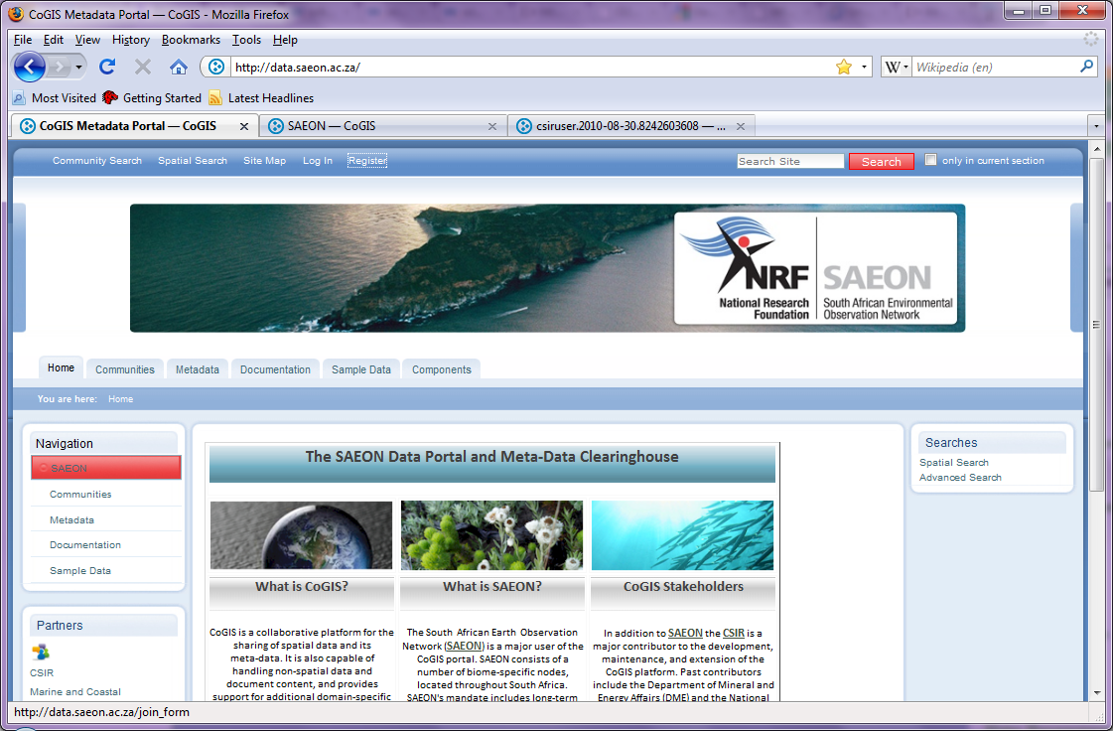
Existing Web Site: http://data.saeon.ac.za
User registration link

Slide 7
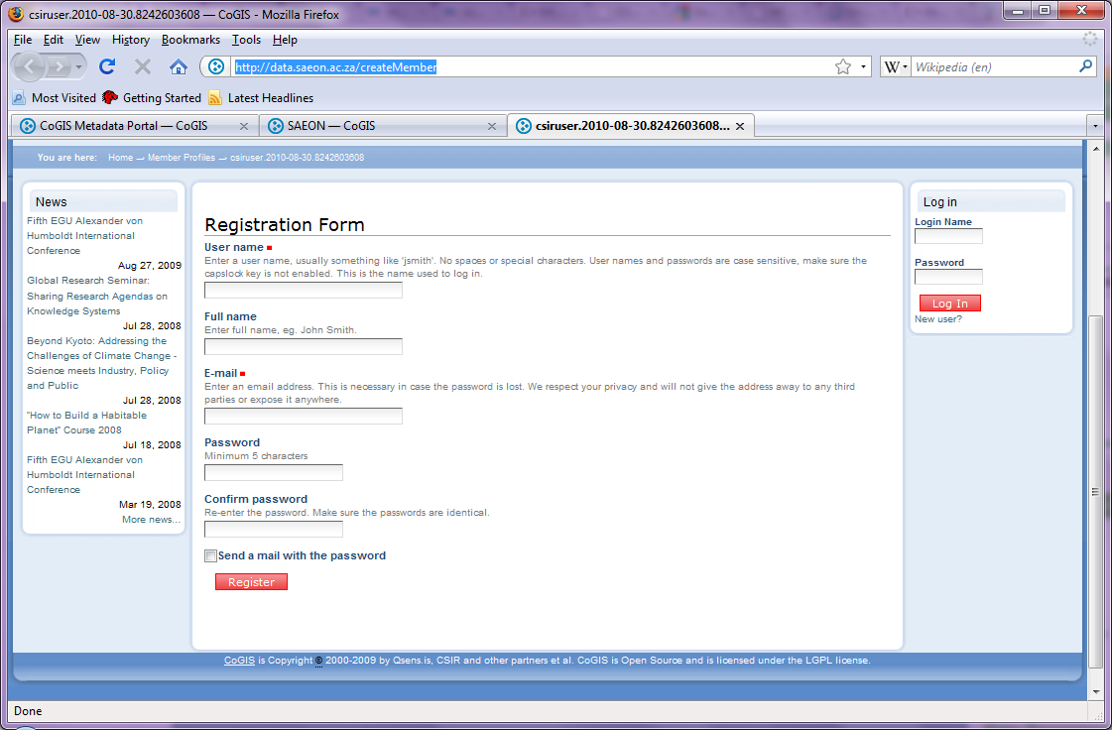
User Registration: http://data.saeon.ac.za/createMember
- Step 1 of 2
Existing view should become page 1 of the registration process
Existing view should become page 1 of the registration process
Next

Slide 8
User Registration: http://data.saeon.ac.za/createMember
Extra page in registration process
- Step 2 of 2
New Form – See Overleaf
Register

Slide 9
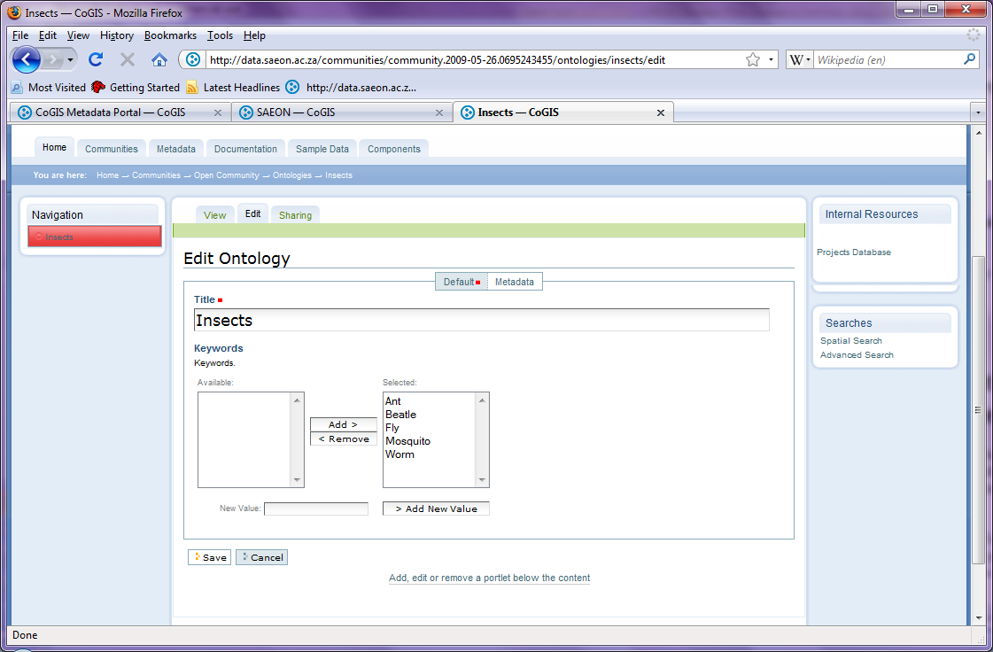
Additional Registration Data
User Organisation
Controlled Vocabulary – see overleaf
Organisation Site
Organisation Type
Organisation Contact Details
Predefined List that Admin Users must be able to adjust
Conditions of Use
Selected
Lists are constructed from page entries in Custodian folder
Custodian B
Custodian D
Custodian E
General Conditions
Custodian A
Custodian C
View
Show appropriate conditions in pop-up window (URL’s from Custodian folder)

Slide 10
Controlled Vocabulary Editor
Organisations
Available
In Use
Organisation C
Organisation D
Organisation E
Organisation A
Organisation B
Organisation F
Controlled Vocabularies/ Lookups can be set up as resources in Community Areas of the portal – this is a convenient location to store and maintain both lookup lists and controlled vocabularies.
Controlled Vocabulary: user looks up a value, but needn’t use it. New values are added automatically
Combo-Box Lookup: cannot add new values.

Slide 11
Test Sources
Ontology Repository
http://data.saeon.ac.za/communities/community.2009-05-26.0695243455/ontologies
Organisation Type Lookups:
http://data.saeon.ac.za/communities/community.2009-05-26.0695243455/ontologies/organisation-types
Organisation Controlled Vocabulary:
http://data.saeon.ac.za/communities/community.2009-05-26.0695243455/ontologies/organisations/view
Uses the Vocabulary Library product to manage the base lists for the ontologies:
http://cogis.qsens.net/portal_vocabularies/GlobalCommunityKeywords

Slide 12
User Account Web Service
Call:
http://<serviceURL>/GetConditions?TOKEN=<userToken>
Return:
Comma-delimited list of conditions (Custodian Names) that the user has agreed to.

