Slide 1
Agenda
Feedback:
  EGU (Vienna)
  GEOSS Workplan Symposium
BioEnergy Atlas: Planning and Actions
Work Plan 2011/12

Slide 2
Actions
Immediate Actions
  Management Spreadsheet
  Workgroup
    Identify participants
    Terms of reference
      LS looks for examples
      WH looks for examples at SAEON
  Action Plan and Milestones/ Budget
  Scoping (data and tools)
    Refine and document requirements
      EU Project Plan and RM - WH
    Compare against existing (EU)(CBERS) initiatives
    Define ‘our’ contribution
    Cost, procure, appoint
  Value Proposition
    WH assist with inputs
    Expert packages

Slide 3
Main Concepts: How SAEOS can be used
First and foremost, SAEOS is a first port of call for searches on earth and environmental observation data for South and Southern Africa.
  It covers remotely sensed and in situ data from a large and growing set of data providers.
  It provides tools for visualisation and download of data if this is allowed by the owner.
It allows online collaboration for researchers in each societal benefit area.
It adds value by creating a resource for each societal benefit area: discussing data sets, linking to major research institutions and initiatives in the field, providing guidance on publications, and so on.
SAEOS components can be used for rapid development of domain-specific portals: we will shortly be assisting both the Council for GeoScience (GeoHazards portal) and DST (BioEnergy Atlas) with re-usable components.

Slide 4
Portals and Platform
SAEOS is a major component of a larger collection of initiatives that share the same platform infrastructure. Specifically, all meta-data can be searched across all portals.
Portals: Main Stakeholders
and Initiatives
Main Shared Platform
Services
Documents
and Publications
Spatial
Data
Other
Data
SAEON Nodes and Initiatives
SAEON
SAEOS
Portal
Data Analysis and Processing
SAEOS
World Data Centre for BHH
Content Visualisation and Presentation
WDC
Risk and Vulnerability Atlas
RAVA
Meta-Data and Data Management Functions
CSIR GeoPortal
CSIR
Data and
Meta-Data
Meta-Data and Data Services
Limpopo GeoEconomic Portal
LGEP
NSIF
Application
NSIF Portal
NSIF

Slide 5
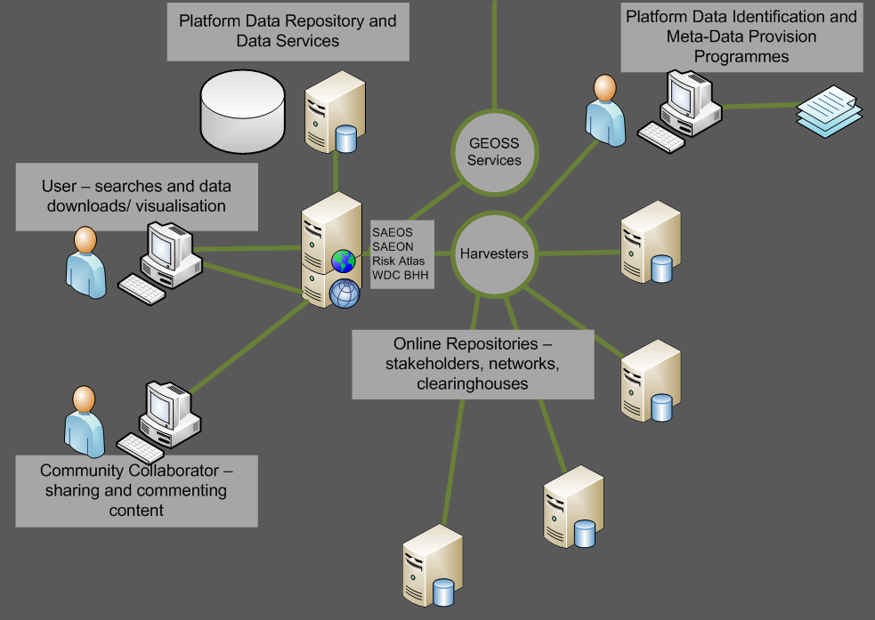
Discovery and Visualisation
The platform is based on a shared and aggregated meta-data repository, and the meta-data repository is capable of accepting and working with a range of well-established meta-data standards.
These include Dublin Core, SANS 1878, the ISO 19115 family, EML, and FGDC. The list is likely to be extended from time to time to accommodate other standards in widespread use by a user community or new provider.
Harvesters can be used to automate meta-data acquisition from standardised providers.
EODC
WAMIS
Council for GeoScience
… and many more.

Slide 6
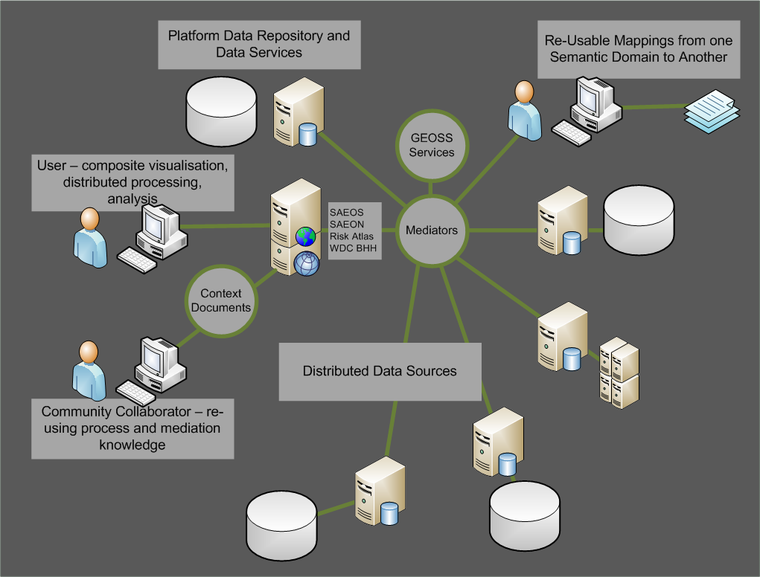
Mediation and Collation
Mediators are required to tailor (bind) a data source or sources to a process or service.
The service can be as simple as a mapping service, and the mediation as rudimentary as renaming the layers to match the context of a map.
More advanced mediations define the linkages between distributed data sets, how data should be aggregated for analysis or display purposes, which columns to match to a charting service, and so on.
Mediations are stored in ‘Web Context Documents’.

Slide 7
Automated Process Chaining
Distributed data sources and processes can also be chained together: in such cases, one needs to describe the process in a standardised way for future re-use.
This happens already in e-commerce systems, and it is likely that the same standards in use for automation of web commerce will be used in scientific process automation – but the jury is still out on this.
Automation and mediation rely greatly on ontologies for their efficient functioning. These are agreed dictionaries of terms, and can automate some of the mediation.
?

Slide 8
Work Packages: April – September 2011
Sensorweb Implementation Project (appointed)
  ARC, SADCO Weather Data as prototypes
  Will result in re-usable components for the rapid future implementation of Sensorweb services at data providers.
NetCDF Implementation Project (funding available): This will allow visualisation and downloading of large atmospheric research, oceanographic, and climate science data sets. Joint project with MRSU, to be executed at CHPC.
Integrated User Behaviour and Analytics (appointed).
Wizard-Driven Spatial Data Publication and Map Creation
Process Chaining and Automation
  Sensorweb implementation will contribute.
  Looking for GEOSS collaboration
Ontology - augmentation of discovery
  Funding available
  Looking for GEOSS collaboration
Improved GEOSS CS/W Implementation:
  ebRIM profile;
  Possibly CEOS profile once this is settled.

Slide 9
Projects and Initiatives – April 2011-March 2012
SAEOS needs to define involvement
BioEnergy Atlas
  Contact made with Peter Zeil – Salzburg Uni
  Linkages with Africa-wide project
  Obtain EO data sets from GEO participants
  Collaboration locally with CSIR-NRE/ SANSA
Risk and Vulnerability Atlas
  Integration into GEOSS – collaboration with
    GEO-WOW/ Water Cycle Data
    Energy and Geo-Resources (DS-07)
    Human Impact Monitoring and Forecasting (DS-08)

Slide 10
Stakeholder Engagement
SANSA:
  re-affirm a joint development initiative
  link operational EODC !
CSI
  Co-opted onto CSI-Data Subcommittee
  Will be providing a collaboration environment to committee
WRC:
  On board via SAEON
CfG:
  Meta-Data – to be uploaded June 2011
  GeoHazards Atlas: Collaboration
ARC:
  Ongoing through SensorWeb Enablement
Meraka has requested a high-level meeting
  DST, Meraka, CHPC, SAEON, R&VA, NRF, CSIR-BE
DMC
  We need a work session with them

Slide 11
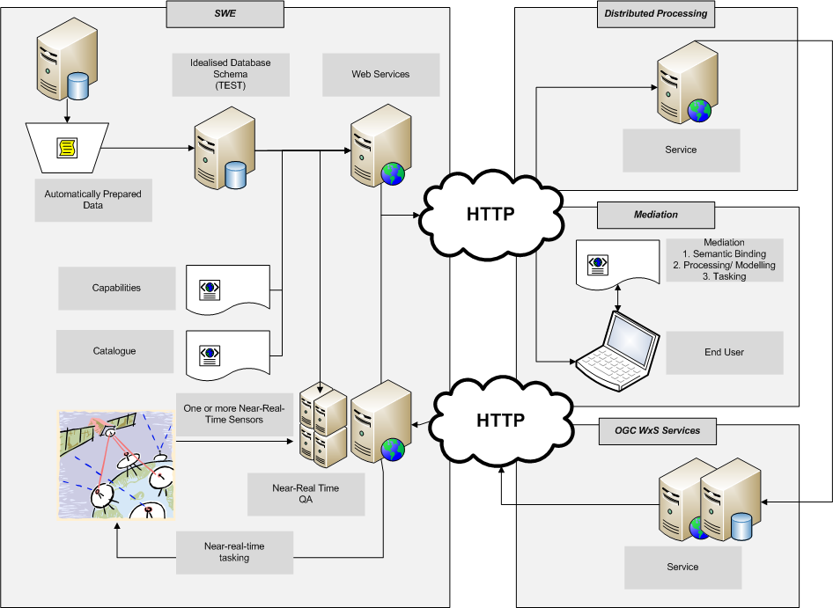
SensorWeb Implementation Architecture

