Slide 1
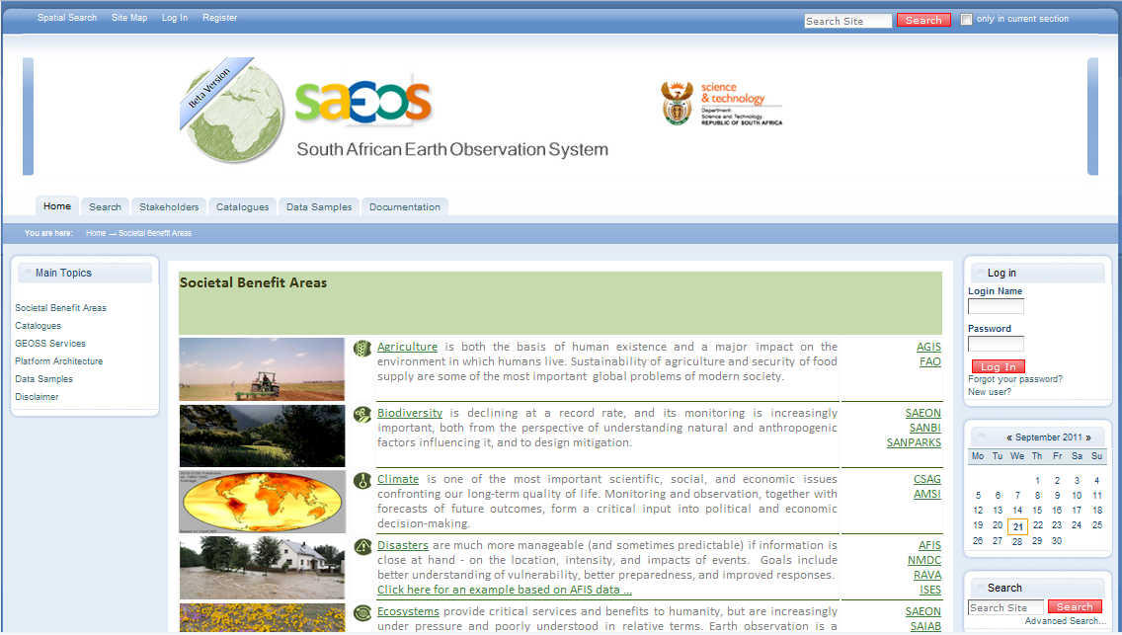
Best View

Slide 2
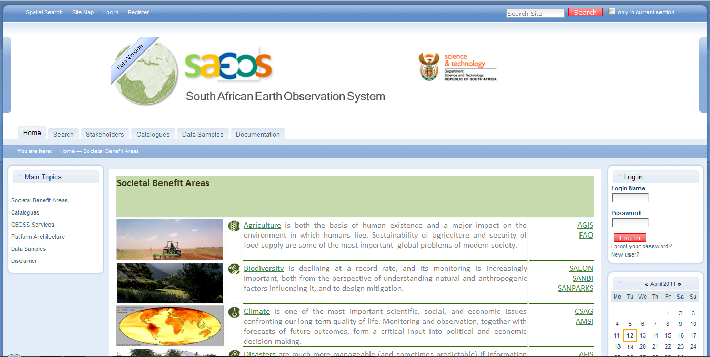
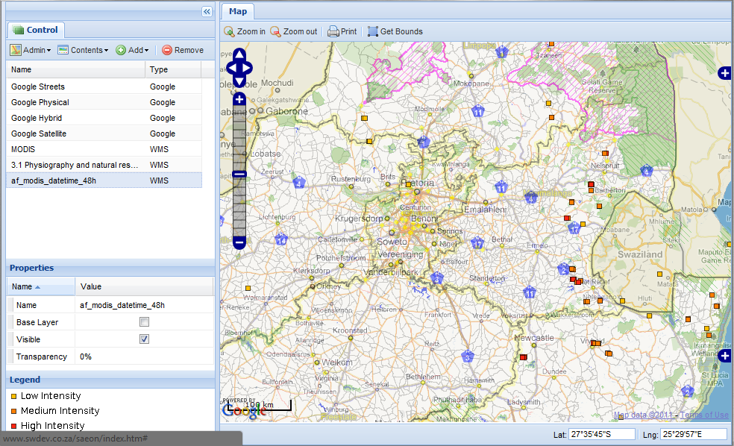
Status Quo
Multi-standard, harvester-maintained metadata repository has been established within an open source content management system.
A large number of community-enabled content types are supported (maps, pages, documents, meta-data records, images, …)
We have an on-going engagement programme with stakeholders to obtain meta-data and data. Recent co-option on the Committee for Spatial Information Data Subcommittee will accelerate this process.
Search results against the catalogue (aggregated repository) can be packaged, and links to automated data can be exploited to create maps based on distributed data sources

Slide 3
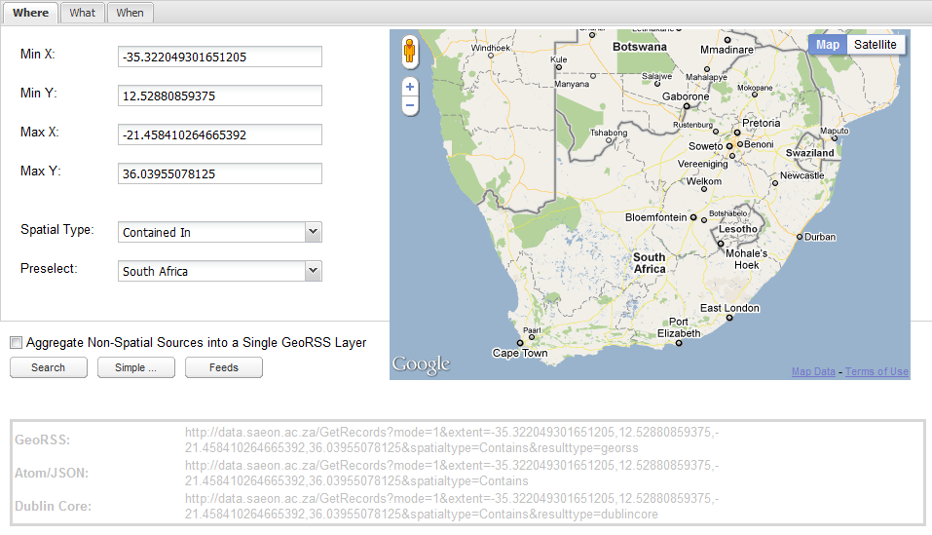
Summary: Recent Activity and Improvements
Improved Search Interfaces allow advanced composite queries against the repository, and output can be on-screen or automated.
Improved Search Interfaces allow advanced composite queries against the repository, and output can be on-screen or machine-readable.
Assistance is provided for the creation of GEOSS-compliant CSW-KVP queries that can be embedded anywhere.
Assistance is provided for the creation of GEOSS-compliant CSW-KVP queries that can be embedded anywhere.
Other recent milestones:
Agreement with National Spatial Data Infrastructure on sharing and collaboration
User assistance for seamless visualisation and/ or use of automated online data resources
Support for WFS
It is a small step to make this a generic user search interface that creates GEOSS-CSW HTTP requests to issue against any GEOSS repository
Project under way to migrate and test the portal on large infrastructure at CHPC.

Slide 4
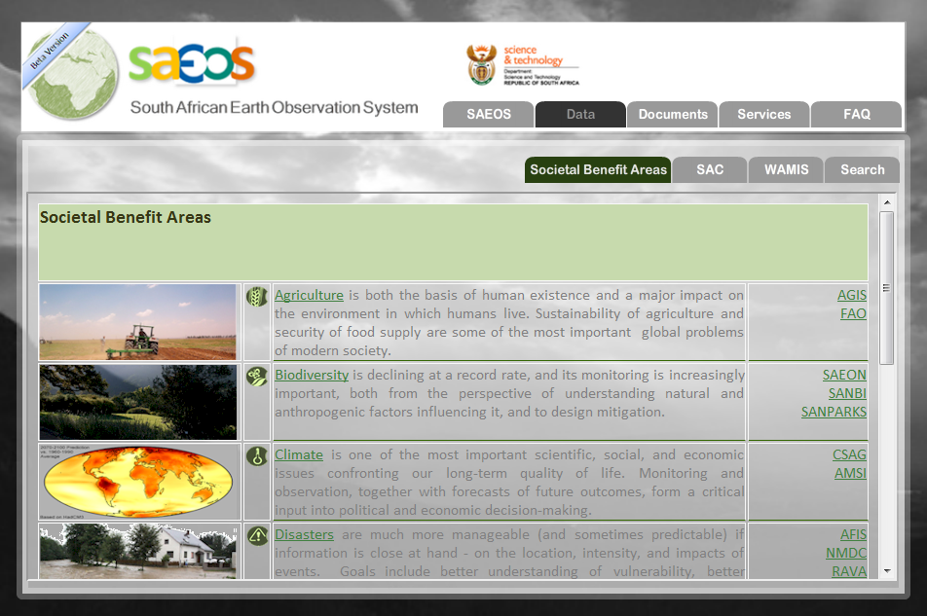
Work Programme and RoadMap
Work has started on a simplified ‘public facing’ interface to the SAEOS portal
Work has also started on describing and packaging the open, GEOSS compliant tools and functions for implementation at other institutions, for example at CfG
Projects are under way to develop Sensor Web implementations that can be applied generically at any data provider
Work will start soon on NetCDF data integration and a suite of visualisation tools for it.
We are actively looking for GEOSS/ EuroGEOSS integration opportunities
We are systematically converting the first portal iteration to a service-oriented architecture
Technology cooperation possibilities with INSPIRE?

Slide 5
Background

Slide 6
Main Concepts: What is SAEOS?
Standardised meta-data repositories make it possible for users to find, apply, and visualise data. Any GeoPortal needs a way to catalogue its data holdings, and such a repository is a prerequisite.
SAEOS acts as a ‘catalogue of catalogues’, supporting automated synchronisation with data provider catalogues (‘harvesting’).
Search facilities are a central function, and these have been developed to be completely service-oriented. Not only does this allow GEOSS-compliant harvesting and searches against SAEOS, but is also allows third parties to embed SAEOS search facilities and results into their own portals.
GeoPortals need to allow users to visualise data, preferably using a web-based map viewer. Not only that: users may also want to overlay data from different providers, manipulate the presentation of layers, and save the resulting map for future use. SAEOS provides all of these components as service-oriented end points.
If data sources are standardised and adequately described in meta-data, they can be included into automated processes where required. Recently commenced projects (specifically Sensorweb enablement) will build this functionality.
Increasingly, data need to be linked to visualisation or processing services through additional information that is provided by the user. Structuring and storing these user interventions are referred to as ‘Mediation’. We have developed prototype charting facilities using this approach.

Slide 7
Main Concepts: How SAEOS can be used
First and foremost, SAEOS is a first port of call for searches on earth and environmental observation data for South and Southern Africa.
  It covers remotely sensed and in situ data from a large and growing set of data providers.
  It provides tools for visualisation and download of data if this is allowed by the owner.
It allows online collaboration for researchers in each societal benefit area.
It adds value by creating a resource for each societal benefit area: discussing data sets, linking to major research institutions and initiatives in the field, providing guidance on publications, and so on.
SAEOS components can be used for rapid development of domain-specific portals: we will shortly be assisting both the Council for GeoScience (GeoHazards portal) and DST (BioEnergy Atlas) with re-usable components.

Slide 8
Portals and Platform
SAEOS is a major component of a larger collection of initiatives that share the same platform infrastructure. Specifically, all meta-data can be searched across all portals.
Portals: Main Stakeholders
and Initiatives
Main Shared Platform
Services
Documents
and Publications
Spatial
Data
Other
Data
SAEON Nodes and Initiatives
SAEON
SAEOS
Portal
Data Analysis and Processing
SAEOS
World Data Centre for BHH
Content Visualisation and Presentation
WDC
Risk and Vulnerability Atlas
RAVA
Meta-Data and Data Management Functions
CSIR GeoPortal
CSIR
Data and
Meta-Data
Meta-Data and Data Services
Limpopo GeoEconomic Portal
LGEP
NSIF
Application
NSIF Portal
NSIF

Slide 9
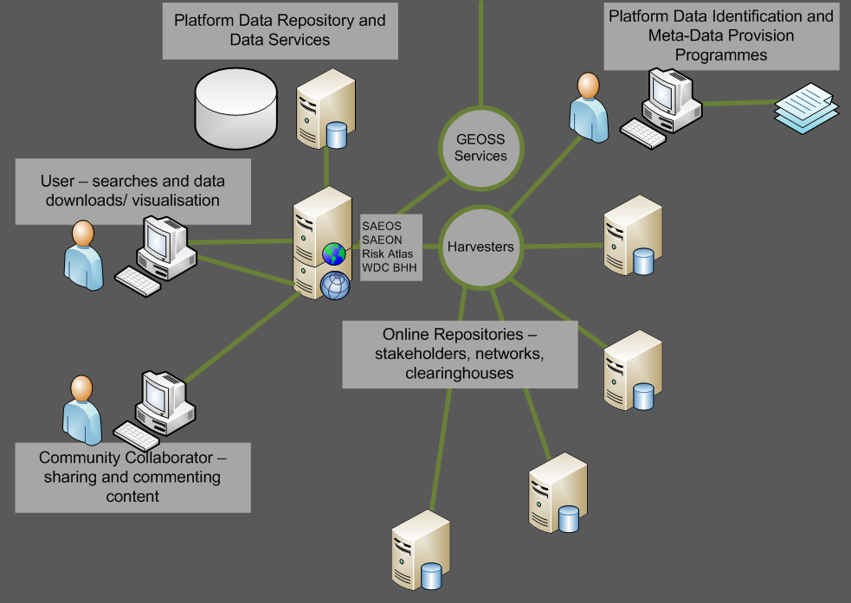
Discovery and Visualisation
The platform is based on a shared and aggregated meta-data repository, and the meta-data repository is capable of accepting and working with a range of well-established meta-data standards.
These include Dublin Core, SANS 1878, the ISO 19115 family, EML, and FGDC. The list is likely to be extended from time to time to accommodate other standards in widespread use by a user community or new provider.
Harvesters can be used to automate meta-data acquisition from standardised providers.
EODC
WAMIS
Council for GeoScience
… and many more.

Slide 10
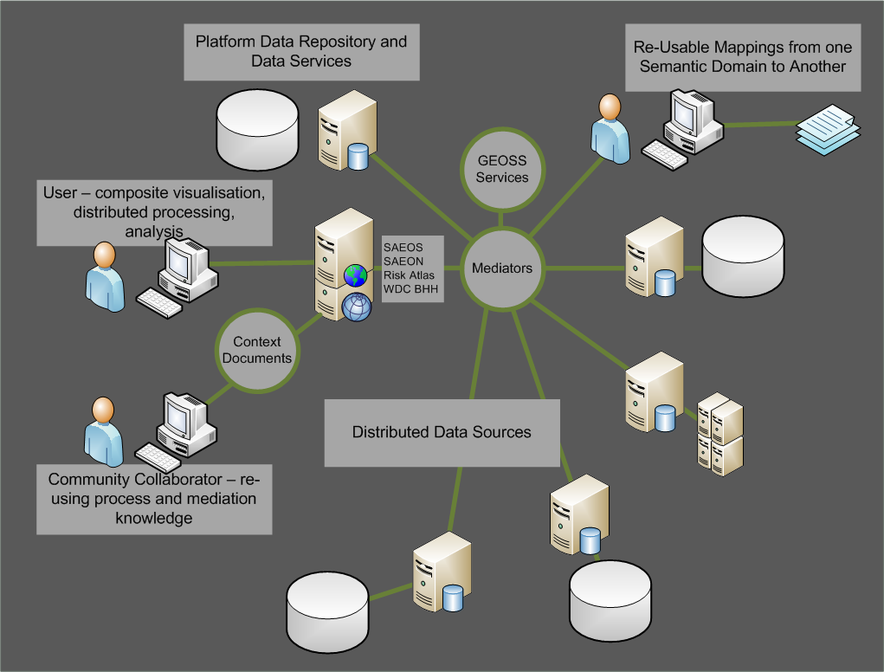
Mediation and Collation
Mediators are required to tailor (bind) a data source or sources to a process or service.
The service can be as simple as a mapping service, and the mediation as rudimentary as renaming the layers to match the context of a map.
More advanced mediations define the linkages between distributed data sets, how data should be aggregated for analysis or display purposes, which columns to match to a charting service, and so on.
Mediations are stored in ‘Web Context Documents’.

Slide 11
Automated Process Chaining
Distributed data sources and processes can also be chained together: in such cases, one needs to describe the process in a standardised way for future re-use.
This happens already in e-commerce systems, and it is likely that the same standards in use for automation of web commerce will be used in scientific process automation – but the jury is still out on this.
Automation and mediation rely greatly on ontologies for their efficient functioning. These are agreed dictionaries of terms, and can automate some of the mediation.
?

Slide 12
Work Packages: April – September 2011
Sensorweb Implementation Project (appointed)
  ARC, SADCO Weather Data as prototypes
  Will result in re-usable components for the rapid future implementation of Sensorweb services at data providers.
NetCDF Implementation Project (funding available): This will allow visualisation and downloading of large atmospheric research, oceanographic, and climate science data sets.
Integrated User Behaviour and Analytics (appointed).
Wizard-Driven Spatial Data Publication and Map Creation (funding available).
Process Chaining and Automation
  Sensorweb implementation will contribute.
  Looking for GEOSS collaboration
Ontology - augmentation of discovery
  Funding available
  Looking for GEOSS collaboration
Improved GEOSS CS/W Implementation:
  ebRIM profile;
  Possibly CEOS profile once this is settled.

Slide 13
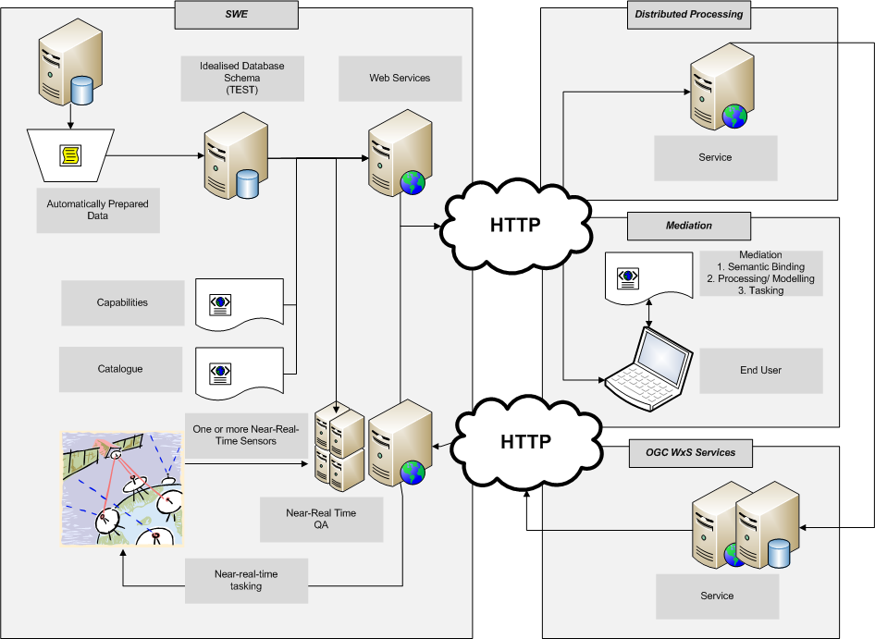
SensorWeb Implementation Architecture

