Slide 1
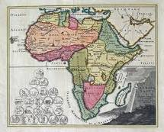
SAEOS
Discussion Notes
SG/ NSIF –
24 Feb 2011

Slide 2
Scope of DISCUSSION
Concepts and Context
Software Platform: Walk-through
Current and Future Data Sets
Three Areas of Potential Cooperation

Slide 3
Context and Concepts

Slide 4
The Bigger Picture
CoSAMP
(SAEON, CSIR)
2005
CoGIS
(SAEON, CSIR)
2007
Open Source
Local
Capacity
Meta-Data I
(SAEON, CSIR)
2008/9
URS I
Spatial Extensions
(SAEON, SAEOS, WDC, R&VA)
2009/10
Structured Data
(SAEON, SAEOS, WDS)
2009/10
URS II
NSIF
2008
URS III
Image Extensions
Admin Extensions
(SAEON, SAEOS)
2010/11
Citations
Service Orientation
(SAEON, SAEOS, R&VA, WDC) 2010/11
Meta-Data II
(SAEON, SAEOS, WDS, R&VA)
2009/10
Process
(CSIR, SAEON)
2011
Knowledge
(CSIR, SAEON)
2011

Slide 5
Broad Concept
Meta-Data Driven Catalogues
  Rely on widely adopted standards
  Describes data for discovery and future application
Search and Discovery
  Advanced Search Capabilities
  GEO compliance
Mapping, Charting, and Visualisation
  Rely on web sources (WMS, WFS, KML, GeoRSS, …)
  Allows map composition and persistence (Web Context)
  Allows integration with portal search facilities
  Visualisation and Informal Correlation
Structured Data
  Visualisation and Informal Correlation
Admin
  Usage Statistics
  Registration

Slide 6
Mandates

Slide 7
Software Platform

Slide 8
Portals and Platform
Main Stakeholders
and Initiatives
Main Platform
Services
Documents
and Publications
Spatial
Data
Other
Data
SAEON Nodes and Initiatives
SAEON
SAEOS
Portal
Data Analysis and Processing
SAEOS
World Data Centre for BHH
Content Visualisation and Presentation
WDC
Risk and Vulnerability Atlas
RAVA
Meta-Data and Data Management Functions
CSIR
CSIR
Meta-Data and Data Services
Limpopo GeoEconomic Portal
LGEP
NSIF
Application
NSIF Portal
NSIF

Slide 9
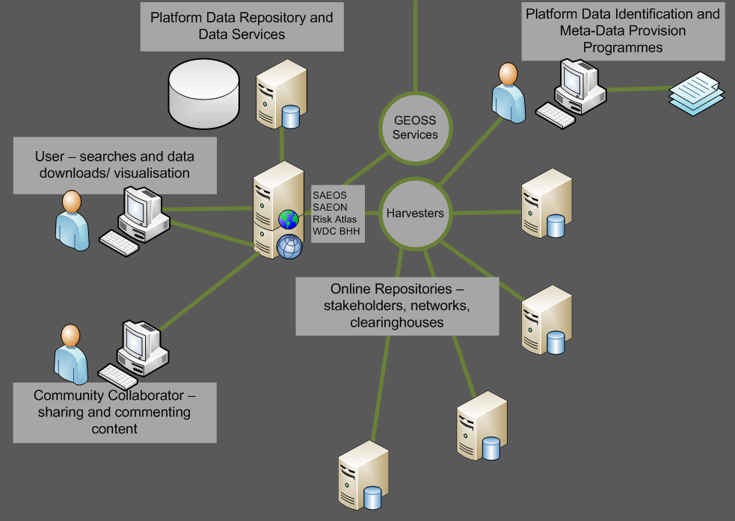
Main Use Cases
Phase 1: DISCOVERY AND VISUALISATION

Slide 10
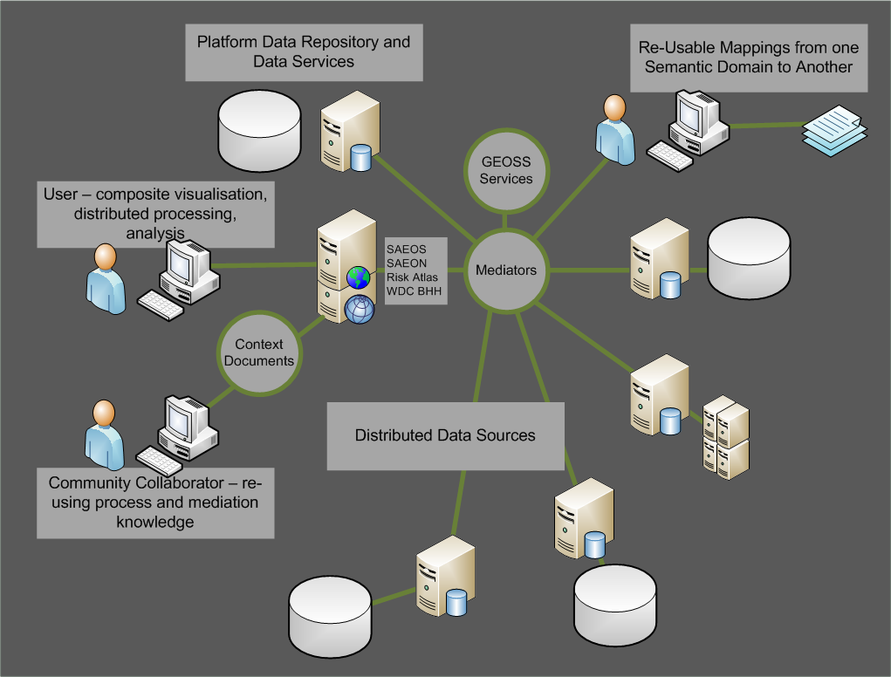
MAIN USE CASES
Phase 2: Mediation and Collation

Slide 11
Platform Architecture: 2009-11
Data/ Primary Services Layer
Application Layer
Client Layer
Meta-Data Repository
Catalogue and Related
Services
Meta-Data Result
Meta-Data View
Home/
Static Links/
Guides
Search Capabilities
Meta-Data Search Result
Search Result View
Themes and Predefined Searches
Data Referral
Data Acquisition View
Resources
Partner Links
Publications
Data Repositories
Exchange/
Query Services
Structured Data View
Maps and Data
(Browse, Gallery, …)
Data Result
(Spatial/ Structured)
Aggregation Services
Spatial Data View
“Packager”
Processing Services
Analysis Result/ Synchronisation
Analysis Request
Large Variety of Services (RSS, CSW, …)
Dynamically Linked Content
Medium Client

Slide 12
Walk-Through
Meta-Data
Searches
Themes
Maps
Services

Slide 13
Main Functions
Sharing of Data and Publications
Discovery and Visualisation of Data
Content Management
Collaborative Development and Value Addition

Slide 14
Data Status
CSAG
BGIS
TIP
External Sources

Slide 15
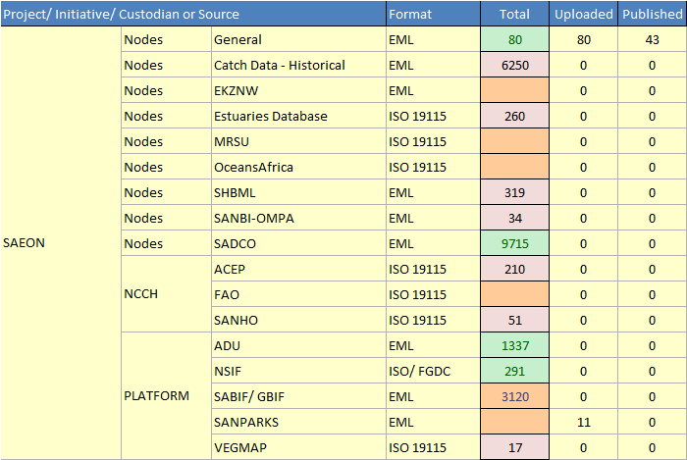
State of Meta-Data

Slide 16
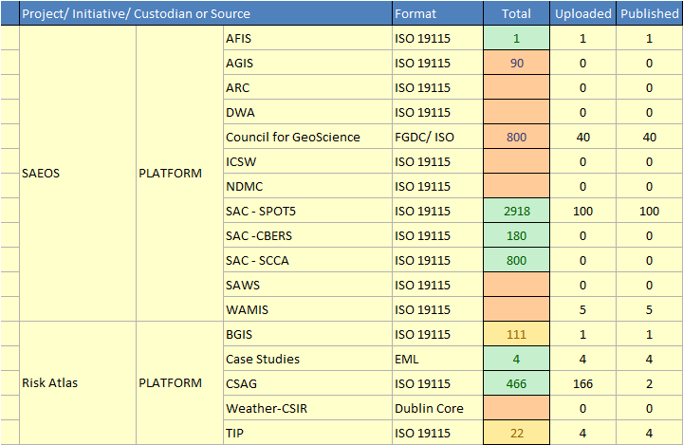
State of Meta-Data (2)

Slide 17
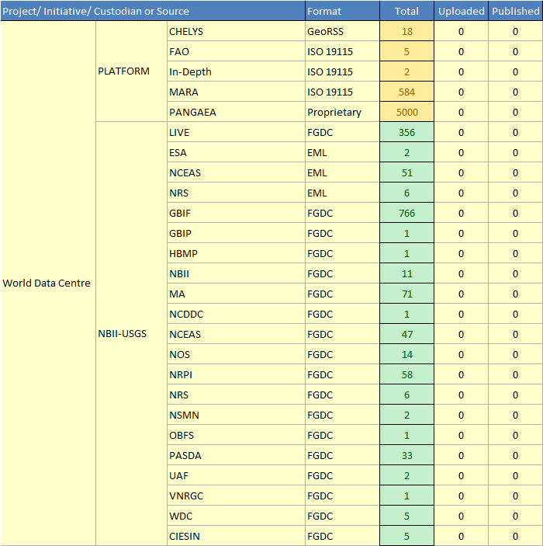
State of Meta-Data (3)

Slide 18
Meta-Data and Data Management Strategy
Pointers to Services
Obtain Meta-Data (M)
Obtain Data
Meta-Data Catalogues
Automate Meta-Data
Standardise Formats and Structures
Assess Data Risks
Optimise and Improve
Meta-Data
Transfer to Archive

Slide 19
Discussion
Meta-Data Exchange
Meta-Data Acquisition
Platform Collaboration

Slide 20
Meta-Data Exchange
  The shared platform and the NSIF software share a common origin, and have a similar approach to meta-data harvesting.
  Exchange and synchronisation of meta-data need to be tested and operationalised.
  The platform serves as a conduit for meta-data to the NSIF.

Slide 21
Meta-Data Acquisition
  The shared platform, in each of its initiatives, have opportunity and instruction to engage with data providers in respect of meta-data acquisition and data archiving or hosting, where required.
  The overlaps and duplication from this, in relation to NSIF work programmes, need to be eliminated – alignment of initiatives.
  Opportunities for shared benefits must be exploited.

Slide 22
JOINT PLATFORM DEVELOPMENT
  The shared platform and the NSIF share a common origin,
  The shared platform has a well-defined and vibrant development programme, aligning the requirements of several stakeholders;
  We foresee a ‘directed open source’ project in which the systems engineering functions are aligned and development priorities are set;
  Agreement on standards will lead to a growing pool of re-usable components;
  Ideally, these components should be offered to GEOSS.

