Slide 1

Infrastructure/ Platform Report Back
GEO Workplan Workshop
23 August 2011
Wim Hugo

Slide 2
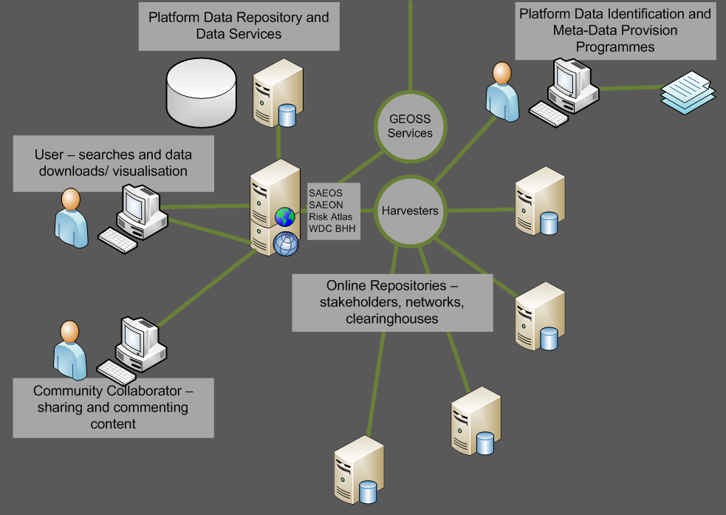
Phase 1: DISCOVERY AND VISUALISATION

Slide 3
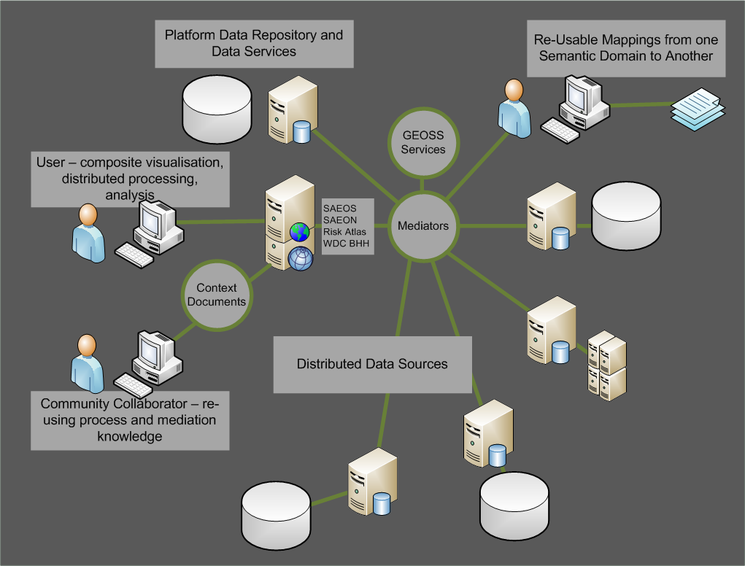
Phase 2: Mediation and Collation

Slide 4
Phase 3: AUTOMATED PROCESS CHAINING
?

Slide 5
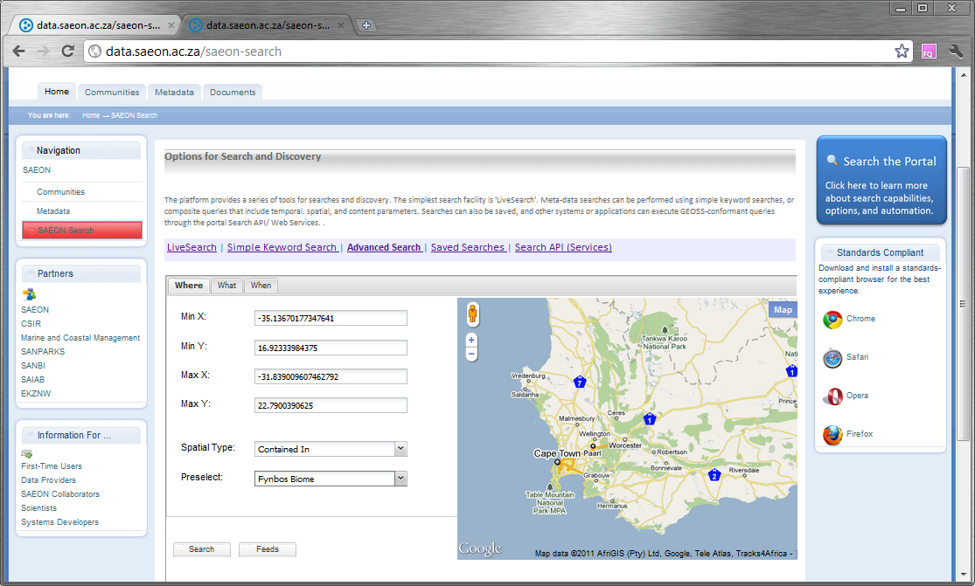
Discovery Tools

Slide 6
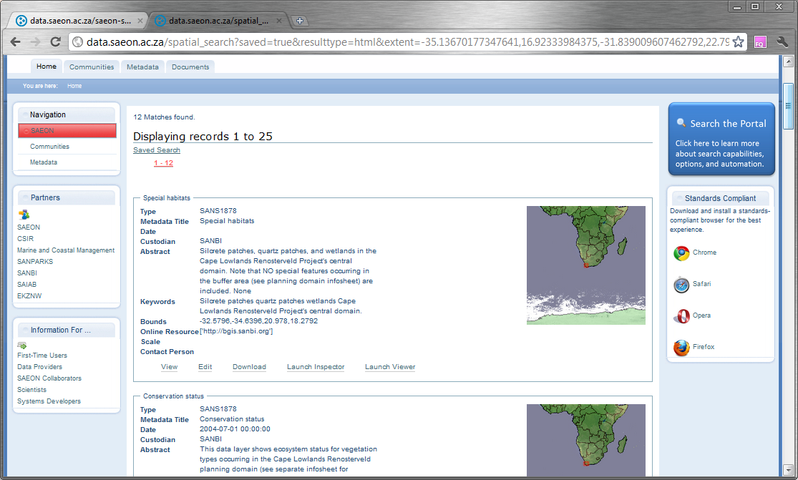
Search Results

Slide 7
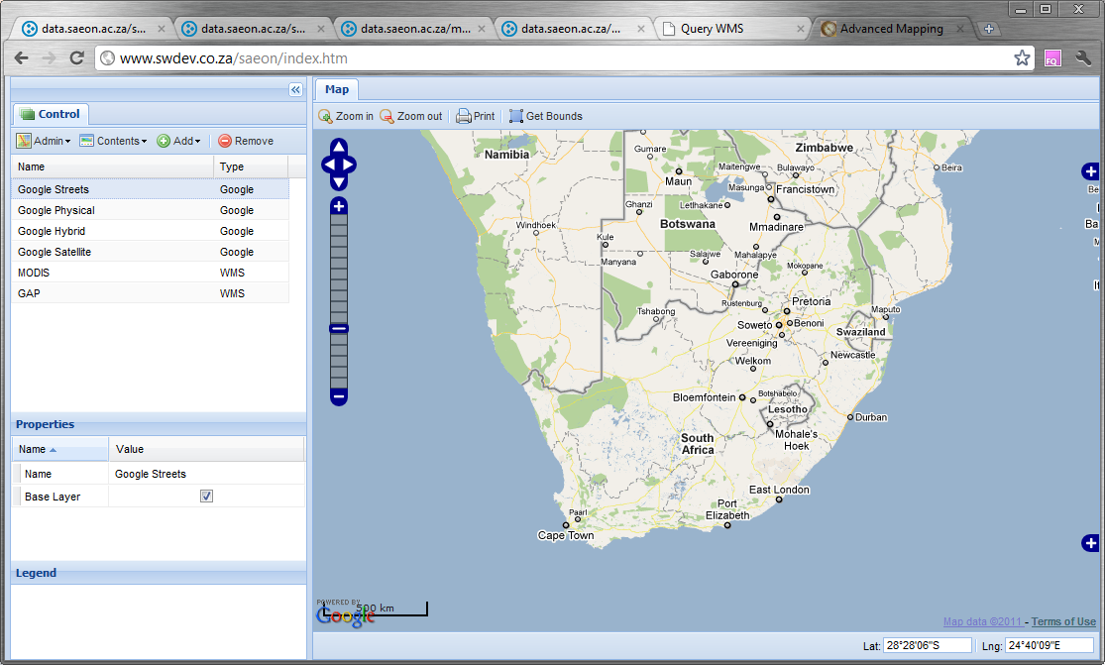
Advanced Mapping Tools and Support

Slide 8
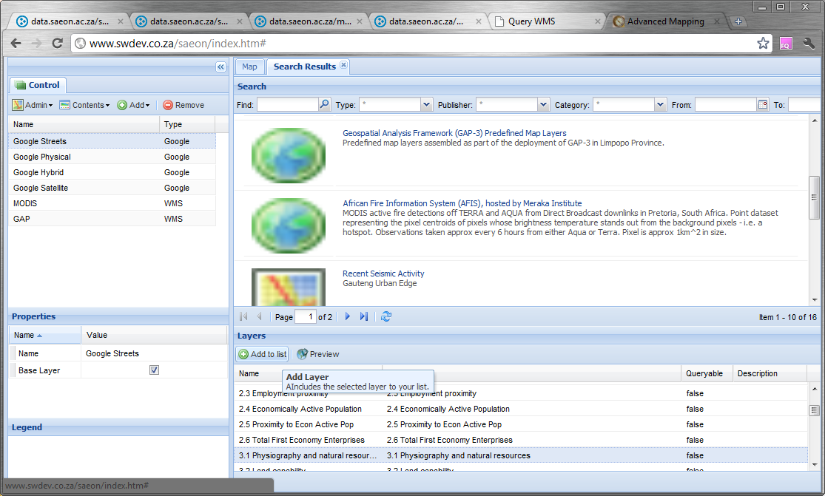
Integrated with Portal Searches…

Slide 9
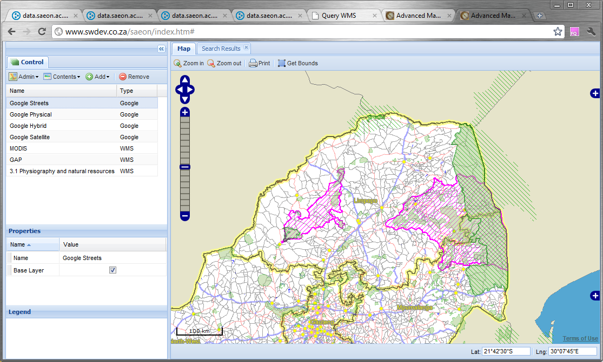
Search Result Displayed

Slide 10
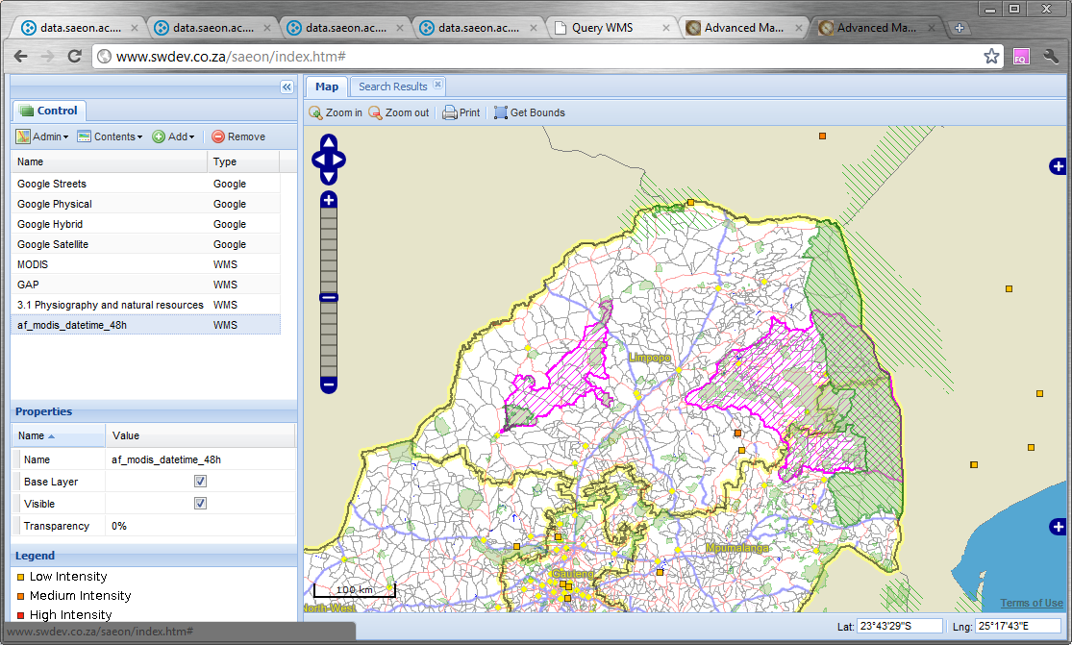
… Collation…

Slide 11
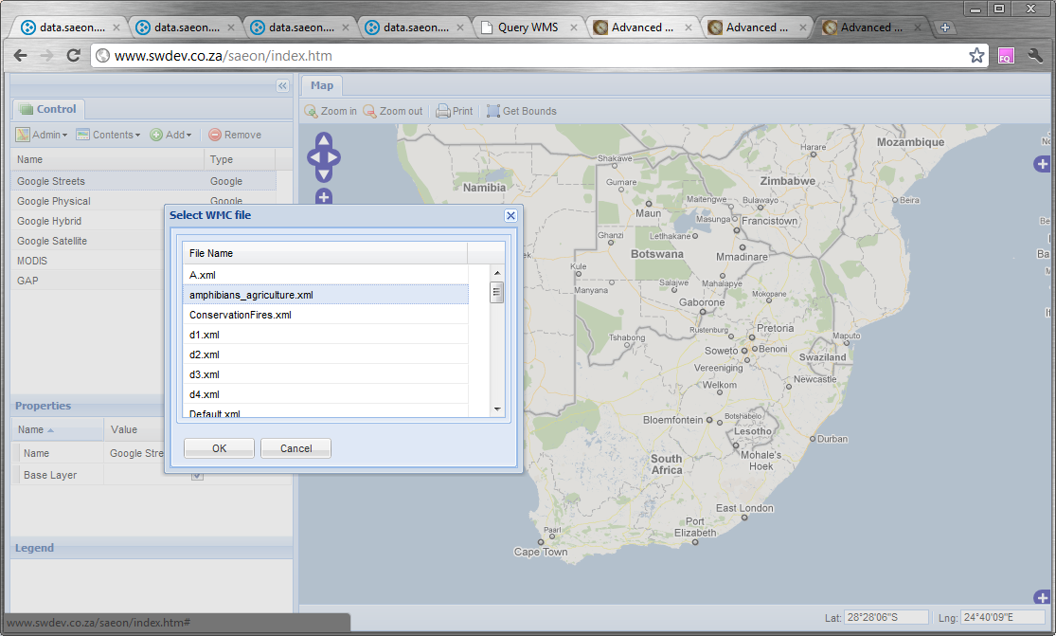
.. And MEDIATION: Saved as a Web Context

Slide 12
Physical Infrastructure
Multiple Virtual Servers
50TB immediate storage
Scalable to 1.2 PB
SANReN Access ☺

Slide 13
Physical Infrastructure
Request a Server on Demand for Modelling or Hosting a Project/ Initiative
Hardware
Virtual Server

Slide 14
Software Infrastructure
Content Management, Security, and Publication Life Cycles
Meta-Data Management Capabilities
Data Archiving, Preservation, and Discovery Capabilities
Data Visualisation, Process Mediation, ….
Hardware
Virtual Server

Slide 15
Software Infrastructure
Use as required, with 2 mandatory requirements:
Standards-compliant meta-data repository with CSW services
Standards-compliant data sources
Service-Oriented Software Architecture
Meta-Data
Repository
Spatial Data
Repository
NetCDF
Repository
SensorWeb Data Sources
Hardware
Virtual Server
Virtual Server
Virtual Server
…

Slide 16
Direct Support for Distributed Operation
Any standards-compliant meta-data store can be harvested.
Standards compliant data:
Distributed visualisation
Distributed analysis and processing
Service-Oriented Software Architecture
Meta-Data
Repository
Meta-Data
Repositories
Meta-Data
Repository
Spatial Data
Repository
NetCDF
Repository
SensorWeb Data Sources
Hardware
Virtual Server
Virtual Server
Virtual Server
Virtual Server
…
Virtual Server
Compliant Data Repositories

Slide 17
Governance
SAGEO
Risk and Vulnerability Atlas
SAEOS Architecture C.O.P.
Service-Oriented Software Architecture
Meta-Data
Repository
Spatial Data
Repository
NetCDF
Repository
SensorWeb Data Sources
Hardware
Virtual Server
Virtual Server
Virtual Server
…
Governance
Technical
Institutional
Financial
TDR &
WDS
Guidance

Slide 18
VLDB and Improved User-Directed Tools
Meso-Database
Statistics
Quality
Overviews
Service-Oriented Software Architecture
Meta-Data
Repository
Spatial Data
Repository
NetCDF
Repository
SensorWeb Data Sources
Hardware
Virtual Server
Virtual Server
Virtual Server
…
Governance
Technical
Institutional
Financial
Guidance

Slide 19
Updated Distributed Standards Architecture
Distributed Web Folders
Standardised Data Services
Standardised Catalogue Services
User Interface Layer
NetCDF
nDTM
OPeNDAP
Server
THREDDS
Server
Viewers
Other Objects
JSON/ Atom
RSS
RDF Services
OGC-CSW
OAI
Mediators
Relational Spatial DB - OGC
Search Interfaces
O&M Schema
3DTM
Sensor Observation Service
Context
Typical Spatial Data
2DM
OGC Map Services
SHP, TIFF, etc.

Slide 20
Portals and Platform
Main Stakeholders
and Initiatives
Main Platform
Services
Documents
and Publications
Spatial
Data
Other
Data
SAEON
Nodes and Initiatives
SAEON
SAEOS
Portal
Data Analysis and Processing
SAEOS
World Data Centre for BHH
Content Visualisation and Presentation
WDC
Risk and Vulnerability Atlas
RAVA
Meta-Data and Data Management Functions
CSIR
CSIR
Meta-Data and Data Services
Limpopo GeoEconomic Portal
LGEP
NSIF
Application
NSIF Portal
NSIF

Slide 21
Initiatives
BioEnergy Atlas
SAGHOS
OceanSAfrica
SensorWeb/ Meraka
ACCESS
WRC
Department of Water Affairs
Capacity Building
  Strategy Workshops?
  Technical Workshops

Slide 22
Liaisons
World Data System and ICSU
JRC
GEO BON
CSI
Eye on Earth (UNEP)

Slide 23
Invitations and Requests
Air Quality Related (PM, Ozone, Nx, CO2)
Health Related
  Malaria
  Rift Valley Fever
  Meningitis
Please contact us and engage!

Slide 24
Notes
Gluster file systems

