Slide 1
SAEON Data Portal Quick Walkthrough
3 June 2011
W Hugo
G342.4.0.1 SDP Overview

Slide 2
Portals and Platform
Multiple portals share the same platform – hardware, software, and networking infrastructure that provides meta-data based data and content management facilities.
Main Stakeholders
and Initiatives
Main Platform
Services
Documents
and Publications
Spatial
Data
Other
Data
SAEON
Nodes and Initiatives
SAEON
SAEOS
Portal
Data Analysis and Processing
SAEOS
World Data Centre for BHH
Content Visualisation and Presentation
WDC
Risk and Vulnerability Atlas
RAVA
Meta-Data and Data Management Functions
CSIR
CSIR
Meta-Data and Data Services
BioEnergy Atlas for South Africa
BEA
NSIF
Application
NSIF Portal
NSIF

Slide 3
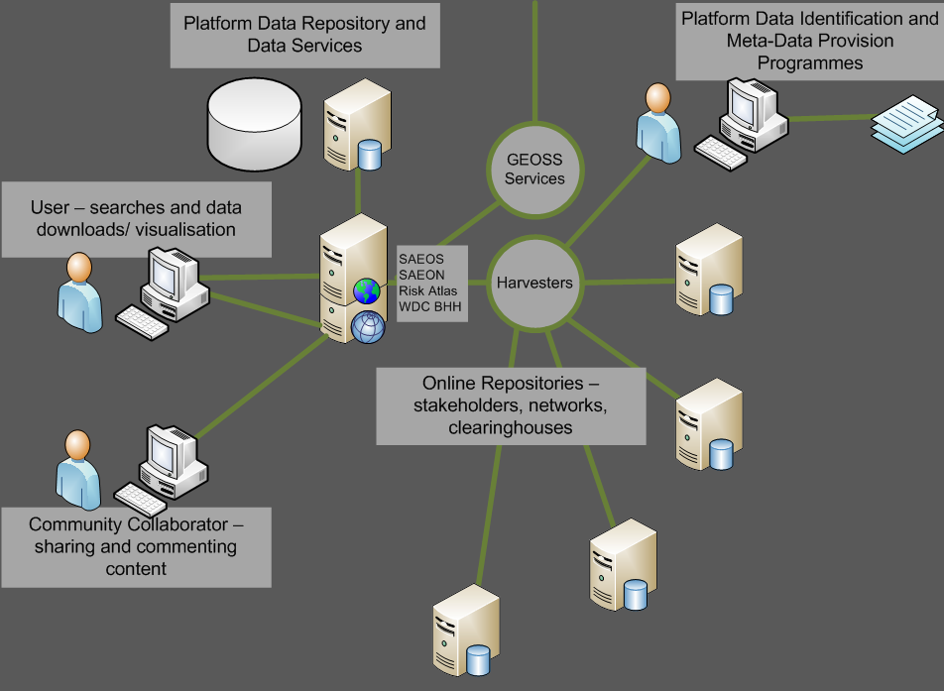
Main Use Cases Phase 1: Discovery and Visualisation

Slide 4
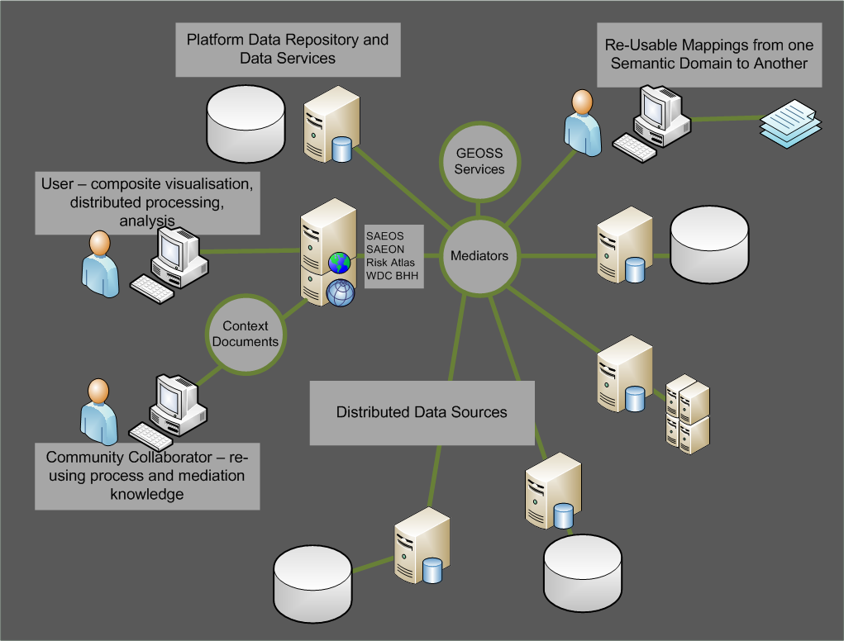
Main Use Cases Phase 2: Mediation and Collation

Slide 5
MAIN USE CASES Phase 3: AUTOMATED PROCESS CHAINING
?

Slide 6
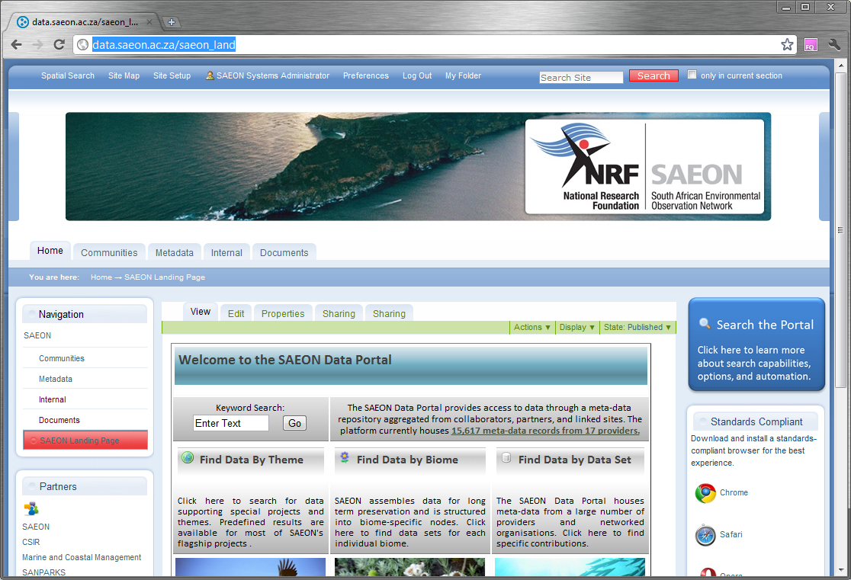
Landing Page
Immediately Searchable
Immediately Searchable

Slide 7
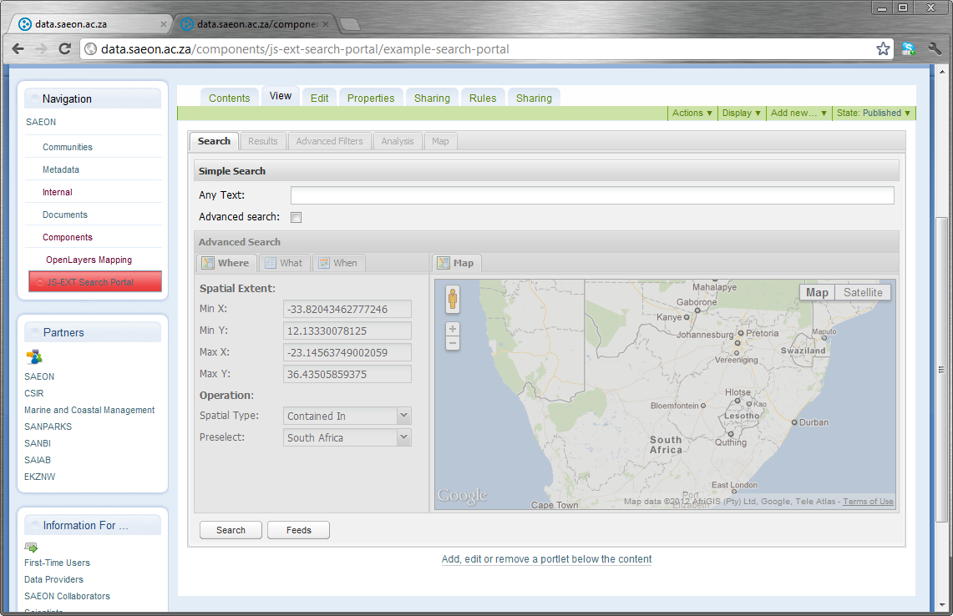
Search Page
Simple and Advanced Searches

Slide 8
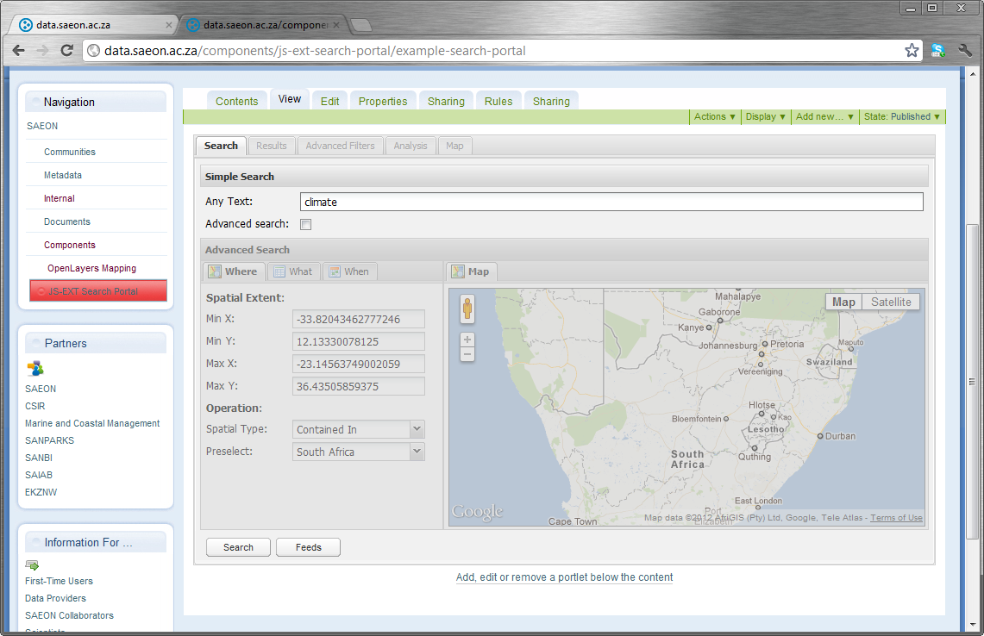
Keyword (Simple) Search
Search on Keyword
Search on Keyword

Slide 9
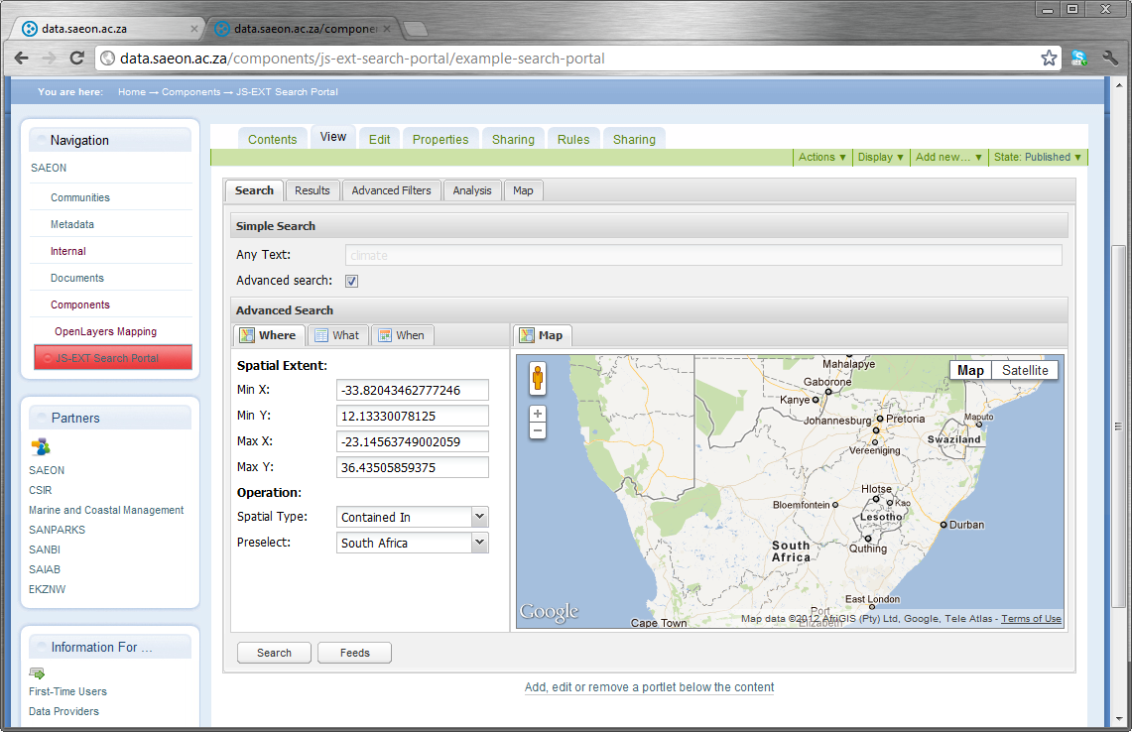
Advanced Search
Advanced Search Facility

Slide 10
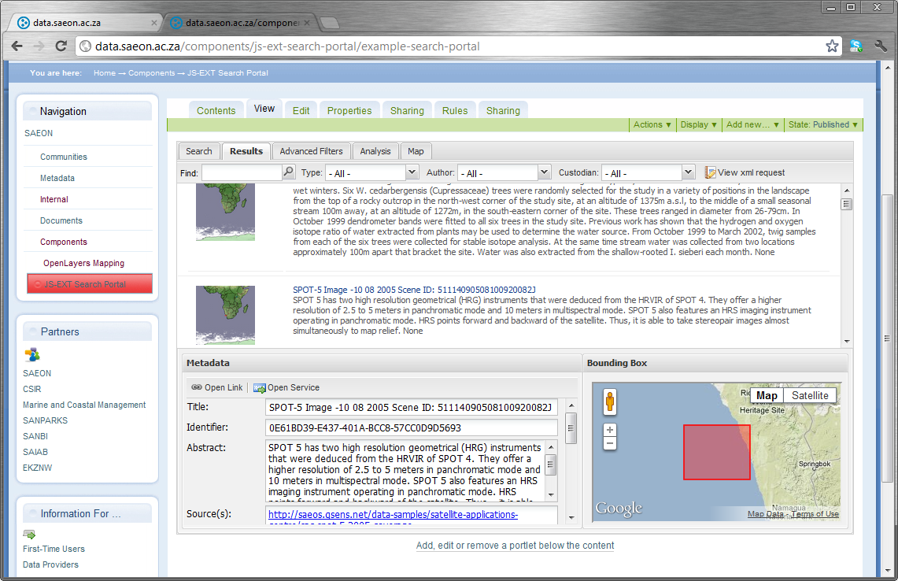
Typical Search Result
Results are returned
Approximate
Location
Appilcable Meta-Data

Slide 11
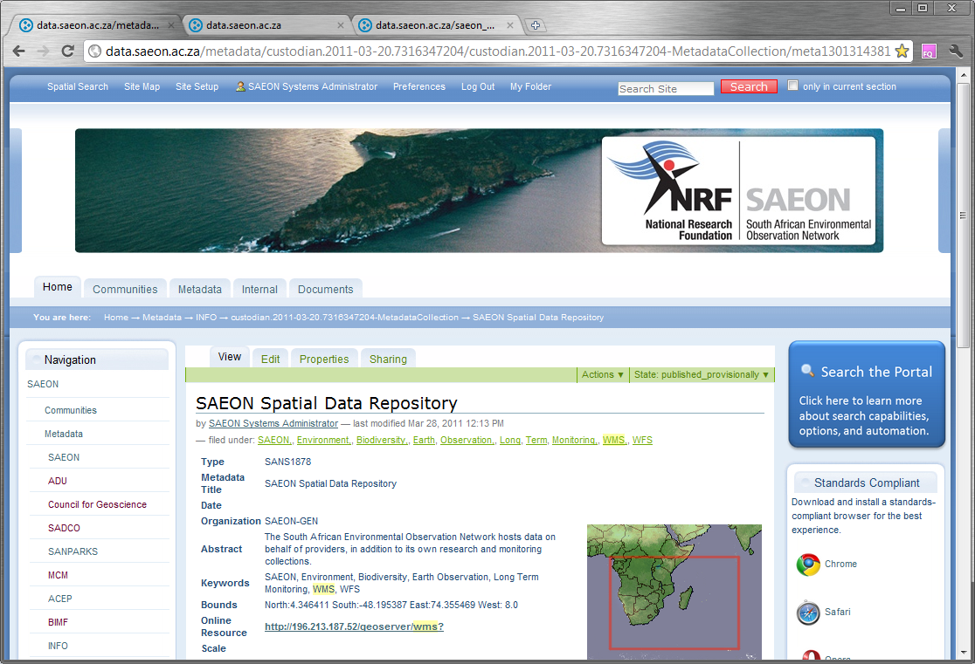
Individual Meta-Data Record
Individual Meta-Data Record

Slide 12
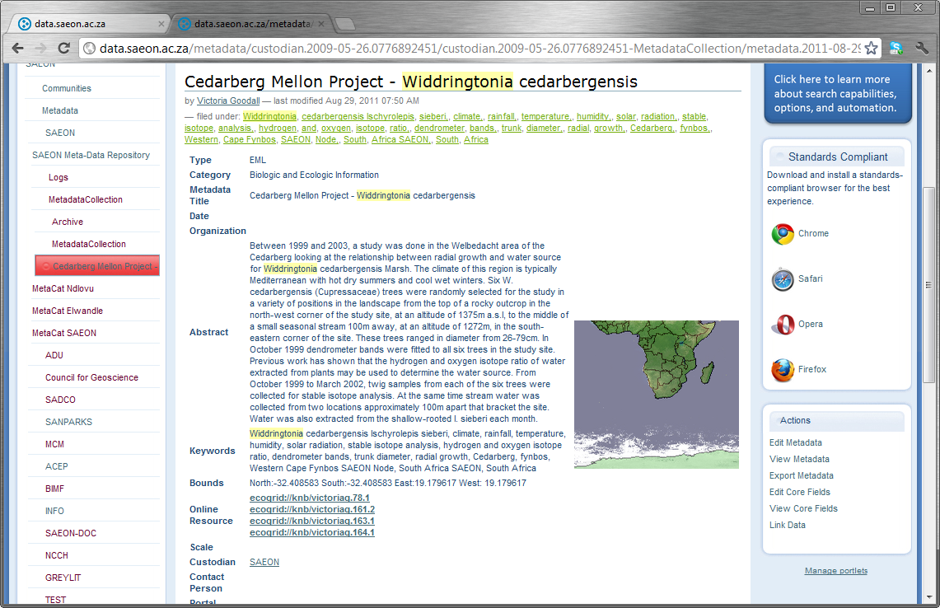
Meta-Data can have multiple links
Multiple Data Links

Slide 13
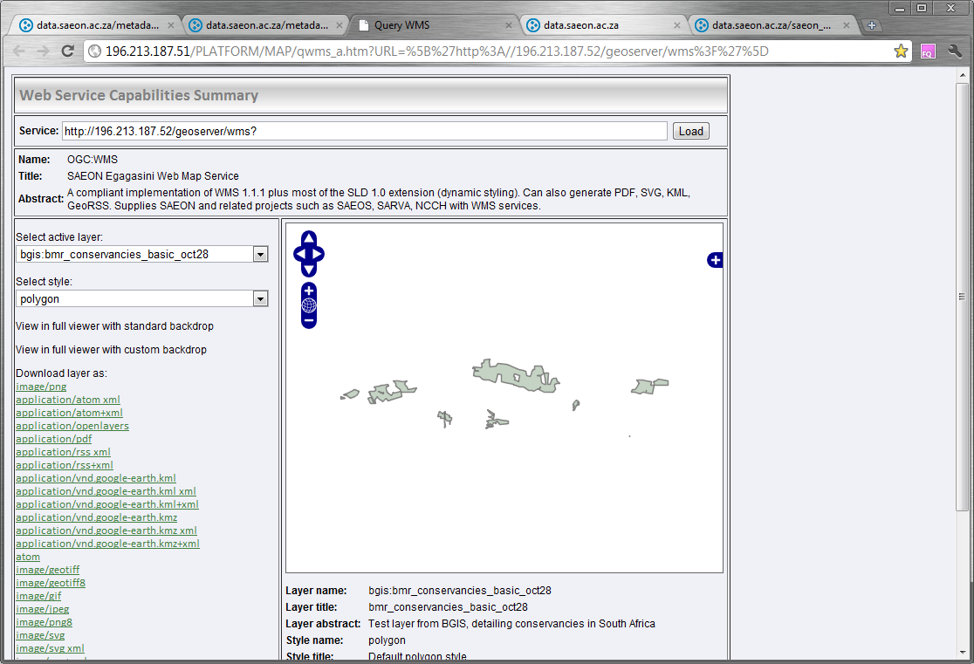
Data Preview
Standardised Data can be previewed
It can also be downloaded in a variety of formats – depending on the type of resource.

Slide 14
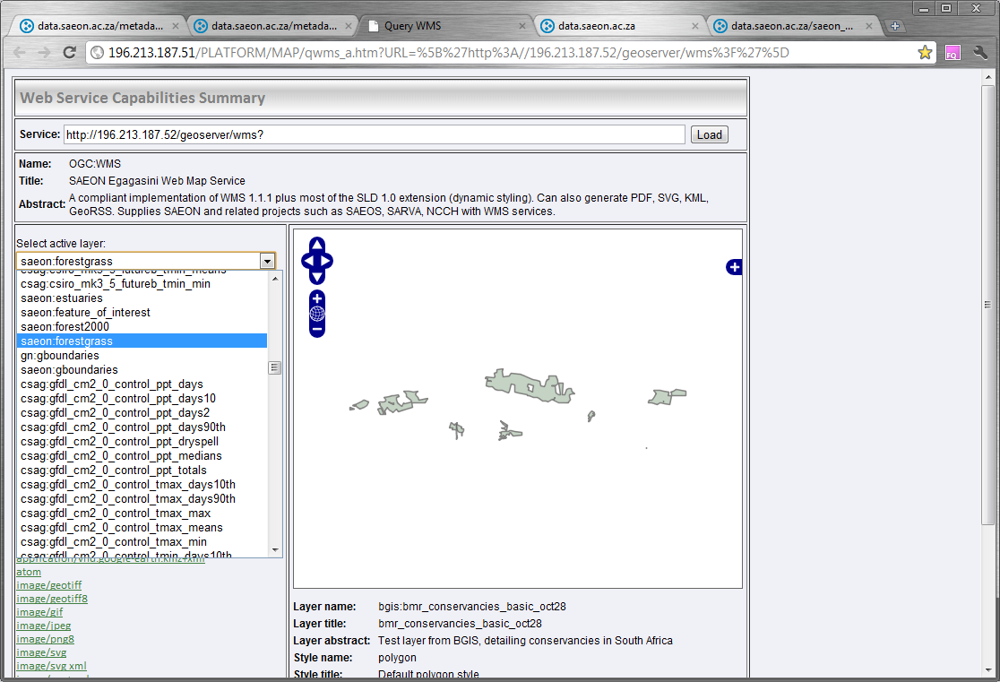
Potentially multiple data layers in the same service
Select alternative layer

Slide 15
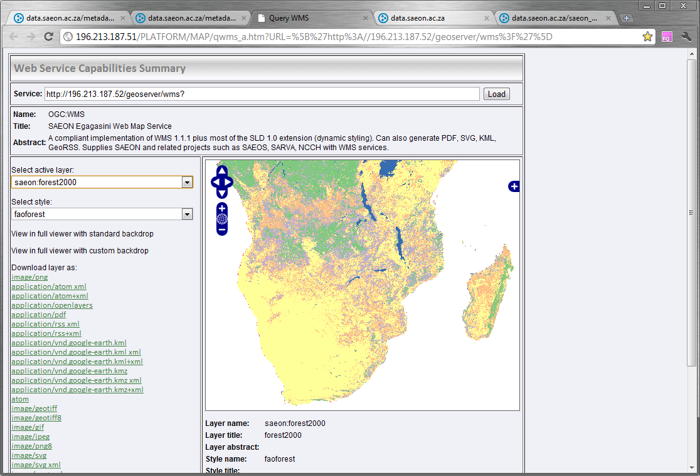
Alternative data layer at same service
FAO Forest Cover

Slide 16
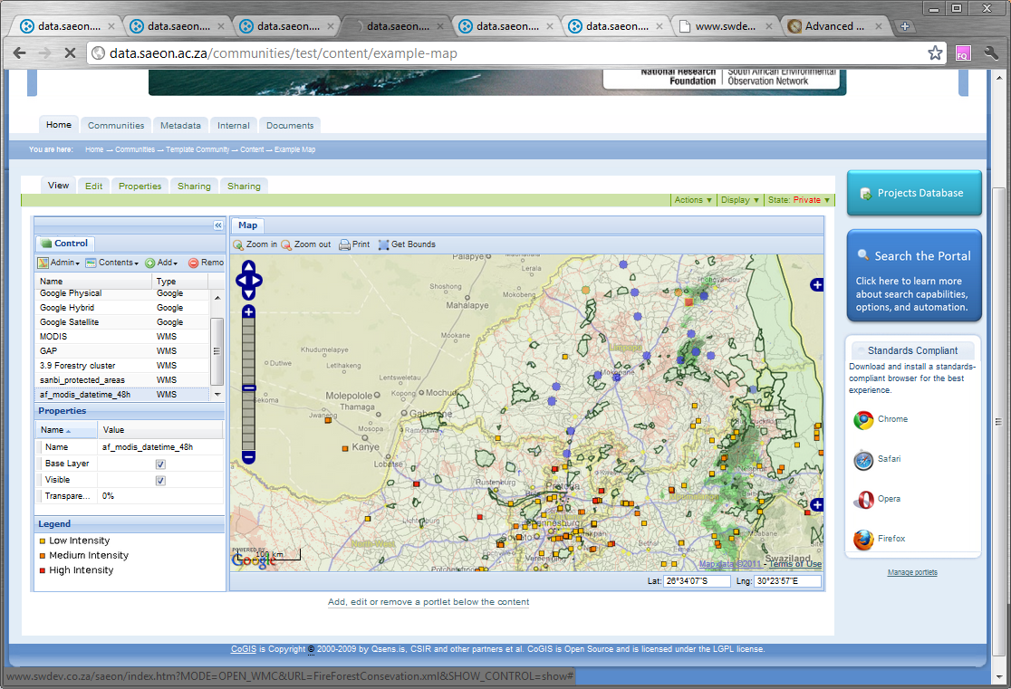
Packaging automated data for display
Composite map from distributed data sources

Slide 17
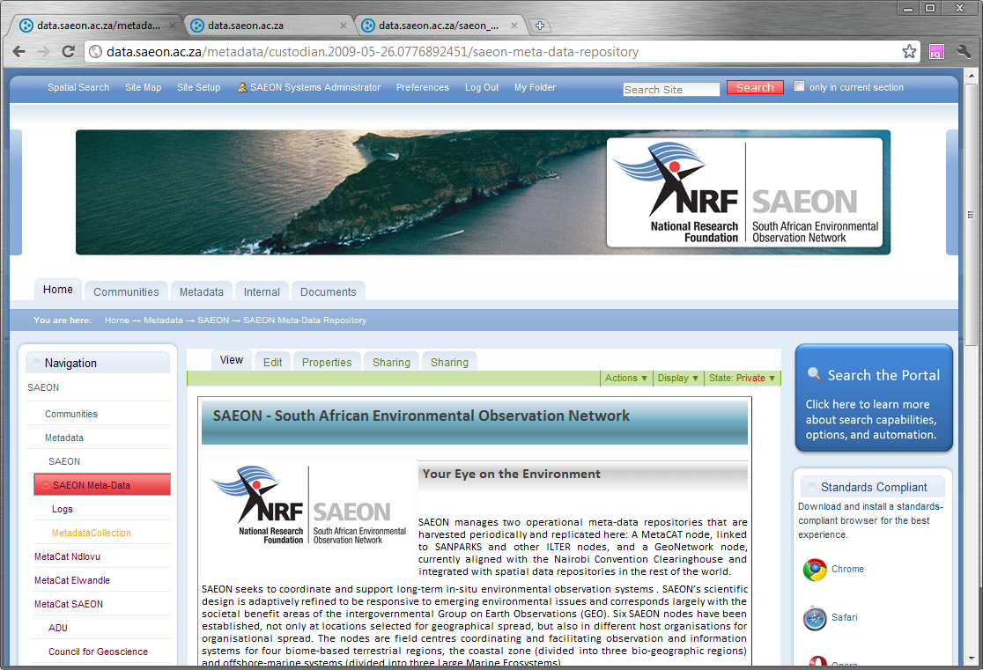
Custodian Landing Page
Detailed Custodian Page

Slide 18
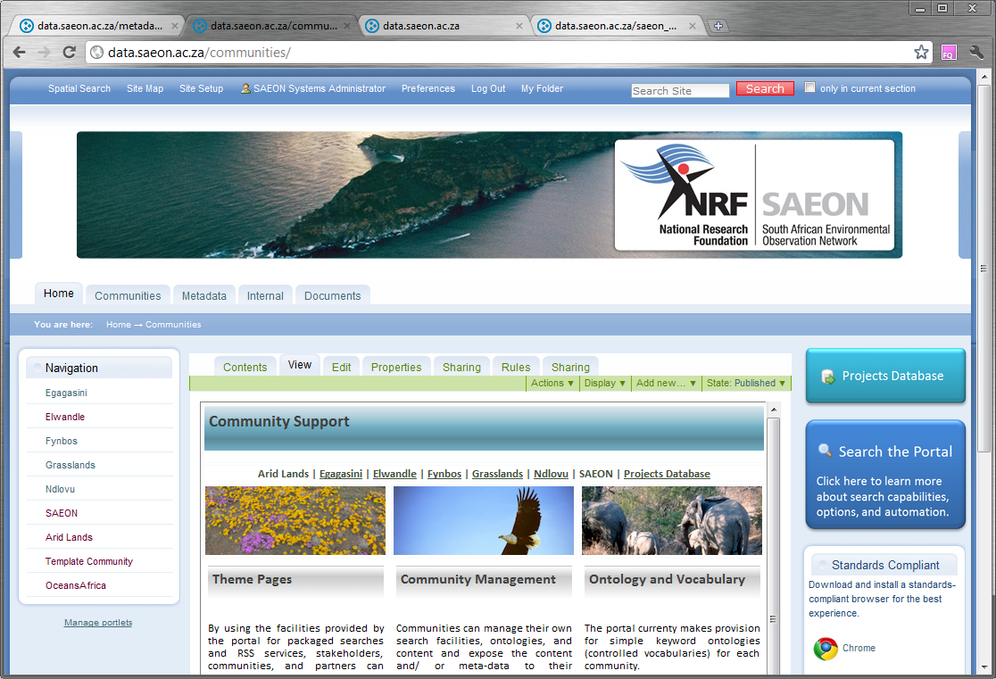
Communities of Practice
Node Communities
Community Pages

Slide 19
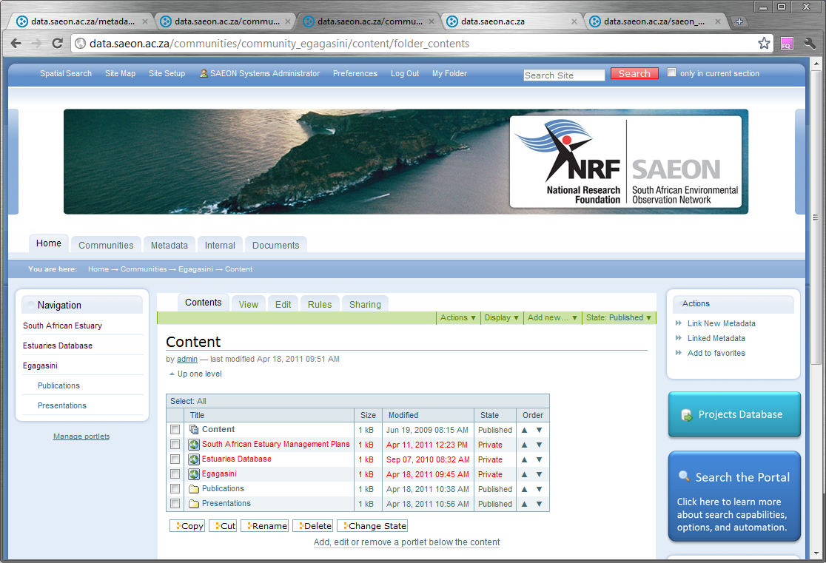
Communities manage their own content …
Community Content

Slide 20
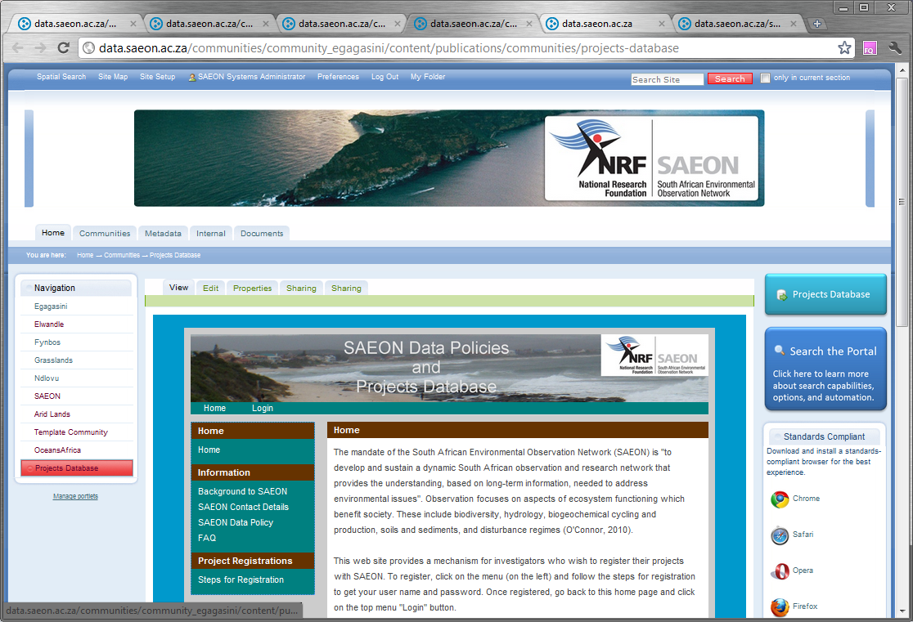
… and embed tools or systems
Community Tools

