Slide 1
Tutorial: Bulk File Uploads
G342.2.1 Bulk File Uploads
Wim Hugo

Slide 2
Using WebDAV to Upload Files
WebDAV is an improved FTP-type protocol for interacting with file systems on a web server or website.
Windows 7:
WebDAV is enabled, but doesn’t work very well.
Issues are security-related – see http://www.techiechips.com/web-folders-web-disk-webdav-problems-on-windows-7/ for more information.
Investigated alternatives: best appears to be a shareware product called BitKinex.
Following slides explain installation and use.
Windows XP:
WebDAV should work – see instructions on last slide.

Slide 3
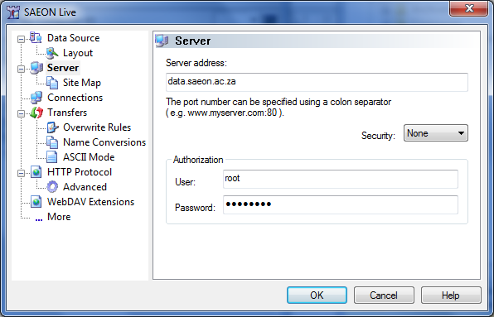
Download and Install BitKinex
Download from the data portal at http://data.saeon.ac.za/documentation/code-repository/bitkinex323.exe
Run and install
On completion, BitKinex asks if the user wants to configure a data source – complete the screen similar to the one below using the data portal web address and your user account information:
SAEON Data Portal Web Address
Username and Password

Slide 4
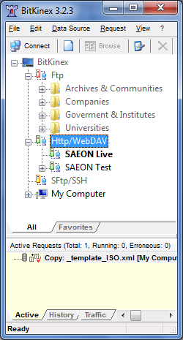
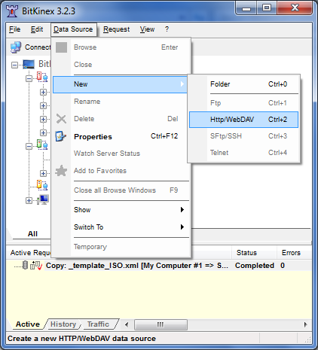
Creating a new Data Source
Alternatively, one can run BitKinex and define a Data Source:
Make sure the ‘HTTP/ WebDAV’ node is selected
Select ‘Data Source’ and ‘New’ from the menu
Choose ‘HTTP/WebDAV’

Slide 5
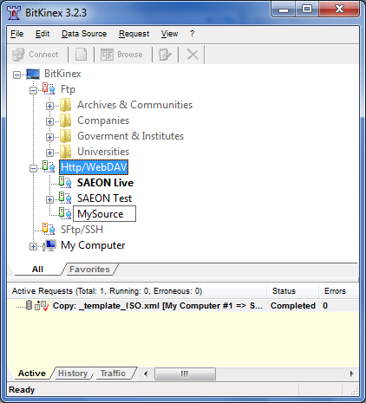
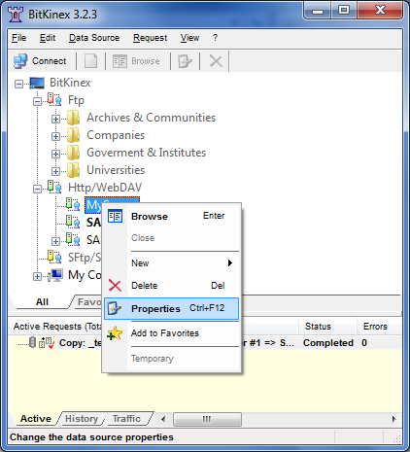
Configuring a Data Source
A new sub-node is opened, and one can then type a name for the source.
Right-click on the new Data Source to set its properties

Slide 6
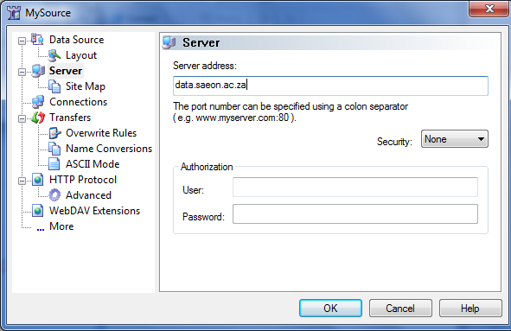
Data Source Properties
Type the web address for the WebDAV target – in this case the SAEON Data Portal.
Provide your user name and password.
Click ‘OK’.
SAEON Data Portal Web Address
Username and Password

Slide 7
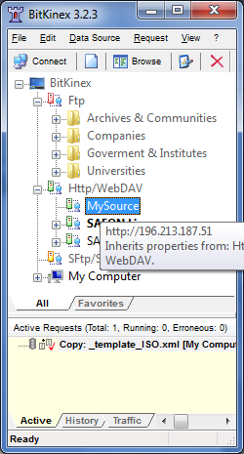
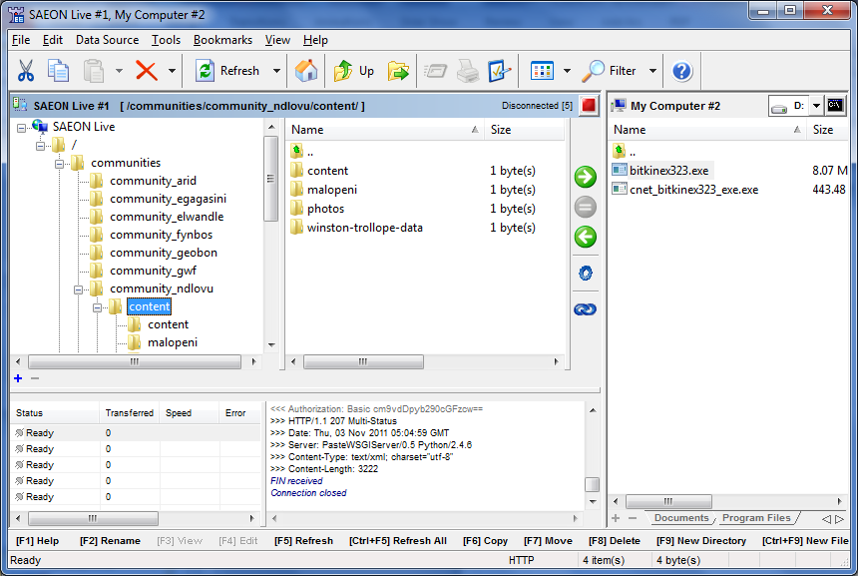
Connecting to the Site
To connect, simply double-click the new WebDAV Node
This opens a separate panel showing the folder structure for the target website

Slide 8
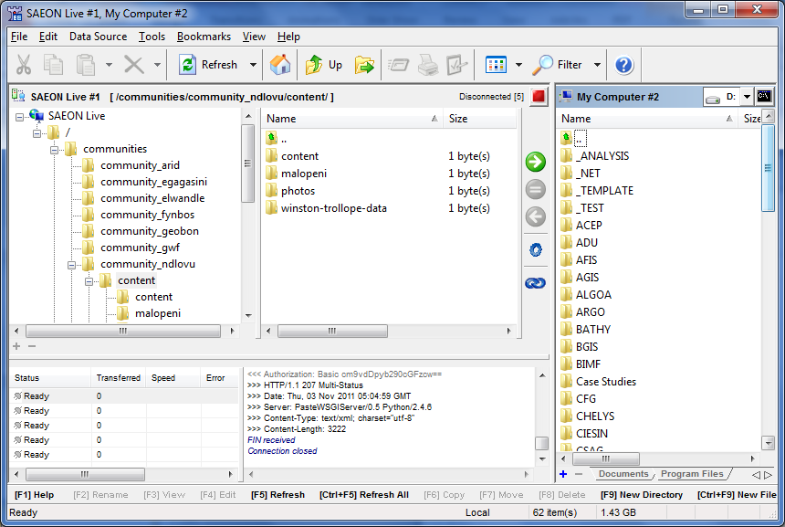
Transferring files
The left-hand panels show the portal file structure
To transfer files, drag them here …
… from the source on your own disk.
Follow transfer progress here.

Slide 9
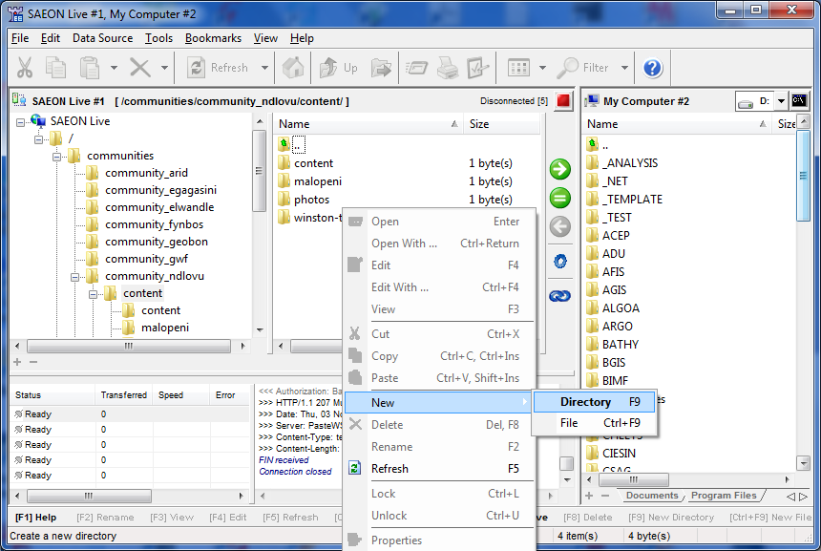
Creating a New Sub-Folder
Right-click here to create a new folder (directory)
NOTE that the folder will be private and that you will have to publish it from the SAEON Data Portal

Slide 10
Please note …
Please transfer content only to the ‘Content’ folders in the respective node community folders (see previous screen shot). These folders are found under the ‘Communities’ folder in the site.
All content is transferred as a Plone ‘File’ type (as opposed to images, etc.). This means that it doesn’t inherit special properties in Plone (such as being able to preview an image in the portal), but this is not a major problem: the content is downloadable and can be linked to meta-data.
Use this method especially for collections that all share the same meta-data (for example a set of PDF’s that will all have one meta-data record). Place all items that need to share a meta-data record in a folder of its own – the folder can be linked to meta-data.
The product appears to work well but hasn’t been tested extensively.

Slide 11
Windows XP
Here are the instructions to set up WebDAV on windows XP:
Open Windows Explorer, Select Tools, and then Map Network Drive...
Select 'Sign up for online storage or connect to a network server' to get to the 'Add Network Place Wizard‘
Select 'Choose another network location' and click Next
In the address, enter http://USERNAME@data.saeon.ac.za‘ and click Next. Replace USERNAME with you site login.
You will be prompted for the site user name and password and finally the name of the Network Place
The target then becomes a folder in which you can navigate, copy, paste, and delete files.

