Slide 1
Adding and Managing Users
Example: SAEON Data Portal
Updated: 14 Nov 2011

Slide 2
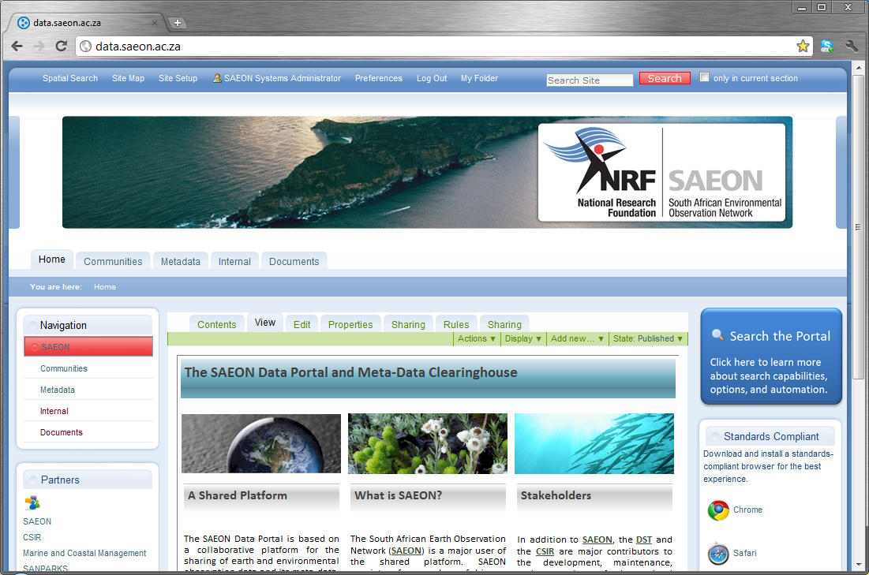
Adding and Managing Users
Click on
‘Site Setup’

Slide 3
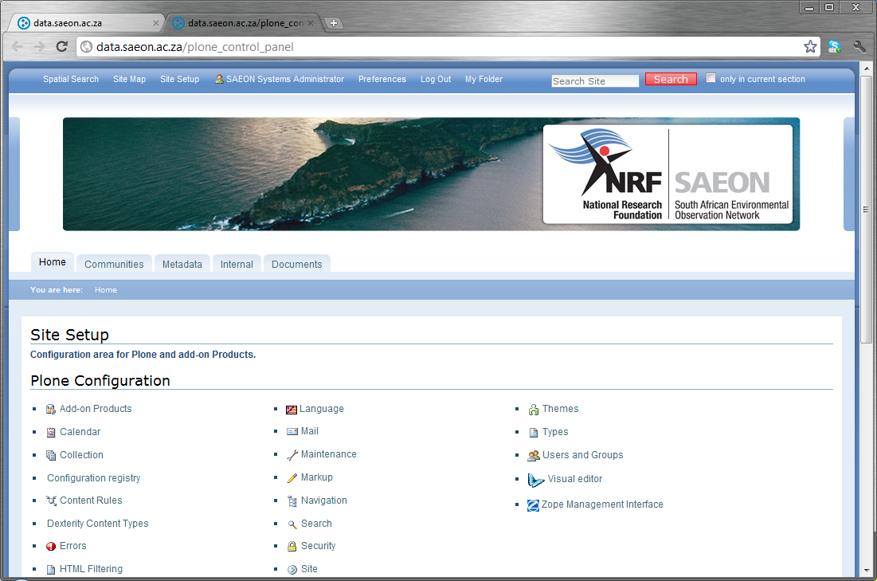
User Management
Click on
‘Users and Groups’

Slide 4
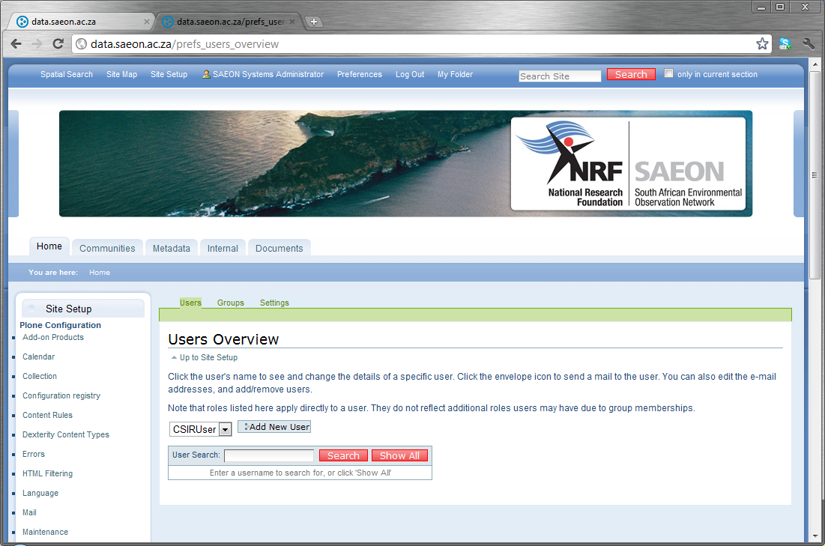
Add a New User
Click on
‘Add New User’
Don’t change the Role – not important here.

Slide 5
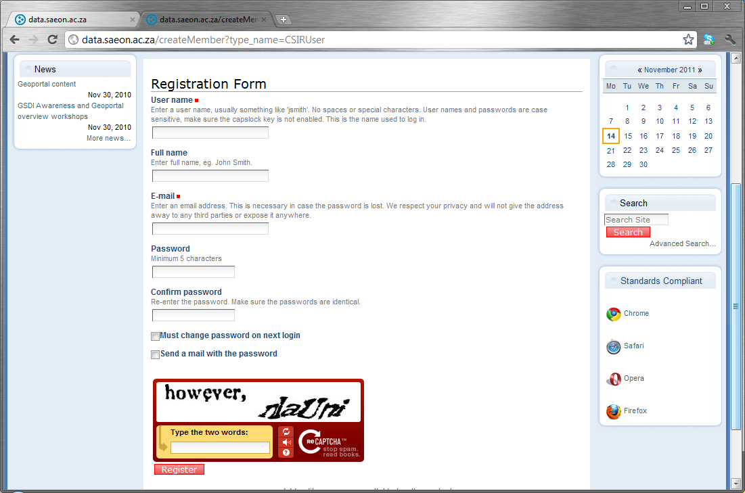
Fill in User Particulars
User Details
User Details
Add a temporary password and tick the 2 boxes
This is to avoid auto-creation of user accounts.
Click ‘Register’

Slide 6
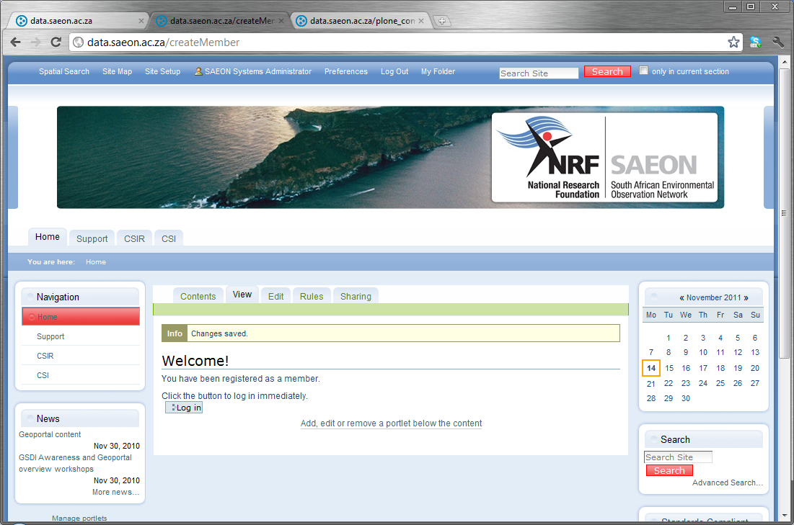
User is added with default privileges
User Details

Slide 7
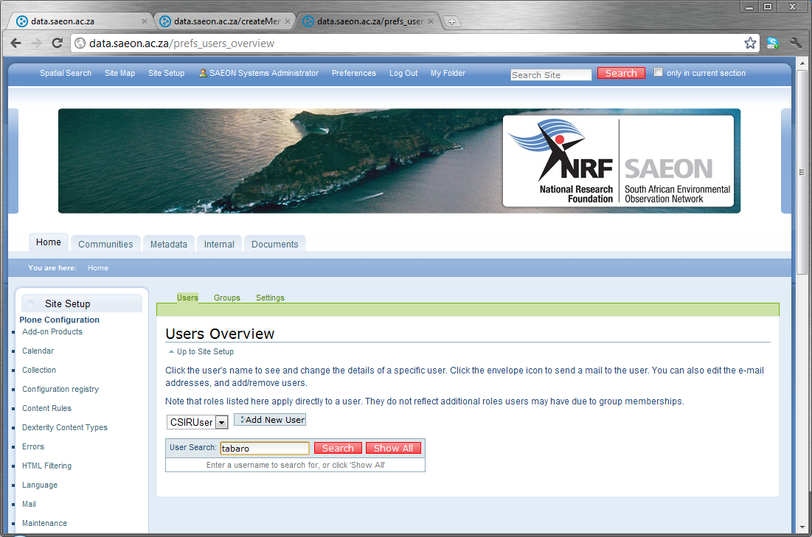
Changing User Privileges
Return to ‘Users and Groups’ in ‘Site Setup’
Return to ‘Users and Groups’ in ‘Site Setup’
Type the user name and click ‘Search’

Slide 8
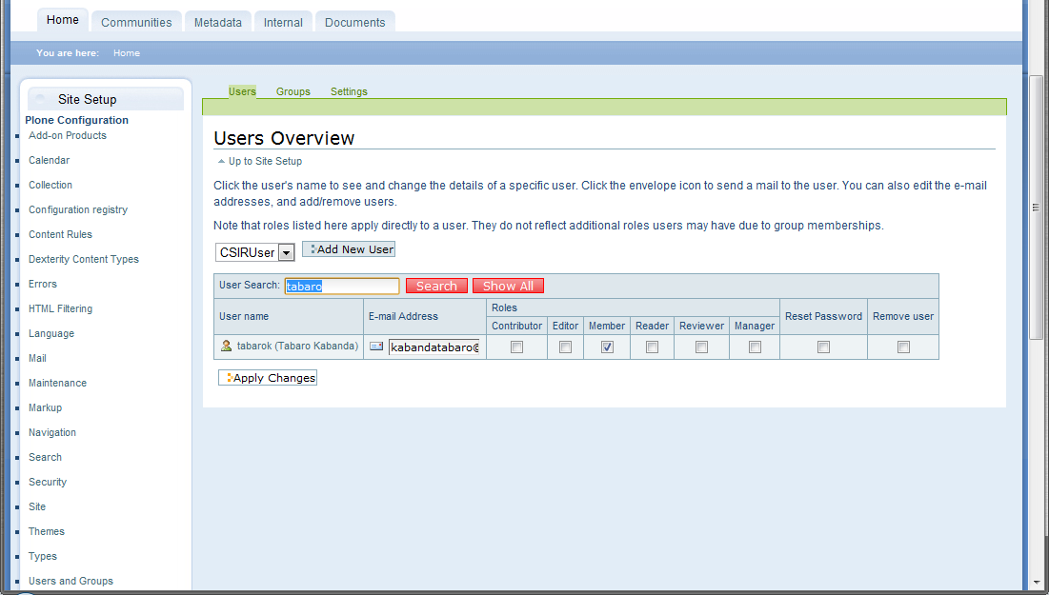
User Roles
Tick appropriate user role.
Click ‘Apply Changes’
Roles:
Can add content and edit their own items. Usually the most appropriate for our collaborators
Editor: Can edit all items – not recommended
Member: default role
Reader – Can see all items – not recommended
Reviewer: Can adjust publication states – not recommended
Manager: Administrative rights - never use this.

