Slide 1
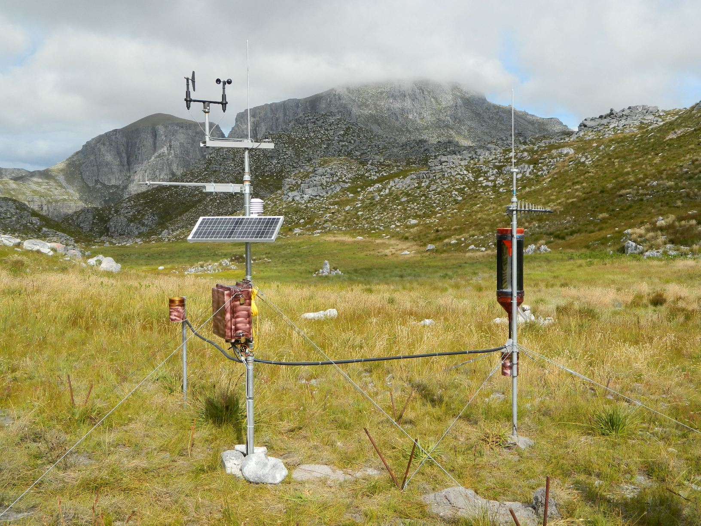
SAEON Observations Database User Documentation
Compiled by: Victoria Goodall
April 2013
Updated February 2014

Slide 2
Observations Database
The online SAEON observations database is a repository of streamflow, weather, soil moisture and other observations made within SAEON or obtained from our collaborators
Data is provided ‘as-is’ with no guarantee as to its quality or recommendation about its potential for analysis
For further details, please contact SAEON Data Scientists: data@saeon.ac.za

Slide 3
Observations Database
URL for the database:
http://observations.saeon.ac.za/
Contact a database administrator for a username and password to access the database
wayne@saeon.ac.za
wim@saeon.ac.za

Slide 4
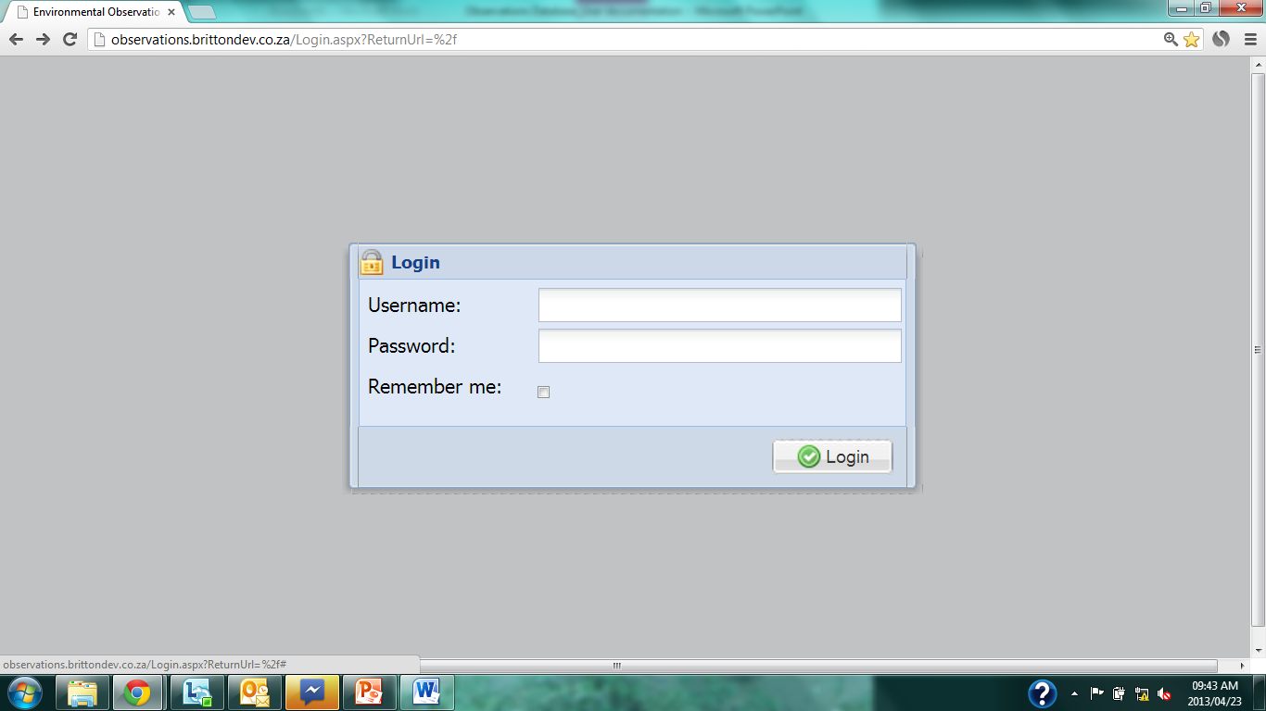
Login
Notes:
Enter username and password.
Click ‘Logon’

Slide 5
Home page – Data User
Notes:
First page as you login

Slide 6
Data Query
Notes:
Click on ‘Data Query Display’

Slide 7
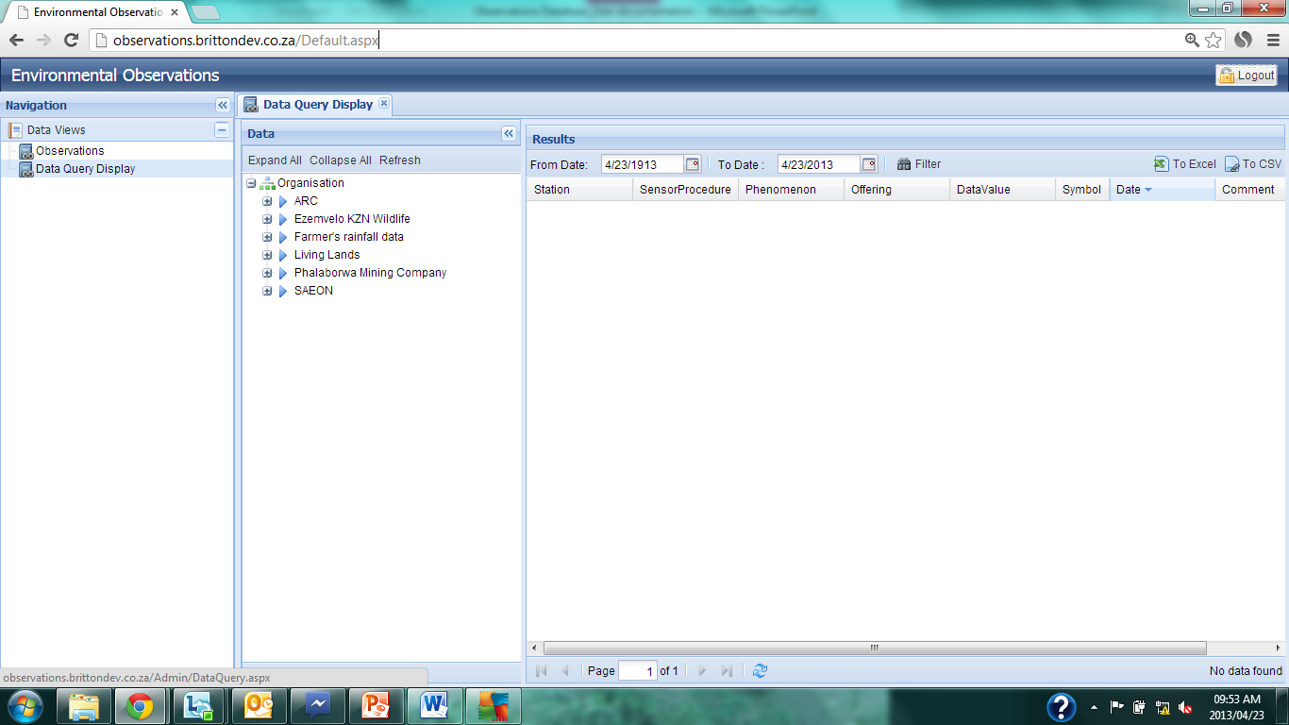
Data Query
Notes:
‘Data Query Display’

Slide 8
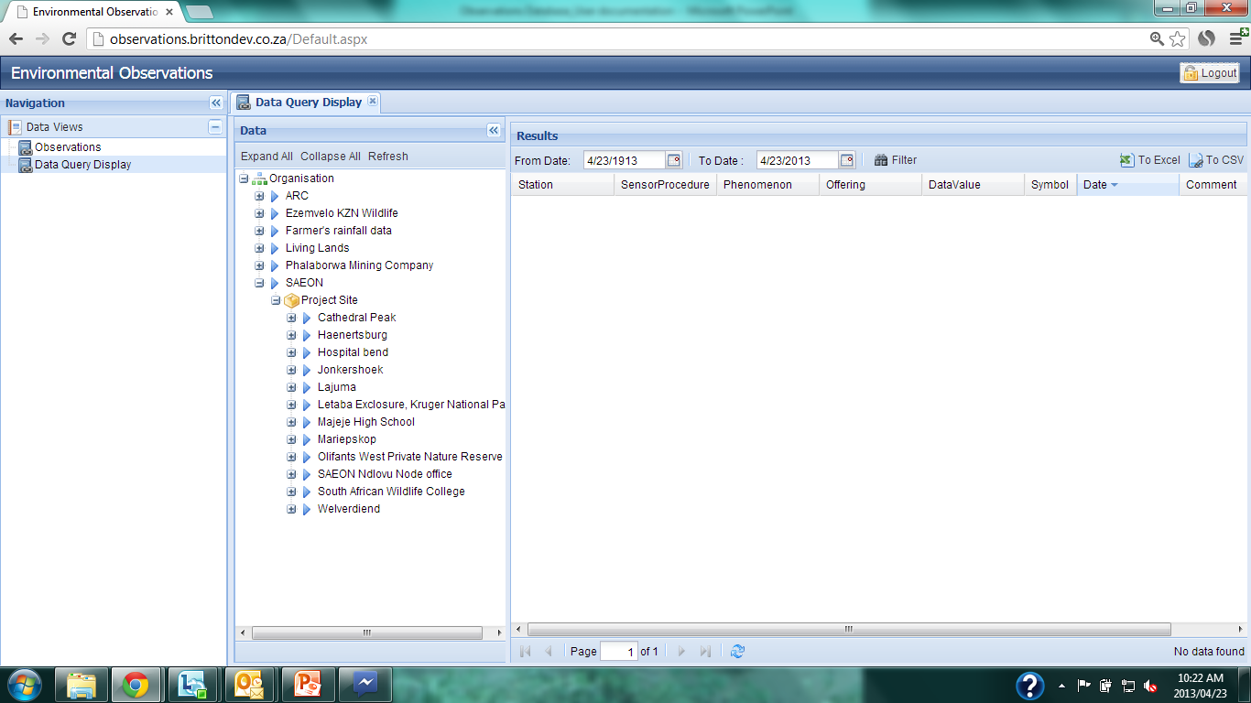
Data Query
Notes:
Click on ‘+’ sign to expand the query. Data are organized by:
Organization, Project Site, Station, Sensor, Phenomenon and Offering (what the variable is of the phenomenon being measured).

Slide 9
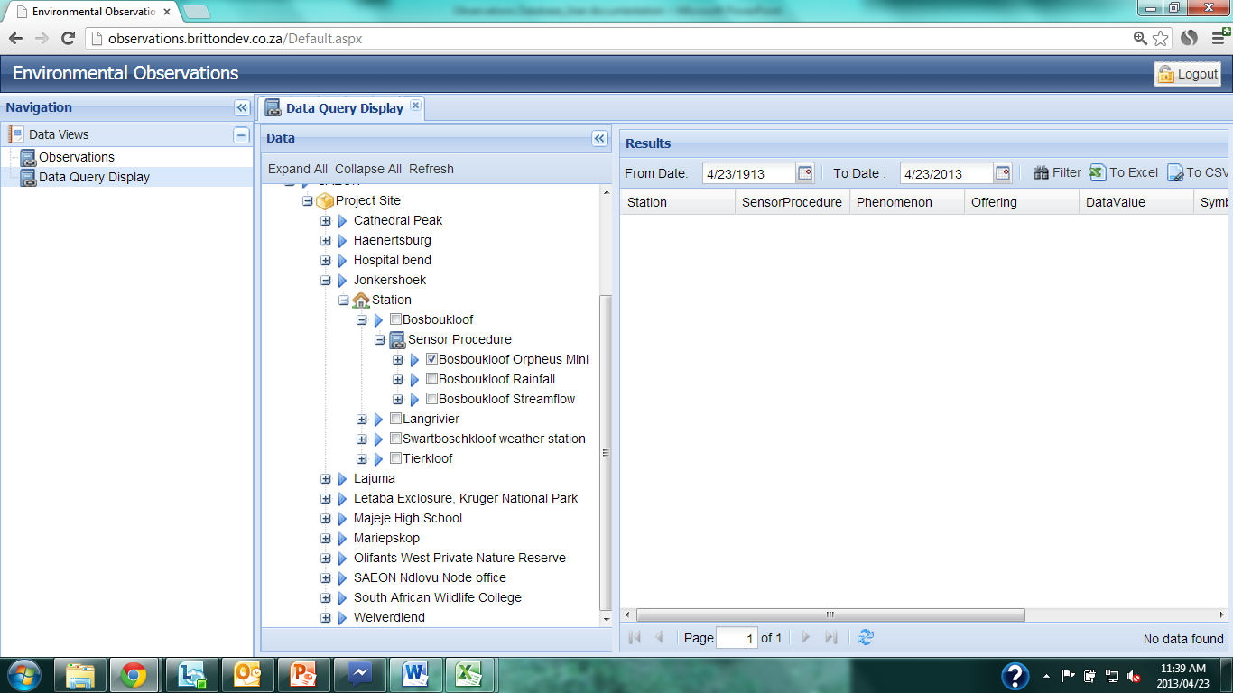
Data Query
Notes:
Drill through the desired station and click in the empty box to select the sensor(s) for which you want to download data. Multiple sensors can be selected.
If the sensor is selected, all phenomena and variables will be extracted. See next slide for example of selecting specific variables.

Slide 10
Data Query
Notes:
Continuing to drill down by clicking on the ‘+’ signs allows the user to rather select a specific phenomenon measured by the sensor (if it records multiple phenomena) and which offerings (or measurements) of a specific phenomenon (if they exist).
a ‘higher level tick’ is the box spaces right?
For this query, the higher level tick on ‘Bosboukloof Orpheus Mini’ will extract all water level and temp variables for that logger.

Slide 11
Data Query
Notes:
Run the query by clicking on either ‘Refresh’ button, highlighted on the slide.

Slide 12
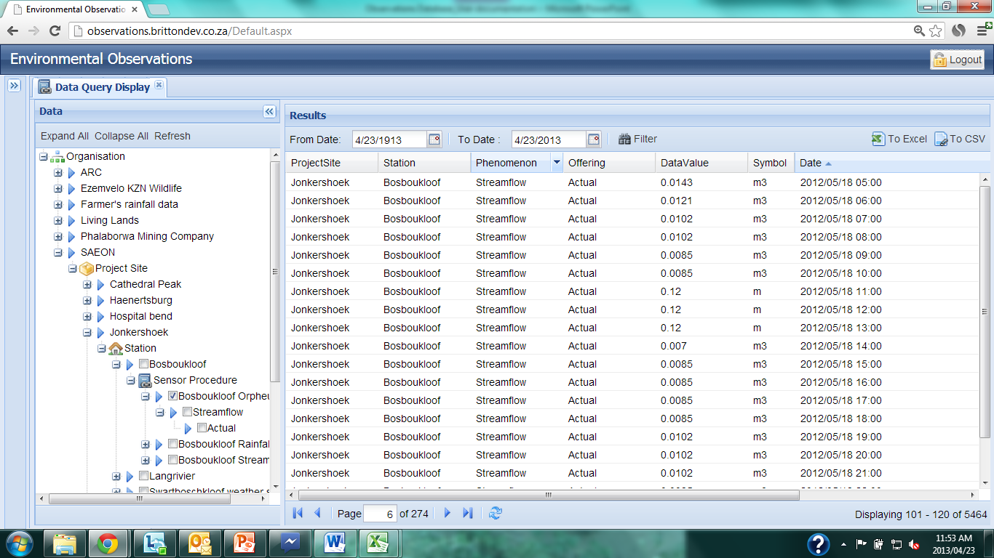
Data Query
Notes:
The data are extracted as specified in the Data Query.
The Data Value column is highlighted. The type of offering ‘Actual’ and ‘Streamflow’ is in the columns to the left, with the symbol for the unit of measure (m³) in the column to the right.

Slide 13
Data Query
Notes:
The date range of the queried data can be altered by adjusting the ‘To’ and ‘From’ dates. To modify the dates, click on the calendar icon to the right of the date. Once the desired date range is selected, click on ‘Filter’.

Slide 14
Data Query
Notes:
The number of records extracted by the query are shown in the bottom right-hand corner, as well as which of those records are shown in the viewing pane at the time.

Slide 15
Data Query
Notes:
The number of pages of results are shown at the bottom, middle of the page. The page that is viewed can be changed by clicking either on the forward or backward arrows or by typing a number into the page box. The data will update after the ‘Enter’ key is pushed or by clicking on the ‘Refresh’ button next to the forward arrows, highlighted above.

Slide 16
Data Query
Notes:
The data view is sorted by the column which has a small arrow to the right of the column name. The direction of the arrow (up or down) indicates the direction the data are sored (ascending or descending).

Slide 17
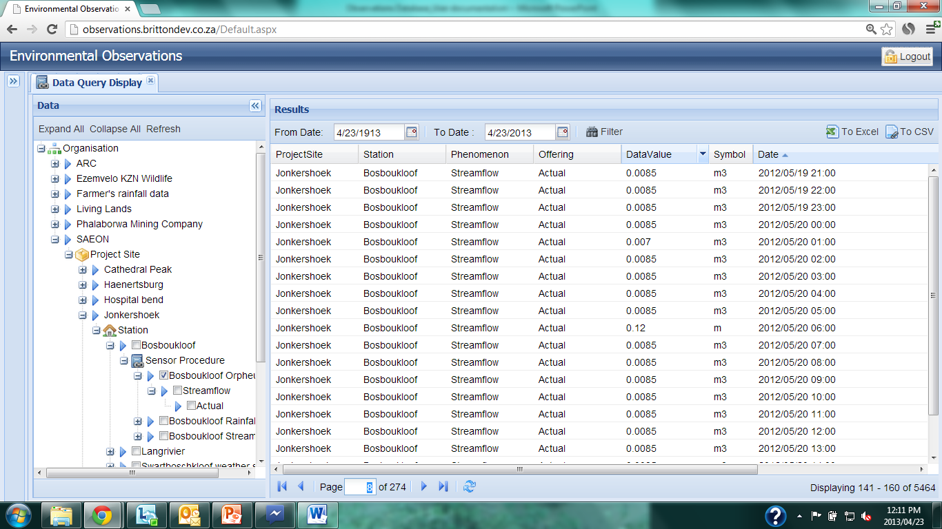
Data Query
Notes:
If the mouse is hovered over one of the column headers, an arrow appears which provides a drop down box. If this arrow is clicked, additional query options become available.

Slide 18
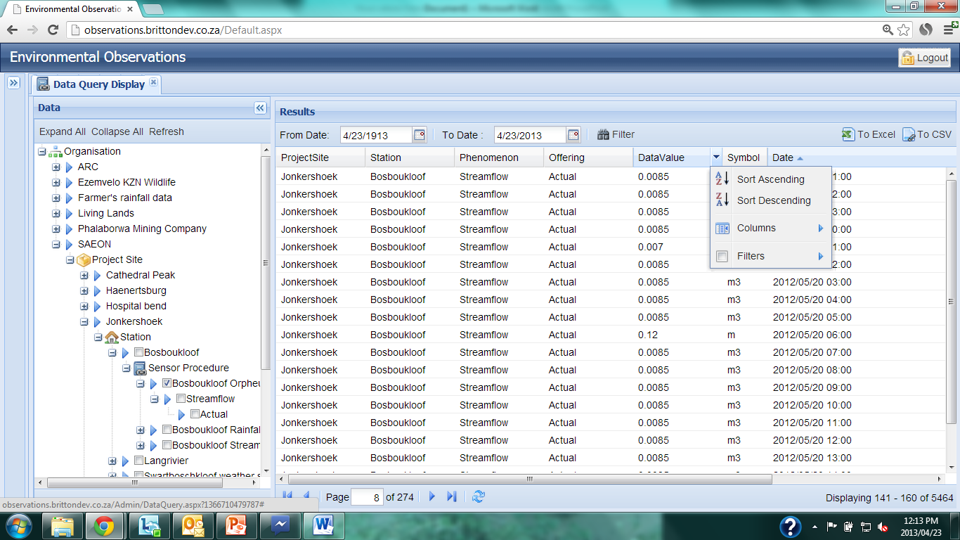
Data Query
Notes:
The queried data can either be sorted ascending or descending order of the highlighted variable; the displayed columns can be altered or additional filters can be added to the query.

Slide 19
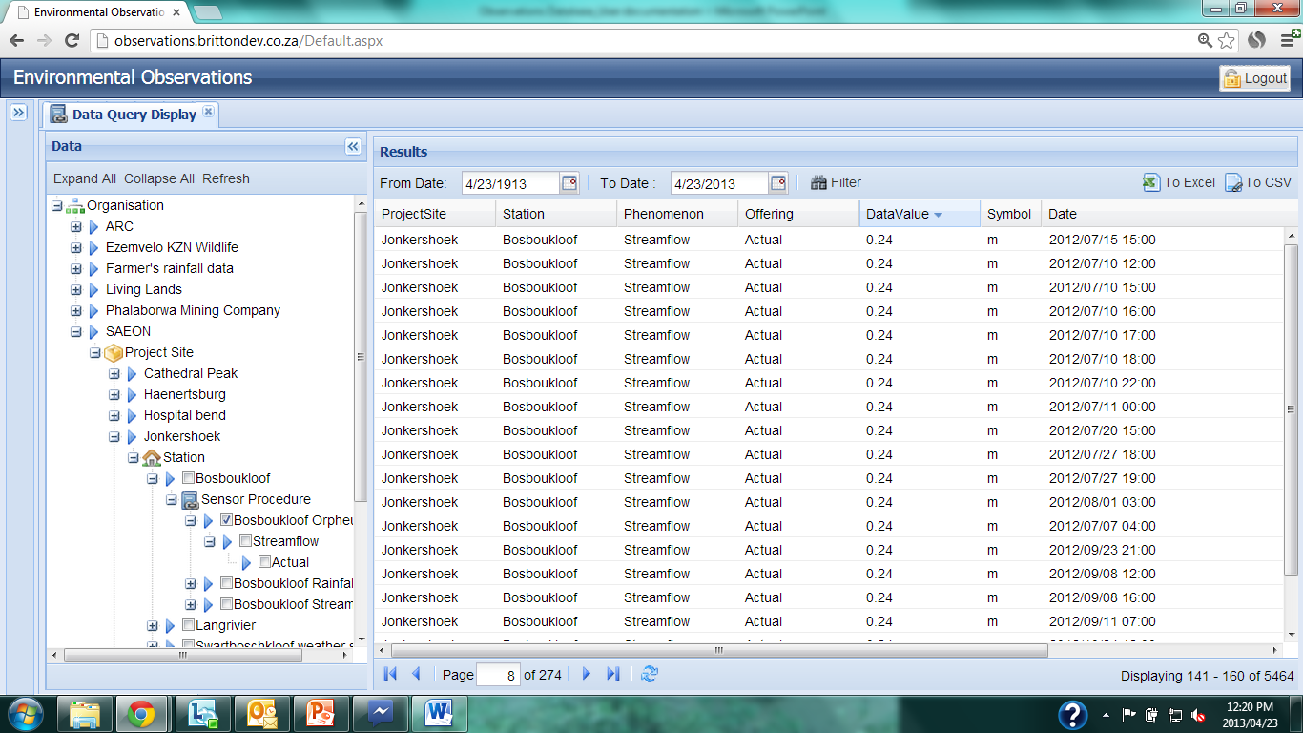
Data Query
Notes:
If Sort Descending is selected, the queried data are sorted by the selected column, and the small ordering arrow shifts from the previous variable to indicate the current sort variable.

Slide 20
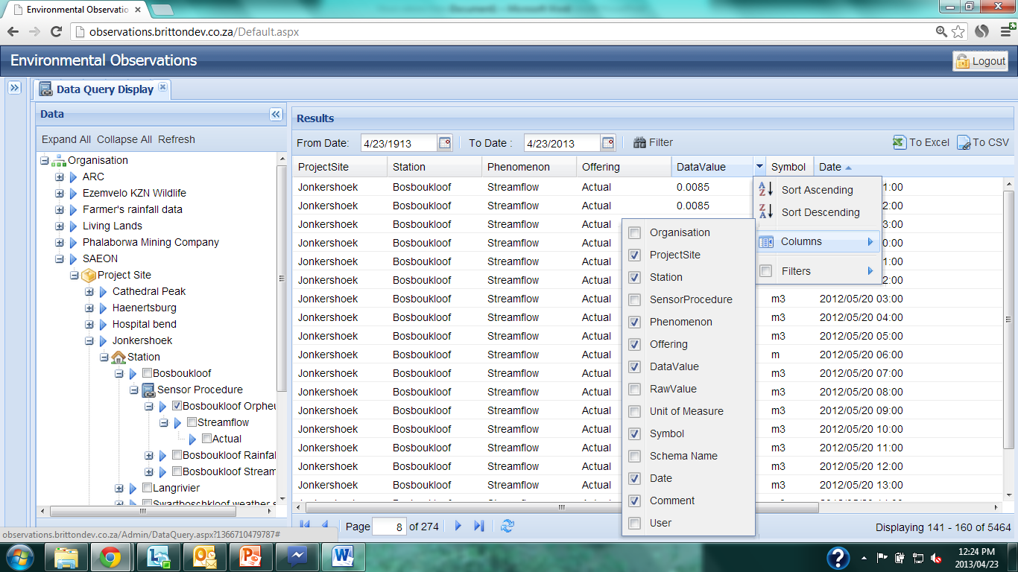
Data Query
Notes:
The columns which are displayed in the Data Query can be changed by selecting ‘Columns’ from the dropdown box, and checking or unchecking the desired column variables.

Slide 21
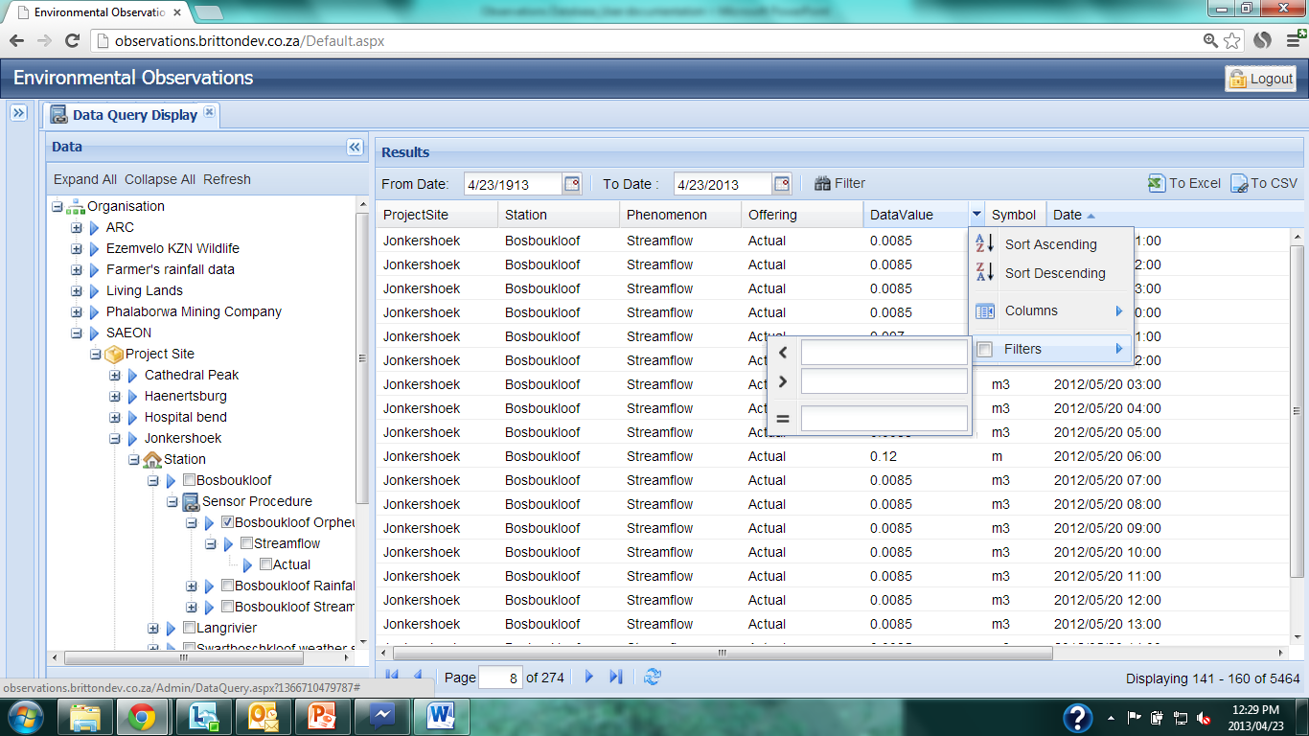
Data Query
Notes:
The data can be filtered further by placing a filter on the selected variable. This can either extract a value range or an exact value for the selected variable.

Slide 22
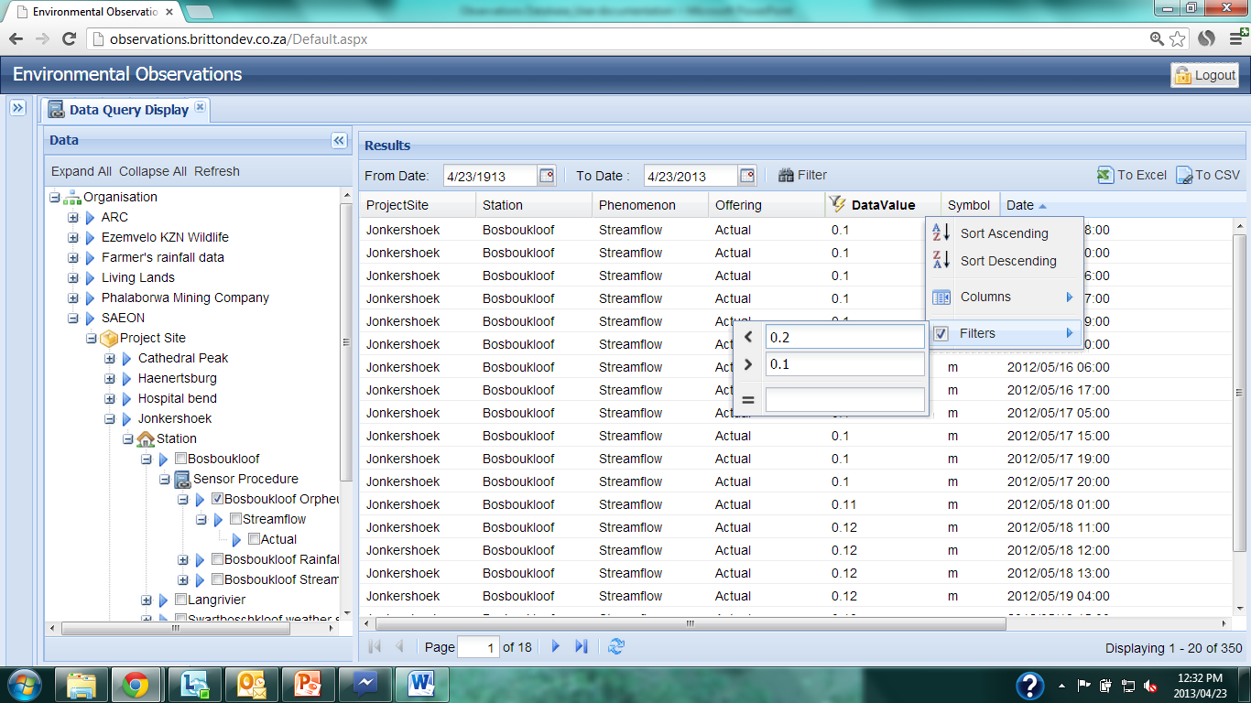
Data Query
Notes:
For example, a filter can be placed on the Data Value column to only extract values between 0.1 and 0.2. You will notice that the number of records returned by the query is now much smaller, as can ne seen in the bottom right hand corner. Or it will say ‘no data found’

Slide 23
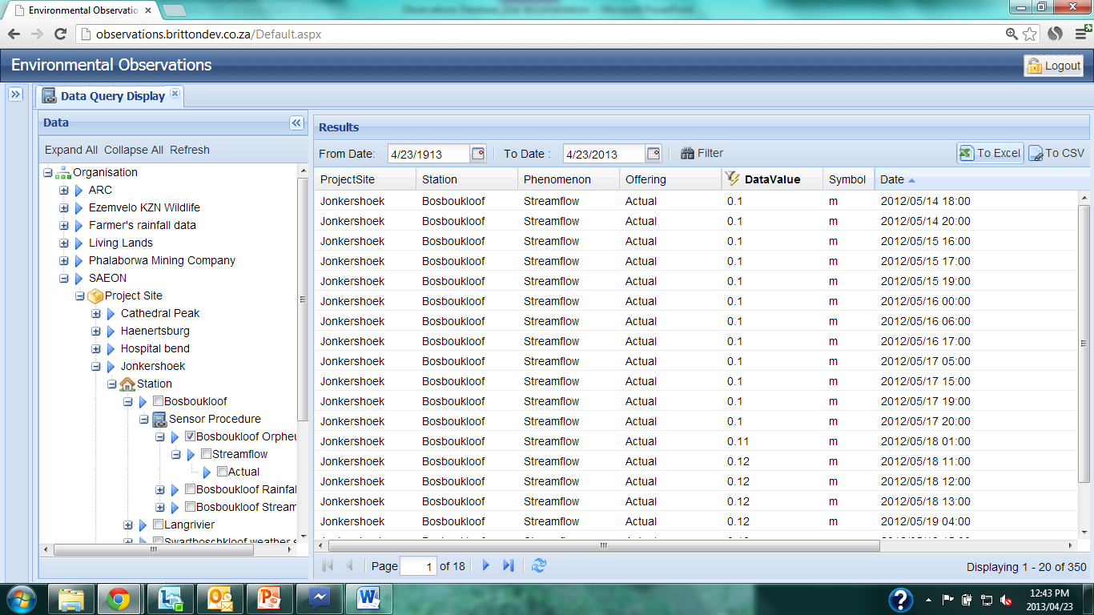
Data Query
Notes:
When the data are being filtered on a column value or range, that column is highlighted with a bold header and a filter sign to the left of the heading.

Slide 24
Data Query
Notes:
The queried data can be download to either a Microsoft Excel file or in .csv format using the buttons on the top right.
NOTE: only the data for the date ranges and applied filters will be extracted. The number of records in the downloaded file will correspond to the number of records in the Data Query display shown on the bottom right.

Slide 25
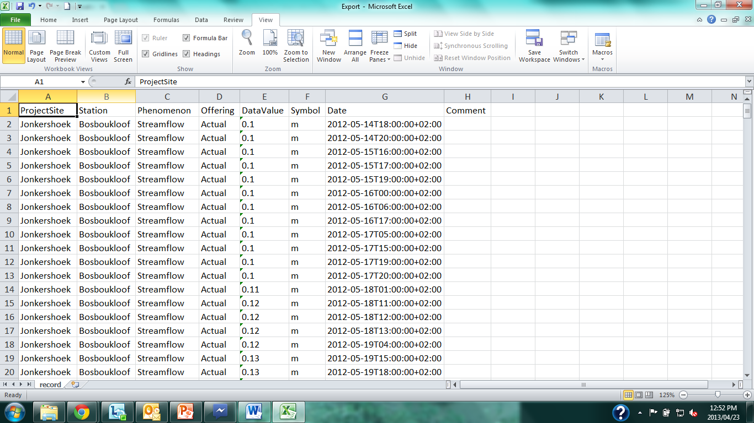
Data Query
Notes:
The queried data can then be opened in the Excel or .csv format.

Slide 26
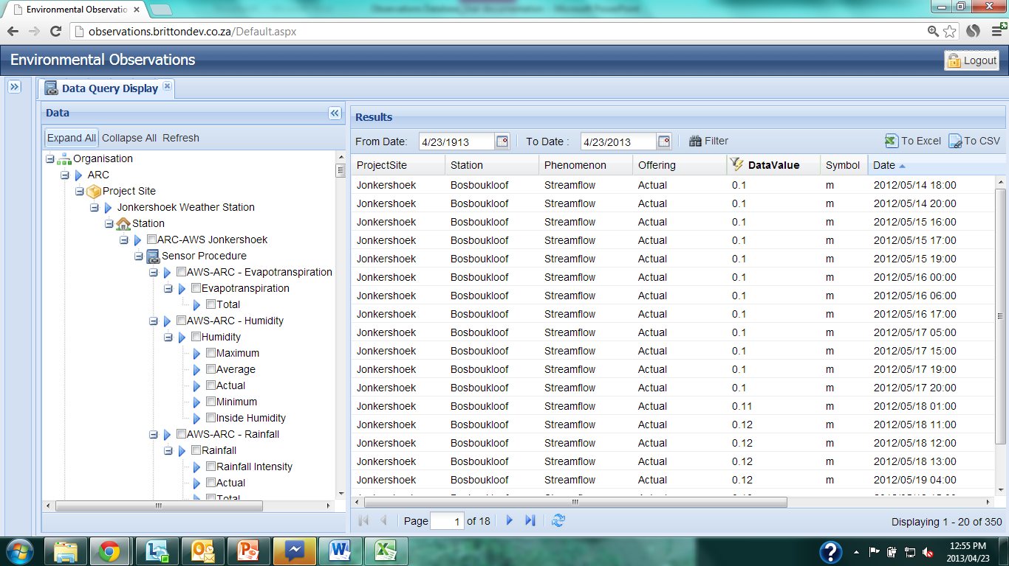
Data Query
Notes:
The Data Query area can be opened up completely to show all offerings, phenomena, stations and organizations by clicking ‘Expand All’.

Slide 27
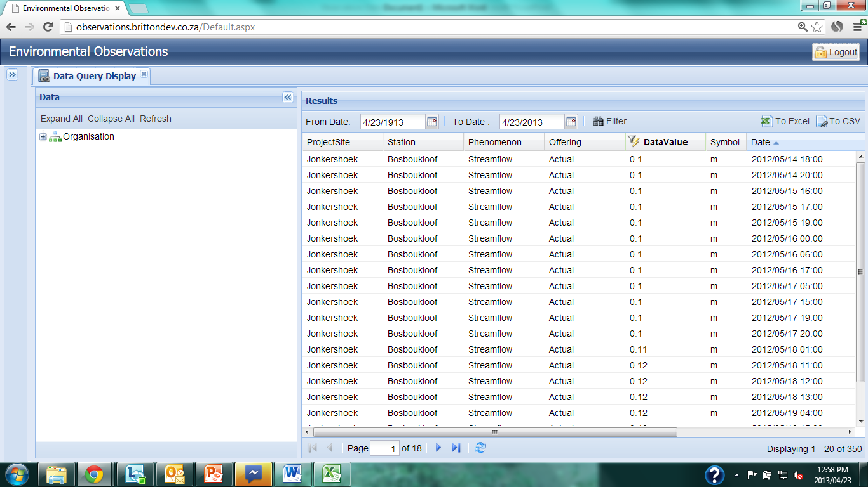
Data Query
Notes:
This view can be changed by clicking ‘Collapse All’.

