Slide 1
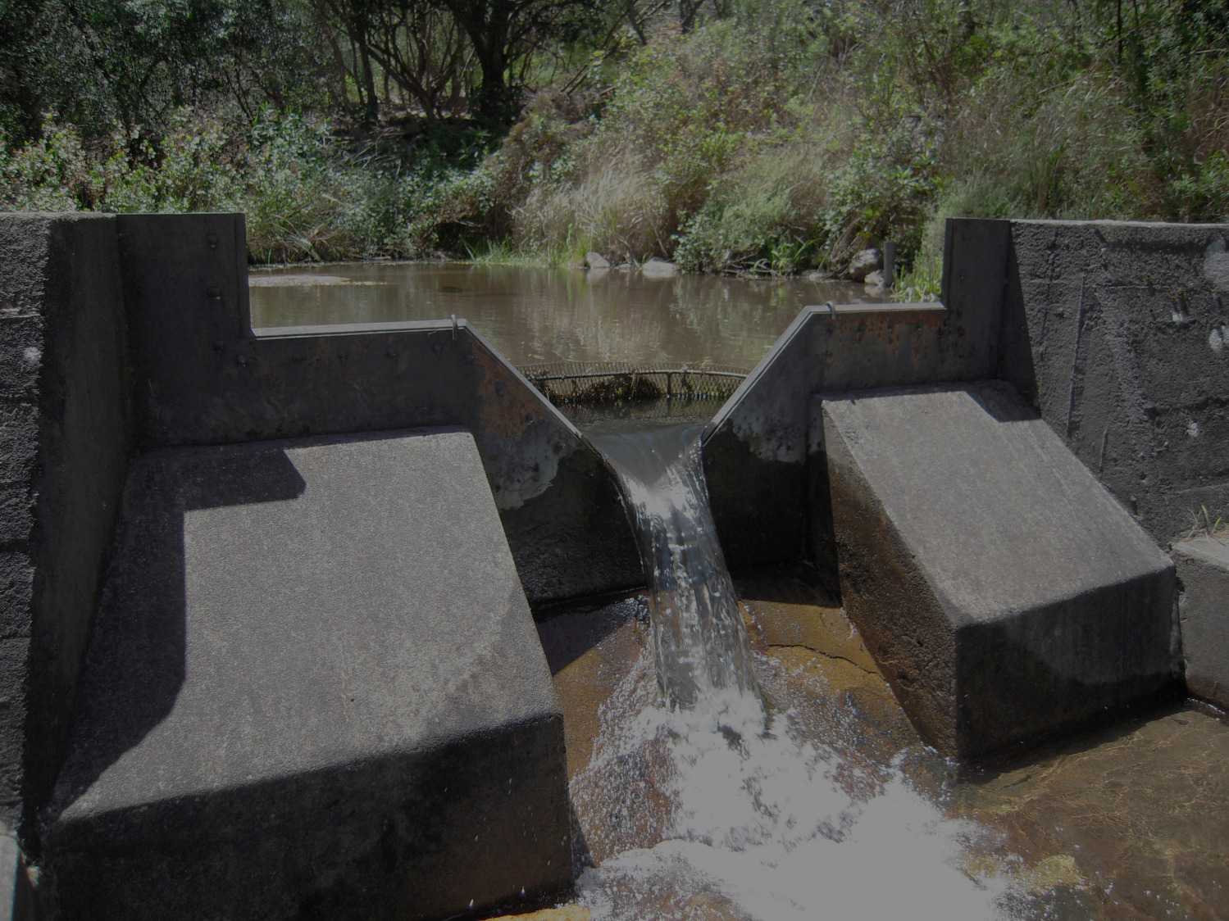
SAEON Observations Database System Administration Documentation
Compiled by: Victoria Goodall
April 2013
Updated February 2014

Slide 2
Observations Database
The online SAEON observations database is a repository of streamflow, weather, soil moisture and other observations made within SAEON or obtained from our collaborators
Data is provided ‘as-is’ with no guarantee as to its quality or recommendation about its potential for analysis
For further details, please contact SAEON Data Scientists: data@saeon.ac.za

Slide 3
Observations Database
URL for the database:
http://observations.saeon.ac.za/
This section is relevant for people who are designated as system administrators for the Observations Database.

Slide 4
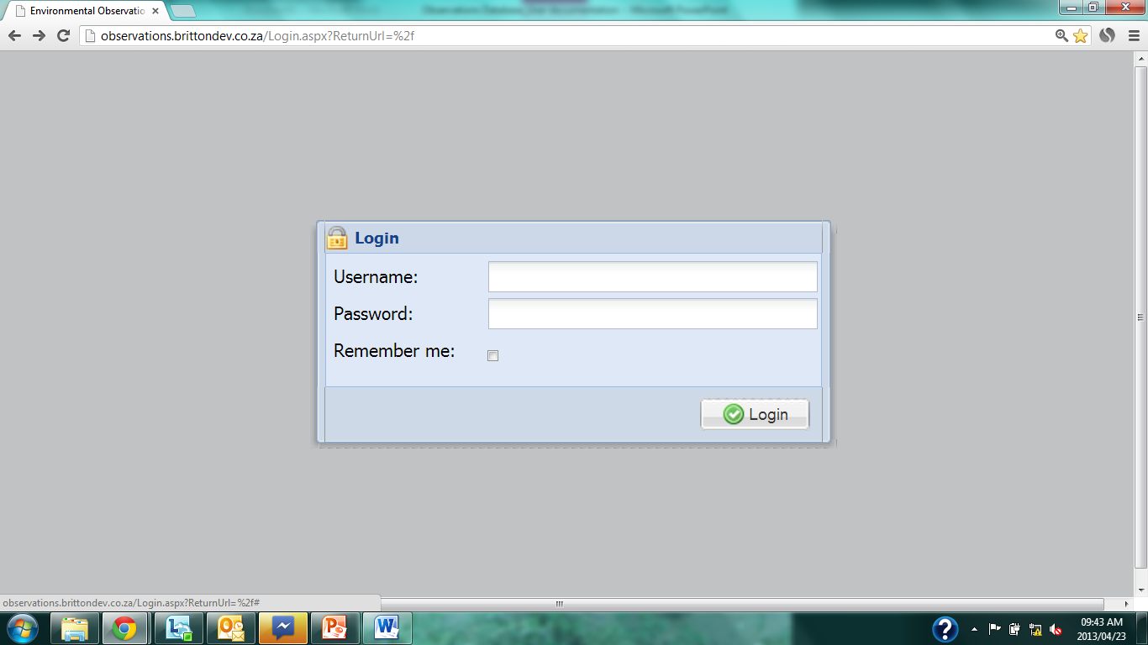
Login
Notes:
Enter username and password.
Click ‘Logon’

Slide 5
Home page – System Administrator
Notes:
First page as you login

Slide 6
User Administration

Slide 7
Add a New User
Notes:
Click on the user option under System Administration in the Navigation pane.

Slide 8
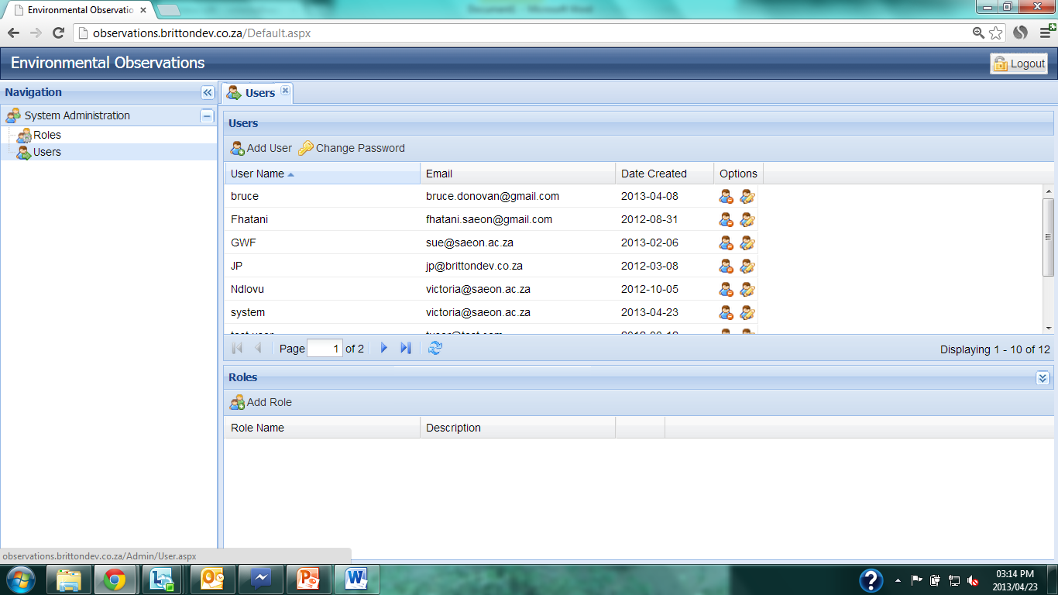
Add a New User
Notes:
Click on ‘Add User’ on the Users tab.

Slide 9
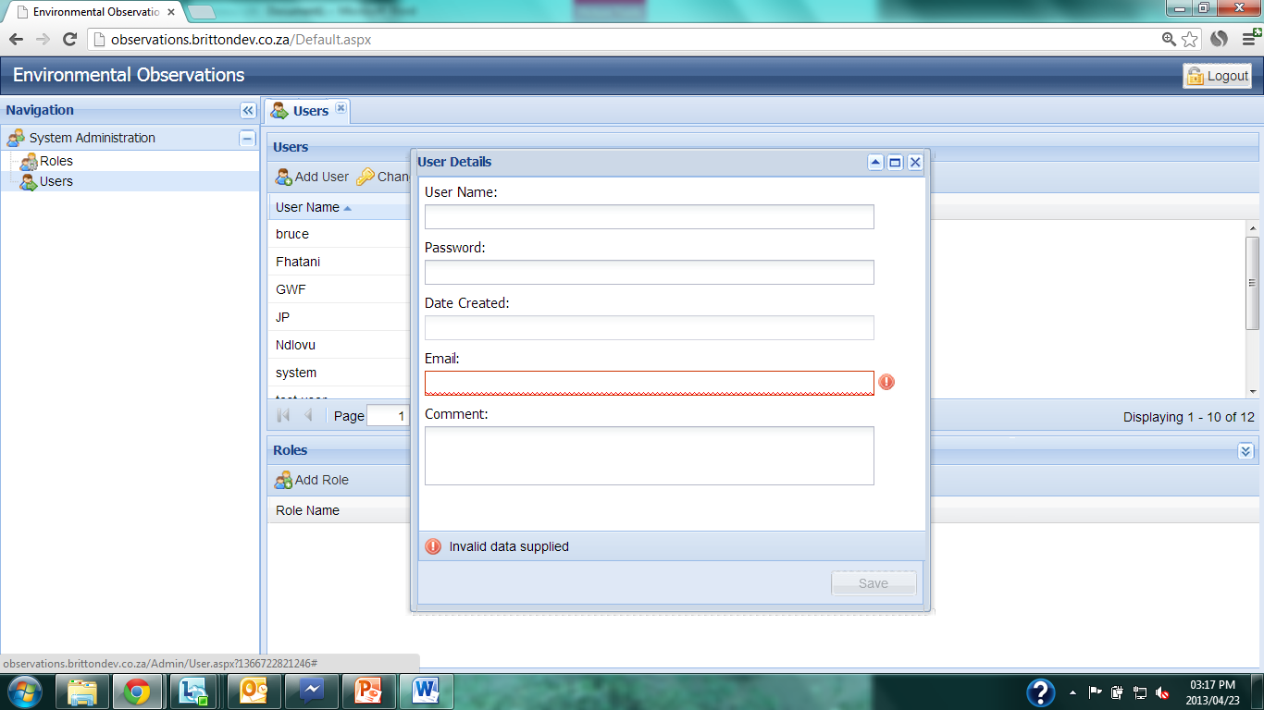
Add a New User
Notes:
User data entry screen will pop up.

Slide 10
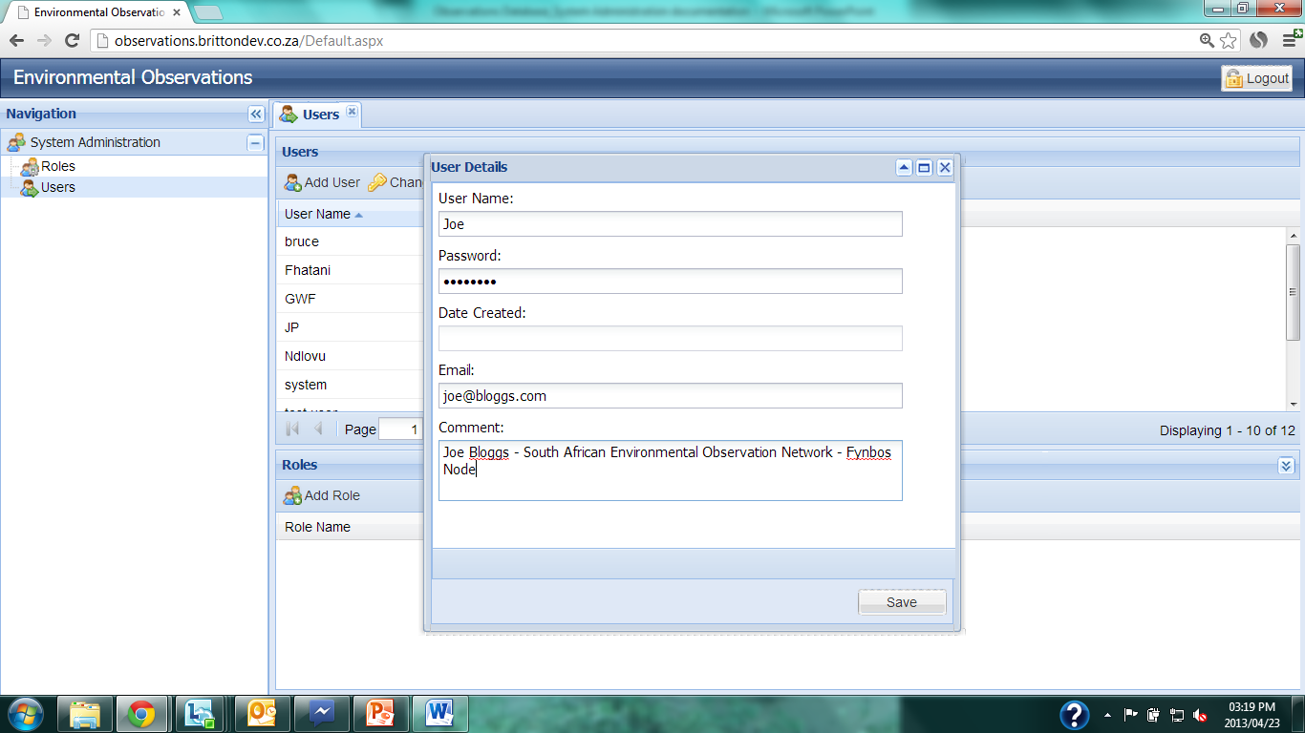
Add a New User
Notes:
Enter the username, password, email and general comment about the new user. The password must be at least 6 characters long.
Click ‘Save’.

Slide 11
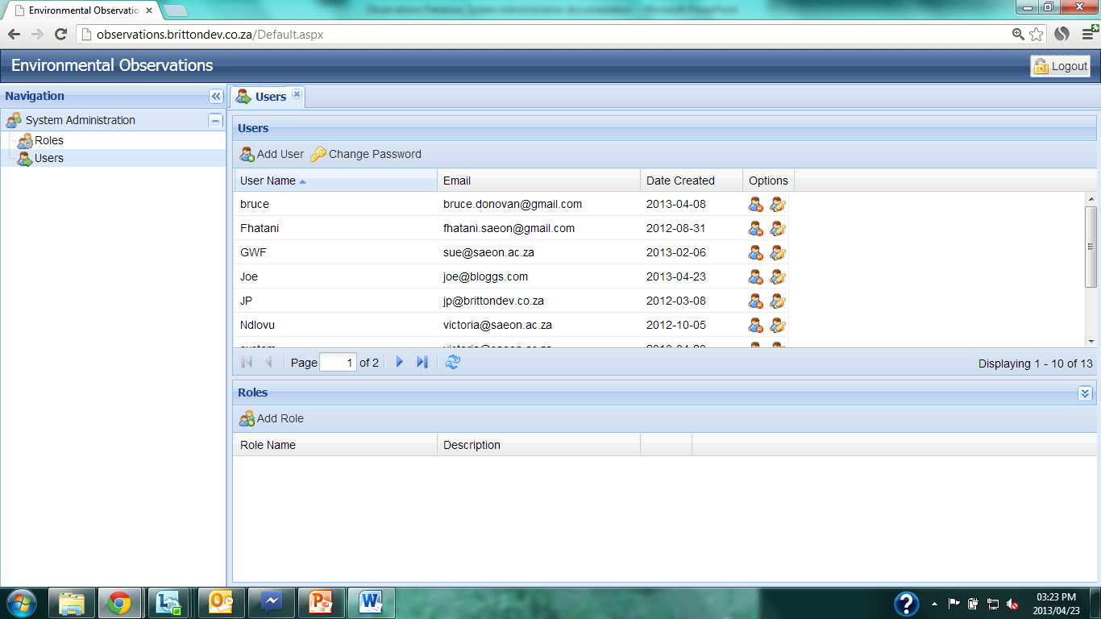
Add a New User
Notes:
The new user is now registered on the system. However, at present they will not be able to access anything within the database since they are not linked to a user role.

Slide 12
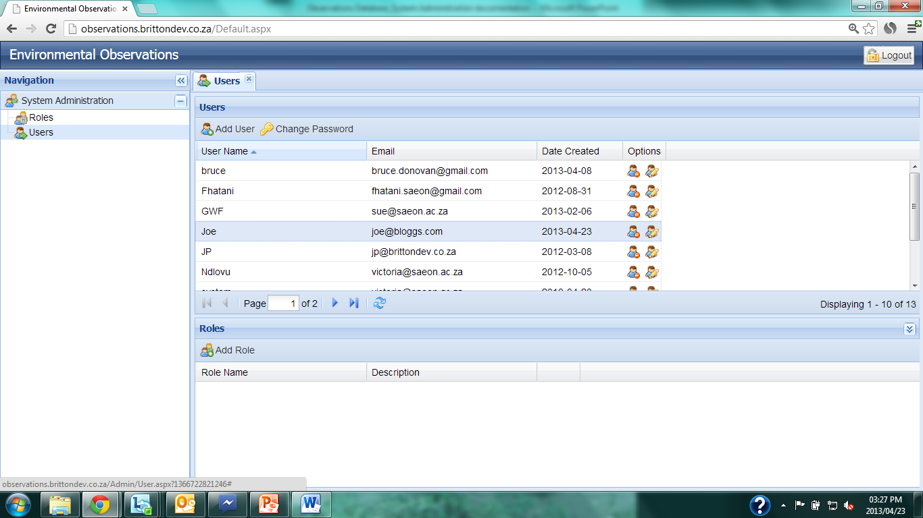
Change User Password
Notes:
If a user forgets their password, they need to have it reset by a user administrator.
Click on the user, and it will be highlighted. Click on ‘Change Password’ under the Users tab.

Slide 13
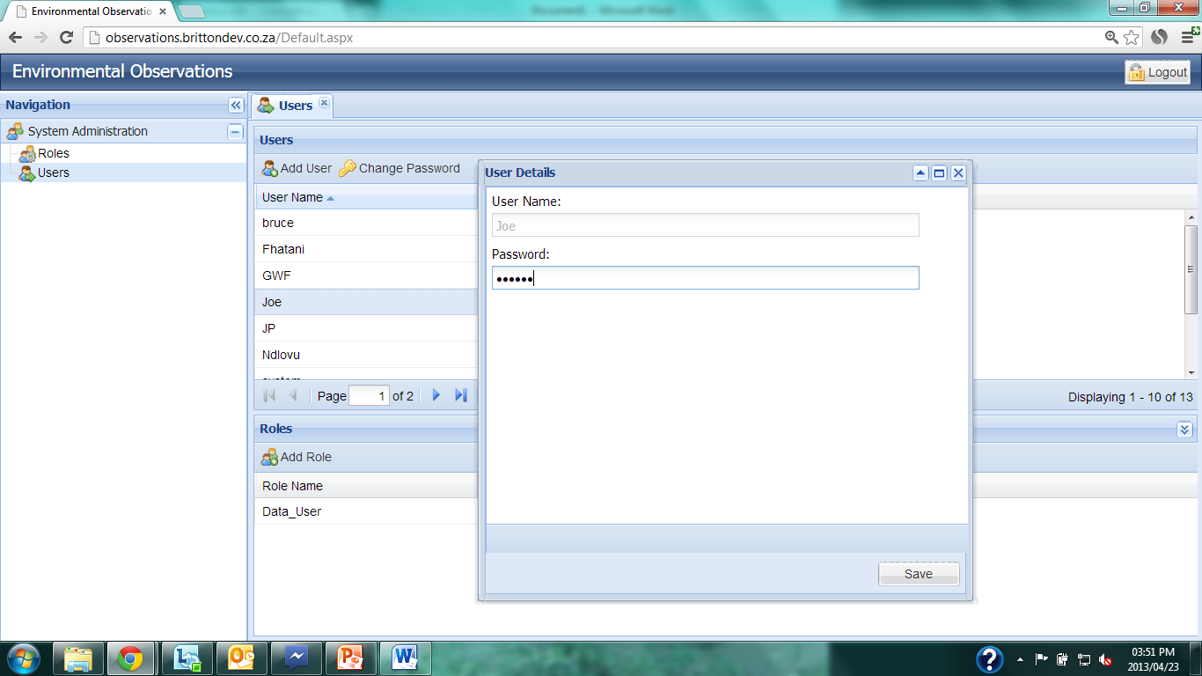
Change User Password
Notes:
Enter the new password and click ‘Save’.
The password needs to be a minimum of 6 characters.

Slide 14
Edit User
Notes:
The email address and comment for a user can be edited using the ‘Edit’ button alongside the user details.

Slide 15
Delete a User
Notes:
A user can be deleted by clicking on the delete icon alongside the user details.

Slide 16
Assign Role to User
Notes:
To assign a role to a user, first click on the user in the User tab, it will become highlighted. Then click on ‘Add Role’ in the Roles tab below.

Slide 17
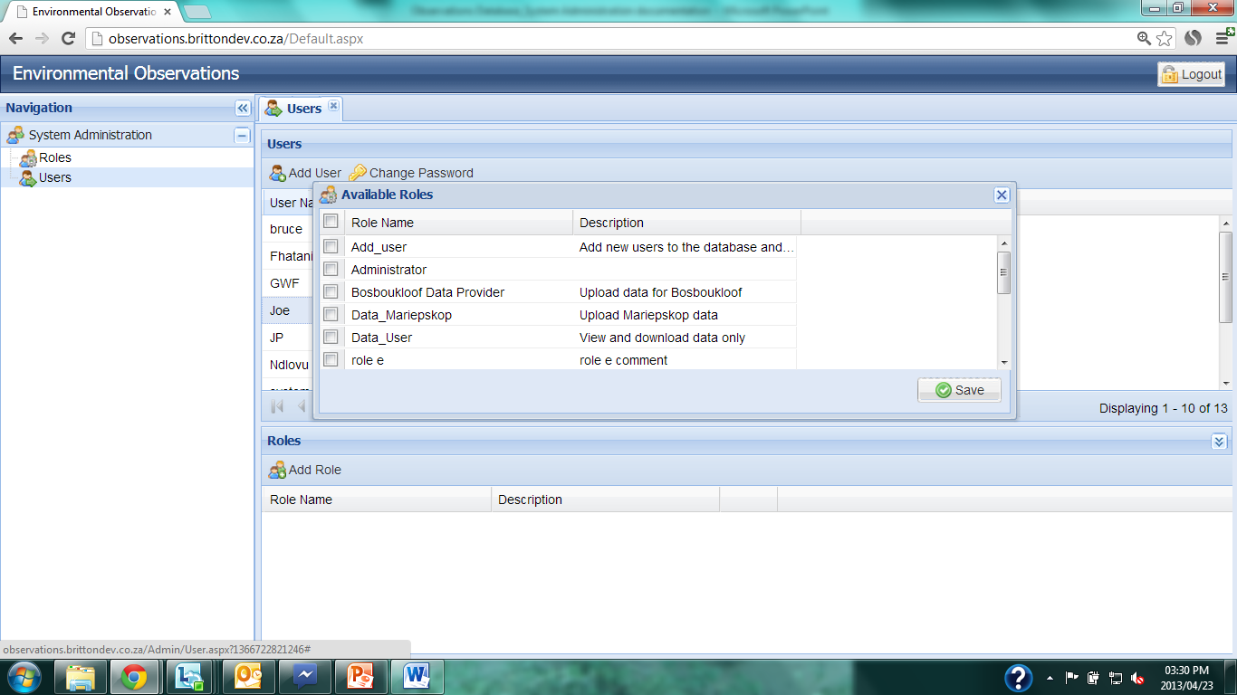
Assign Role to User
Notes:
A list of available roles will pop up.

Slide 18
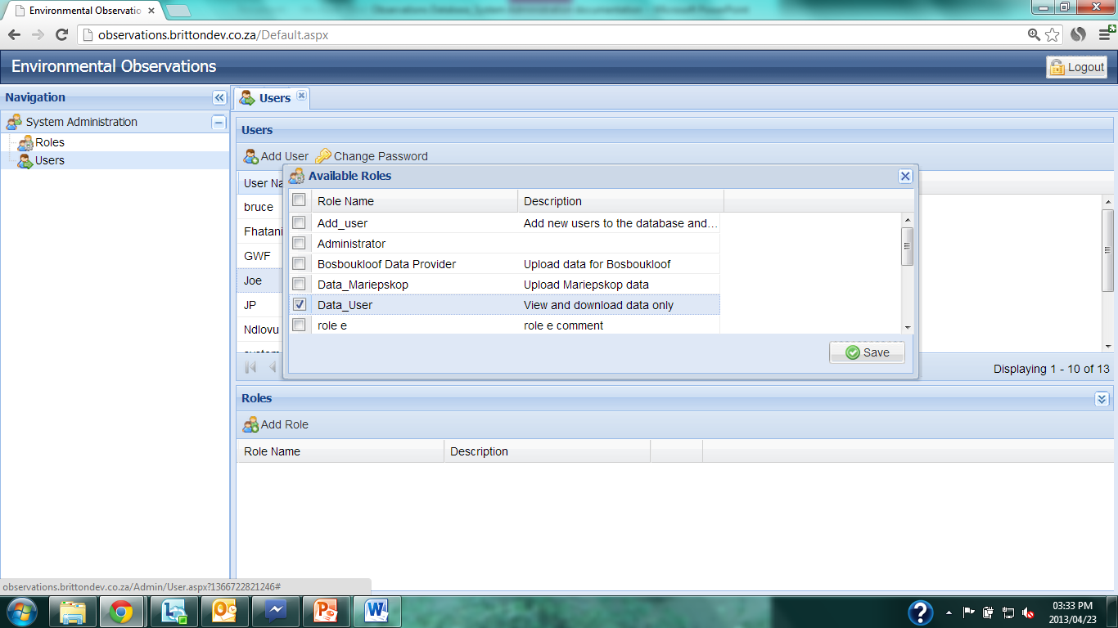
Assign Role to User
Notes:
Check the necessary role(s) and click ‘Save’.

Slide 19
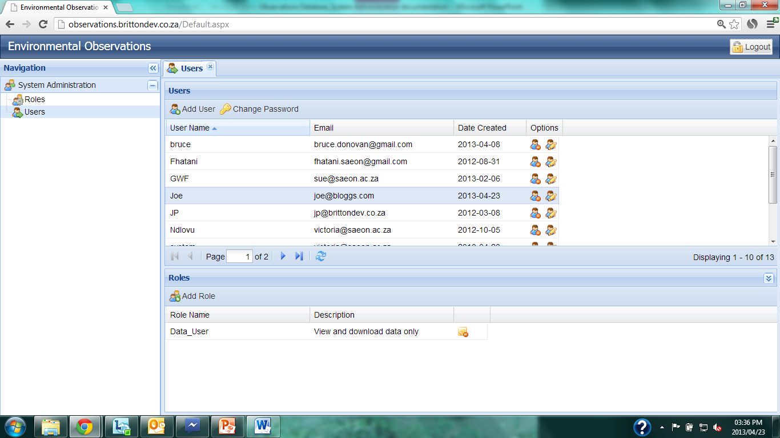
Assign Role to User
Notes:
The user is now linked to the selected role(s). This will allow them access to certain modules within the database. Further details to be discussed later in this document.

Slide 20
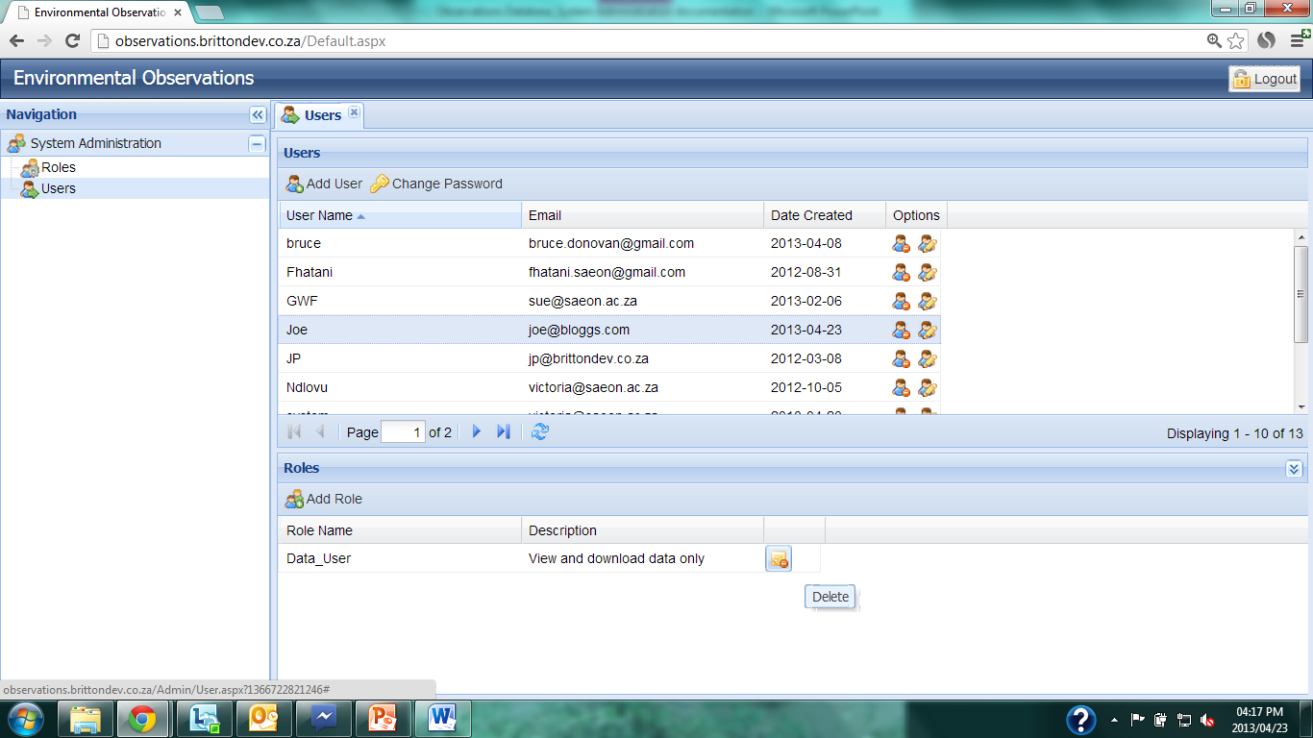
Delete User Role
Notes:
A role can be removed from a user’s profile by clicking on the delete icon to the right of the role that is no longer required.

Slide 21
Role Administration

Slide 22
Manage Roles
Notes:
Only certain users will have access to this System Administration function.
To manage roles, click on the ‘Role’ icon under the System Administration tab.

Slide 23
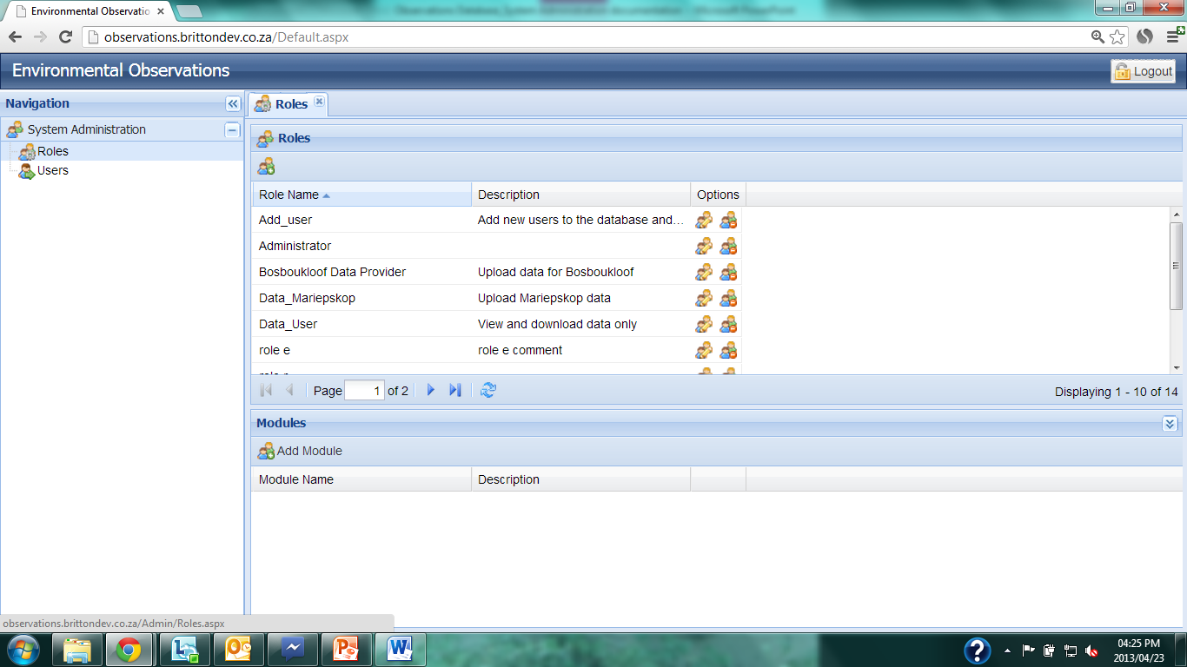
Roles
Notes:
Every role is linked to a module(s) which governs what that particular role is able to do in the database. Modules are assigned corresponding to the options available under the Navigation tab. A list of the current roles is given on the next slide. Modifications to the roles should be limited and described in detail about their purpose and target users.

Slide 24
Database Roles
Role | Description
Add_User | Add, edit and delete users. Assign roles to users.
User_Management | Add, edit and delete users. Assign roles to users. Add new roles.
Data_User | Query data, download data. Access to datasets controlled by date range linked to Data Source
Data_Provider | Upload data to the database. Rights to upload data controlled by date range linked to Data Source. Multiple versions of this role will exist, targeted at specific user communities.
Master_Data_Management | Add phenomena, offerings and units of measure.
Data Provider_Administration | Add, edit or delete: Data Schemas, Data Sources, Organizations, Projects/Sites, Sensors, Stations

Slide 25
New Role
Notes:
To add a new role, click on the ‘Add Role’ icon in the left corner of the Roles pane.

Slide 26
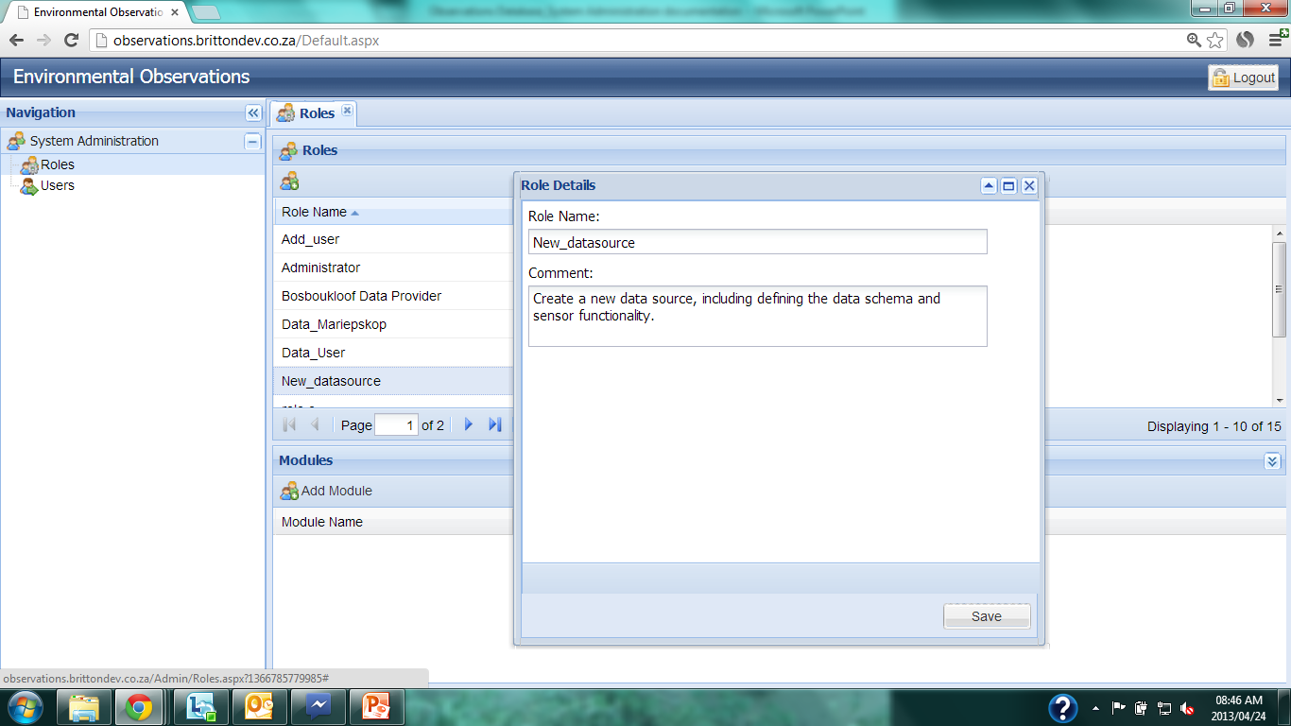
New Role
Notes:
Enter a role name and a comprehensive description of what the role will be able to do. Click ‘Save’.

Slide 27
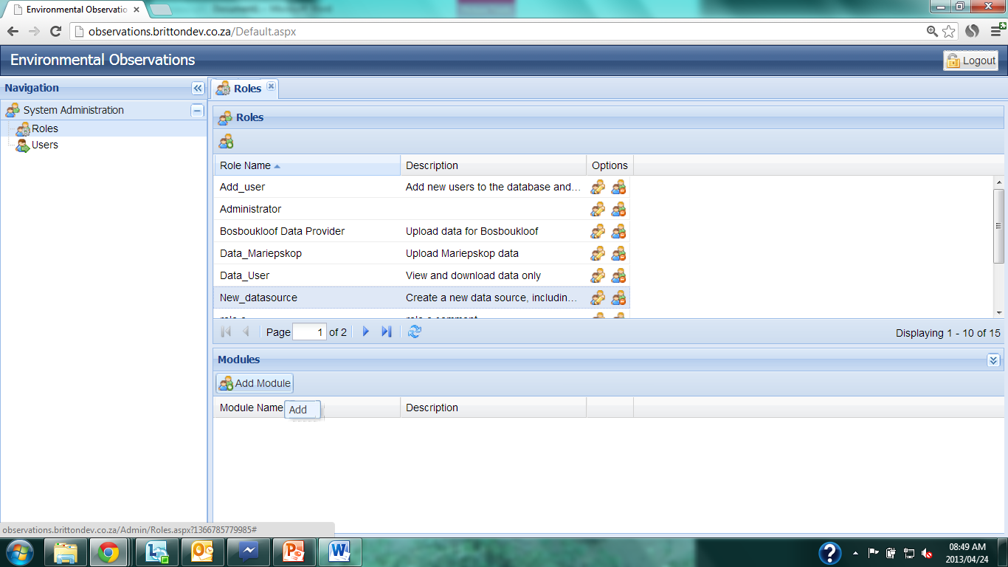
New Role
Notes:
Click on the new role under the roles tab, it will be come highlighted. Then click on the ‘Add Module’ icon under the Modules tab.

Slide 28
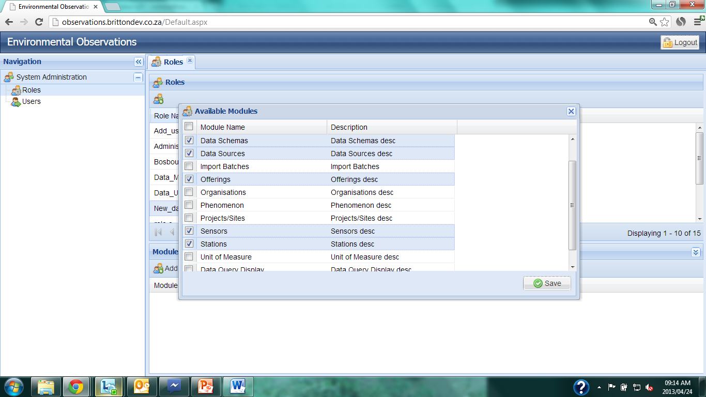
New Role
Notes:
Check the desired modules that are required for the new role. The modules correspond to the various sections under the Navigation tab. Click ‘Save’.

Slide 29
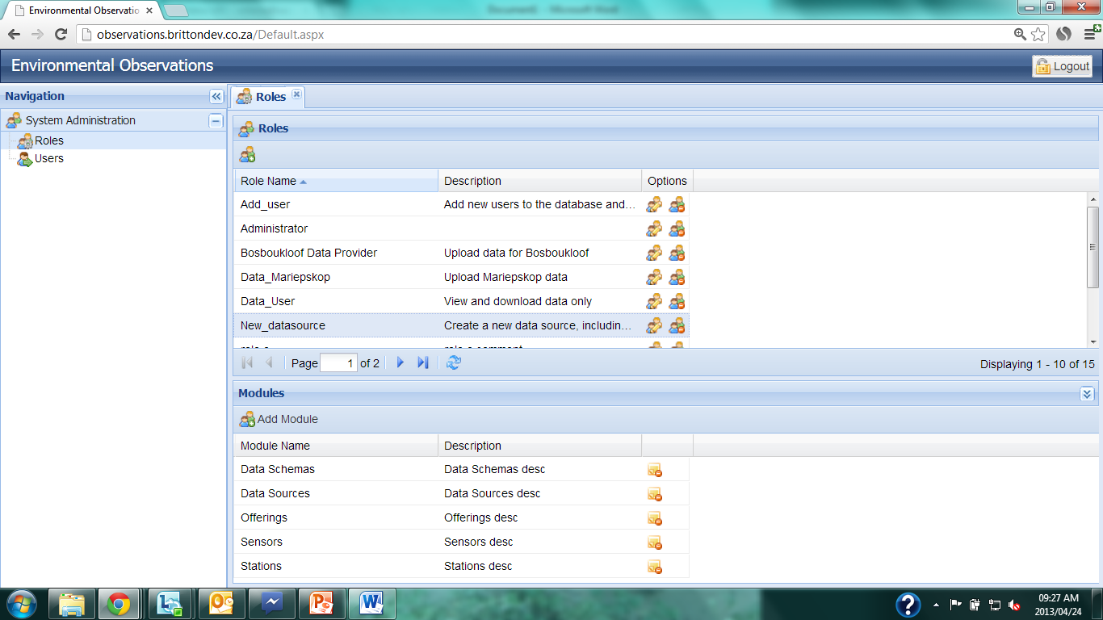
New Role
Notes:
The modules associated with the highlighted role are now shown below under the Modules tab.

Slide 30
Delete Modules
Notes:
A module can be removed from the highlighted role by clicking on the ‘Delete’ icon to the right of the Module details.

Slide 31
Edit Role
Notes:
The name and description of the role can be edited by clicking on the ‘Edit’ icon under the roles tab.

Slide 32
Delete Role
Notes:
A role can be deleted by clicking on the ‘Delete’ icon under the Roles tab.

Slide 33
Delete Role
Notes:
To logout of the database, click on the ‘Logout’ button.

