Slide 1
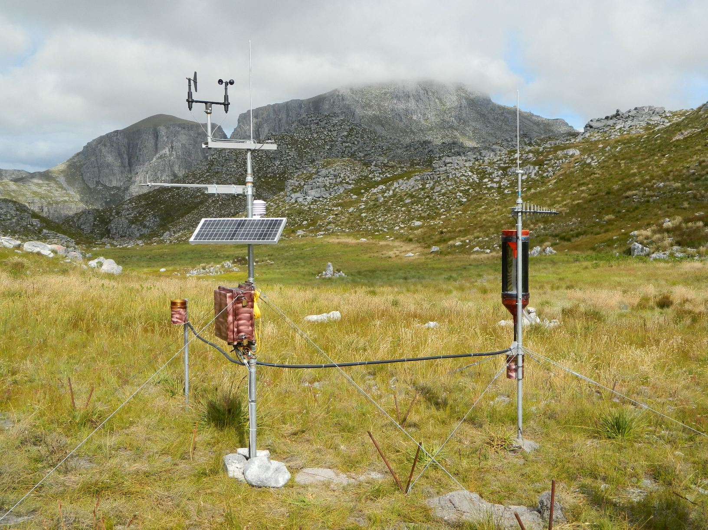
SAEON Observations Database Master Data Management Documentation
Compiled by: Victoria Goodall
May 2013
Updated February 2014

Slide 2
Observations Database
URL for the database:
http://observations.saeon.ac.za/
Contact a database administrator for a username and password to access the database
wayne@saeon.ac.za
wim@saeon.ac.za

Slide 3
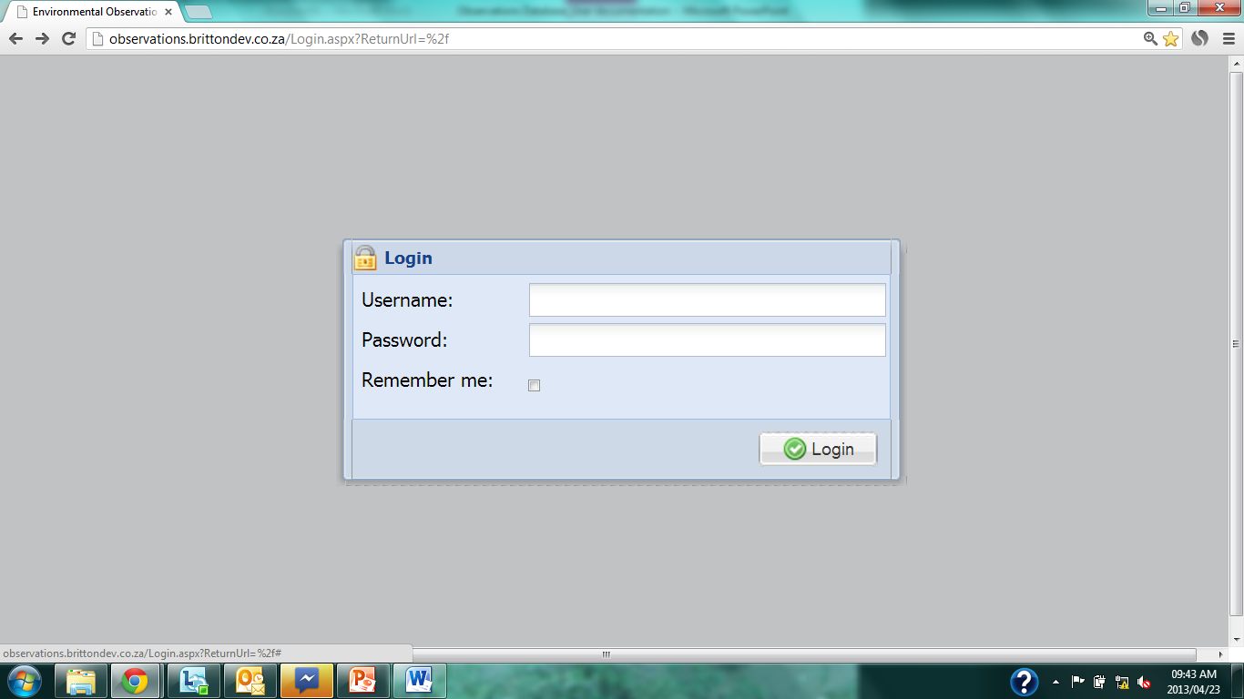
Login
Notes:
Enter username and password.
Click ‘Logon’

Slide 4
Home page – Data Manager
Notes:
First page as you login.
NOTE: Depending on your user role, you may not have access to all of the functionality described in this documentation.

Slide 5
Observations Database
Master Data Management

Slide 6
Create New Phenomenon
Notes:
Click on ‘Phenomenon’ under the Master Data Management tab, in the Navigation pane.

Slide 7
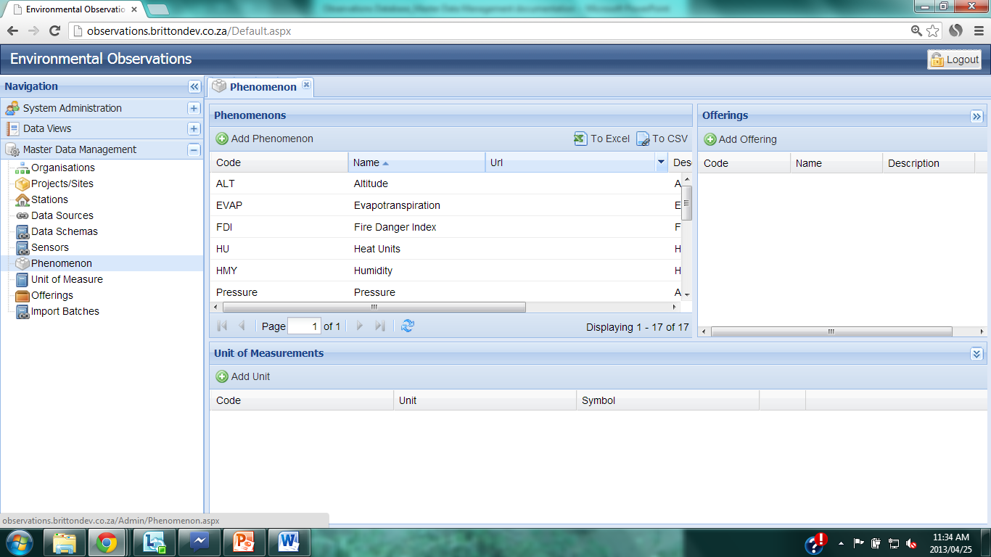
Create New Phenomenon
Notes:
List of loaded phenomena shown under the Phenomenon tab. To create a new phenomenon, click on the ‘Add Phenomenon’ tab.

Slide 8
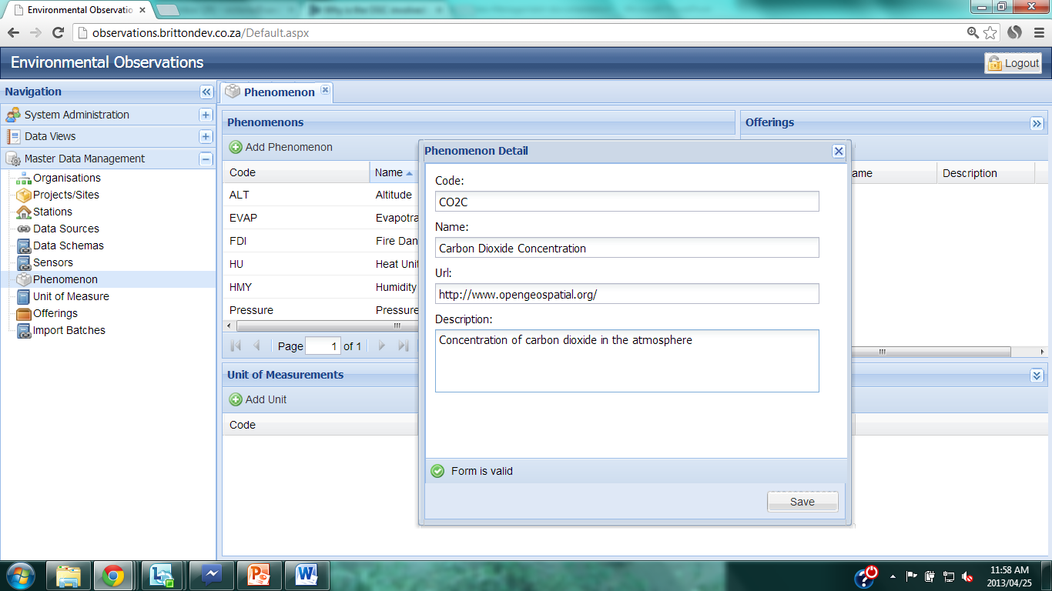
Create New Phenomenon
Notes:
Enter a 4-letter code for the phenomenon, using a suitable abbreviation for the phenomenon. Use upper case letters.
Example: CO2C

Slide 9
Create New Phenomenon
Notes:
Enter a name for the phenomenon. This must be the scientifically recognized name for the phenomenon.
Example: Carbon Dioxide concentration.

Slide 10
Create New Phenomenon
Notes:
Insert the URL of the current SensorWeb ID for the phenomenon. This can be found at …
Example: http://www.opengeospatial.org/
<ows:Value>urn:x-ogc:def:property:OGC::Precipitation1Hour</ows:Value>
<ows:Value>urn:ogc:def:property:OGC::Precipitation1Hour</ows:Value>
<ows:Value>urn:ogc:def:property:OGC::Luminance</ows:Value>
<ows:Value>urn:x-ogc:def:property:OGC::Luminance</ows:Value>
<ows:Value>urn:ogc:def:property:OGC::RelativeHumidity</ows:Value>
<ows:Value>urn:x-ogc:def:property:OGC::RelativeHumidity</ows:Value>
<ows:Value>urn:x-ogc:def:property:OGC::BarometricPressure</ows:Value>
<ows:Value>urn:ogc:def:property:OGC::BarometricPressure</ows:Value>
<ows:Value>urn:ogc:def:property:OGC::Temperature</ows:Value>
<ows:Value>urn:x-ogc:def:property:OGC::Temperature</ows:Value>
<ows:Value>urn:x-ogc:def:property:OGC::AirTemperature</ows:Value>
<ows:Value>urn:x-ogc:def:property:OGC::WindSpeed</ows:Value>
<ows:Value>urn:ogc:def:property:OGC::WindSpeed</ows:Value>
<ows:Value>urn:x-ogc:def:property:OGC::WindDirection</ows:Value>
<ows:Value>urn:ogc:def:property:OGC::WindDirection</ows:Value>
<ows:Value>urn:ogc:def:property:OGC::visibilityRange</ows:Value>

Slide 11
Create New Phenomenon
Notes:
Provide a general description of the phenomenon.
Example: Concentration of carbon dioxide in the atmosphere.

Slide 12
Create New Phenomenon
Notes:
When sufficient information has been entered, a green tick will appear and the text ‘Form is valid’.
Click on ‘Save’.

Slide 13
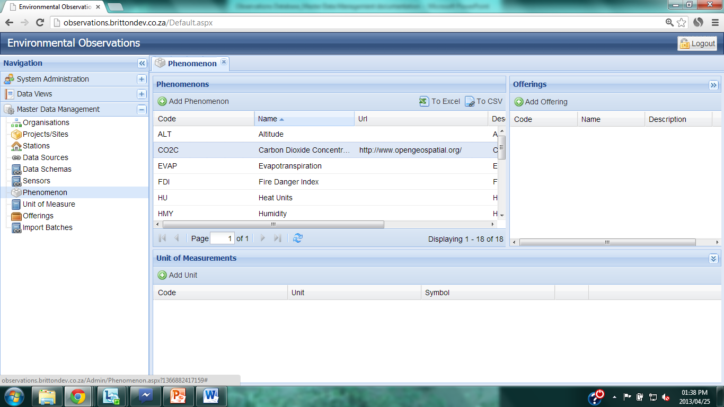
Create New Phenomenon
Notes:
The new phenomenon is now listed under the Phenomenon’s tab.

Slide 14
Create a new Unit of Measurement
Notes:
Click on ‘Unit of Measure’ under the Master Data Management tab in the Navigation pane.

Slide 15
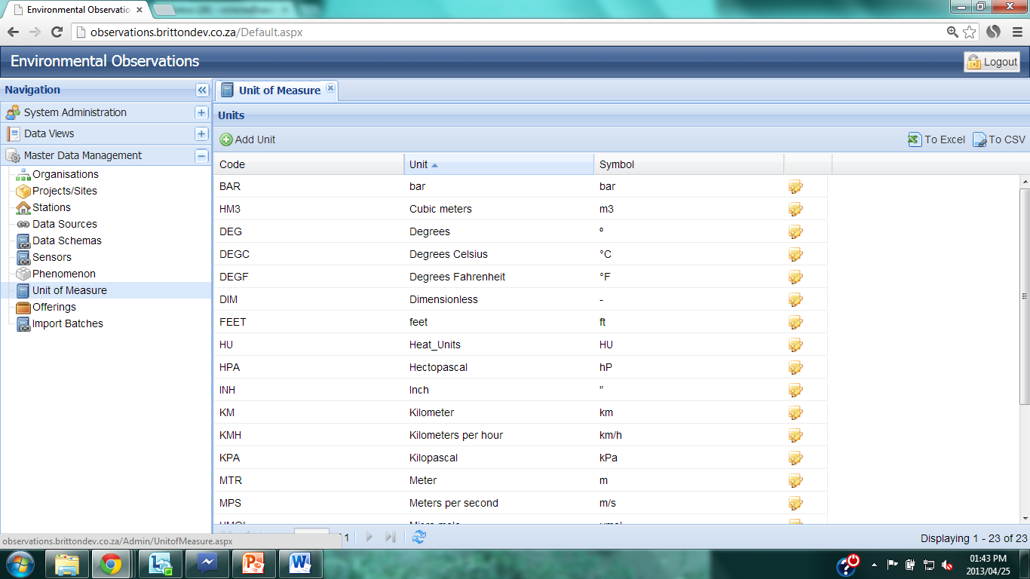
Create a new Unit of Measurement
Notes:
The list of units of measurement are shown. To create a new unit of measurement, click on the ‘New Unit’ button.

Slide 16
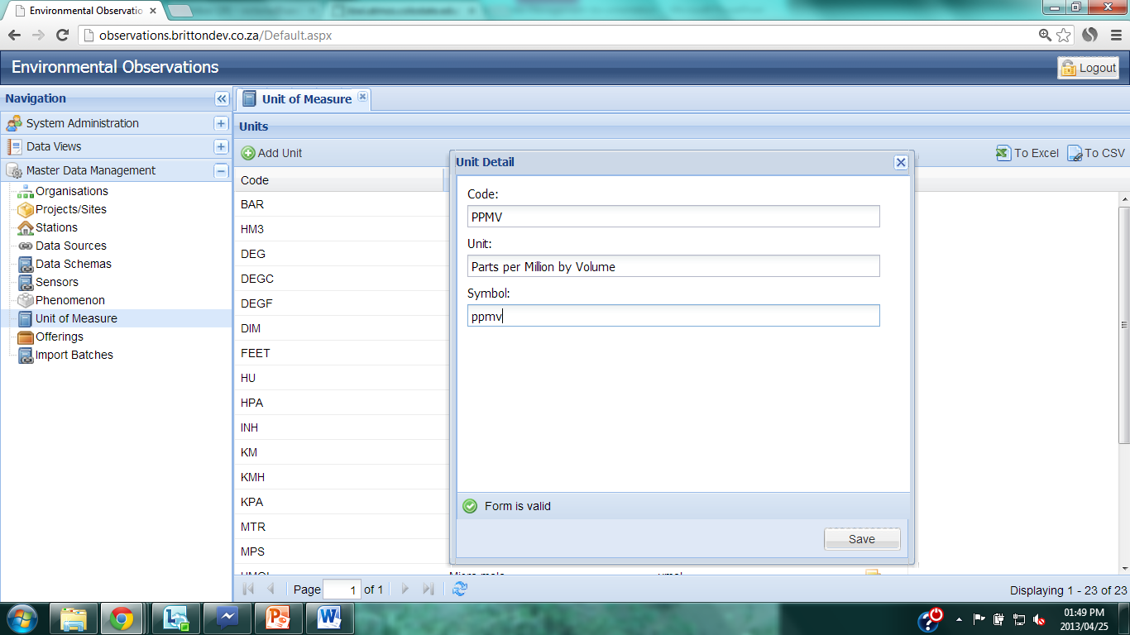
Create a new Unit of Measurement
Notes:
Enter a 3 or 4 letter code for the unit, using similar letters to the unit name. Use upper case.
Enter the Unit, this is the internationally recognized English description of the unit.
Enter the international symbol for the unit.

Slide 17
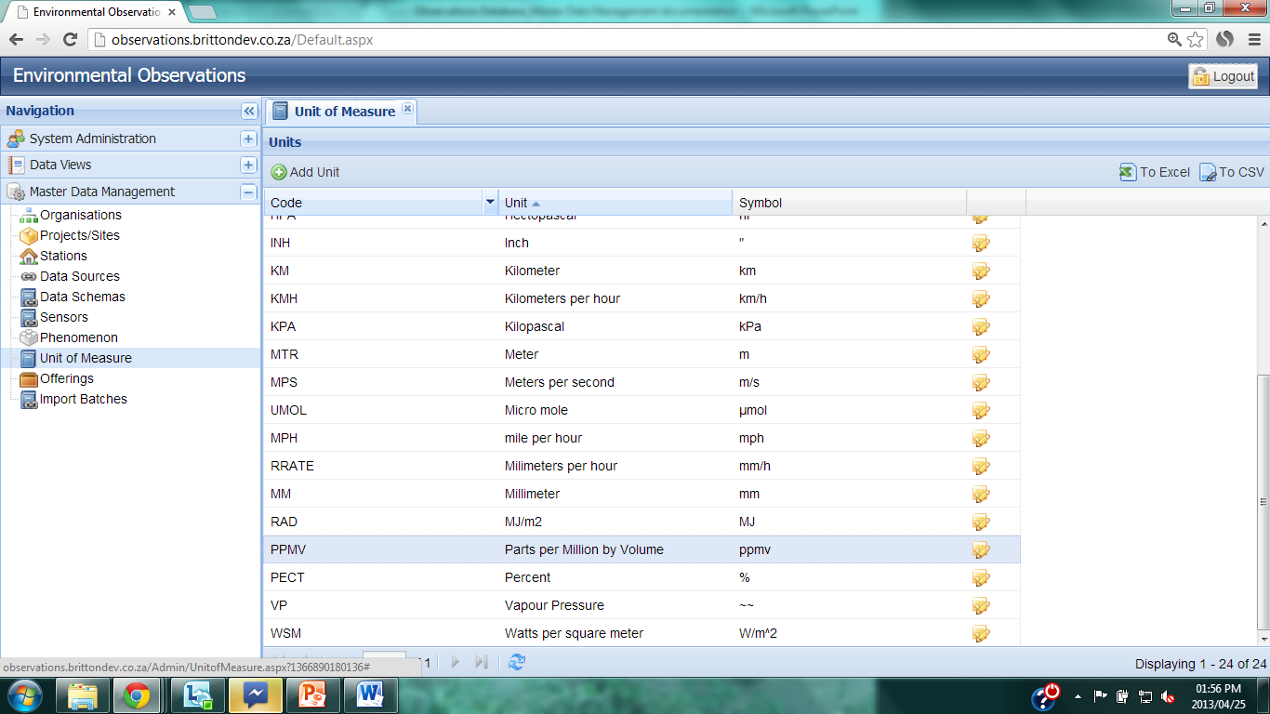
Create a new Unit of Measurement
Notes:
Enter a 3 or 4 letter code for the unit, using similar letters to the unit name. Use upper case.
Enter the Unit, this is the internationally recognized English description of the unit.
Enter the international symbol for the unit.

Slide 18
Create a new Unit of Measurement
Notes:
Enter a 3 or 4 letter code for the unit, using similar letters to the unit name. Use upper case.
Enter the Unit, this is the internationally recognized English description of the unit.
Enter the international symbol for the unit.

Slide 19
Edit Unit of Measurement
Notes:
To edit the details of the Unit of Measure, click on the ‘Edit’ icon to the right of the Unit details.

Slide 20
Create an Offering
Notes:
To create a new offering, click on ‘Offering’ under the Master Data Management tab on the Navigation pane.

Slide 21
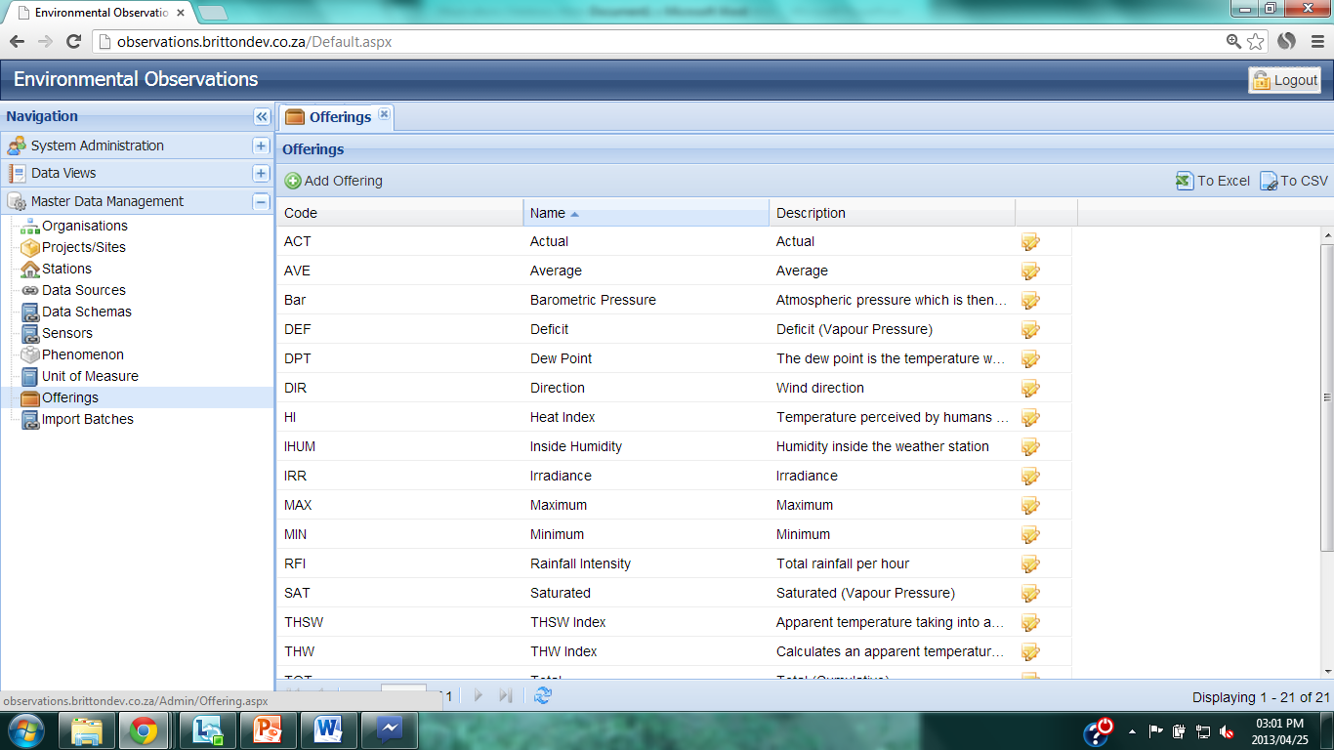
Create an Offering
Notes:
The list of current offerings are shown under the Offerings tab.

Slide 22
Create an Offering
Notes:
To create a new Offering, click on the ‘Add Offering’ button.

Slide 23
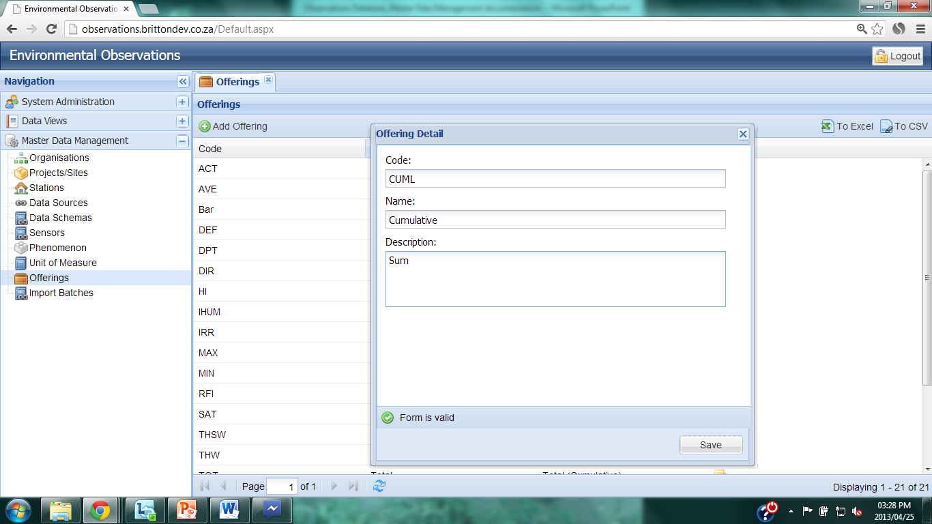
Create an Offering
Notes:
Enter a 3- or 4-letter code for the offering which makes sense given the name of the offering.
Enter the name of the offering which makes it clear what the quantity is when stored in the database.
Provide a detailed description of what the quantity describes.
When complete, the ‘Form is valid’ icon will display.
Click ‘Save’.

Slide 24
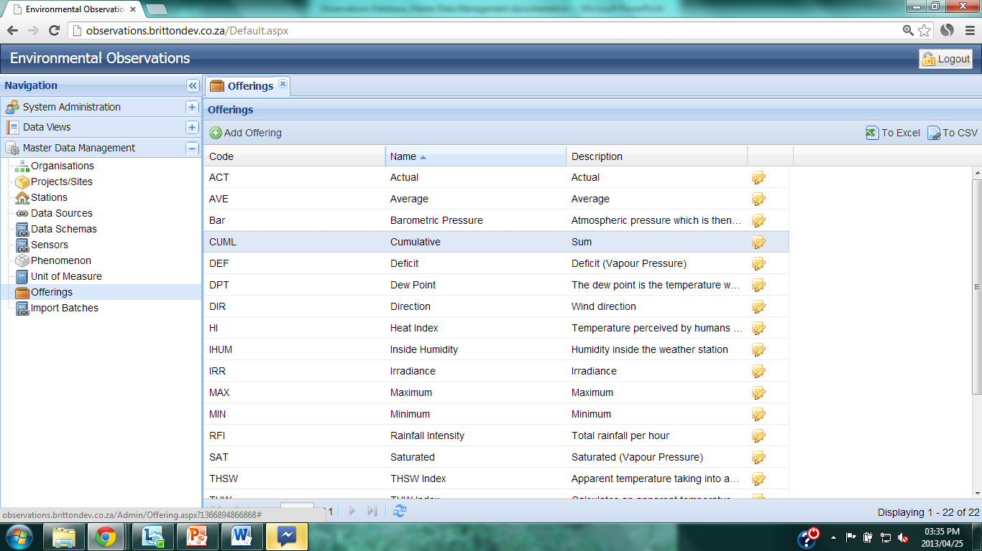
Create an Offering
Notes:
The new offering is then shown in the list of Offerings.

Slide 25
Edit an Offering
Notes:
To edit an offering, click on the Edit icon to the right of the offering details.

Slide 26
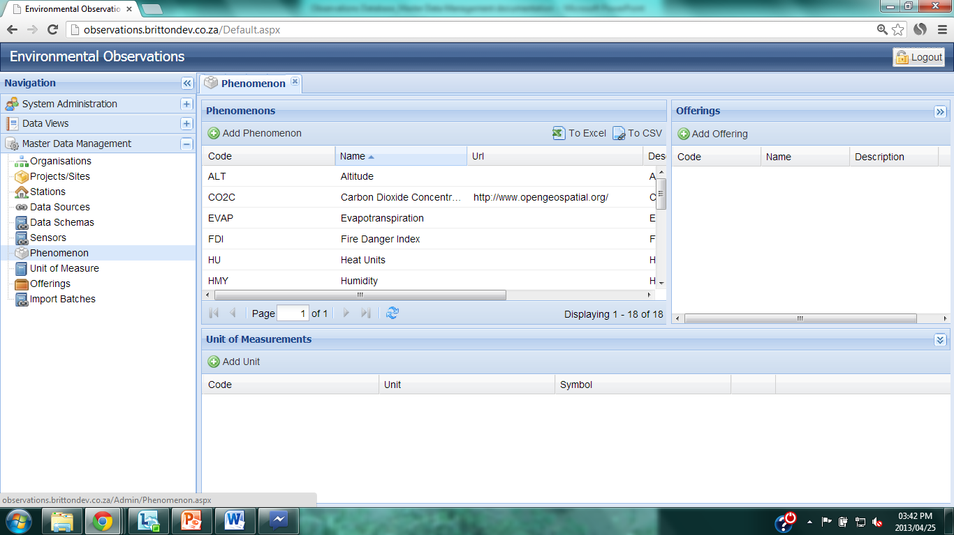
Linking Offerings and Units
Notes:
Every phenomenon must be linked to offerings and units of measure for that offering.
Click on ‘Phenomenon’ under the Master Data Management tab of the Navigation page.

Slide 27
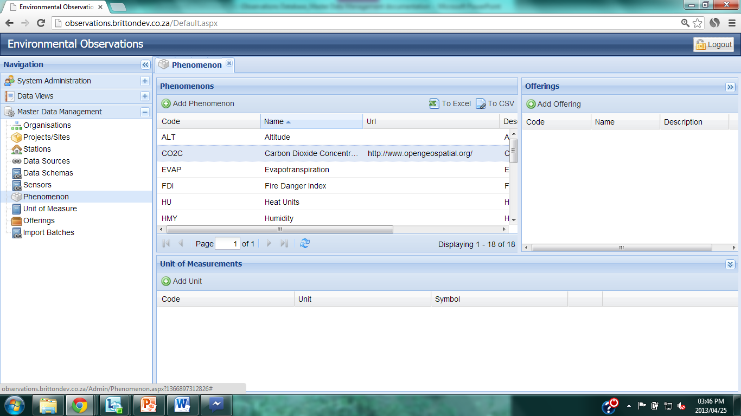
Linking Offerings and Units
Notes:
Click on the phenomenon to be linked, and it will become highlighted.

Slide 28
Linking Offerings and Units
Notes:
Offerings linked to that phenomenon will be show in the Offerings pane on the right. Offerings include options such as minimum, maximum, total, rate, intensity etc.
To link a new offering to the highlighted phenomenon, click on the ‘Add Offering’ button.

Slide 29
Linking Offerings and Units
Notes:
Offerings linked to that phenomenon will be show in the Offerings pane on the right. Offerings include options such as minimum, maximum, total, rate, intensity etc.
To link a new offering to the highlighted phenomenon, click on the ‘Add Offering’ button.

Slide 30
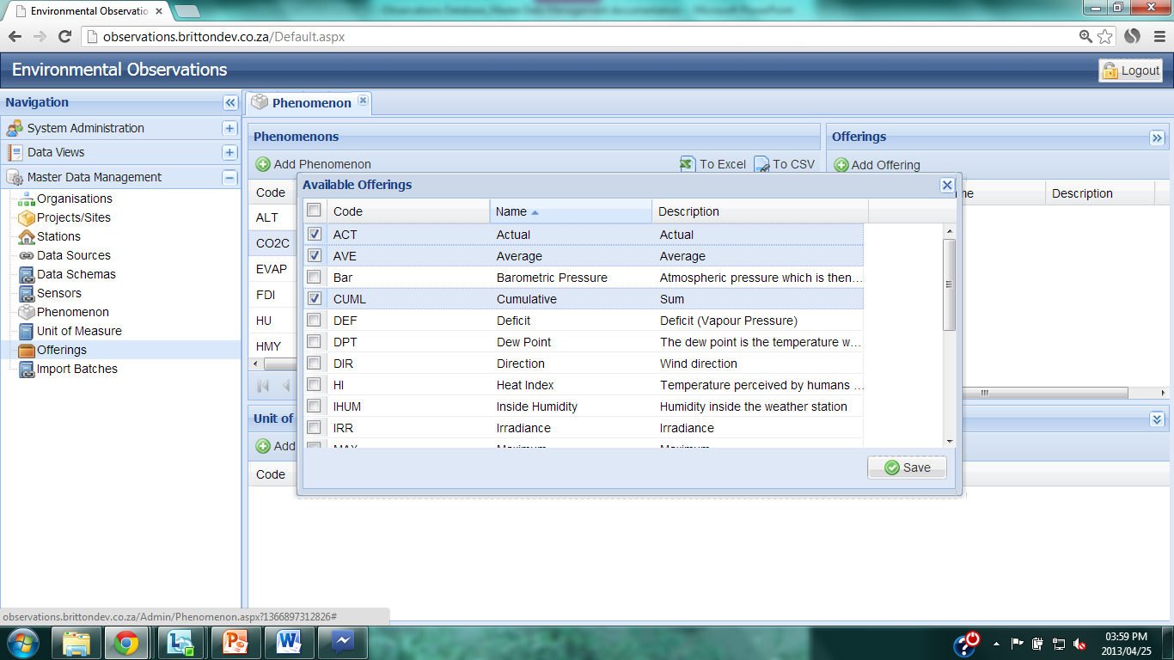
Linking Offerings and Units
Notes:
Check the required offerings for that phenomenon and click ‘Save’.

Slide 31
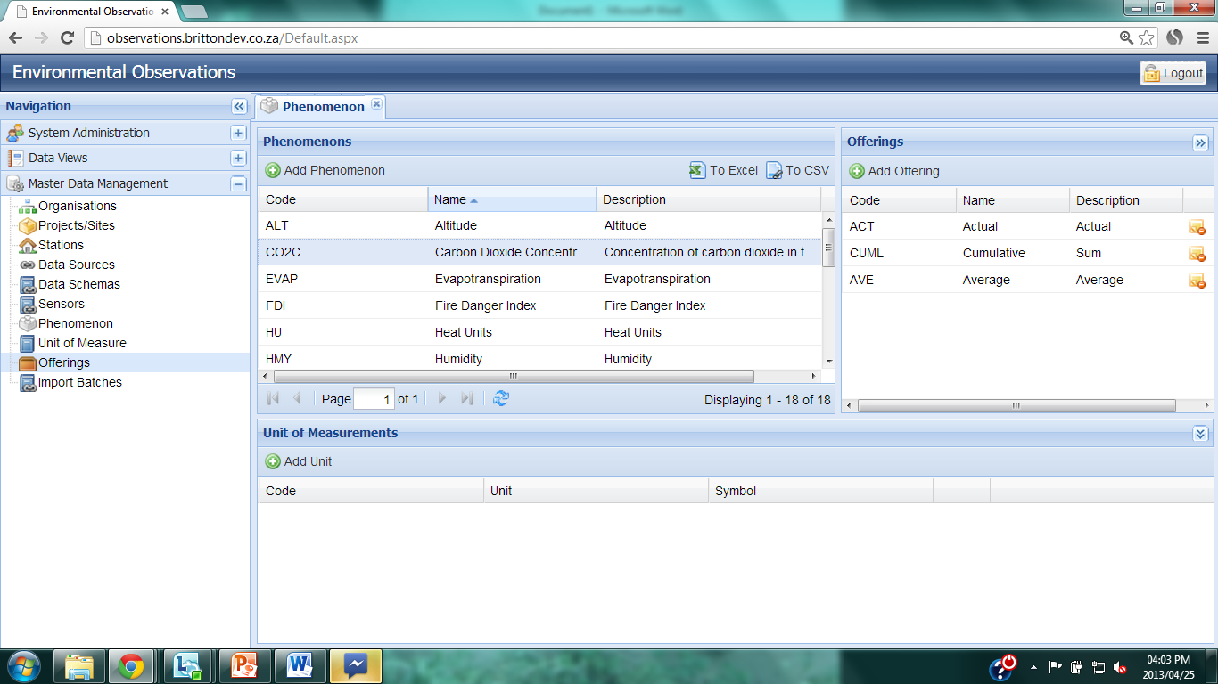
Linking Offerings and Units
Notes:
The linked offerings are now shown for the highlighted phenomenon in the Offerings pane.

Slide 32
Linking Offerings and Units
Notes:
To link units of measurement to a particular phenomenon, ensure that the correct phenomenon is highlighted and then click on ‘Add Unit’ in the Units of Measurement pane.

Slide 33
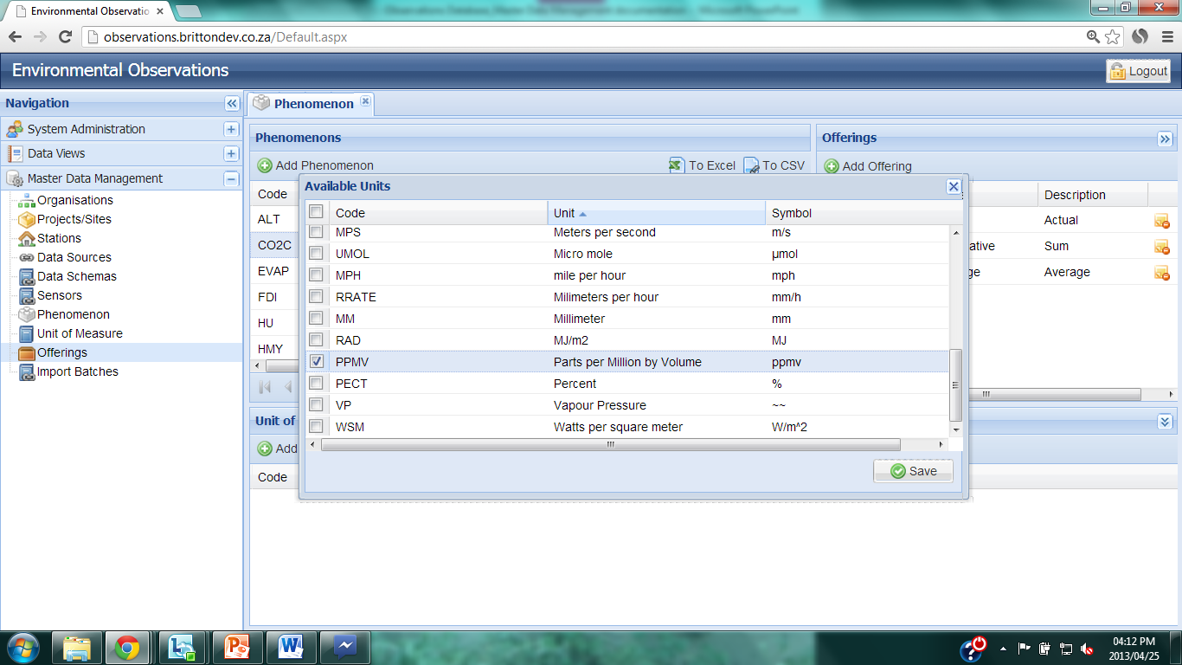
Linking Offerings and Units
Notes:
Check the appropriate units of measure for this phenomenon and click ‘Save’.

Slide 34
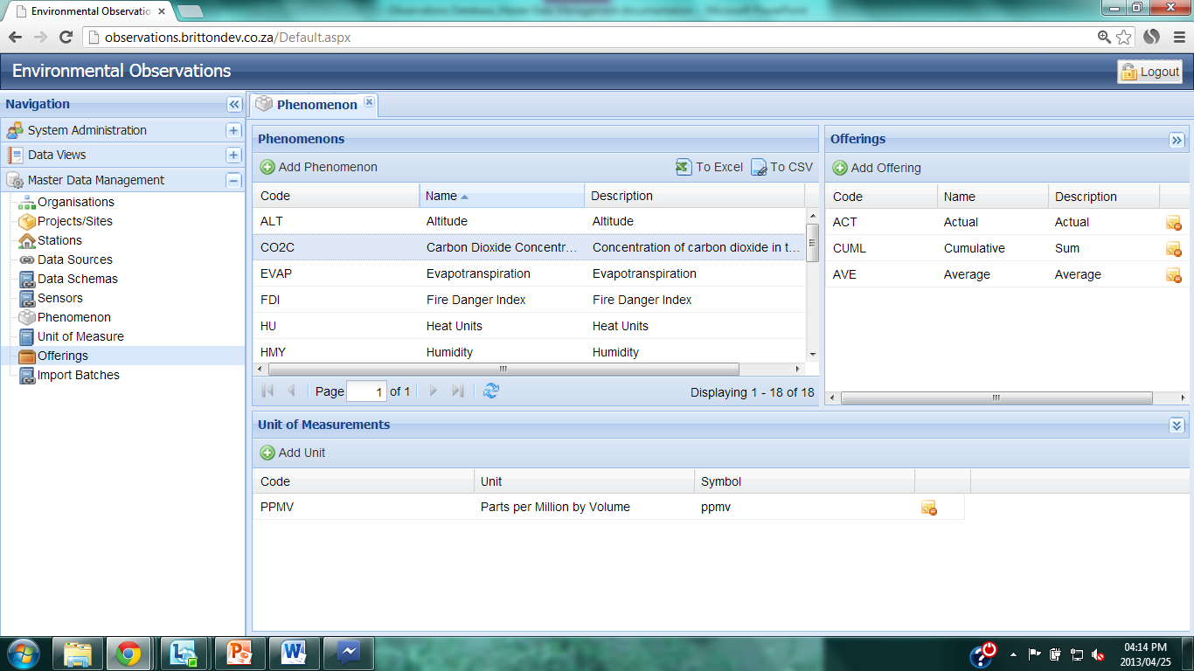
Linking Offerings and Units
Notes:
The appropriate units of measure and offerings are now linked to the phenomenon.

Slide 35
Deleting Offerings and Units
Notes:
The link between units of measure and offerings can be removed by clicking on the delete icons next to the appropriate unit/offering.

Slide 36
Downloading lists
Notes:
Any list can be dowloaded to Excel or .csv format by clicking the ‘To Excel’ or ‘To CSV’ icons.

Slide 37
Observations Database
Data Provider Administration

Slide 38
Create an Organization
Notes:
To create a new organization, click on ‘Organization’ under the Master Data Management tab on the Navigation pane.
The organization is the one who ultimately owns the data which are associated with it.

Slide 39
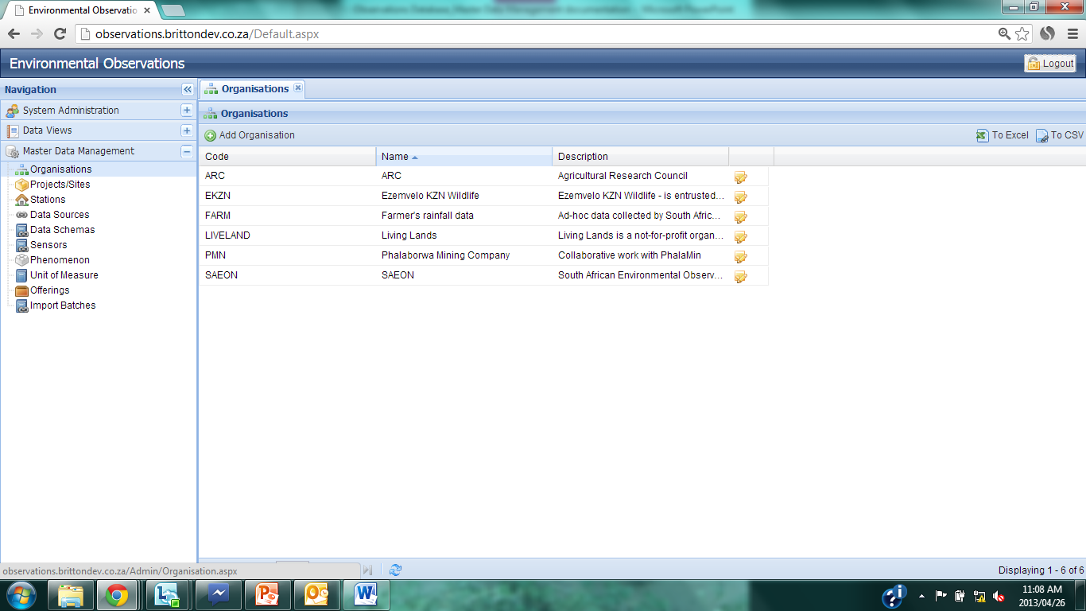
Create an Organization
Notes:
The current list of organizations associated with the data in the database are shown in the Organizations pane. To load a new organization, click on ‘Add Organization’.

Slide 40
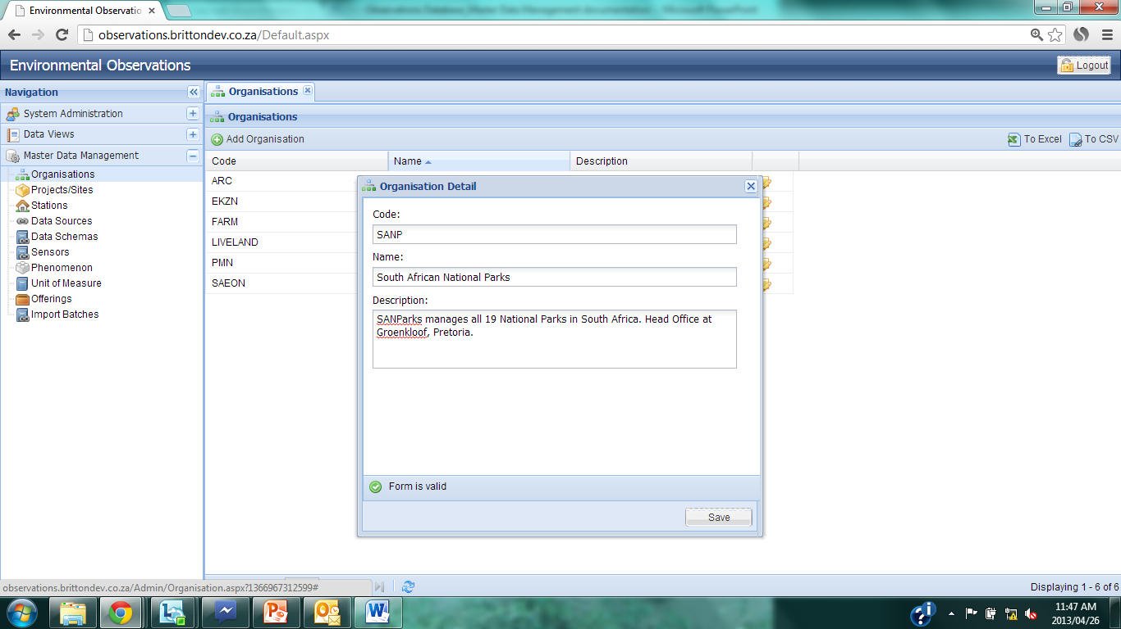
Create an Organization
Notes:
Enter 3 – 6 letter code for the organization. Use the recognized acronym for that organizations if it exists (e.g. SAEON, SANP, ARC).
Enter the full name for the organization (e.g. South African Environmental Observation Network, South African National Parks).
Provide a description of the organization.
When sufficient information has been provided, the “Form is valid’ icon will show. Click ‘Save’.

Slide 41
Edit Organization
Notes:
The new organization is now shown in the list of organizations. The details for the organization can be edited by clicking on the ‘Edit’ icon.

Slide 42
Create Project/Site
Notes:
To create a new Project / Site to link to an existing organization, click on ‘Projects/Sites’ under the Master Data Management tab in the Navigation pane.
A project or site will describe the research site where the data were collected. Every Project/Site must be linked to an organization. For example: Organization = SAEON; Project/Site = Jonkershoek.

Slide 43
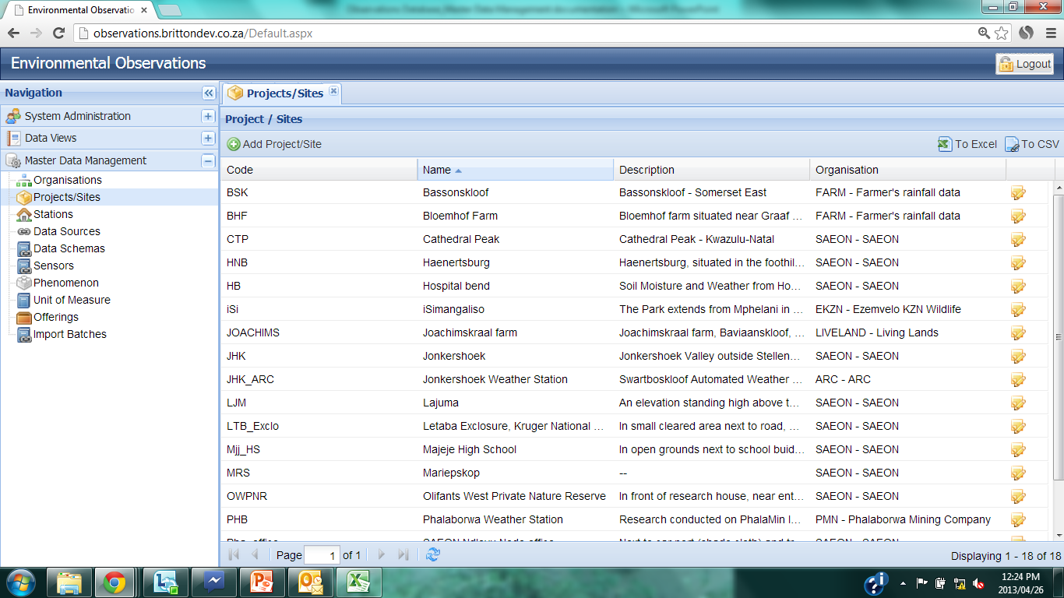
Create Project/Site
Notes:
The list of current Projects/Sites are shown. If additional pages exist, this will be shown at the bottom of the page.
To add a new Project/Site, click on the ‘Add Project/Site’ button.

Slide 44
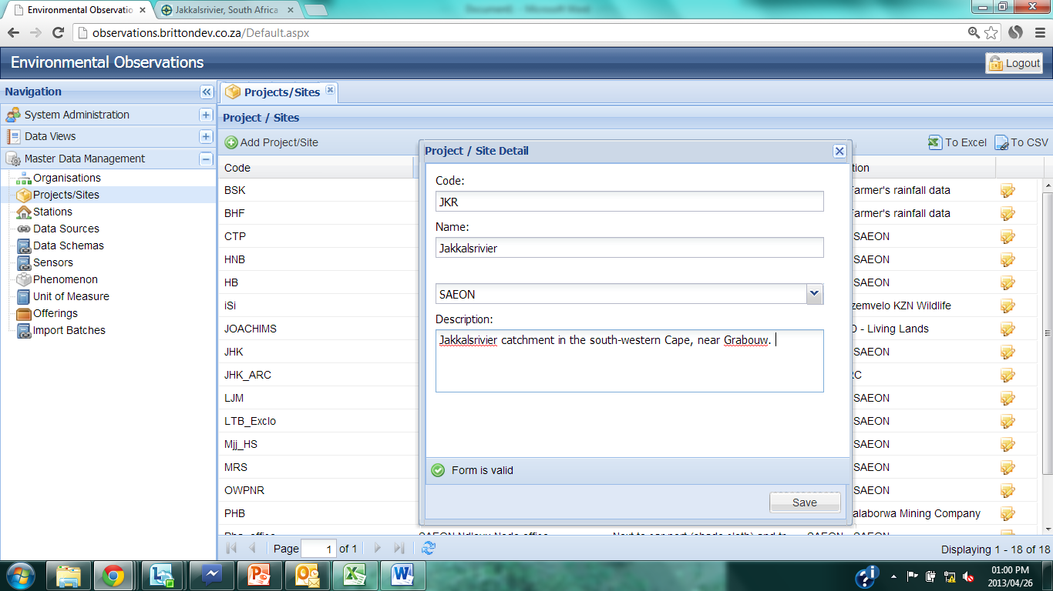
Create Project/Site
Notes:
Enter code for the Project/Site. 3- or 4–letter code in upper case, based on the name of the site. The first letter of the code, must the same as the first letter of the name of the site. (Example: JKR – Jakkalsrivier)
Enter the name of the project site.
Use the dropdown box to link the project/site to an organization. Every Project/Site has to be linked to an organization.
Enter a description of the site.
When all fields have been completed, the ‘Form is valid’ icon will appear.
Click ‘Save’.

Slide 45
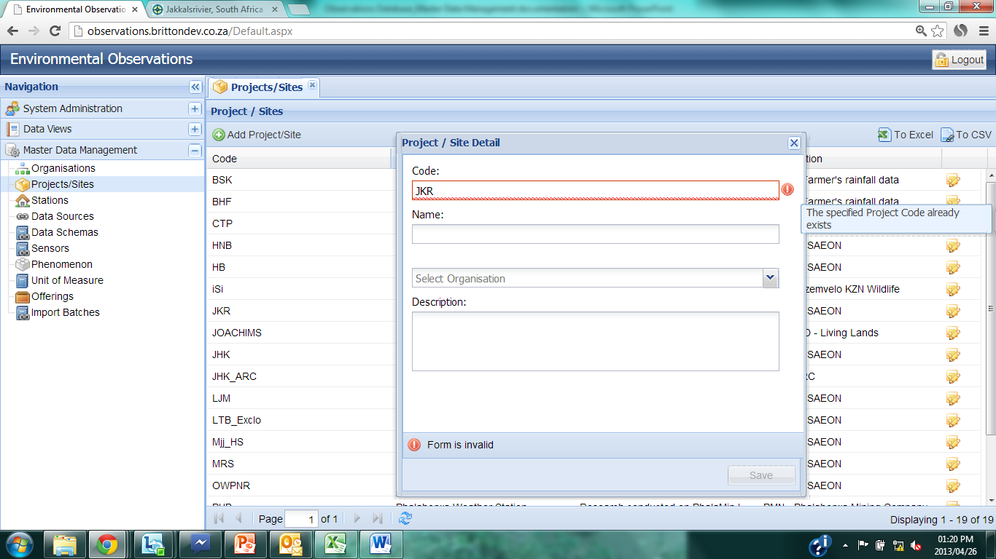
Create Project/Site
Notes:
If the code you select is already used in the database, an error line will show, the box will be highlighted in red, with a red exclamation mark at the end of the box. If you hover the mouse over exclamation mark, a popup box will show “This specified Project Code already exists”.
Revise the code.

Slide 46
Create Station
Notes:
To create a Station to link to an existing Project/Site, click on ‘Stations’ under the Master Data Management tab in the Navigation pane.
A station will describe the area within the site where the data were collected. Every Station must be linked to a Project/Site. For example: Organization = SAEON; Project/Site = Jonkershoek; Station = Bosboukloof catchment.

Slide 47
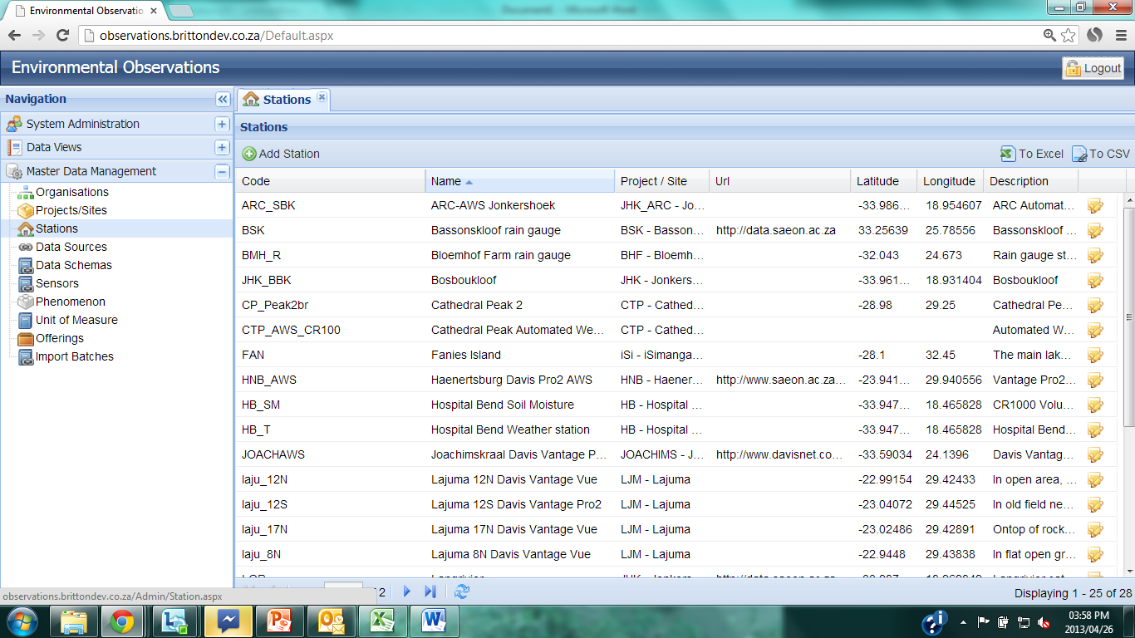
Create Station
Notes:
List of the current stations is shown in the Stations pane. To add a new station, click ‘Add Station’.

Slide 48
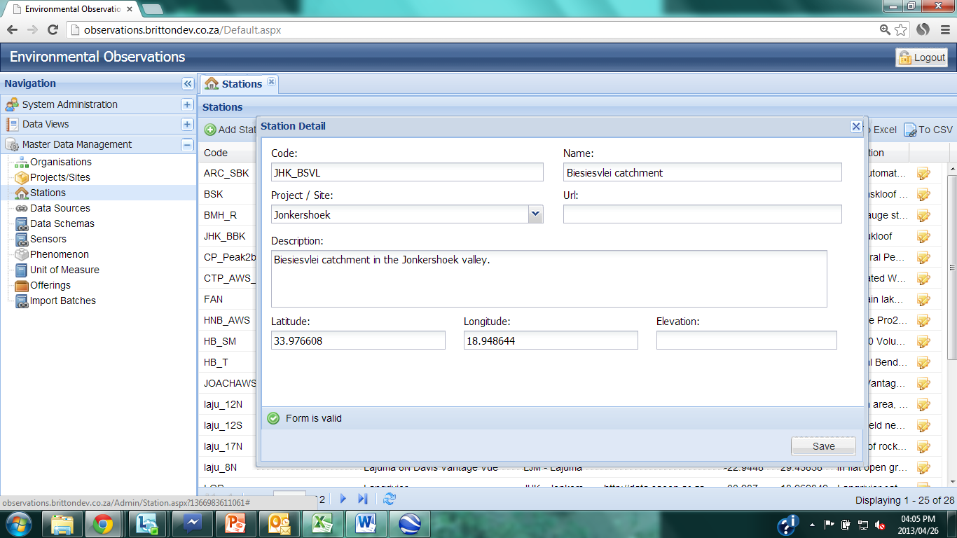
Create Station
Notes:
Enter a code for the station. This must contain the code for the Project/Site where the station is, underscore, and then 4 letter or numbers to identify the station.
Organization = SAEON; Project/Site = Jonkershoek; Station = Biesiesvliei catchment: Code= JHK_BSVL.
Enter a name for the station. Use the dropdown box to link the station to the associated Project/Site. Enter a URL for the station if a sensible one exists which will provide more information on the station. Enter a description of the station, and provide the longitude, latitude and elevation for the station. The longitude and latitude values are mandatory.
When all fields have been completed, the ‘Form is valid’ icon will appear. Click ‘Save’.

Slide 49
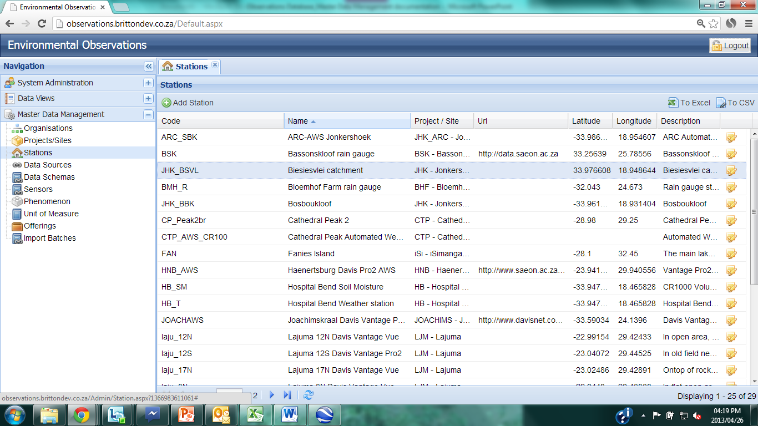
Edit Station
Notes:
The new station is now listed in the database of stations. Details about the station can be edited by clicking on the ‘Edit’ icon.

Slide 50
Define the Data Schema
Notes:
The Data Schema specifies the layout of the file which is uploaded to the database. It provides the database with the important information on what the file layout is, what phenomenon are being measured, the type of offering and the unit of measurement. How the Data Schema is defined depends on the layout of the file and whether repeated phenomena/offerings exist within the file.
Data Schemas can be used for multiple Data Sources if the exact same file layout is used. This will often be the case for automated loggers which often have a consistent file layout.

Slide 51
Define the Data Schema
Are multiple phenomena recorded within the data file?
Yes
No
Each phenomenon has unique offering/s
At least one phenomenon has more than one identical offering
Repeated offerings
Unique offerings
MULTIPLE DATA SCHEMAS
SINGLE DATA SCHEMA

Slide 52
Define the Data Schema
Single Data Schema

Slide 53
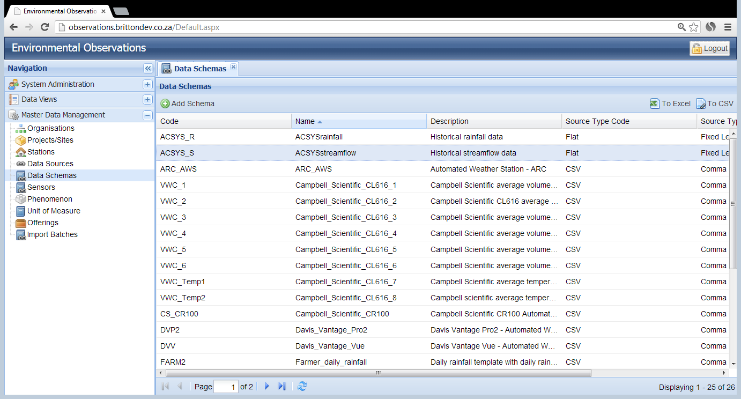
Single Data schema
Notes:
Having clicked on the ‘Data Schemas’ button under the Master Data Management tab on the Navigation pane, a list of the current Data Schemas is shown.
If a Data Schema does not already exist for the file layout required, click on the ‘Add Schema’ icon.

Slide 54
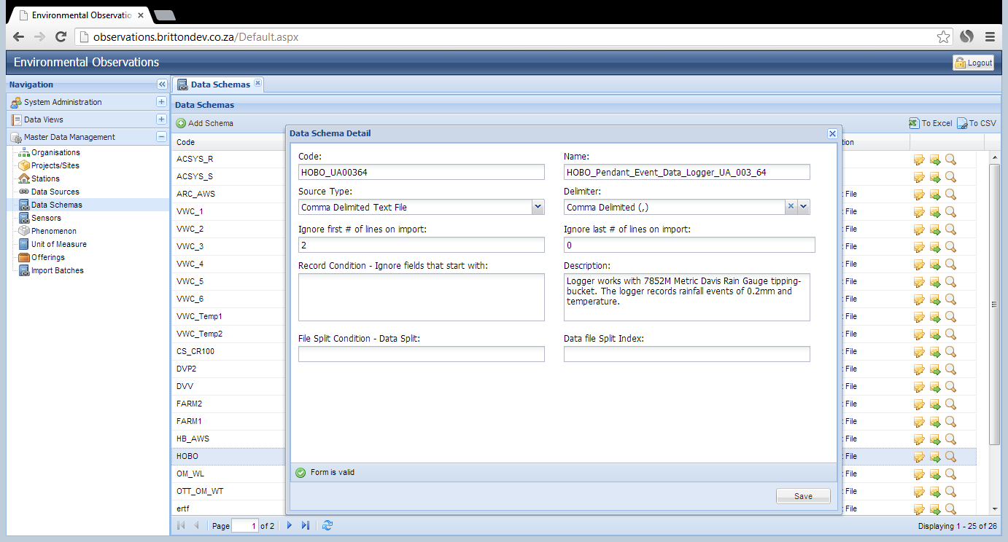
Single Data schema
Notes:
- Enter a code for the Data Schema.
3-4 letter code, upper caser to denote the manufacturer name of the logger, underscore, part name/number for logger. OR
3-4 letter code using first letter of the name of the Data Schema for an ad hoc file layout.
- Provide a name for the Data Schema. The Schema name cannot contain spaces, use an underscore to separate words. For a logger, the name will contain the full official name of the logger; or for an ad hoc file, an ad hoc descriptive name for the Data Schema.
- Select a Source Type for the data file from the dropdown box; either ‘Comma Delimited Text File’, ‘Fixed Length Flat file’ or ‘SMS or USSD messages’. A ‘Comma Delimited Text File’ is any text file with a delimiter between successive variables, not only commas. A ‘Fixed Length Flat file’ is a text file with specified widths for each variable. ‘SMS or USSD messages’ is a specific format developed for the SMS messages obtained from automated loggers.
- If ‘Comma Delimited Text File’ is selected, use the dropdown box to select the appropriate delimiter. The options are comma (,), pipe (|), tab (\t) or semi-colon (;). These delimiters are the most widely used in data file formats.
- Specify the number of lines in the data file which must be ignored, until the first line of data. All header rows must be excluded. If 2 rows are to be ignored, then row 3 is the first one which contains data.
- Specify the number of rows at the end of the data file to be excluded if additional rows are added below the last row of data.
- Specify the Record Condition. In some file formats, text at the beginning of the row indicates that specific row is not a data record. These rows need to be excluded.
- Provide a detailed description of this Data Schema and the file formats that it is to be used for.
- File split condition – some data files contain data for more than one offering or phenomena. In this case, multiple data schemas are required. This case will be discussed later in the documentation.
The Data file Split index will remain blank. This case will be discussed later in the documentation.
When sufficient information has been entered, the ‘Form is valid’ icon will appear.
Click ‘Save’.

Slide 55
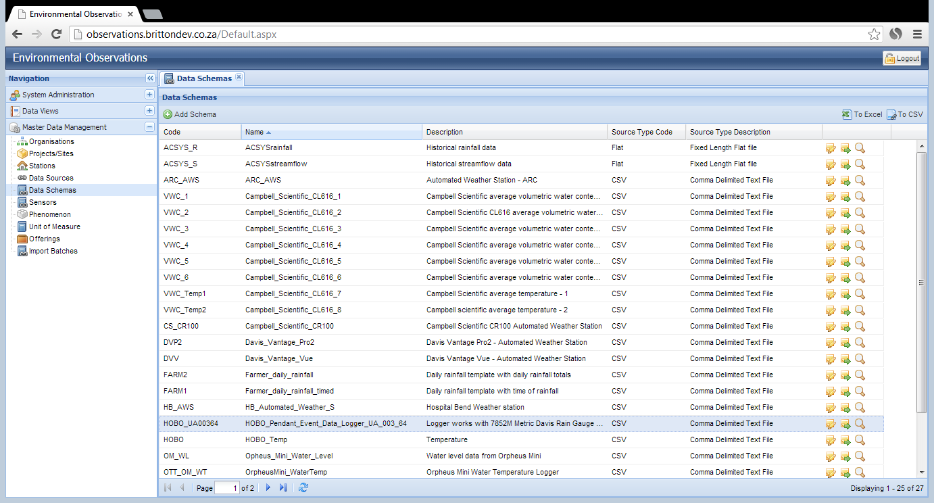
Single Data schema
Notes:
The new Data Schema is now visible in the Data Schemas pane. To Edit the details of the schema, click on the ‘Edit’ icon.

Slide 56
Single Data schema
Notes:
The file layout for this Data Schema is specified by clicking on the middle icon to the right of the schema details.

Slide 57
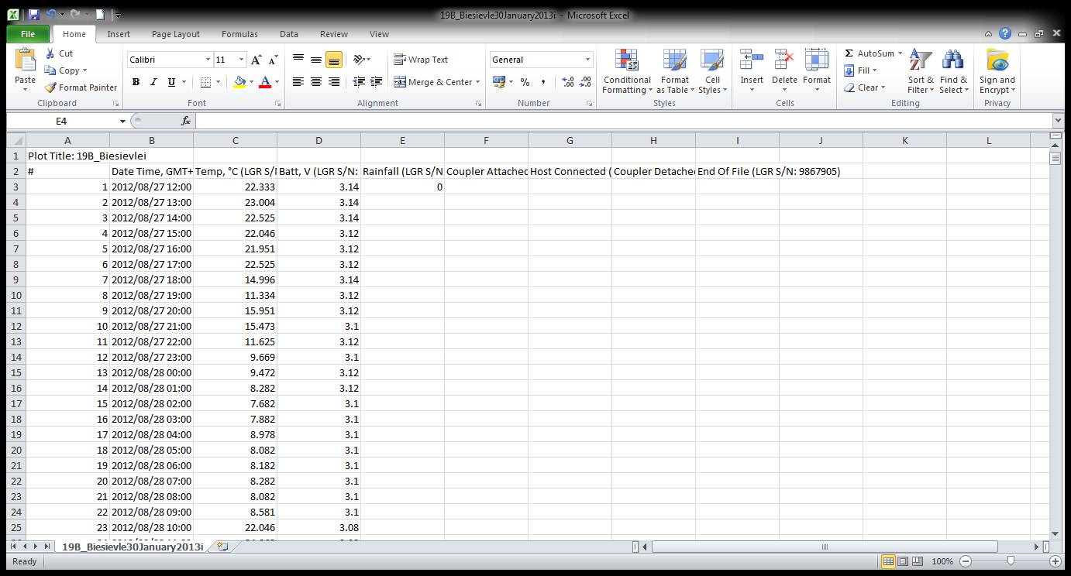
Single Data schema
Notes:
Example of file format to specify in Data Schema layout.

Slide 58
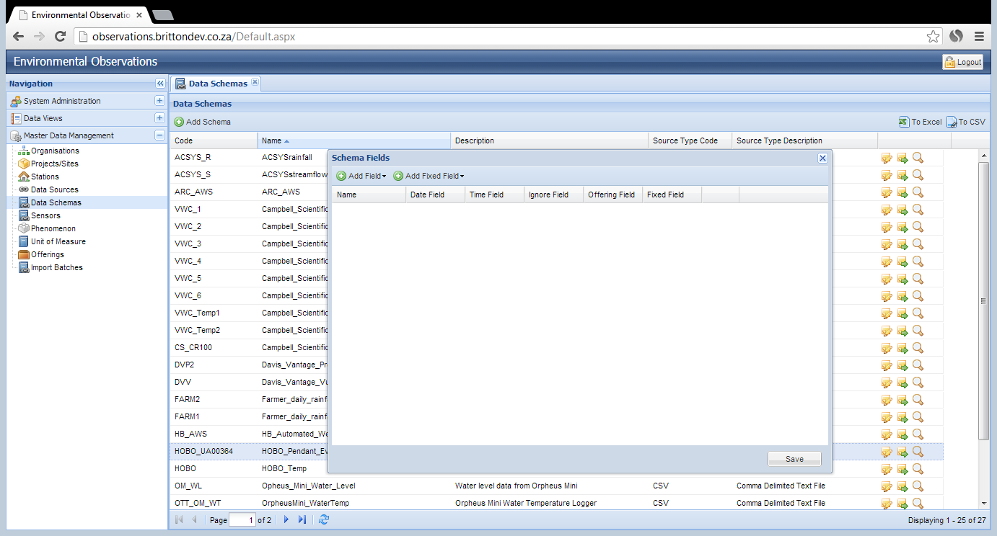
Single Data schema
Notes:
Each of the variables in the file need to be uploaded. Every single column must be specified, even if it is to be ignored.

Slide 59
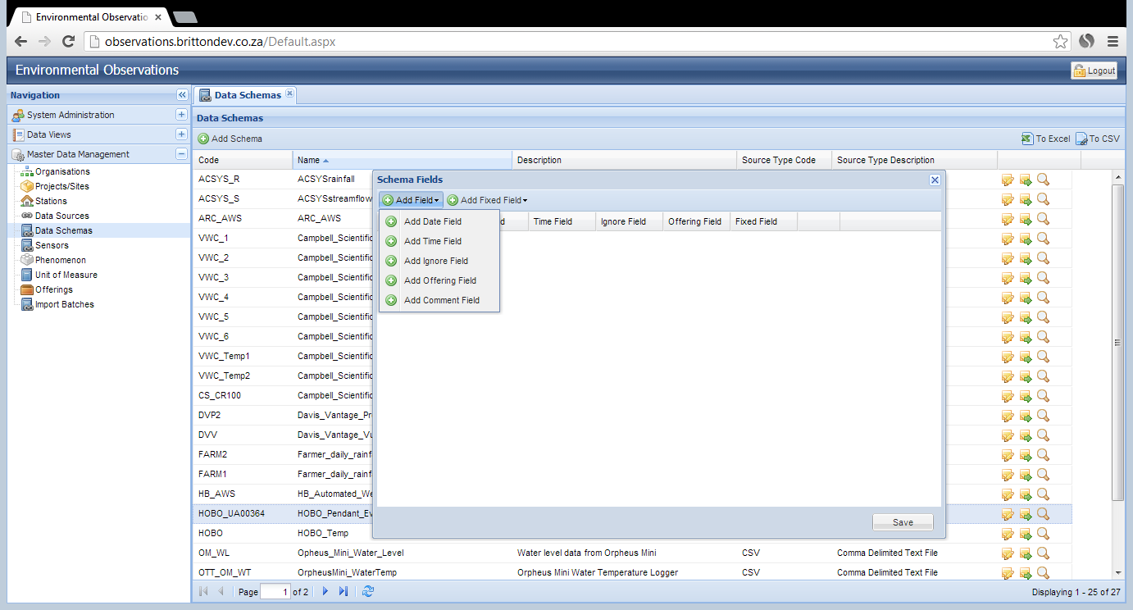
Single Data schema
Notes:
- To add a field to the file layout, click on ‘Add Field’ icon. A dropdown box will appear. Every variable must be chosen to be a Date, Time, Ignore, Offering or comment filed.
Date: the column contains the date or date/time of the observation.
Time: the column contains the time of the observation.
Ignore: the contents of the column is not required in the database.
Offering: the column contains the raw data observation required in the database.
Comment: a text field containing a comment relevant to the observation.
- Select the appropriate field type.

Slide 60
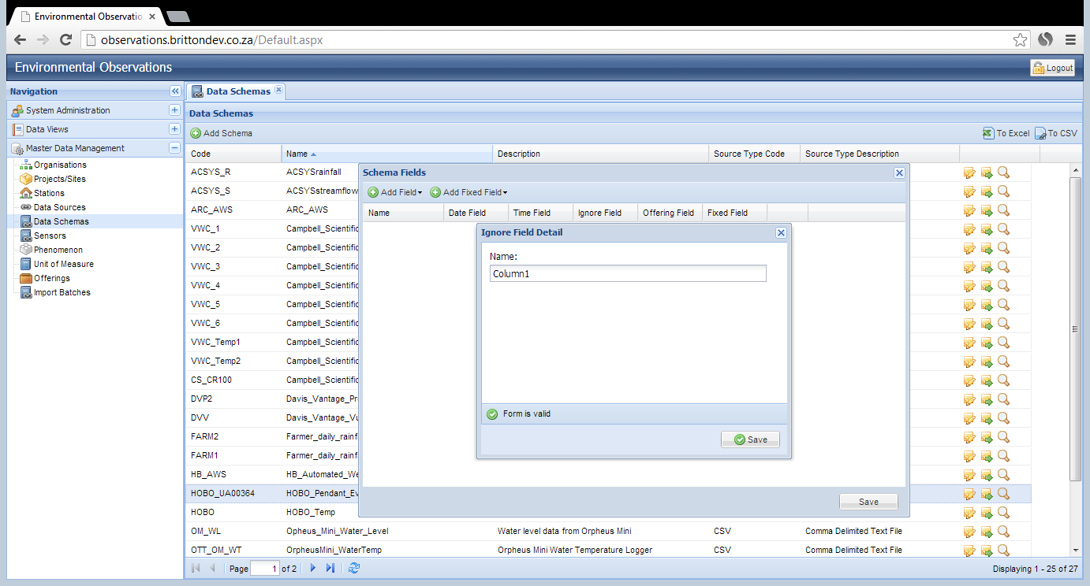
Single Data schema
Notes:
The first column in the csv file contains the ID for the observation and is not necessary for the database. This is specified as an ignore field.
Provide a name for the column, does not have to be descriptive.
The ‘Form is valid’ icon will appear.
- Click ‘Save’.

Slide 61
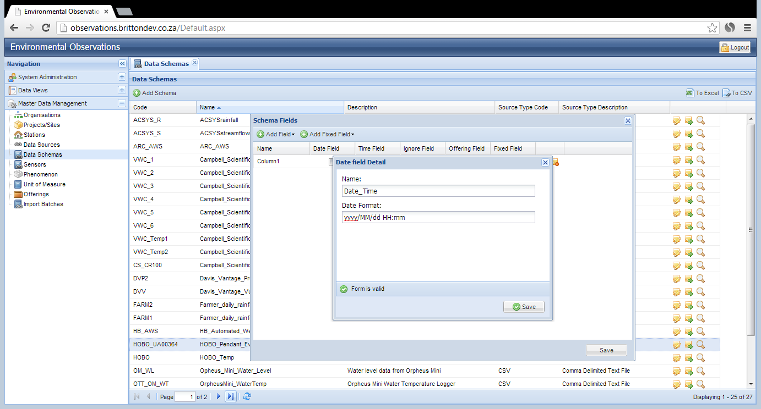
Single Data schema
Notes:
The second column in the csv file contains the date and the time that the observation was made. This is specified as Date field. Since both the date and time are specified in one column, only the Date field will be defined for this file layout.
Provide a descriptive name for the column. No spaces are allowed in the name field.
Enter the format of the Date as it appears in the file. Note that if viewing the file in Excel format, the view of the date could be different to how it is saved in the raw text file. It is worth opening the file in text format (i.e. Notepad) to confirm the date format.
The ‘Form is valid’ icon will appear.
- Click ‘Save’.
Date and time formats:
yyyy – 4 digits for the year (e.g. 2013)
yy – 2 digits for the year (e.g. 13)
MM – 2 digits for the month (e.g. 01, 02,…, 09, 10, 11, 12)
M – 1 digit for the month (e.g. 1, 2,…, 9, 10, 11, 12)
dd – 2 digits for the day (e.g. 01, 02,…, 09, 10,…, 30, 31)
d – 1 digit for the day (e.g. 1, 2,…, 9, 10,…, 30, 31)
hh – 2 digits for hour, 12 hour clock (e.g. 01:00am; 01:00pm)
h – 1 digit format for hour, 12 hour clock (e.g. 1:00am, 1:00pm)
HH – 2 digits for hour, 24 hour clock (e.g. 01:00, 13:00)
H – 1 digit for hour, 24 hour clock (e.g. 1:00, 13:00)
\t – A or P to indicate AM/PM
\tt – AM or PM to indicate AM/PM

Slide 62
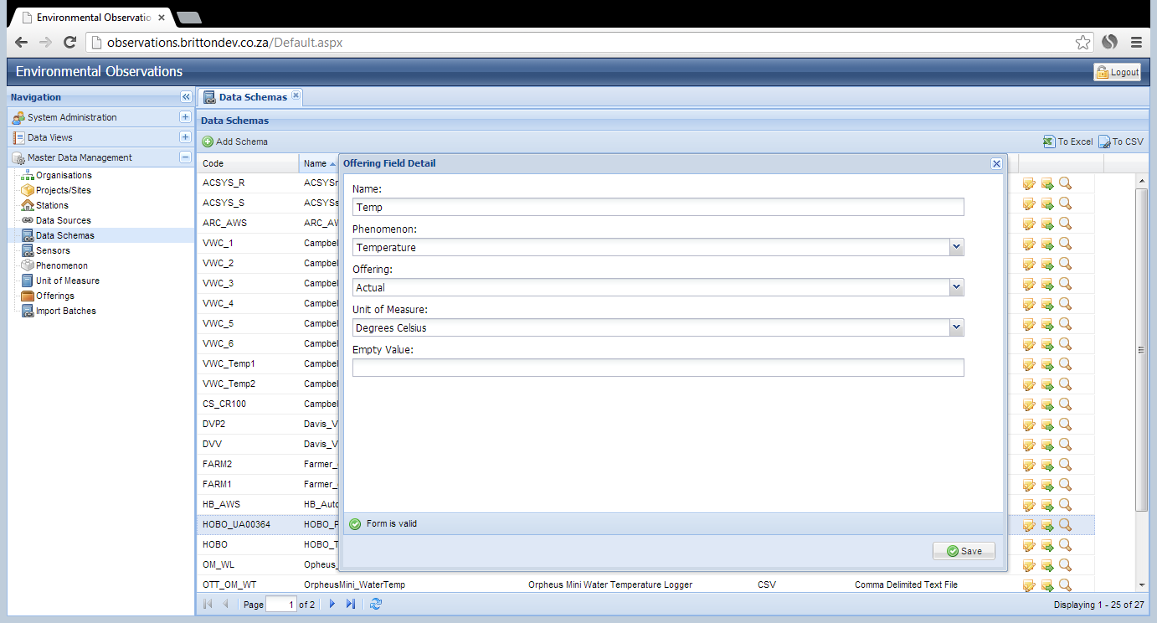
Single Data schema
Notes:
The third column in the file contains the temperature data, recording the actual ambient temperature at the time of the observation.
- Enter a descriptive name for the variable.
- Select the appropriate Phenomenon which is being measured from the dropdown list.
- Select the appropriate Offering from the dropdown list.
- Select the appropriate Unit of Measure from the dropdown list.
- If appropriate enter the code that is used in the file to indicate missing data (e.g. ---, #NA, NA, -99.99). These records will then be recorded as system missing in the database.
When sufficient data have been entered, the Form is Valid icon will appear.
- Click ‘Save’.

Slide 63
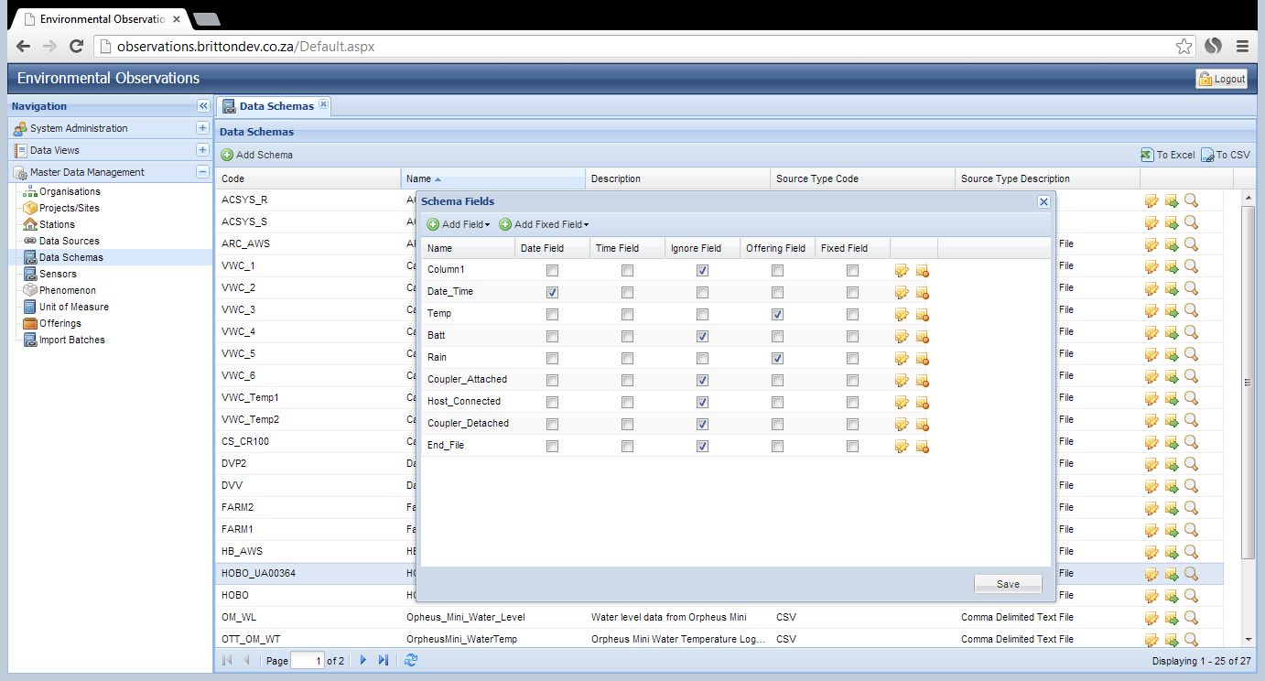
Single Data schema
Notes:
Repeat the above steps to specify EVER column in the input file. Every column has to be specified as a date, time, ignore, offering or comment.
Click ‘Save’.

Slide 64
Single Data schema
Notes:
To ensure that the file layout that has been specified is adequate for the input file, click on the ‘Upload’ icon.

Slide 65
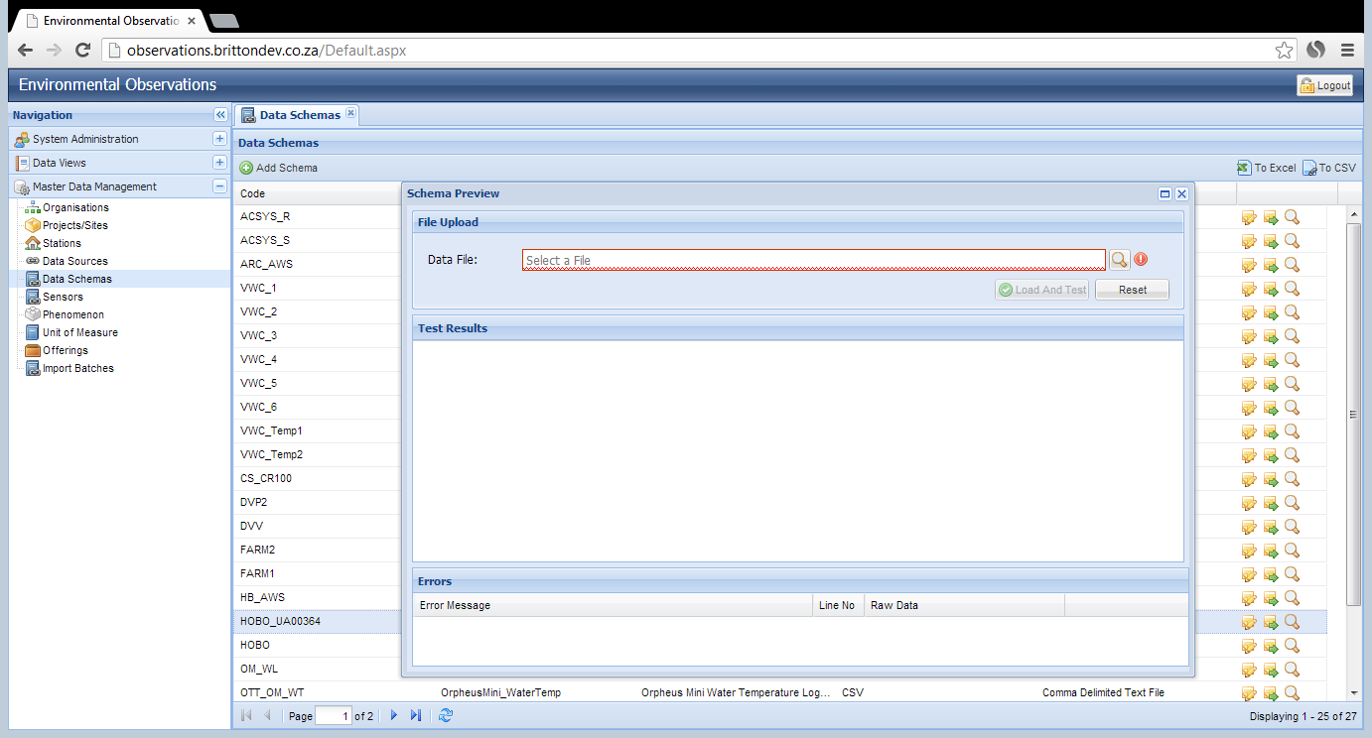
Single Data schema
Notes:
To upload the datafile, click on the ‘Upload’ icon.
Choose the appropriate file location.

Slide 66
Single Data schema
Notes:
Click ‘Load and Test’ icon.
The test can be run for very large datasets, but only a subset of the data will be uploaded to save time.

Slide 67
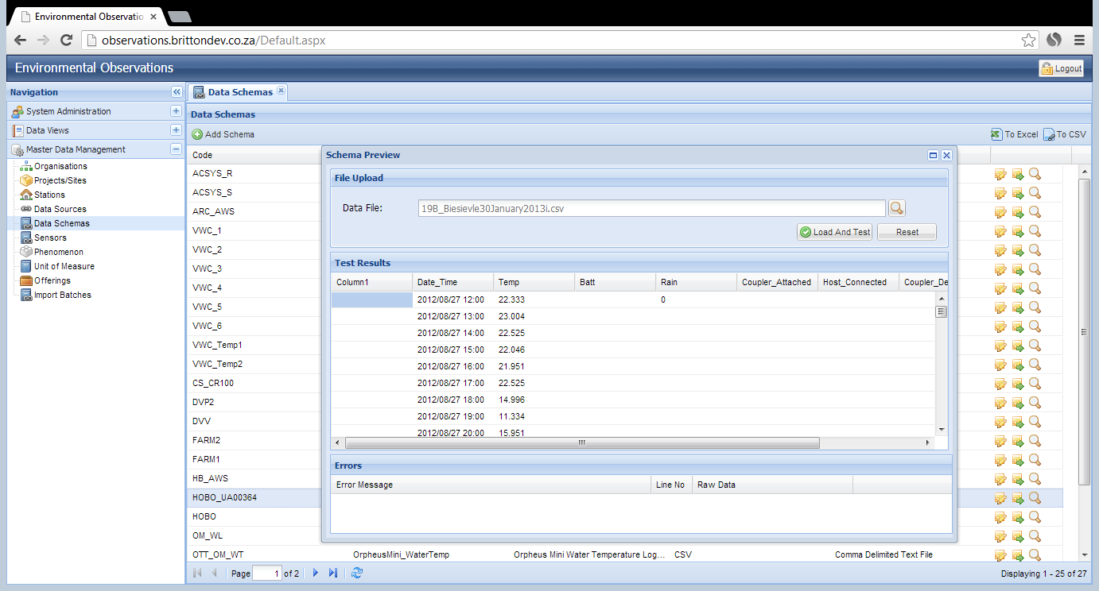
Single Data schema
Notes:
The result of the file upload will be shown in the ‘Test Results’ pane. Every column in the upload file should be shown.

Slide 68
Single Data schema
Notes:
If errors are found in the test upload, they will be shown in the ‘Errors’ pane. These must be rectified by editing the Data Schema.
If no errors are found, the Data Schema is complete and ready to be used.

Slide 69
Define the Data Schema
Multiple Data Schemas

Slide 70
Multiple Data Schemas
If multiple offerings of the same type exist in a file for the same phenomenon, multiple Data Schemas need to be defined for the data file
Example: rainfall data from 5 gauges in the same file
6 soil moisture sensors recorded by 1 logger
Each data schema has to contain unique offerings
If 5 data for 5 rain gauges are in 1 file, 5 Data Schemas must be specified

Slide 71
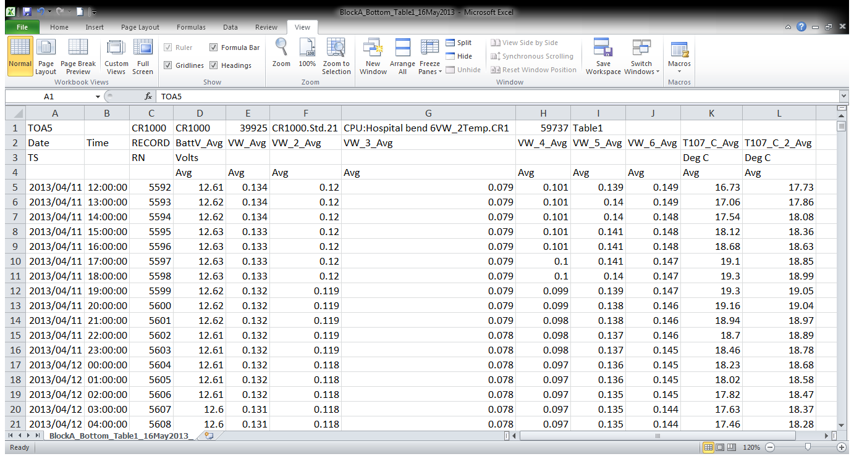
Multiple Data Schemas
Notes:
Example data file showing multiple sensors recording the same phenomena.

Slide 72
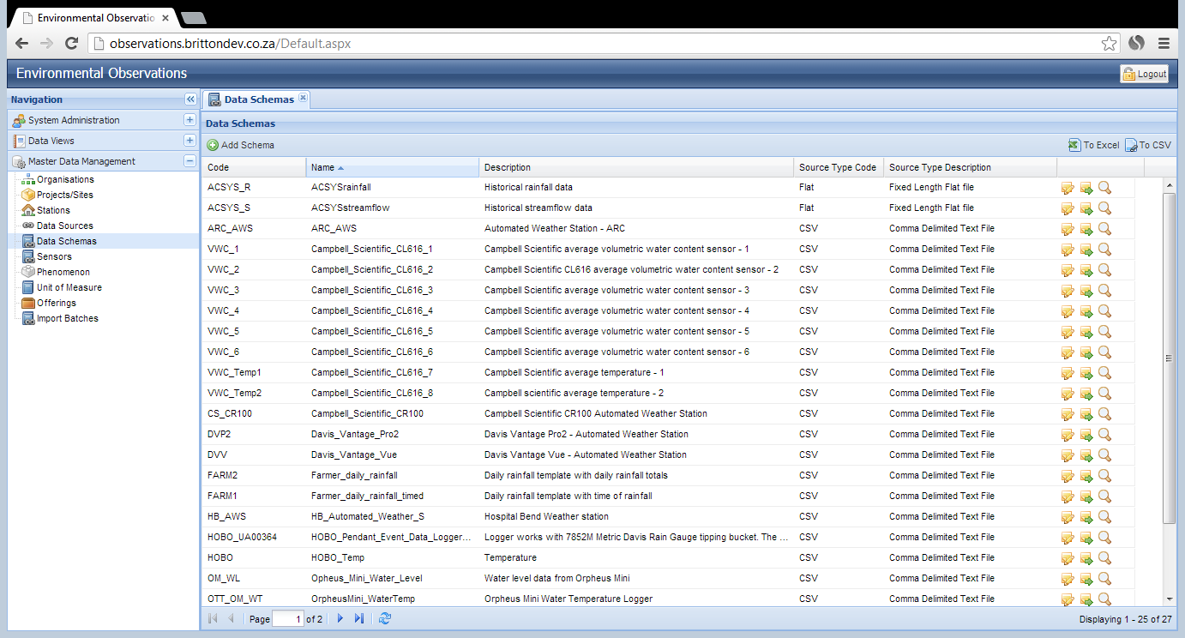
Multiple Data Schemas
Notes:
A separate Data Schema has been defined for the variables in the data file.
6 Schemas for the 6 soil moisture probes and 2 for the soil temperatures.
(Note: in this case 1 Data Schema could have been created for Soil1 and Temp 1; 1 Schema for Soil2 and Temp2; and individual schemas for Soil3, Soil4, Soil5, Soil6. This would have been a total of 6 Schemas instead of 8).
Both layouts will result in exactly the same data being archived.

Slide 73
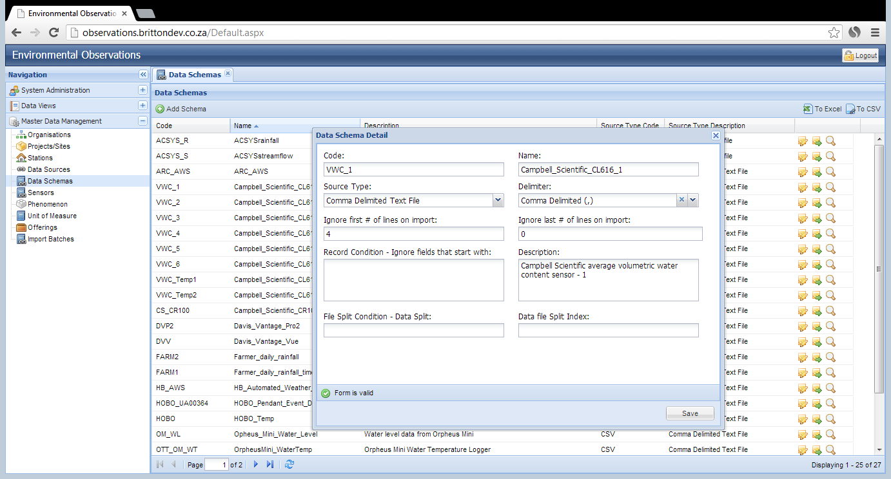
Multiple Data Schemas
Notes:
Data Schema – Soil 1

Slide 74
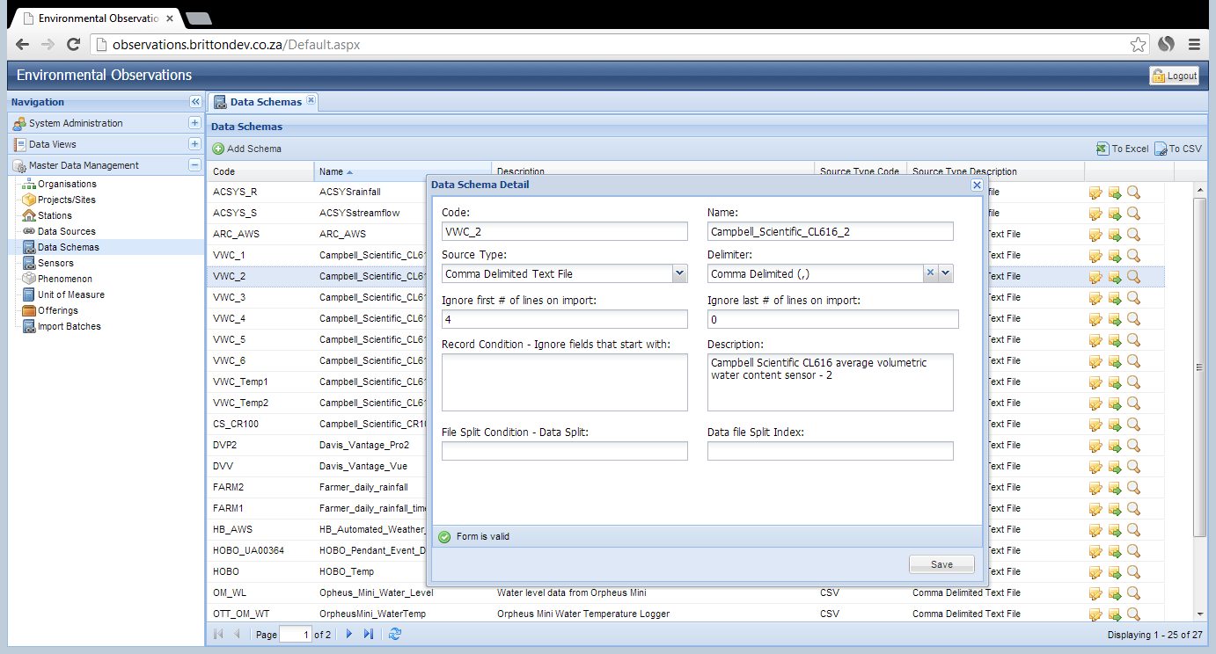
Multiple Data Schemas
Notes:
Data Schema – Soil 1

Slide 75
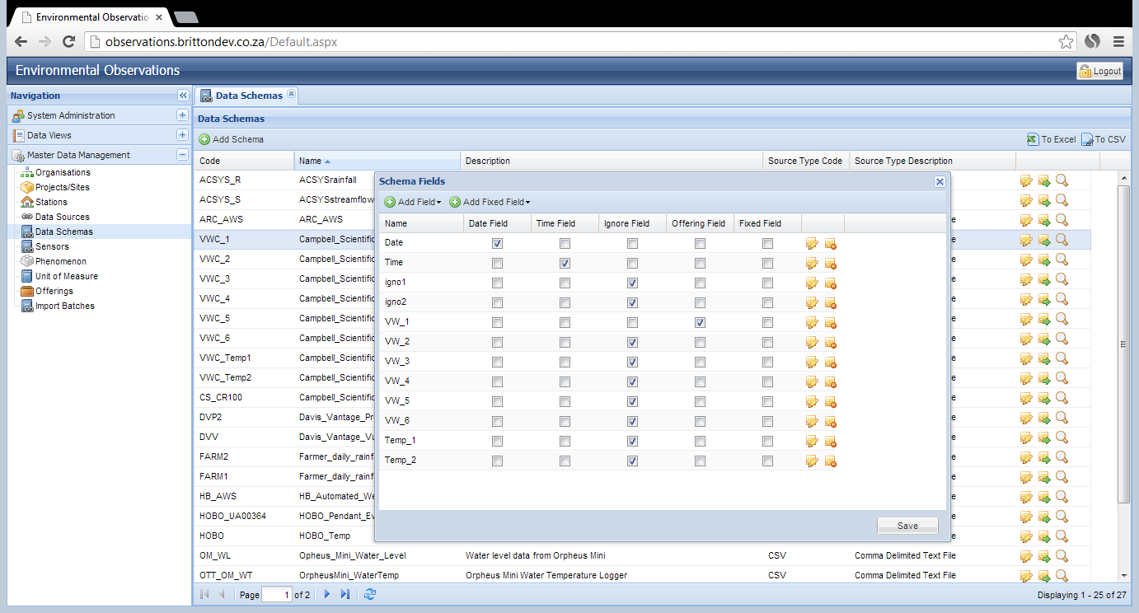
Multiple Data Schemas
Notes:
Data Schema – Soil 1
The columns in the file for the additional offerings of the same phenomenon are recorded as ignore fields. The date, time and the unique offerings for this Data Scheme are recorded as ‘Offering’ fields.

Slide 76
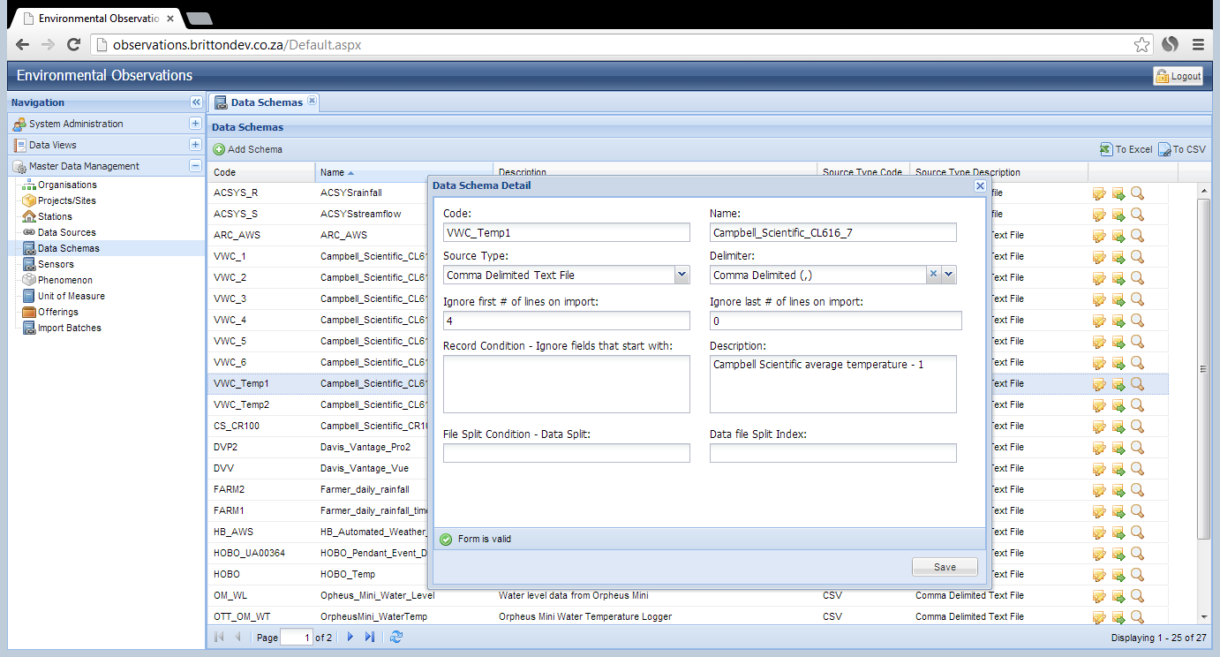
Multiple Data Schemas
Notes:
Data Schema – Temp 1

Slide 77
Data Source
Notes:
A unique Data Source has to be specified for every unique data file source. If the data file is described by a single Data Schema only, this linkage will be done in directly from the Data Source. Multiple schema’s will be discussed later in this documentation.
To create a new Data Source, click on ‘Data Source’ under the ‘Master Data Management’ tab on the Navigation pane.

Slide 78
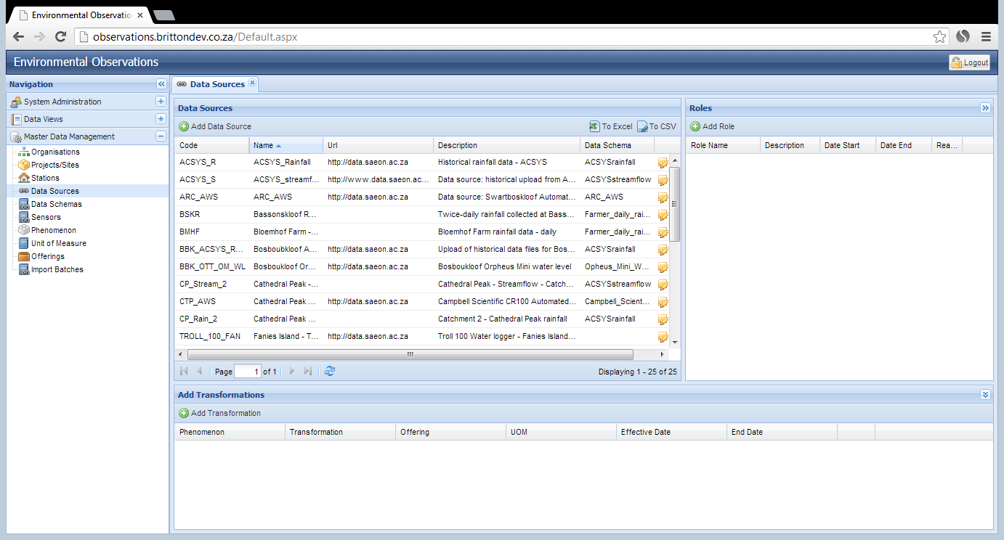
Data Source
Notes:
A list of the current Data Sources are shown in the ‘Data Source’ pane.
To create a new Data Source, click on the ‘Add Data Source’ icon.

Slide 79
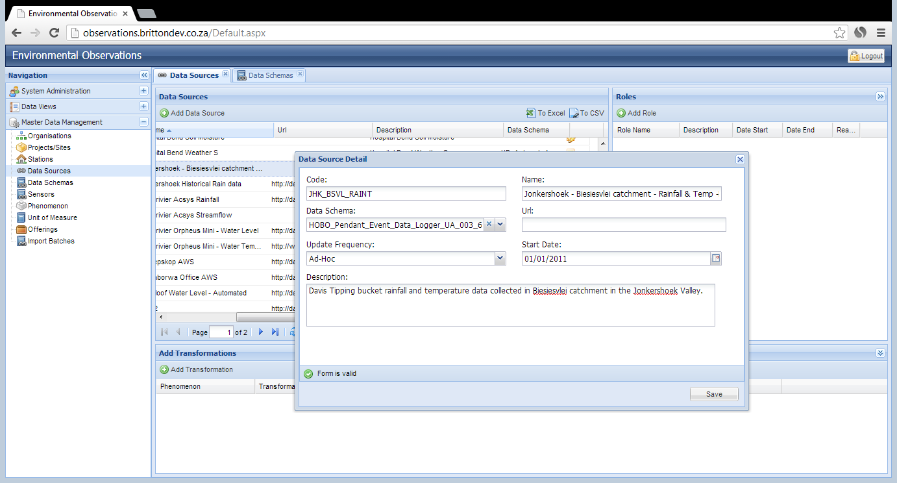
Data Source
Notes:
Enter a code for the Data Source. This must include the code for the station, underscore, and between 4 to 8 letters or numbers to identify the source of the data file for that station. (e.g. JHK_BSVL_RAINT)
Enter the name of the Data Source, this must be as descriptive as possible. (e.g. Jonkershoek - Biesiesvlei catchment - Rainfall & Temp -Davis Rain Gauge tipping bucket)
Use the dropdown box to link the Data Source to the appropriate Data Schema (e.g. HOBO_Pendant_Event_Data_Logger_UA_003_64 )
Provide an appropriate URL for the Data Source if one exists. If a program file exists for the logger/equipment a URL pointing to that file on the SAEON Portal MUST be included in the URL field.
Update frequency: use the dropdown box to indicate how often the data from this source is updated within the database.
Start Date: use the calendar icon to select the date from which this Data Source is valid.
Provide a detailed description of the Data Source. This will be extremely important for the situations when multiple equipment loggers are monitoring various phenomena in the same area.
When sufficient information has been entered, the ‘Form is Valid’ icon will appear. Click ‘Save’.

Slide 80
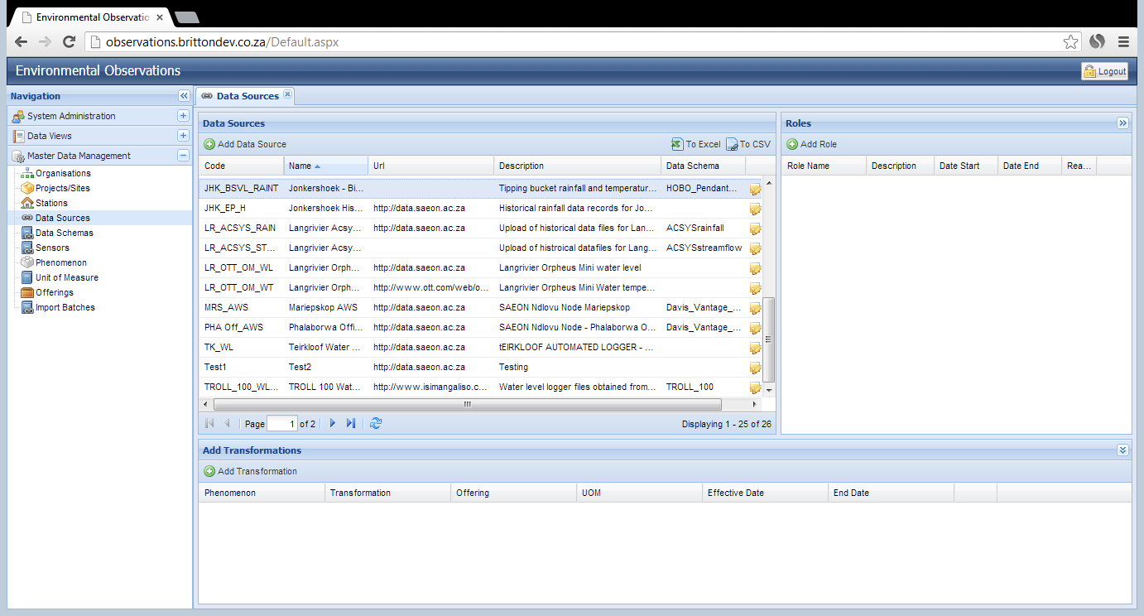
Data Source
Notes:
The new Data Source is now shown in the list of Data Sources.
To edit the details of the Data Source, click on the ‘Edit’ icon.

Slide 81
Data Source
Notes:
In order for a Data Source to be accessible to a data provider, the Data Source needs to be linked to the appropriate roles. To link roles to the Data Source, highlighted the Data Source by clicking on it, and then click on ‘Add Role’ under the Roles tab.

Slide 82
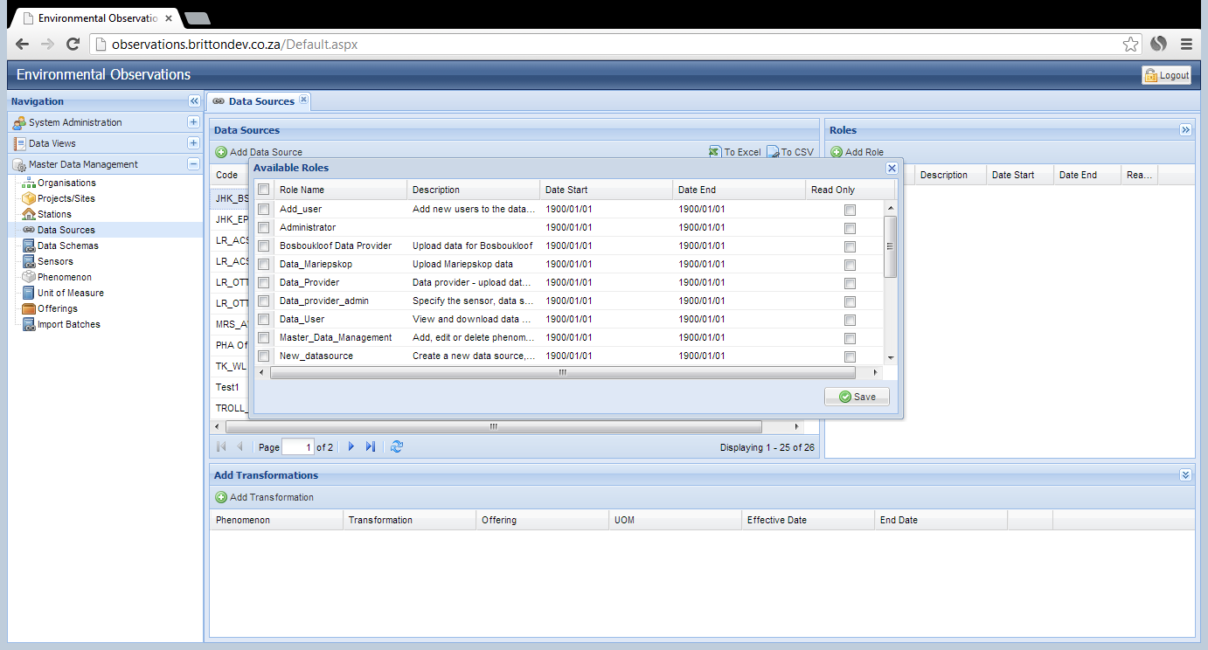
Data Source
Notes:
The list of available roles to be linked to this Data Source is shown.
To link a role to the Data Source, check the select boxes on the left of the available roles detail detail.
The Administrator role must always be linked to every Data Source.

Slide 83
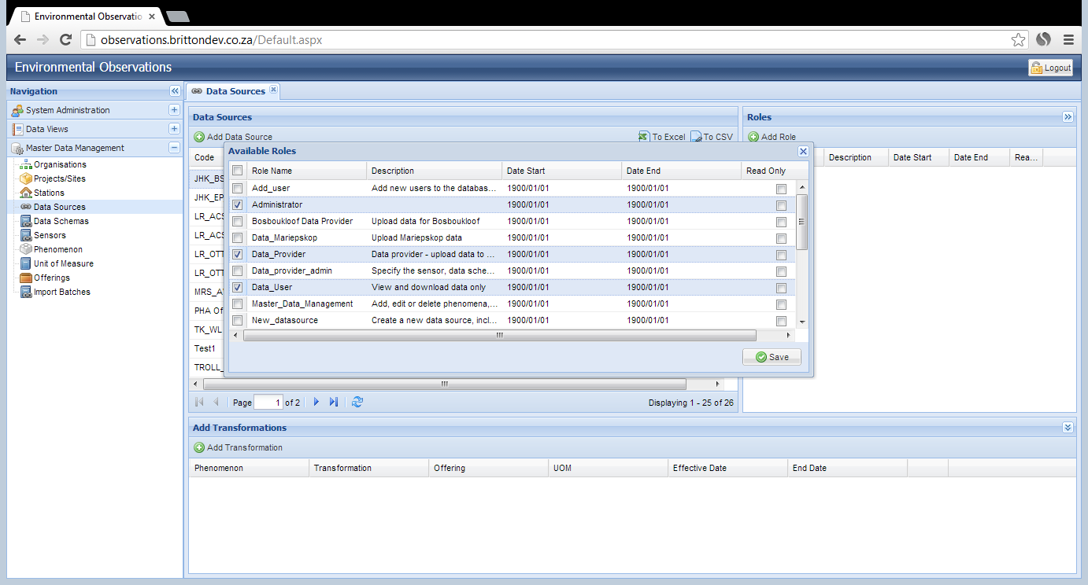
Data Source
Notes:
The Read Only ‘check box’ should be selected if the associated role can only see the data and query it from the Data View, and not upload new data to the database.
NOTE: the Start and End date for the selected roles are set by default to 1900/01/01; once selected, they are not yet activated.
When all the appropriate roles are selected, click ‘Save’.

Slide 84
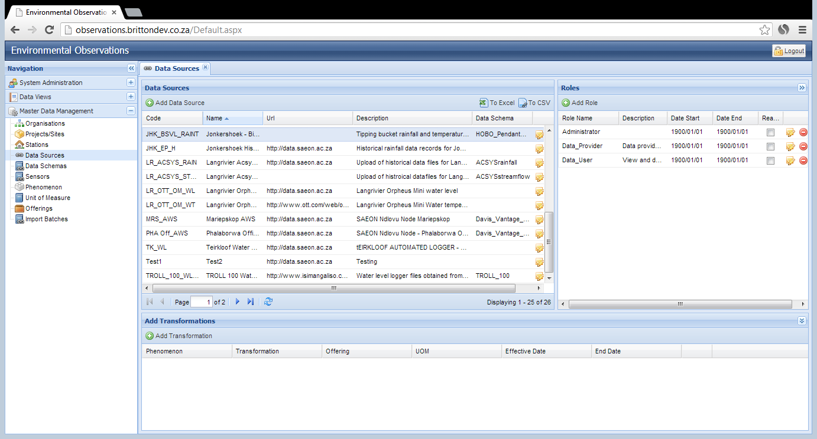
Data Source
Notes:
The selected roles are now linked to the Data Source, however they are not yet activated. To activate a role, click on the ‘Edit’ icon.

Slide 85
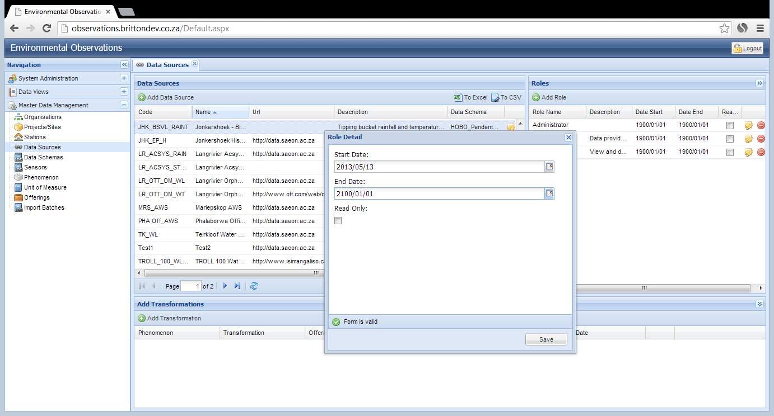
Data Source
Notes:
Use the calendar icons to select the appropriate dates. The date range defines the time period when that role will be able to access that Data Source. A new role can be created for a specific Data Source, if the data are embargoed and only to be made available to limited users.
For a Data Source where the access will range indefinitely, select the End Date as 2100/01/01.
When suitable dates are selected, the ‘Form is Valid’ icon will appear, click ‘Save’.

Slide 86
Data Source
Notes:
Once the roles have had their date ranges adjusted, the users associated with those roles will now be able to access the data from this Data Source.
To remove a role from a Data Source, click on the ‘Delete’ icon.

Slide 87
Data Source
Notes:
It is also possible to link any Data Source to a transformation. A transformation will take an offering from the original raw data, process a calculation on it and then store the raw record and the transformed value in the database.
A transformation can take the form of a rating table (e.g. flow rates for a weir), correction/calibration (e.g. rain gauge correction factor) or quality control on values (rainfall cannot be negative).
To add a new transformation for an offering in the Data Source, click on ‘Add Transformation’.

Slide 88
Data Source
Notes:
Use the dropdown box to select the appropriate transformation type (e.g. Rating Table).
Use the dropdown box to select the phenomenon in the file which will have the transformation applied to it. Each transformation is only applied to a single phenomenon.
Use the dropdown box to select the specific offering of the phenomenon to which the transformation must be applied.
Use the dropdown box to select the unit of measure for the raw data value.
Click on the calendar icon, and select the date from which this transformation must be applied to raw data observations (for example, the ratings tables for a weir can change overtime, as the profile of the pond changes).
The ratings, calibration or quality parameters must be defined in the ‘Transformation Definition’ pane. See the next slide for information on how to specify the transformation. The same formats will be used for the transformation definition for each of the transformation types.
Specify the offering which is obtained via the transformation using the dropdown box.
Select the unit of measure for the transformed value using the dropdown box.
When all the information about the transformation has been specified, the ‘Form is Valid’ icon will appear. Click ‘Save’.

Slide 89
Observations Database
Transformation details
Correction / Calibration (formula applied to the raw value to correct for measurement error, equipment change etc. E.g. rain gauge
Quality control on values (E.g. rain fall must be > 0)
Rating table (streamflow: conversion from stream height to volume of streamflow)

Slide 90
Correction/Calibration

Slide 91
Rating table

Slide 92
Rating table

Slide 93
Quality control
Notes:
Only the minimum and maximum values for an offering can be specified. Other quality control must be done before upload to the database.

Slide 94
Quality control
Notes:
Erroneous observations are rejected during upload. These can be rectified by clicking on the ‘Edit’ or ‘Delete’ icons.

Slide 95
Quality control
Notes:
The correct data value can be manually updated if the correct value is known. There needs to be 100% certainty about the manual update. Otherwise, delete the batch, validate all of the data and import a new batch.
A comment about the update can be included.

Slide 96
Data Source
Notes:
The new transformation is now shown in the Transformation pane, linked to the Data Source which is highlighted in the Data Source pane above.
To edit a transformation, click on the ‘Edit’ icon next to the transformation details.

Slide 97
Sensor
Notes:
Every phenomenon which is measured for a Data Source has to be linked to one sensor, this means that every sensor will link to ONE Station, ONE Phenomenon and ONE Data Source. If the Data Source has a single data schema, then the sensor will NOT link to aData Schema.
If the Data Source links to multiple schemas, then the Sensor will link to ONE Data Schema.
To define a new sensor, click on the ‘Sensor’ item under the Master Data Management tab in the Navigation pane.

Slide 98
Sensor
Notes:
The list of current sensors in show in the Sensor pane.
To define a new sensor, click on ‘Add Sensor’.

Slide 99
Sensor
Notes:
Enter a code for the sensor: Station code, underscore, 4-8 letters or numbers to identity the sensor used (e.g. JHK_BSVL_DAVIS_R and JHK_BSVL_DAVIS_T)
Enter a name for the sensor which provides a description of the locality and the equipment (e.g. Jonkershoek - Biesiesvlei catchment 7852M Metric Davis Rain Gauge tipping bucket).
Enter a URL which provides more information about the type of sensor used, for example the manufacturers webpage (e.g. http://www.scientificsales.com/7852M-Metric-Davis-Rain-Gauge-p/7852m.htm)
Link the sensor to the appropriate station using the dropdown box.
Link the sensor to the phenomenon which it records using the drop down box.
Link the sensor to the appropriate Data Source using the dropdown box. If mulitple schema’s exist, then the Sensor will be linked to the appropriate Data Schema. In the case of a single Data Schema, this has already been linked directly to the Data Source. In this case, the Data Schema will remain blank.
When sufficient information has been loaded, the ‘Form is valid’ icon will appear, click ‘Save’.

Slide 100
Sensor
Notes:
The new sensor is now shown in the list of sensors.
NOTE: for this example two sensors were defined since temperature and rainfall are recorded by the Davis Model 7852M Metric Rain Collector.

Slide 101
Multiple Sensors
Notes:
When Multiple Data Schemas are defined for a data file, these will link to the Data Source via the Sensors. A sensor has to be defined for each of the multiple Data Schemas. If there were 6 Data Schemas, there need to be 6 Sensors defined.
Each sensor will link to a Data Source for the situation where multiple Data Schemas exist

Slide 102
Data Upload
Notes:
The full specification for the Biesievlei catchment Davis Model 7852M Metric Rain Collector is now complete since the Data Schema, Data Source and Sensors have been defined.
The data are now ready to upload.
Click on the ‘Import Batches’ under the Master Data Management tab on the Navigation pane.

Slide 103
Data Upload
Notes:
The list of previous batches of data uploaded to the database are shown in the Import Batches pane.
To upload a new data file, click on ‘New Import’.

Slide 104
Data Upload
Notes:
Use the dropdown box to select the appropriate Data Source for which you wish to upload data. Only the Data Sources for which your user profile has access will be shown in the dropdown list.
Click on the magnifying glass icon to select the path to the file containing the data records for the Data Source selected.
Do NOT select a log file. This is only used for a certain type of historical data.
Click on ‘Import Data’ icon.

Slide 105
Data Upload
Notes:
Once the file has uploaded successfully, it is shown in the list of Import Batches.
The status of any errors in the file are shown under the ‘Status’ column.
For this file, the Status is ‘No Errors in Log’ and the Data Log pane is empty.

Slide 106
Data Upload
Notes:
If there are any errors found during the upload process, the Status of the file is shown as ‘Errors in Datalog’.
A list of all the erroneous records are shown in the Data Log pane.
In this case, duplicate records were found in the file which had already been uploaded to the database. The reason for the error is shown in the Status column in the Data Log pane.
The details of the erroneous records are shown to the left of the status in the Data Log pane.

Slide 107
Data Upload
Notes:
Errors can be addressed directly using the ‘Edit’ and ‘Delete’ icons on the right of the Data Log pane.
The ‘Edit’ button allows the user to enter a comment against the erroneous record to explain it.
The ‘Delete’ icon removes the erroneous record and it will not be uploaded to the database. Click ‘Yes’ to confirm the deletion of the record.

Slide 108
Data Upload
Notes:
If an issue is found with the whole batch of records which were imported, the entire batch can be removed from the database by clicking on the ‘Delete’ icon on the right of the Import Batches pane.

Slide 109
Data Upload
Notes:
These records can now be queried from the Data Query Display and download as required.

