Slide 1

SAEON Data Portal
Feedback and Work Programme
7 June 2011
W Hugo

Slide 2
Scope of Work: Systems Engineering
CHPC Peripheral
CHPC Infrastructure
SAEON Infrastructure
HSRC
Corporate
Support
CSIR
GeoPortal
Research
Opportunities
CSIR-TIP
SAEON
Data Products
Risk Atlas
GAP
SAEOS
SAEON
Spatial
DB
SAEON Data Portal
VLDB
GeoHazards Portal
BioEnergy Atlas
SAEON
SensorWeb
WDC BHH
SAEON
IOMS
MRC

Slide 3
Scope of Work: Liaison
Domain-Specific
Nationally
International
Digital Curation
NeDICC
Line Departments
ISPRA-EGU
CSI Data Committee
Risk Atlas Theme Convenors
ICSU
WDS
NSIF
GEOSS
SIMSC
OceanSAfrica
USGS
CSIR:
CoastGIS

Slide 4
Scope of Work: Capacity Building
Domain-Specific
Nationally
International
GeoPortal Cookbook
ICSU Africa
Maturity Model
Meta-Data Management
COP/
Ontologies
COP/
Ontologies
SAEON
IT Strategy

Slide 5
Scope of Work: Specific Projects
CHPC Peripheral
Shared Infrastructure
SAEON Infrastructure
Education
Platform Spatial Extensions
ScienceBook
NetCDF
Extensions
Observations
SensorWeb
IOMS
Indexing
Chained Processing
Historical Catch DB
Meta-Database
Algoa
Sentinel

Slide 6
SAEON Data Portal Status
URS III changes completed with exception of 4 remaining tasks – with service provider
Transfer to CSIR completed
Development/ Test Site at CHPC in process
  Three virtual machines, 2 for fail-over
  32 GB RAM
  50 TB shared storage
Service Provider Swap in Process
  QSENS completing contract 6 months late
  WebTide to be appointed shortly

Slide 7
Portals and Platform
Main Stakeholders
and Initiatives
Main Platform
Services
Documents
and Publications
Spatial
Data
Other
Data
SAEON
Nodes and Initiatives
SAEON
SAEOS
Portal
Data Analysis and Processing
SAEOS
World Data Centre for BHH
Content Visualisation and Presentation
WDC
Risk and Vulnerability Atlas
RAVA
Meta-Data and Data Management Functions
CSIR
CSIR
Meta-Data and Data Services
Limpopo GeoEconomic Portal
LGEP
NSIF
Application
NSIF Portal
NSIF

Slide 8
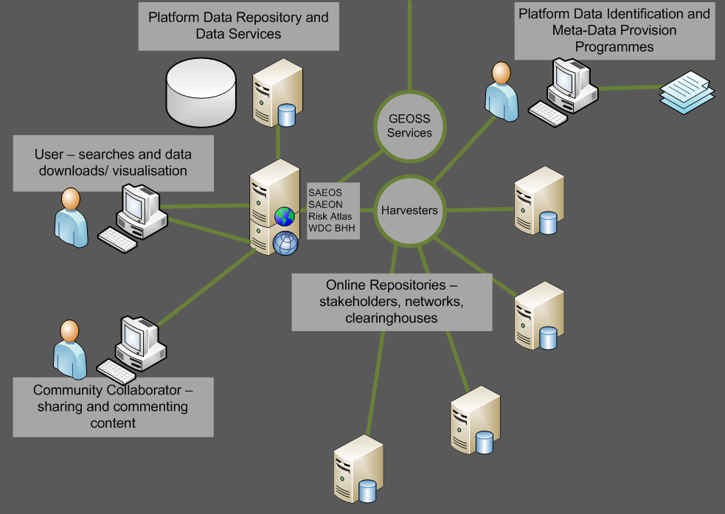
Main Use Cases
Phase 1: DISCOVERY AND VISUALISATION

Slide 9
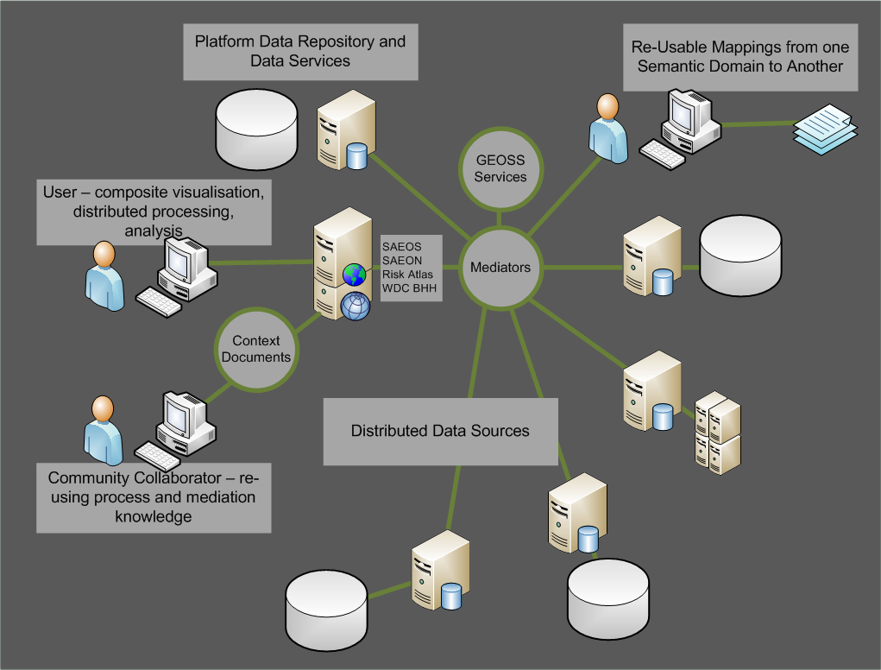
Main Use Cases
Phase 2: Mediation and Collation

Slide 10
MAIN USE CASES
Phase 3: AUTOMATED PROCESS CHAINING
?

Slide 11
Updated Distributed Standards Architecture
Distributed Web Folders
Standardised Data Services
Standardised Catalogue Services
User Interface Layer
NetCDF
nDTM
OPeNDAP
Server
THREDDS
Server
Viewers
Other Objects
JSON/ Atom
RSS
RDF Services
OGC-CSW
OAI
Mediators
Relational Spatial DB - OGC
Search Interfaces
O&M Schema
3DTM
Sensor Observation Service
Context
Typical Spatial Data
2DM
OGC Map Services
SHP, TIFF, etc.

Slide 12
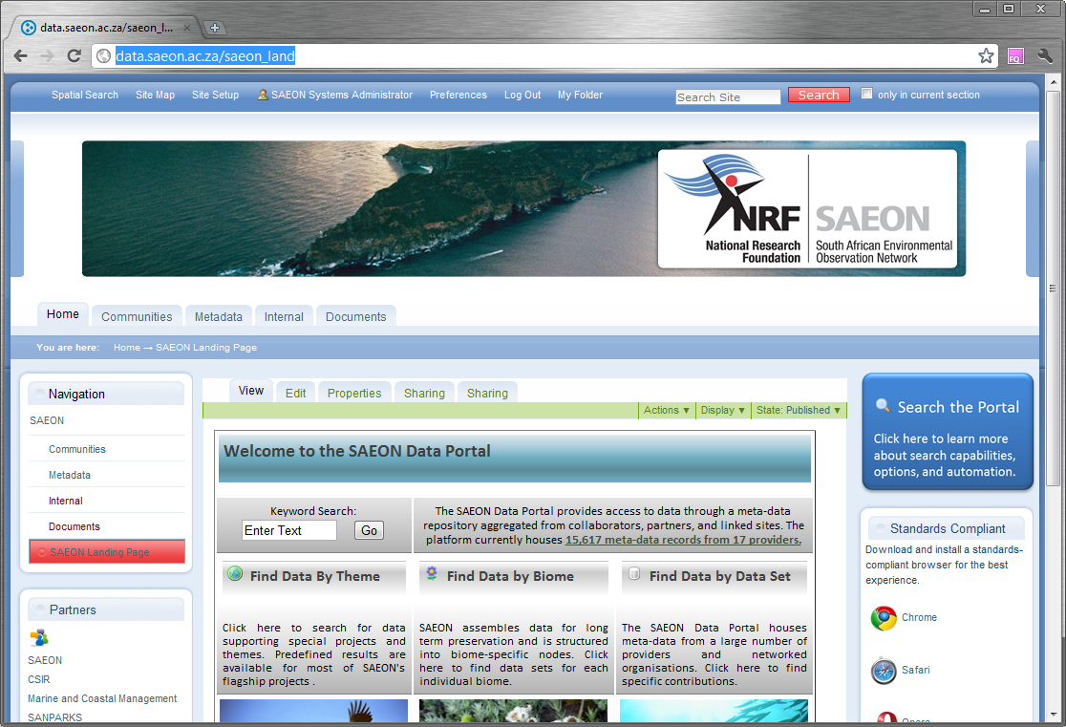
Landing Page
Immediately Searchable
Immediately Searchable

Slide 13
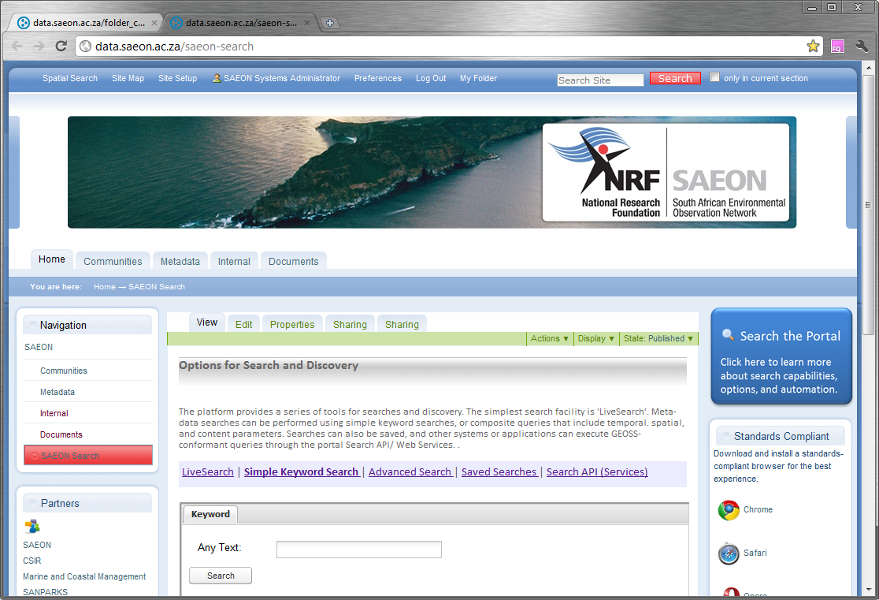
Search Page
Simple and Advanced Searches

Slide 14

Keyword (Simple) Search
Search on Keyword

Slide 15
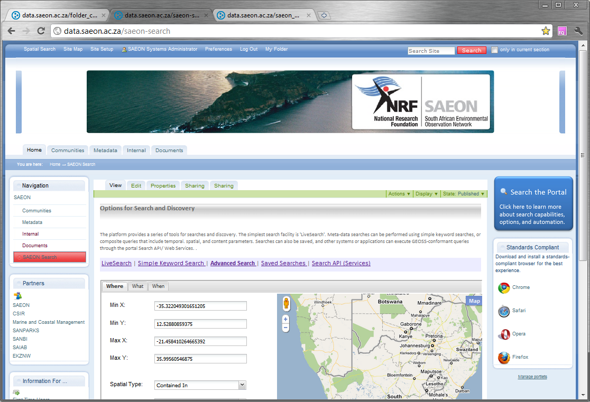
Advanced Search
Advanced Search Facility

Slide 16
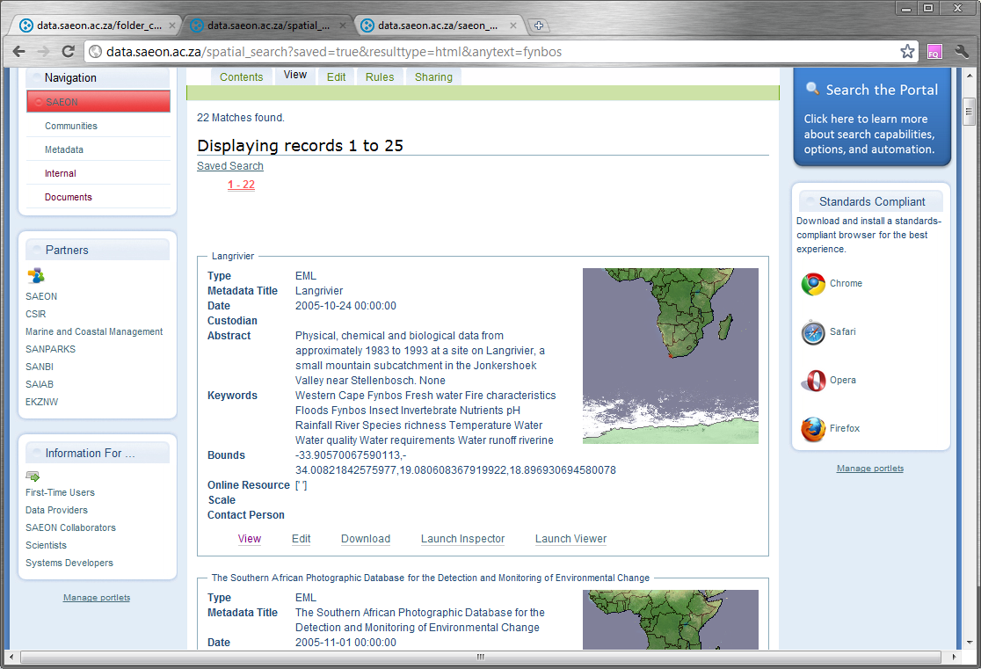
Search Results
Results are returned

Slide 17
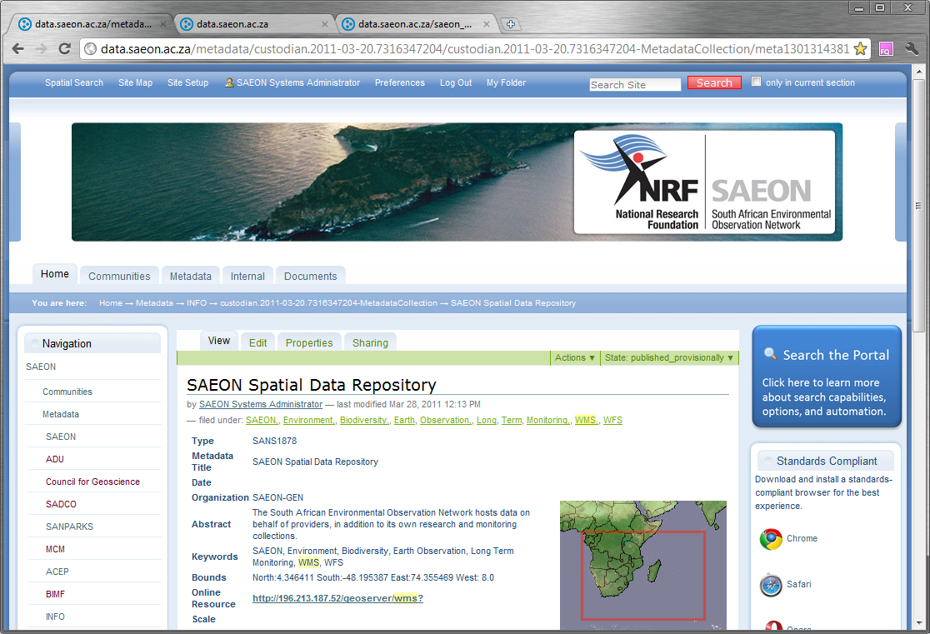
Individual Record
Individual Meta-Data Record

Slide 18
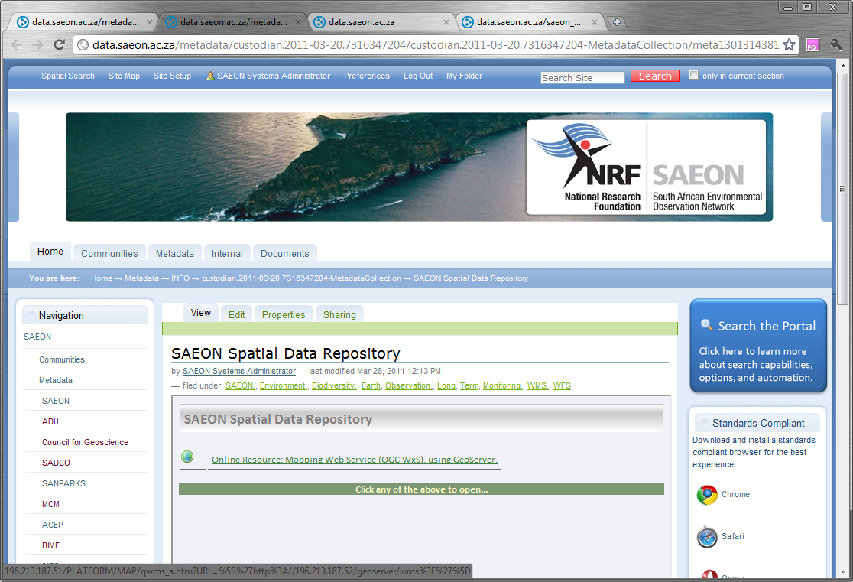
Meta-Data can have multiple links
Assessment of Links

Slide 19
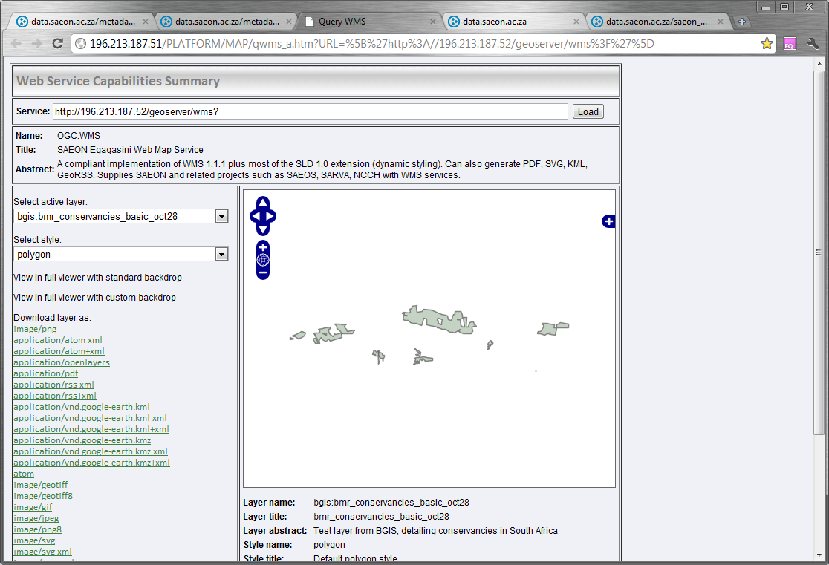
Data Preview
Standardised Data can be previewed

Slide 20
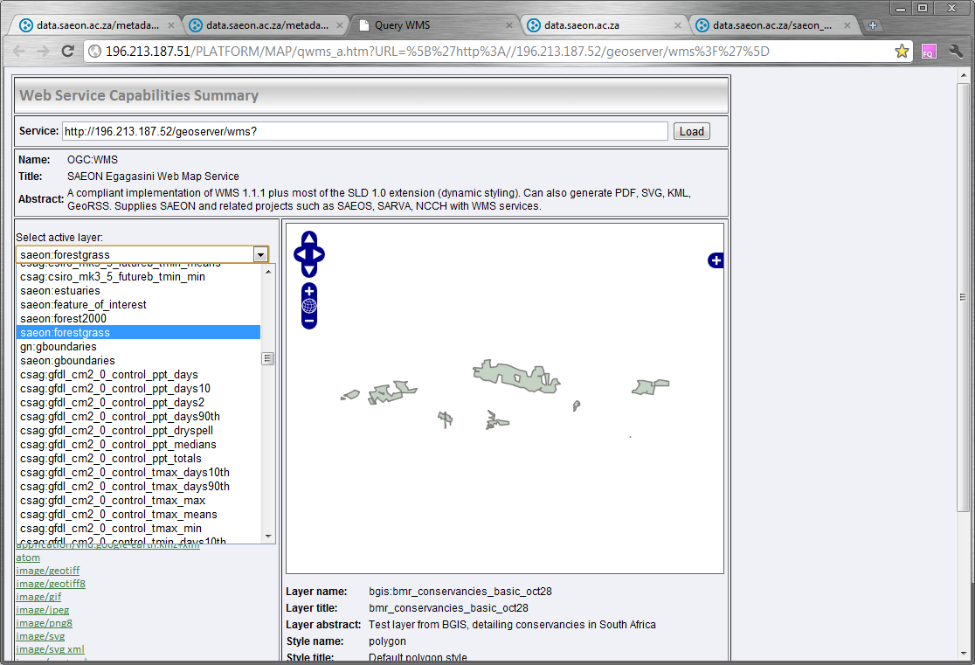
Potentially multiple sources
Select alternative layer

Slide 21
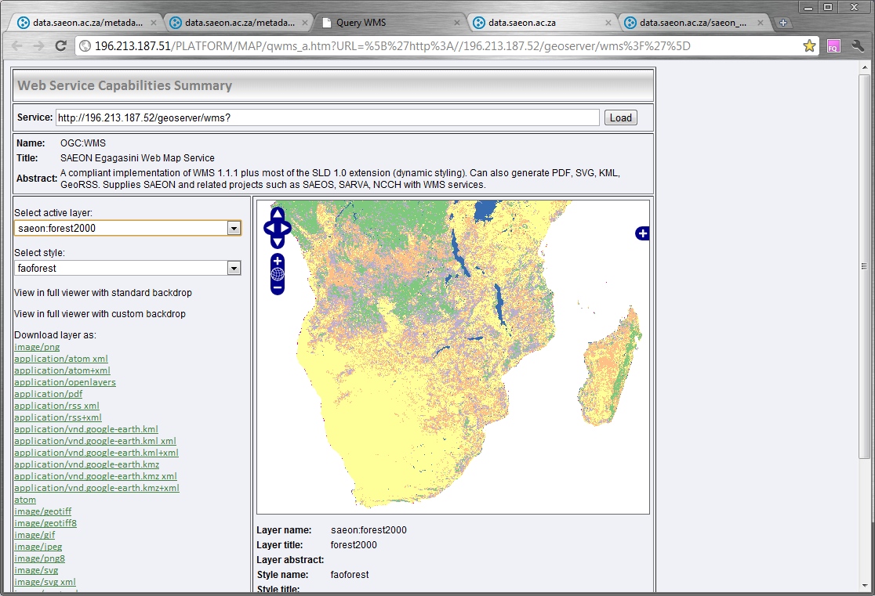
Alternative data layer at same source
FAO Forest Cover

Slide 22
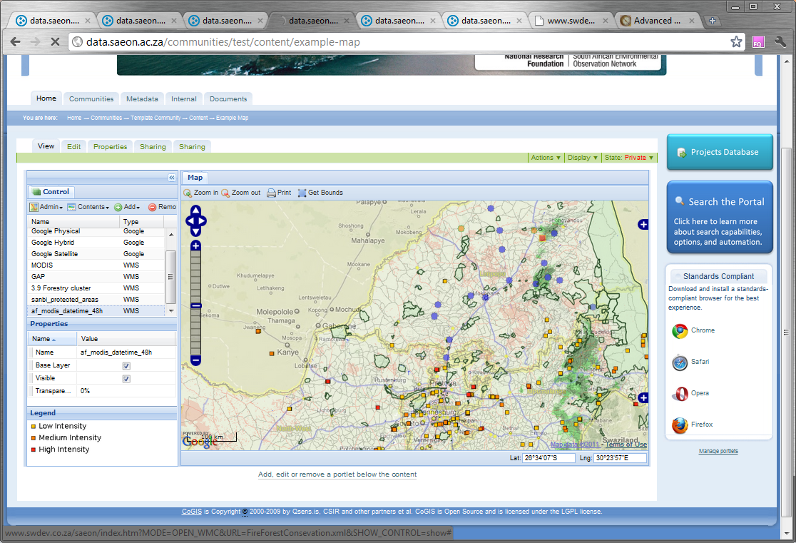
Packaging automated data for display

Slide 23
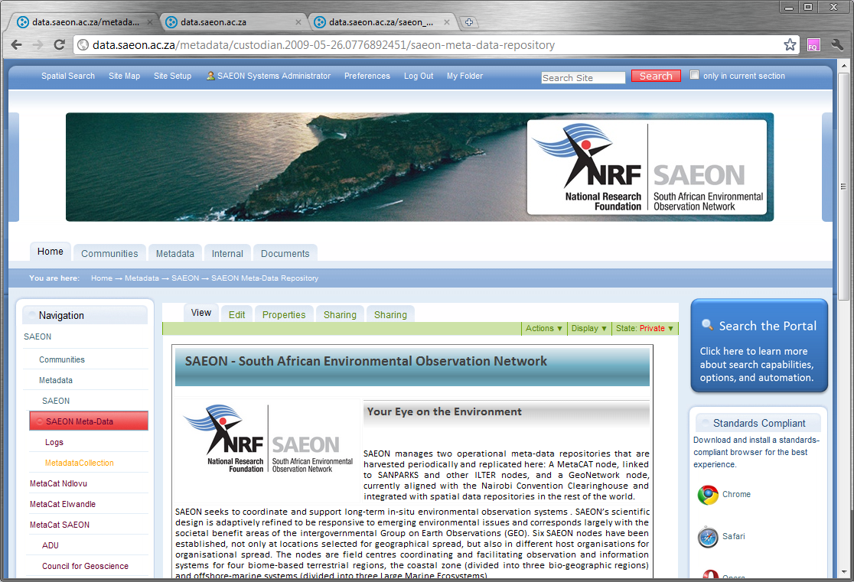
Custodian Landing Page
Detailed Custodian Page

Slide 24
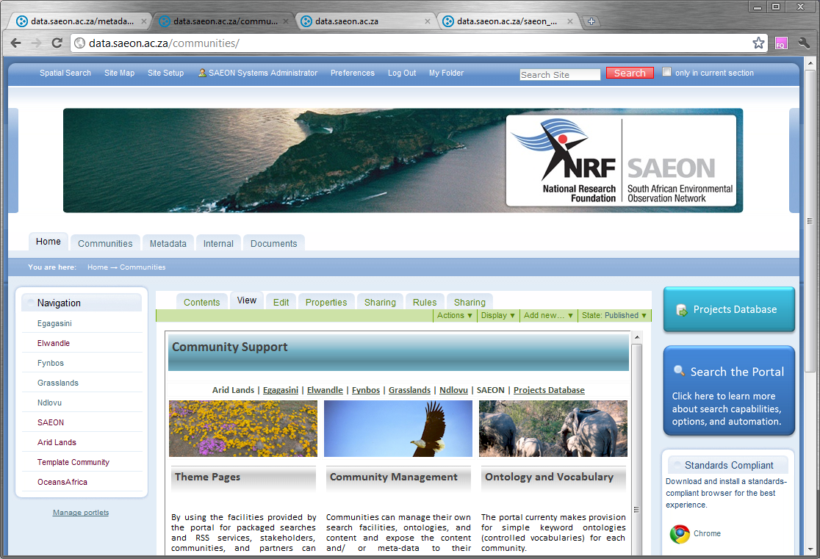
Communities of Practice
Node Communities
Community Pages

Slide 25
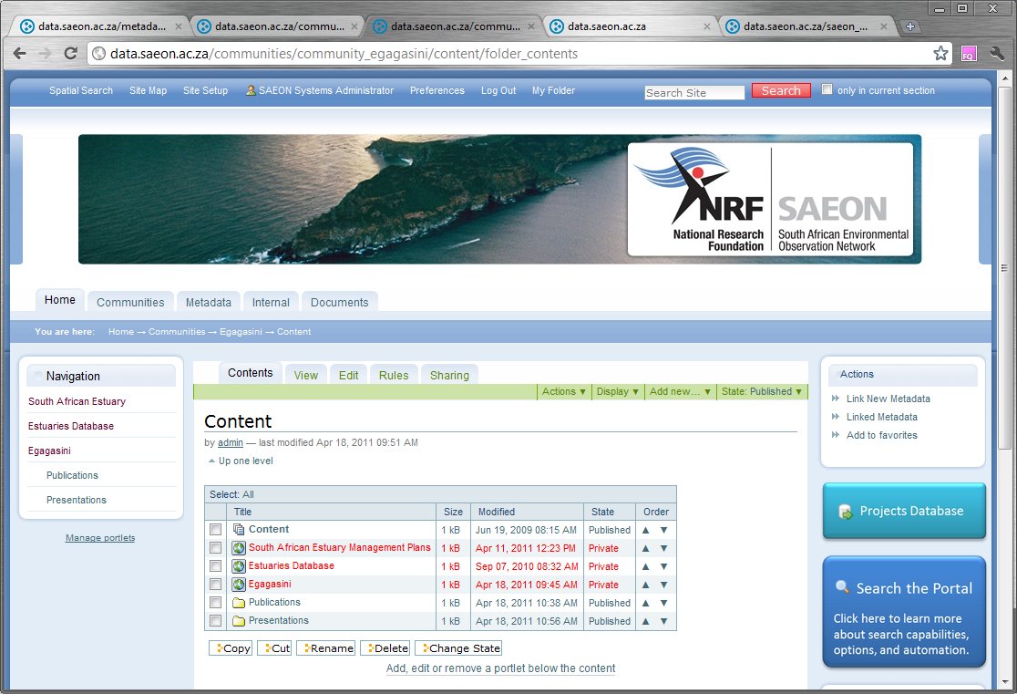
Communities manage their own content …
Community Content

Slide 26
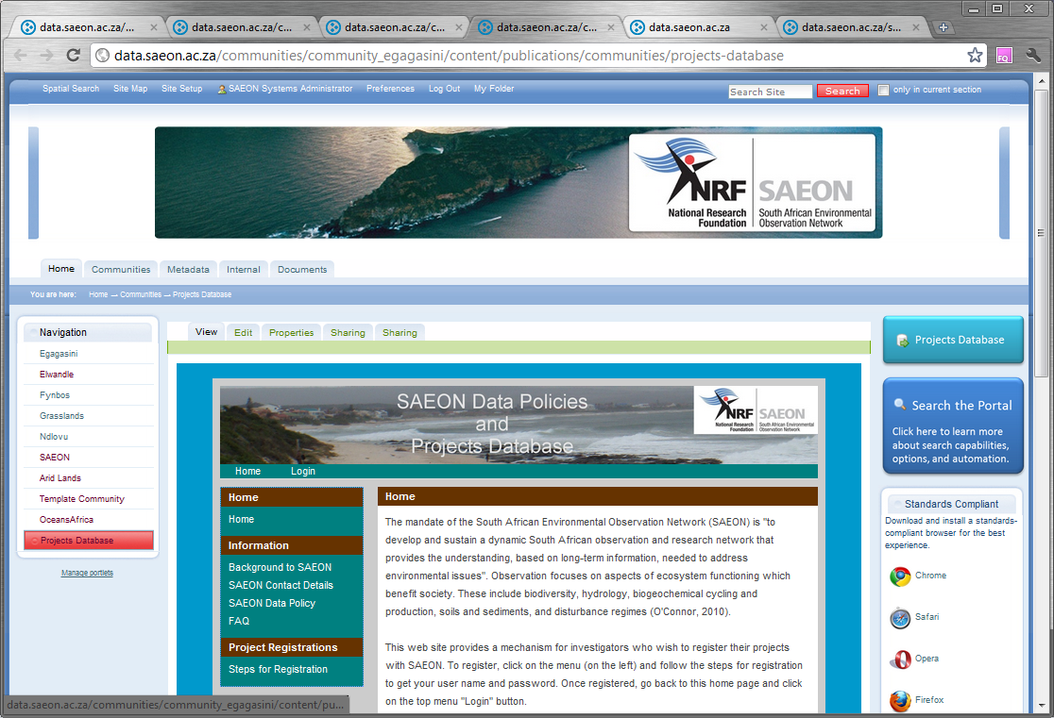
… and embed tools or systems
Community Tools

Slide 27
Meta-Data and Data Work Programme
Node Inputs – first round completed
Consolidated with National Process
  Committee for Spatial Information
Consolidated with Sister Initiatives
Feedback required
Estimated 10000-14000 meta-data records

Slide 28
Major SAEON Projects
CHPC (VLDB, HSRC, MRC, …)
MRSU (NetCDF, VLDB)
SensorWeb Enablement (ARC, SADCO)
Integrated Observations and Measurements DB
Education Functions Support System
Meta-Data Migration Project
Shared Development Path
  Multiple observation capturing tools
  Configurable web forms
  Configurable services
  Shared ‘Integrated Observation & Measurements System’
  Subset of the VLDB

Slide 29
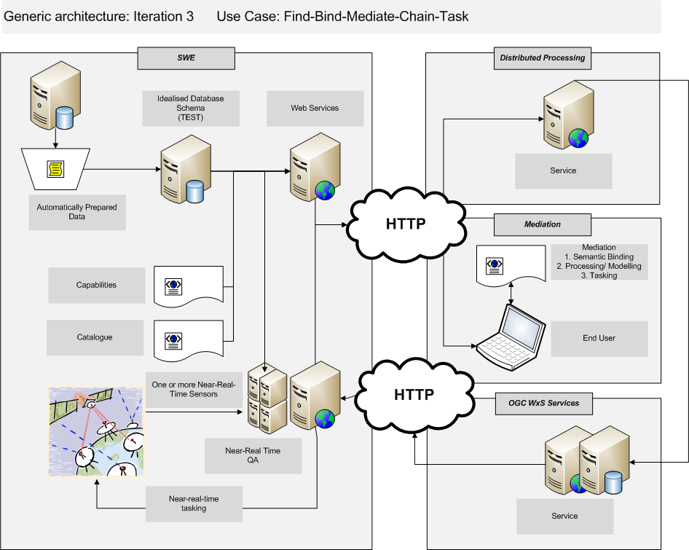
Generic Architecture: SensorWeb

Slide 30
Education Outreach Support Systems
Node/Head Office/Other
School
Sites
Map Location
Type
Name
Contact Particulars
….
Name
Type
Map Locatiion
PID: Node
Name
Type
Map Locatiion
PID: Node
Persons
Learner/ Teacher
School-Programme
Name
Role
PID: Node/ Organisation
Name
Contact Details
PID: School
Type
Grade
Tertiary Education
Employment
PID: School
PID: Programme
PID: Site
Grade
Programme Hierarchy
URLs-Persons
Name
PID: Programme
PID: Owner (Node)
Subject Stream
PID: Person
PID: URL
School-Programme-Learner
URLs
PID: School-Programme
PID: Learner
Attended (Yes/No)
Title
Type
URL
Other Meta-Data
School-Programme-Persons
PID: School
PID: Programme
PID: Site
Grade

Slide 31
Education Outreach Support Systems (2)
Node/Head Office/Other
Map Location
Type
Name
Contact Particulars
….
Persons
Name
Role
PID: Node/ Organisation
Courses-Persons
PID: Person
PID: URL
Courses
Title
Type
URL
Other Meta-Data

Slide 32
VLDB
Shared Set Space
  n Dimensions (Geometric or Geographic)
  Time
  Measure(s) of Phenomena
  Semantics and Topics, bound by Ontology
Typical domain data have
  bounding coverages
  current coverages
  expressed as nodes in n-tuple space

Slide 33
Node Websites
Design Principles:
  Mainstream frameworks
  Service-oriented
  Single source of truth
Prototype(s) developed
More important: service-oriented architecture established and documented
Awaiting feedback and inputs
RDF databases for unstructured resources

Slide 34
Other Data Projects
Historical Catch Database
Algoa Bay Sentinel Site
…
Underlines need for guidelines, both for meta-data and for data.
Guideline document available, awaiting feedback.

Slide 35
Non-SAEON Projects and Initiatives
SAEOS and GEOSS
Risk Atlas
BioEnergy Atlas
GeoHazards Portal with CfG
  GeoPortal Cookbook
Open Proposals (MOST, FP-7)
NeDICC and Data Preservation
  Maturity Model for Digital Repositories
WDS-ICSU

Slide 36
Next Steps
Development
  SAEON DP Lite
  Range of smaller refinements
  Process chaining
  Mediation and collation of structured data
Collaboration Projects
  GEOSS Integration: Actively looking for pilot projects and collaborators
    NetCDF collaboration confirmed
    BioEnergy Atlas for Africa under way - EnerGEO
  Human-Environment Interactions: Process Chaining/ Distributed Sources
  MOST (Ministry of Science, China)
  FP7 – African Forest Systems and Drought/ Risk Atlas
Migration to Sustainable Infrastructure/ Resources
  Funding for
  Move towards file/ object relational databases
  Hosting at CHPC – relatively large computing facility, fast connections
  VLDB project
  Service Providers

Slide 37
Big Questions
Communities of Practice and Ontology Development
Streamlining Data and Meta-Data Flows
Additional Training and Capacity Building
Define Procedures and Ways of Working
  Data and Meta-Data Guidelines
  SAEON Data Projects
  SAEON Data Dissemination
  Data Requests and Requirements
Data Value Addition
  Syntactic
  Schematic
  Value Judgment
Confirmation of Roles and Responsibilities

