Slide 1

Data Portal Platforms for South Africa
17 June 2011
JRC, Ispa
Wim Hugo

Slide 2
Scope of Work: Systems Engineering
CHPC Peripheral
CHPC Infrastructure
SAEON Infrastructure
HSRC
Corporate
Support
CSIR
GeoPortal
Research
Opportunities
CSIR-TIP
SAEON
Data Products
Risk Atlas
GAP
SAEOS
SAEON
Spatial
DB
SAEON Data Portal
VLDB
GeoHazards Portal
BioEnergy Atlas
SAEON
SensorWeb
WDC BHH
SAEON
IOMS
MRC

Slide 3
Scope of Work: Liaison
Domain-Specific
Nationally
International
Digital Curation
NeDICC
Line Departments
EGU
CSI Data Committee
Risk Atlas Theme Convenors
ICSU
WDS
NSIF
GEOSS
SIMSC
OceanSAfrica
USGS
CSIR:
CoastGIS
NBF

Slide 4
Scope of Work: Capacity Building
Domain-Specific
Nationally
International
GeoPortal Cookbook
ICSU Africa
Maturity Model
Meta-Data Management
COP/
Ontologies
SAEON
IT Strategy

Slide 5
Scope of Work: Specific Projects
CHPC Peripheral
Shared Infrastructure
SAEON Infrastructure
Education
Platform Spatial Extensions
ScienceBook
NetCDF
Extensions
Observations
SensorWeb
IOMS
Indexing
Chained Processing
Historical Catch DB
Meta-Database
Algoa
Sentinel

Slide 6
The Bigger Picture
CoSAMP
(SAEON, CSIR)
2005
CoGIS
(SAEON, CSIR)
2007
Open Source
Local
Capacity
Meta-Data I
(SAEON, CSIR)
2008/9
URS I
Spatial Extensions
(SAEON, SAEOS, WDC, R&VA)
2009/10
Structured Data
(SAEON, SAEOS, WDS)
2009/10
URS II
URS III
Image Extensions
Admin Extensions
(SAEON, SAEOS)
2010/11
Citations
Service Orientation
(SAEON, SAEOS, R&VA, WDC) 2010/11
Meta-Data II
(SAEON, SAEOS, WDS, R&VA)
2009/10
Process
(CSIR, SAEON)
2011
Knowledge
(CSIR, SAEON)
2011

Slide 7
Portals and Platform
Main Stakeholders
and Initiatives
Main Platform
Services
Documents
and Publications
Spatial
Data
Other
Data
SAEON
Nodes and Initiatives
SAEON
SAEOS
Portal
Data Analysis and Processing
SAEOS
World Data Centre for BHH
Content Visualisation and Presentation
WDC
Risk and Vulnerability Atlas
RAVA
Meta-Data and Data Management Functions
CSIR
CSIR
Meta-Data and Data Services
Limpopo GeoEconomic Portal
LGEP
NSIF
Application
NSIF Portal
NSIF

Slide 8
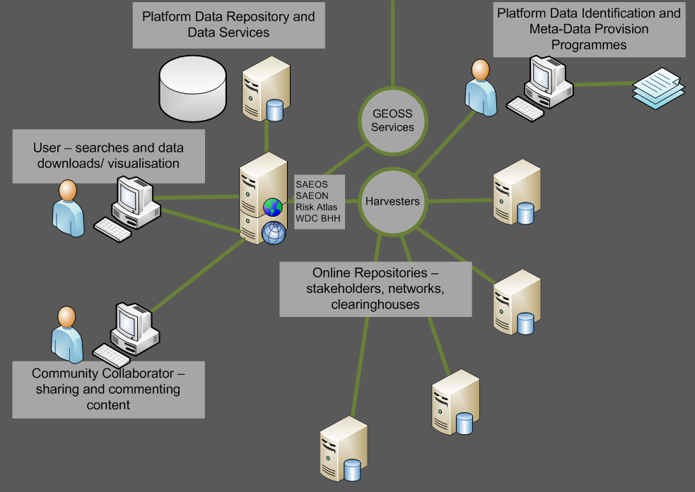
Main Use Cases
Phase 1: DISCOVERY AND VISUALISATION

Slide 9
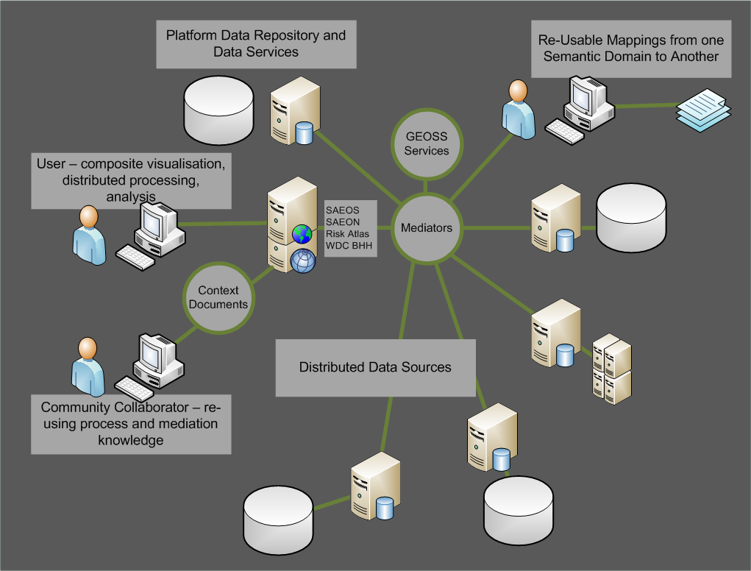
Main Use Cases
Phase 2: Mediation and Collation

Slide 10
MAIN USE CASES
Phase 3: AUTOMATED PROCESS CHAINING
?

Slide 11
Updated Distributed Standards Architecture
Distributed Web Folders
Standardised Data Services
Standardised Catalogue Services
User Interface Layer
NetCDF
nDTM
OPeNDAP
Server
THREDDS
Server
Viewers
Other Objects
JSON/ Atom
RSS
RDF Services
OGC-CSW
OAI
Mediators
Relational Spatial DB - OGC
Search Interfaces
O&M Schema
3DTM
Sensor Observation Service
Context
Typical Spatial Data
2DM
OGC Map Services
SHP, TIFF, etc.

Slide 12
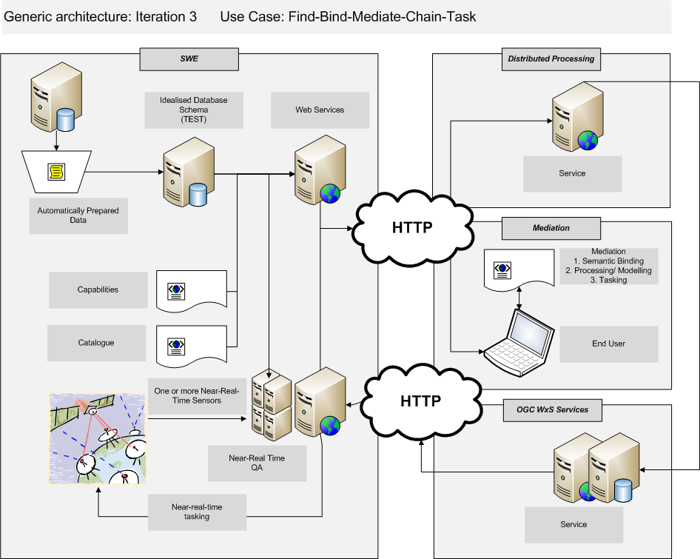
Generic Architecture: SensorWeb

Slide 13
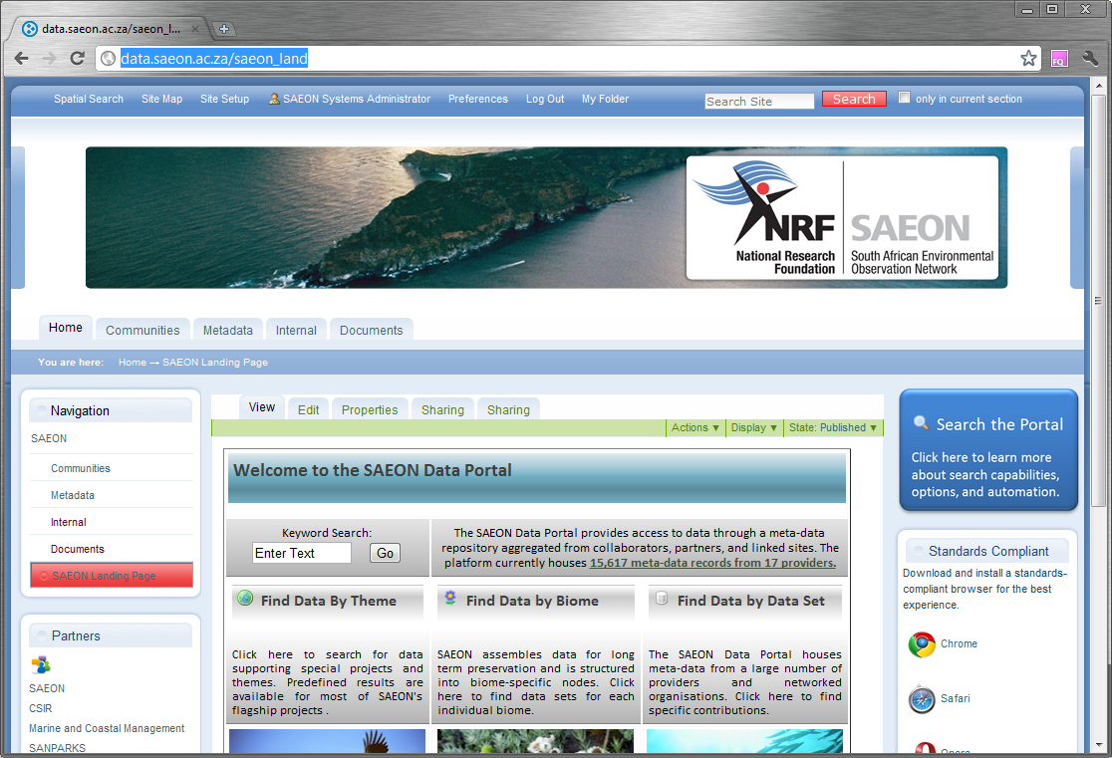
Landing Page
Immediately Searchable
Immediately Searchable

Slide 14
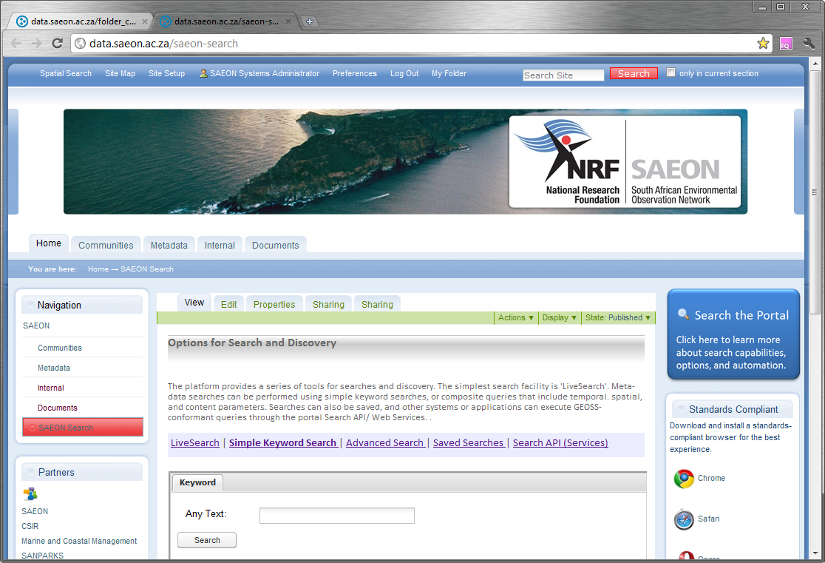
Search Page
Simple and Advanced Searches

Slide 15

Keyword (Simple) Search
Search on Keyword

Slide 16
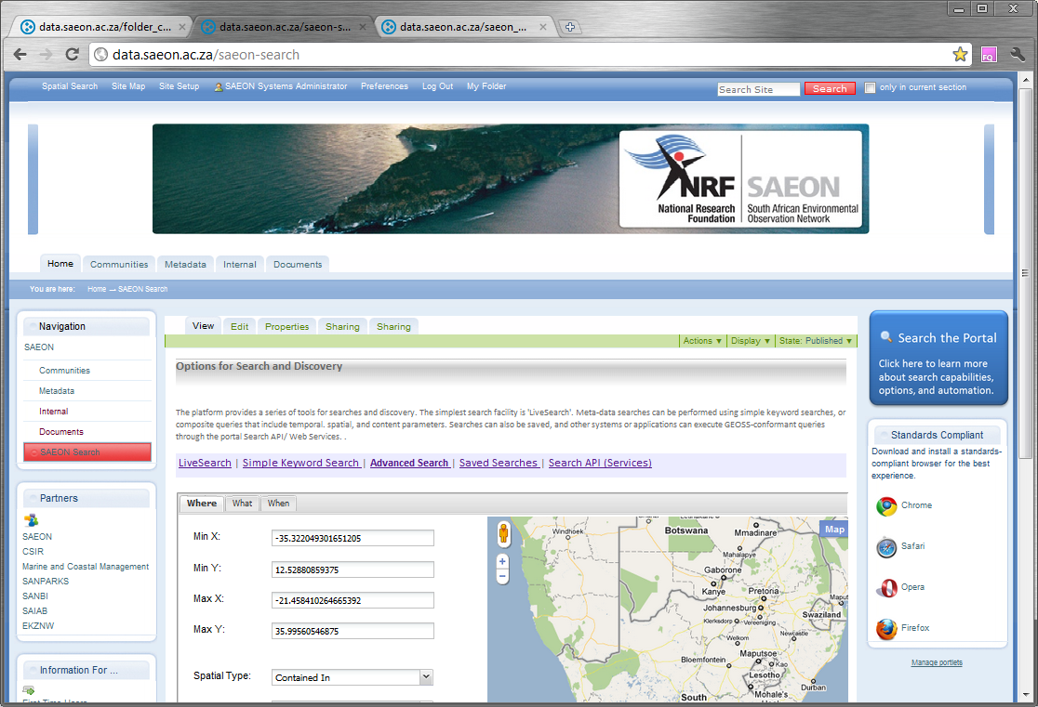
Advanced Search
Advanced Search Facility

Slide 17
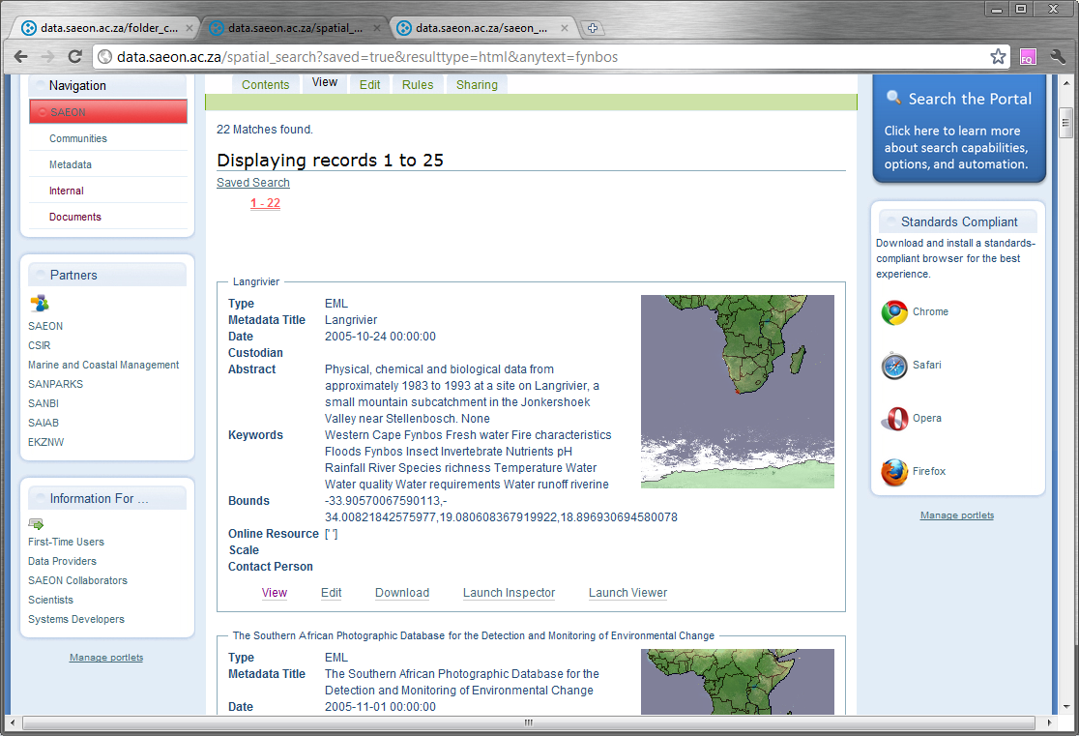
Search Results
Results are returned

Slide 18
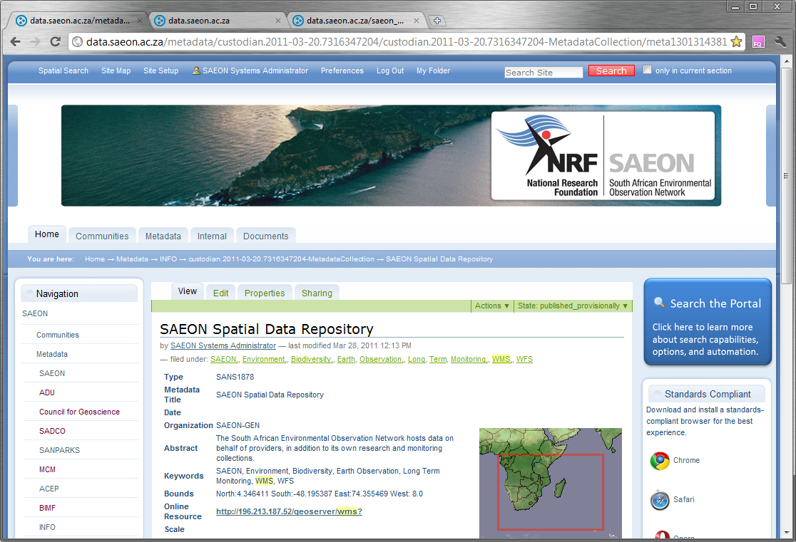
Individual Record
Individual Meta-Data Record

Slide 19
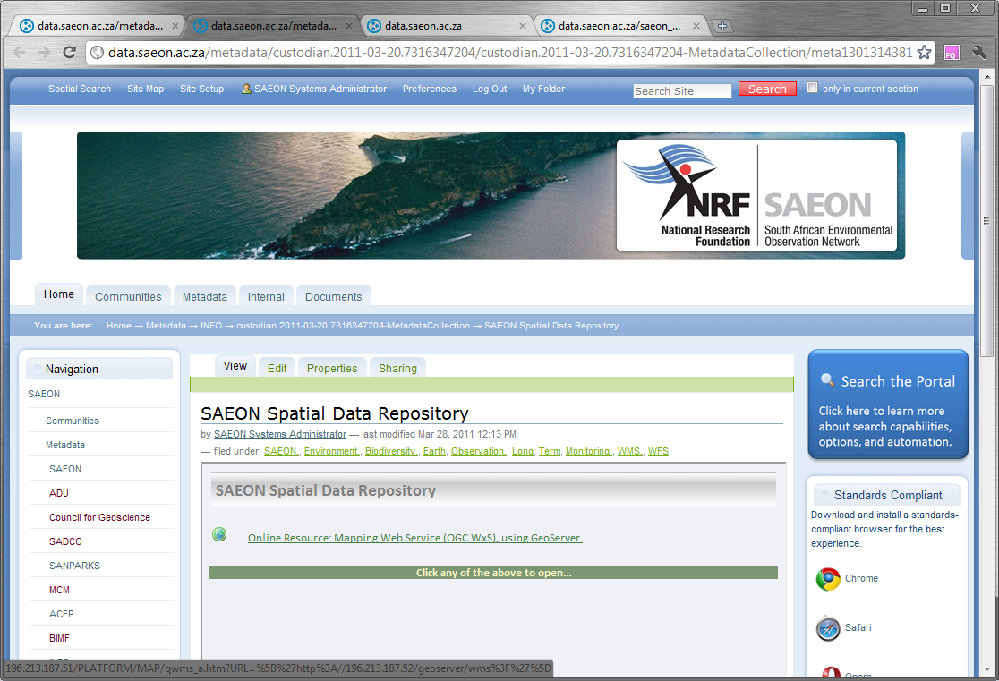
Meta-Data can have multiple links
Assessment of Links

Slide 20
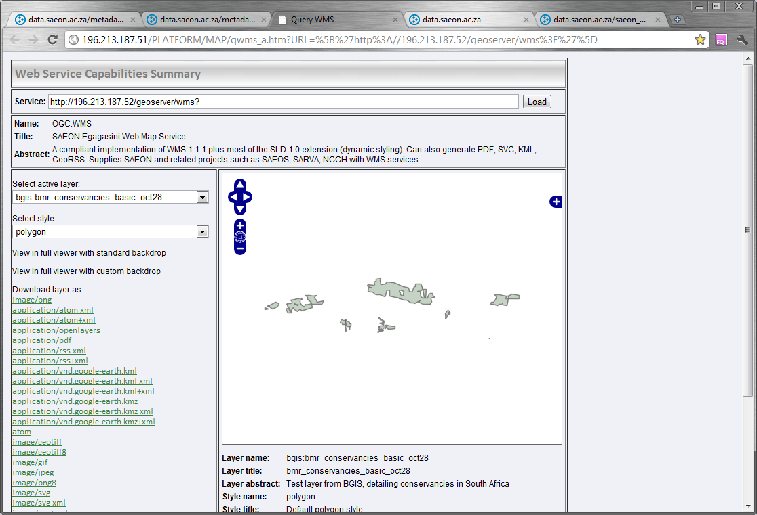
Data Preview
Standardised Data can be previewed

Slide 21
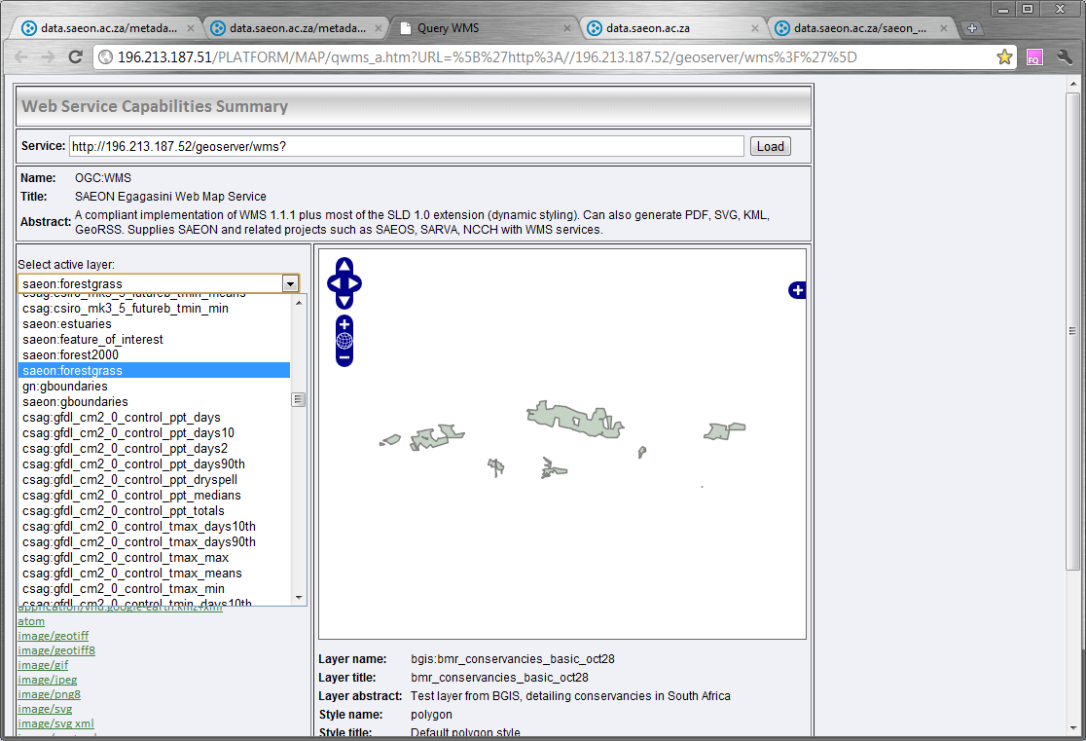
Potentially multiple sources
Select alternative layer

Slide 22
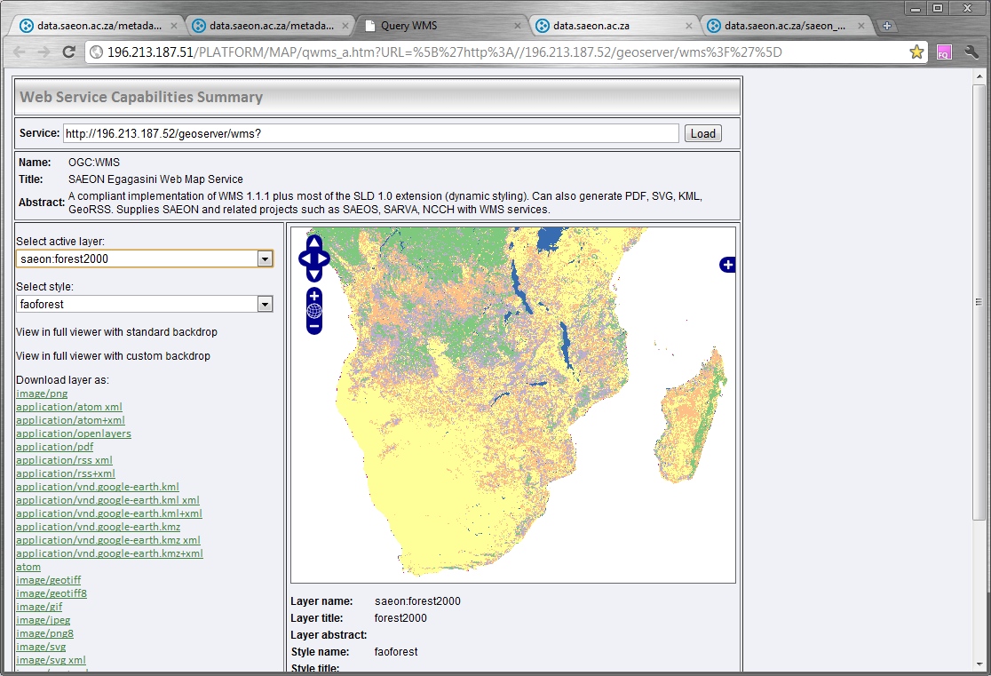
Alternative data layer at same source
FAO Forest Cover

Slide 23
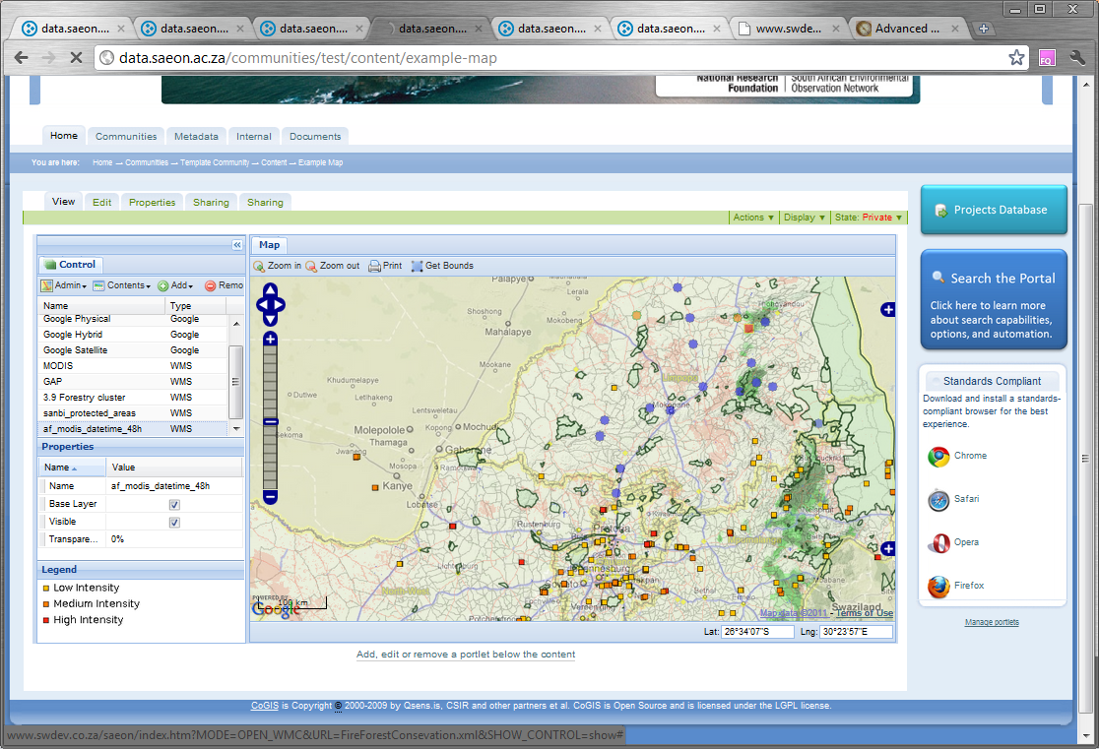
Packaging automated data for display

Slide 24
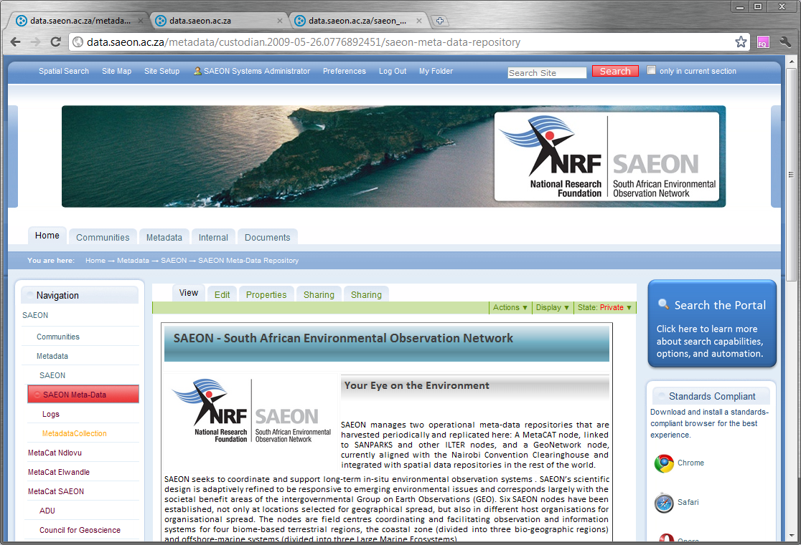
Custodian Landing Page
Detailed Custodian Page

Slide 25
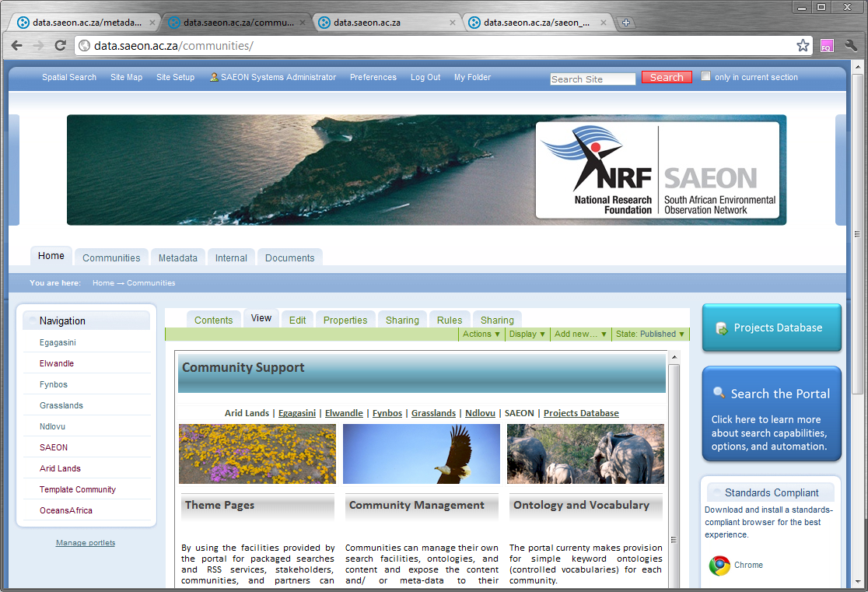
Communities of Practice
Node Communities
Community Pages

Slide 26
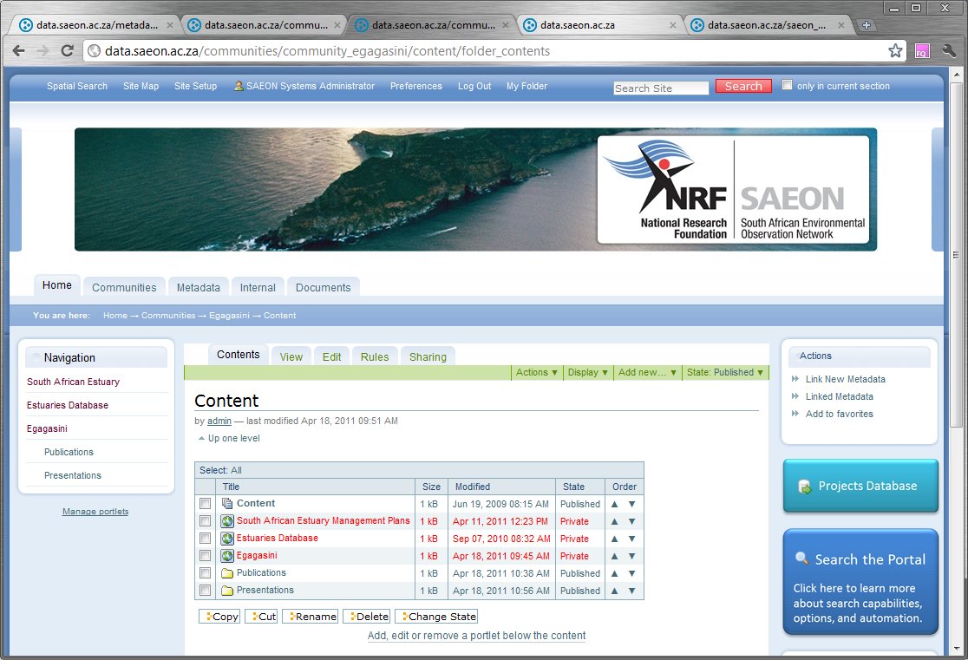
Communities manage their own content …
Community Content

Slide 27
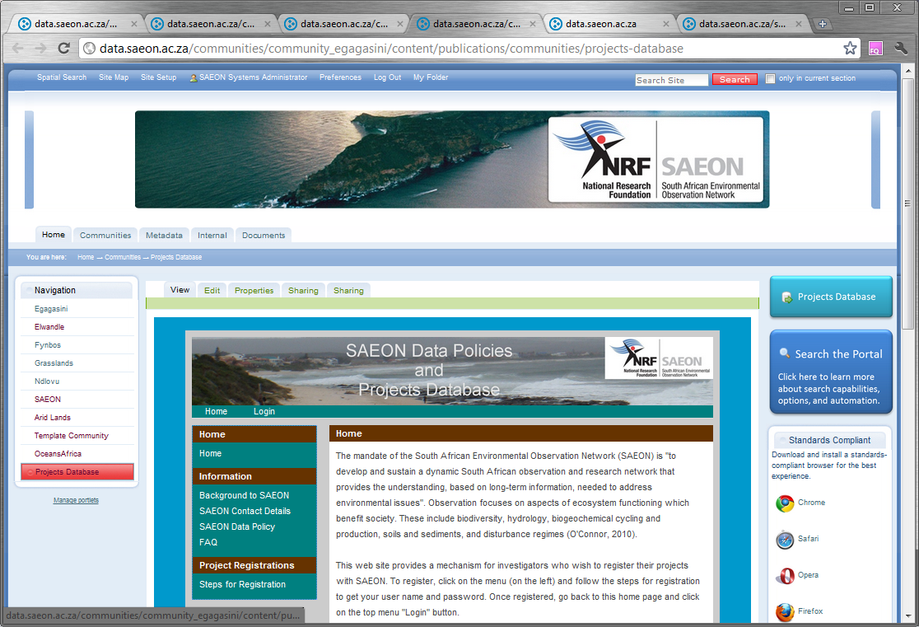
… and embed tools or systems
Community Tools

Slide 28
NEXT STEPS
Development
  Process chaining
  Mediation and collation of structured data
  NetCDF Support
  SensorWeb Support
Collaboration Projects
  GEOSS Integration: Actively looking for pilot projects and collaborators
  Human-Environment Interactions: Process Chaining/ Distributed Sources
Migration to Sustainable Infrastructure
  Move towards file/ object relational databases
  Hosting at CHPC – relatively large computing facility, fast connections
  VLDB project

