Slide 1
DIRISA Data-Intensive Research Initiatve for South Africa
Wim Hugo
Chief Data and Information Officer – SAEON
ICSU WDS
wim@saeon.ac.za

Slide 2
Manifesto
It is possible, desirable, and in the public interest to:
Ensure that scientific data is described properly, preserved properly, and discoverable;
Once discovered, its utility, quality, and scope can be understood, even if the data sets are huge;
Once understood; it can be accessed freely and openly;
Once accessed, it can be included into distributed processes, preferably automatically, and on large scales;
Once processed, the knowledge gathered can be re-used.
… across multiple domains, multiple channels, and integrated into the Semantic Web

Slide 3
Specific Drivers
Data Publication and Citation
CoDATA Task Group
RDA/ ICSU World Data System Working Group
Open and Free Access to Publicly Funded Data
CoDATA/ WDS
RDA
GEO
Research Data Alliance:
https://www.rd-alliance.org/node
ICSU World Data System
http://icsu-wds.org/
Group on Earth Observation:
http://earthobservations.org
CoDATA
http://www.codata.org/

Slide 4
Origins
Earth and Environmental Observation “Shared Platform”
Developed by SAEON for its own use and on behalf of stakeholders
Accommodates multiple meta-data standards, distributed physical repositories, integrated discovery, and visualisation/ download capabilities in addition to generalised content management
CHPC
VLDB Project
Large WOS Storage
“Bottom Up” Collaboration from late 2011 – “DIRISA”

Slide 5
Concept
Science Gateway
DDL
DL
DIRISA
DL
DDA
Applications/
Aggregation
Science Gateway
DDL
DDL
DL
Quality Assurance Filters
World Data System Component
DDA

Slide 6
Use Cases
Describe RDI outputs (register data, services and publications), using a variety of meta-data standards.
Link the meta-data to (hopefully) standardised information objects.
The standardisation assists with its application, visualisation, collation, and automated processing.
Allow search and discovery of the RDI outputs.
Support mediation whereby processes, data, services, and its metrics can be orchestrated into optimised distributed processing.
Allow proper citation and cross-referencing of data and services.
Support the long-term preservation management of RDI outputs.

Slide 7
Shared Platform
“Shared Implementation”
a framework containing architecture guidelines, abstract specifications and user requirements, recommended interoperability standards, and reference implementations.
a directed open source community that contributes to, extends, and maintains the shared implementation.
National funding provides for a baseline of operations and “infrastructure of last resort”.
not domain-specific, but function-specific.
Range of engagement options.
Almost all knowledge portals and science gateways share a base set of functions that are re-usable.

Slide 8
Shared Platform
“Shared Meaning”
meta-data standards selection
crosswalks (inter-standard translations)
controlled vocabularies, thesauri, and ontologies associated with standards –
these are often domain and region-specific

Slide 9
Shared Platform
“Shared Processes”
coordinated training and awareness creation on the importance of meta-data and data management
data sharing and meta-data provision policies / guidelines to be implemented at research institutions and as a condition of funding
coordination of and assistance with contributions to national infrastructure
creation of forums for the validation of decisions and guidelines

Slide 10
Soft and Hard Infrastructure
Funders
Stakeholders and CoPs
Research Institutions, HEIs
External Systems and VREs
Collaborators
DIRISA: RDI/ Science Ecosystem
Research and Joint/ Collaborative projects
Knowledge Bases, Courseware, Implementation Assistance, and Workshops
Community and Domain-Specific Special Initiatives
Products, Services, Cloud-Based Portal/ Gateway Implementations, SLAs
Service-Oriented, Standards-Based Components
Basic Infrastructure
HPC
DATA
NREN

Slide 11
DIRISA Components @ CHPC
Secure Services
Mainstream Application Environments
DMZ
HPC
Computational Facilities
(Clusters, Grid)
Domain-Specific Software
Science Gateways
Web-Based Applications and Content Management Frameworks
Portal Environments
Support Software enabling Research Channels
Data/ Object Storage Facilities
(iRODS, WOS)
Meta-Data
Semantic Interoperability Tools
Communications
(SANREN/TENET)

Slide 12
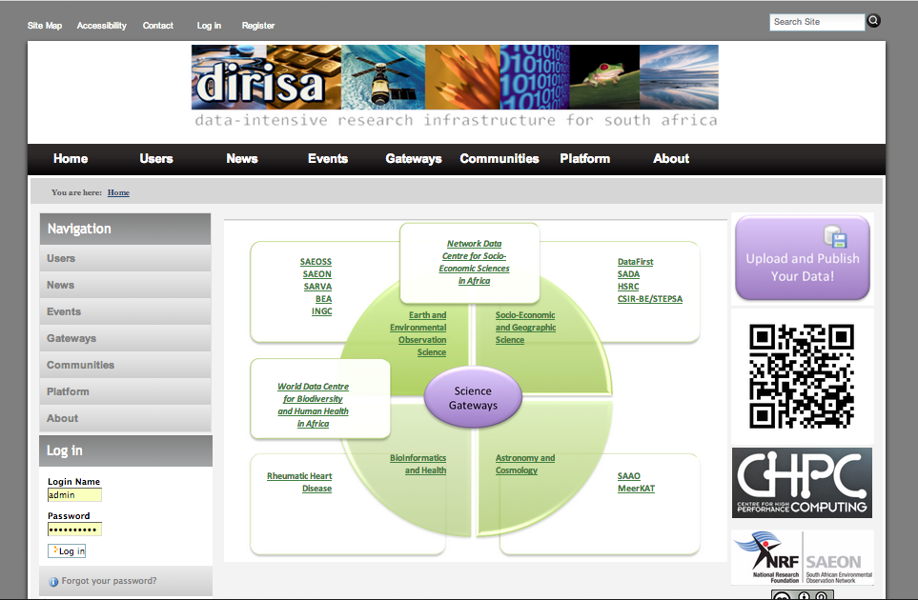
DIRISA Portal

Slide 13
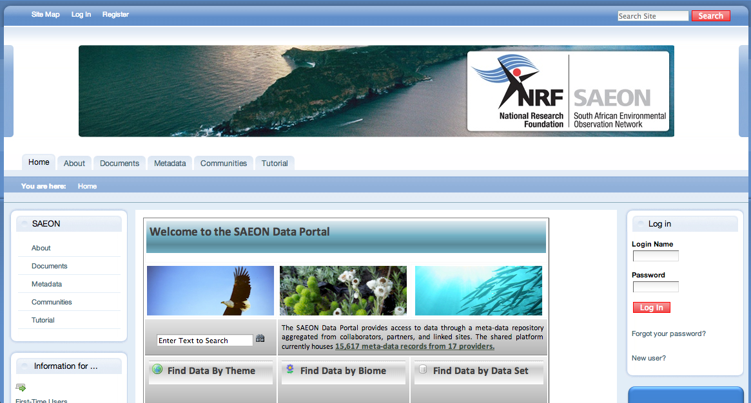
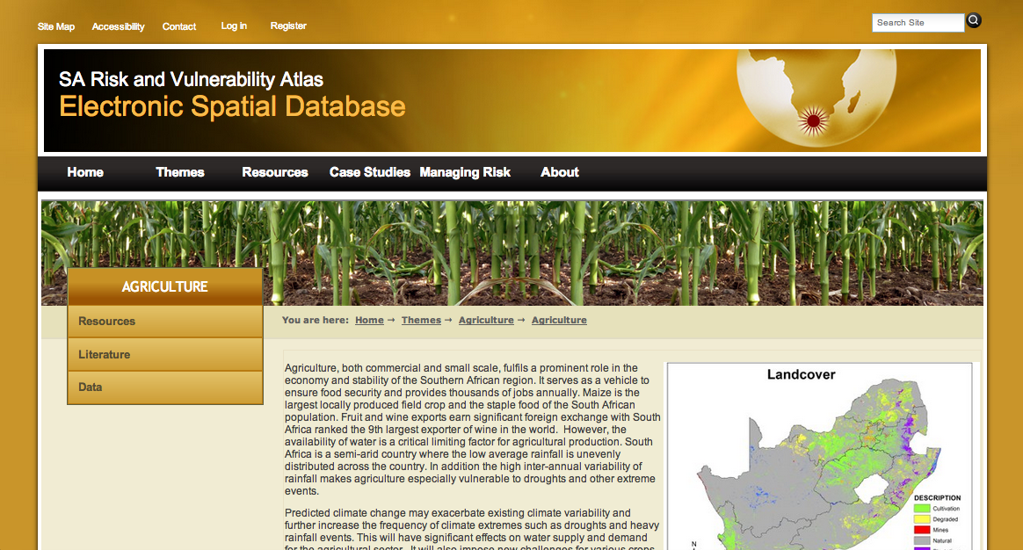
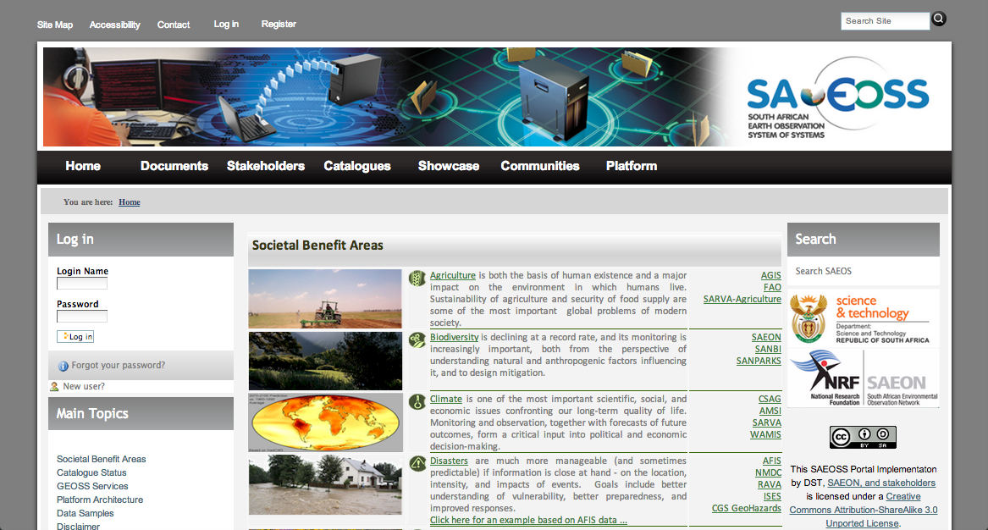
Science Gateway Examples

Slide 14
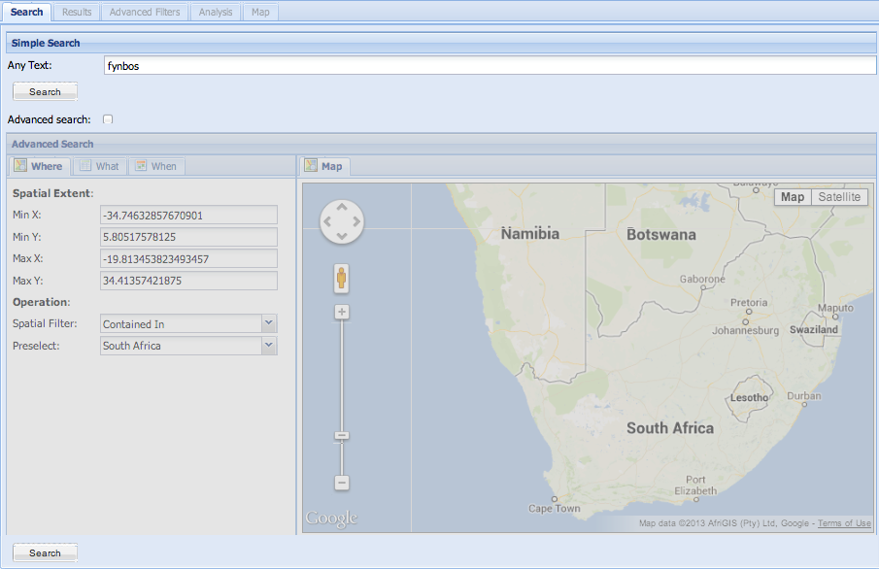
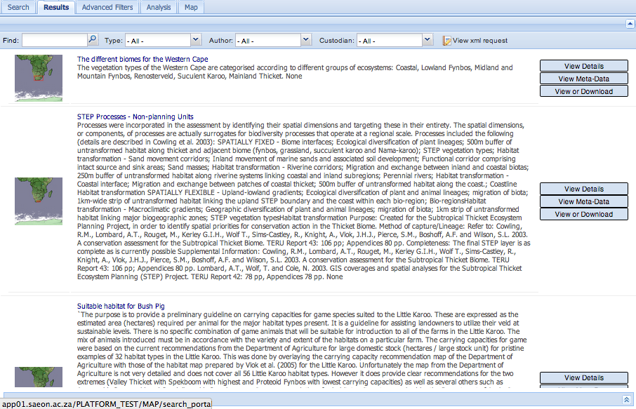
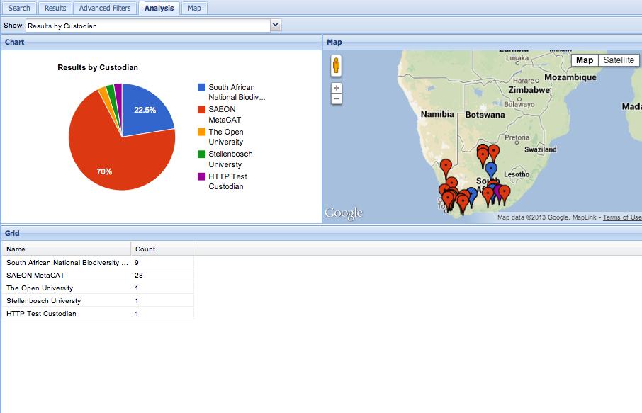
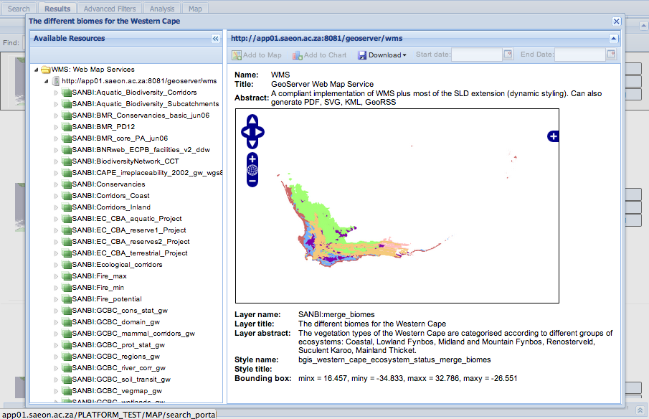
Component Examples

Slide 15
Expectations and Gaps
Hosting Excellence: Establish virtualisation environment, allowing creation and operationalisation of Science Gateways on demand.
Trusted Digital Repository: Most, if not all, potential users will benefit from or require certification of the facility as a ‘Trusted Digital Repository’. This implies a specific, focused programme to achieve those criteria.

Slide 16
Expectations and Gaps
Clear Definition of Products and Services:
Product and service offerings need to be aligned
Roles and responsibilities in respect of its provision, support, and marketing need to be defined.
Development of Policies and SLAs
Develop and Implement the Maturity Model:
We need to manage our infrastructure, products, and services across a broad spectrum of governance, accreditation criteria, legal requirements, marketing imperatives, technology drivers, and corporate goals.

Slide 17
Immediate Priorities
Extension to Other Domains:
Human Geography, Social Sciences and Economics
Astronomy and Cosmology
BioInformatics and Human Health
Preservation Management Software and Policies
Applies only to data hosted directly
“Upload Anything from Anywhere”
First Release is in Development and Almost Ready
Digital Object Identifiers:
Prerequisite for long-term preservation, and for data citation

Slide 18
Crystal Ball
Policy in Respect of Publicly Funded Data
Development of NICI and the formalisation of DIRISA
Governance
Mandate
Funding

Slide 19
Thank You!

Slide 20
E&EO: Shared Platform
Main Stakeholders
and Initiatives
Main Platform
Services
Documents
and Publications
Spatial
Data
Other
Data
SAEON Nodes and Initiatives
Collaboration and Security Services
SAEON
SAEOS
Portal
Data Analysis and Processing
SAEOS
World Data Centre Components
WDC
Content Visualisation and Presentation
Risk and Vulnerability Atlas
RAVA
Meta-Data and Data Management Functions
BioEnergy Atlas
CSIR
Meta-Data and Data Services
…
….
NSIF
Application
NSIF Portal
NSIF
Governance, Security, Systems Engineering, Liaison, Hardware

Slide 21
Shared Platform
“Shared Implementation”
a framework containing architecture guidelines, abstract specifications and user requirements, recommended interoperability standards, and reference implementations.
a directed open source community that contributes to, extends, and maintains the shared implementation.
National funding provides a baseline of operations and activity.
not domain-specific, but function-specific.
Range of engagement options.
Almost all knowledge portals share a base set of functions that are re-usable.

Slide 22
Shared Platform
“Shared Meaning”
meta-data standards selection
crosswalks (inter-standard translations)
controlled vocabularies, thesauri, and ontologies associated with standards –
these are often domain and region-specific

Slide 23
Shared Platform
“Shared Processes”
coordinated training and awareness creation on the importance of meta-data
data sharing and meta-data provision policies / guidelines to be implemented at research institutions and as a condition of funding
coordination of and assistance with contributions to national infrastructure
creation of forums for the validation of decisions and guidelines

Slide 24
Management Framework
Institutional and Organisational Development
Function
Business Engineering Function
Programme Management Function
Systems Engineering Function
Risk Management Function
Strategic Alignment
Corporate Strategy, Goals,
And Corporate Objectives
Alignment and Liaison
IT
Strategy
Audits and Assessments
Governance
IT Governance and Management Frameworks
Policies
Policy
Planning
and Coordination
Business Unit
Coordination
Implementation Plans and Sub-Strategies
Implementation
and Operations
Contracts/ Service Level Agreements

Slide 25
Problem Statement #1
How do we make an objective assessment of a complex, multi-faceted situation?
How do we know where we are in terms of performance, and how do we account for multiple sets of objectives and criteria for compliance?
What do we need to do to improve?
Will someone else reach the same conclusion?

Slide 26
Maturity Models
A set of structured levels that describe how well the behaviours, practices and processes of an organization can reliably and sustainably produce required outcomes.
a place to start and ‘join the club’
the benefit of prior experiences
a common language and a shared vision
a framework for prioritizing actions.
a way to define what improvement means for your organization.
Useful as
a benchmark for assessment
Qualitative metrics
and as an aid to understanding
for comparative evaluation.
http://www.sei.cmu.edu/cmmi/start/

Slide 27
NRF
R 4.4 B/a
TIA
R 434 m/a
NRF
R 1.1 B/a
CSIR
R 687 m/a
HSRC
R 206 m/a
SANSA
R 94 m/a
Others
R 44 m/a

Slide 28
The Case for RDI Output Management
RDI Outputs are ASSETs
OECD/G20 Governments and Public Companies spend 1.8% of GDP on average on R&D
Translates to approximately $ 600 billion a year on R&D (GERD)
3% Management and Preservation Fee: $ 18 billion per annum.
Publishing Industry: $ 19 billion per annum (2008)
http://www.oecd-ilibrary.org/sites/factbook-2010-en
McGuigan GS, Russell RD. (2008).

Slide 29
RDI
Funding
RDI
Outputs
Research
Development
Innovation

Slide 30
RDI
Grant Funding
Research Publication Embargo
Restricted Access
Meta-Data
Protection under IPR Act
Conservation, Privacy, Legal Restriction
Free and Open Access
Significant Budget Contribution
Open Access at Cost
Information Classification Filter
Restricted Access – No Meta-Data
State-Generated Data

Slide 31
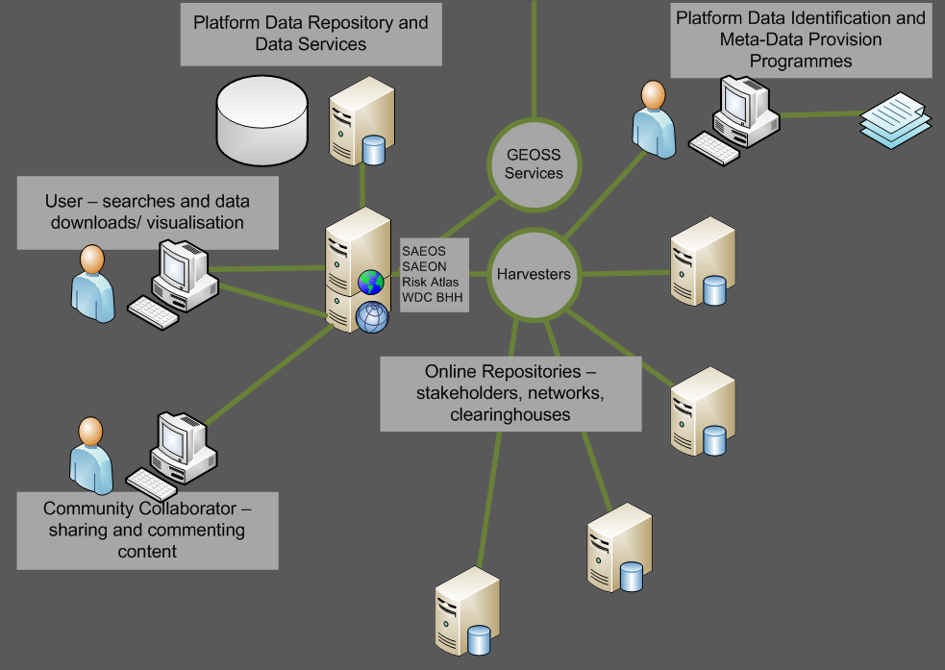
Main Use Cases DISCOVERY AND VISUALISATION
The platform is based on a shared and aggregated meta-data repository, and the meta-data repository is capable of accepting and working with a range of well-established meta-data standards.
These include Dublin Core, SANS 1878, the ISO 19115 family, EML, and FGDC. The list is likely to be extended from time to time to accommodate other standards in widespread use by a user community or new provider.
Harvesters can be used to automate meta-data acquisition from standardised providers.

Slide 32
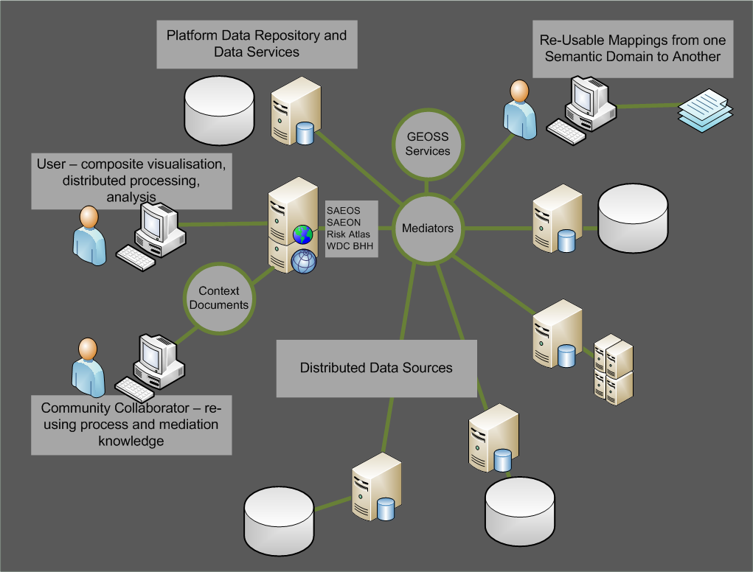
MAIN USE CASES Mediation and Collation
Mediators are required to tailor (bind) a data source or sources to a process or service.
The service can be as simple as a mapping service, and the mediation as rudimentary as renaming the layers to match the context of a map.
More advanced mediations define the linkages between distributed data sets, how data should be aggregated for analysis or display purposes, which columns to match to a charting service, and so on.
Mediations are stored in ‘Web Context Documents’.

Slide 33
MAIN USE CASES AUTOMATED PROCESS CHAINING
Distributed data sources and processes can also be chained together: in such cases, one needs to describe the process in a standardised way for future re-use.
This happens already in e-commerce systems, and it is likely that the same standards in use for automation of web commerce will be used in scientific process automation – but the jury is still out on this.
Automation and mediation rely greatly on ontologies for their efficient functioning. These are agreed dictionaries of terms, and can automate some of the mediation.
?

